Slide 1
Engineering Friction and Grip
Observation of Surface Roughness

Slide 2
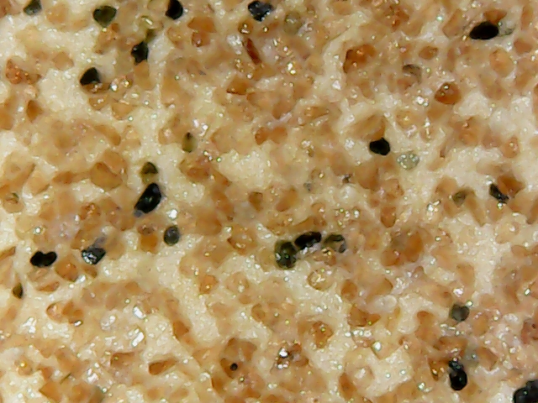
What are we looking at?
What is this?

Slide 3
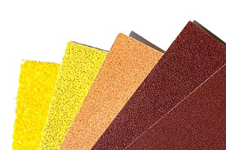
Observation of surface roughness
Use your digital microscopes to observe surface roughness of the materials you are provided. Take pictures of eight surfaces and organize them in the page corresponding to your group’s number. Label each surface appropriately. Connect your digital microscopes to your laptop. Go to your camera app and change the camera to the digital microscope. Adjust the light using the black wheel on the cable. Use the wheel to focus on the surface. To take clear pictures of surfaces, make sure you are not moving the surface or the microscope.

Slide 4
Group 1 – observation
Surface 1 | Surface 2 | Surface 3 | Surface 4
Image 1 | Image 2 | Image 4 | Image 4
Surface 5 | Surface 6 | Surface 7 | Surface 8
Image 5 | Image 6 | Image 7 | Image 8
Photos should be a
square like this.
#6091ba
#9fcc3b
#8d64aa

Slide 5
Group 2 – observation
Surface 1 | Surface 2 | Surface 3 | Surface 4
Image 1 | Image 2 | Image 4 | Image 4
Surface 5 | Surface 6 | Surface 7 | Surface 8
Image 5 | Image 6 | Image 7 | Image 8
Photos should be a
square like this.
#6091ba
#9fcc3b
#8d64aa

Slide 6
Group 3 – observation
Surface 1 | Surface 2 | Surface 3 | Surface 4
Image 1 | Image 2 | Image 4 | Image 4
Surface 5 | Surface 6 | Surface 7 | Surface 8
Image 5 | Image 6 | Image 7 | Image 8
Photos should be a
square like this.
#6091ba
#9fcc3b
#8d64aa

Slide 7
Group 4 – observation
Surface 1 | Surface 2 | Surface 3 | Surface 4
Image 1 | Image 2 | Image 4 | Image 4
Surface 5 | Surface 6 | Surface 7 | Surface 8
Image 5 | Image 6 | Image 7 | Image 8
Photos should be a
square like this.
#6091ba
#9fcc3b
#8d64aa

Slide 8
Group 5 – observation
Surface 1 | Surface 2 | Surface 3 | Surface 4
Image 1 | Image 2 | Image 4 | Image 4
Surface 5 | Surface 6 | Surface 7 | Surface 8
Image 5 | Image 6 | Image 7 | Image 8
Photos should be a
square like this.
#6091ba
#9fcc3b
#8d64aa

Slide 9
Observation of surface roughness
Now that all groups have taken all of their pictures, it is time for each group to decide to categorize these surfaces based on structure, texture, roughness, geometry, or any other criteria. Discuss in your groups and make sure you are ready to justify your classifications. Designate a group member to share your justifications with the entire class.

Slide 10
Group 1 – classification
Photos should be a
square like this.
#6091ba
#9fcc3b
#8d64aa

Slide 11
Group 2 – classification
Photos should be a
square like this.
#6091ba
#9fcc3b
#8d64aa

Slide 12
Group 3 – classification
Photos should be a
square like this.
#6091ba
#9fcc3b
#8d64aa

Slide 13
Group 4 – classification
Photos should be a
square like this.
#6091ba
#9fcc3b
#8d64aa

Slide 14
Group 5 – classification
Photos should be a
square like this.
#6091ba
#9fcc3b
#8d64aa

