Slide 1
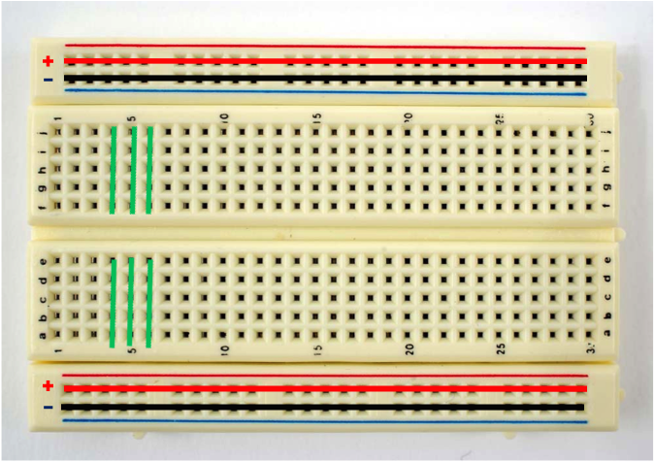
How a Breadboard Works
Notes:
Teacher Notes: This picture depicts the connections on a breadboard. A breadboard is a device used to make simple electrical connections. Each column on the breadboard is connected, with a break in the center, as shown by the green lines. Each row on the top and bottom is connected horizontally, as displayed by the red and black lines.

Slide 2
How the VOC Sensor Works
Notes:
Notes to Teacher: This slide depicts how the VOC sensor works for students in upper grades or physics courses. The resistor, labeled (1), is a very small resistor attached to the positive and negative terminals. In general resistors are designed to drop the voltage of the current as it flows from one terminal to the next. A resistor is primarily used to create and maintain a known safe current within an electrical component. What happens when we attach the negative and positive terminals to each other with very little resistance? The wire heats up. This is similar to a short circuit, but just enough resistance is provided to stop the wire from burning up. This heats up the sensor, which needs to be warmed up to operate.
Resistor number two is connected to the positive terminal and to resistor 3, which is connected to the negative terminal. This setup is called connecting resistors in series, and the current flows from the negative terminal, through resistor 3, then through resistor 2 to the positive terminal.

