Slide 1
Heterogeneous vs. Homogeneous
Mixtures
Notes:
Heterogeneous vs. Homogeneous Mixtures Presentation, Mixture Dualism in Blood activity, TeachEngineering.org
Note: The slides are “animated,” so clicking the mouse or keyboard advances the next text, image or slide.

Slide 2
How are they different?
Homogeneous mixtures have uniform composition
Heterogeneous mixtures have non-uniform composition

Slide 3
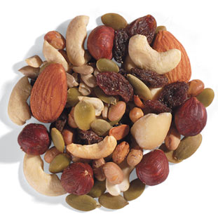
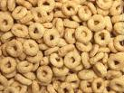
What type of mixtures are these?
Cheerios
Trail mix

Slide 4
Trail mix is HETEROGENEOUS
Cheerios is homogeneous

Slide 5
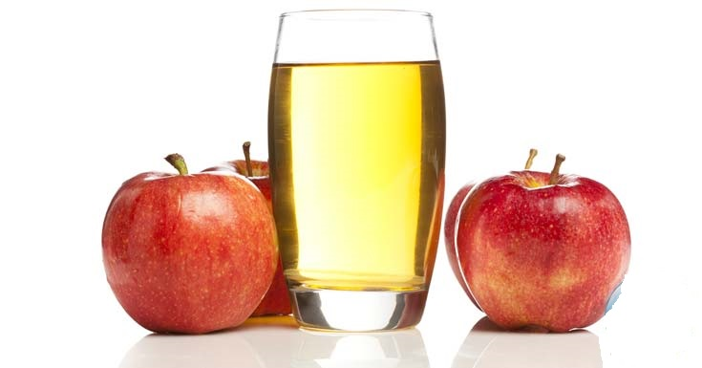
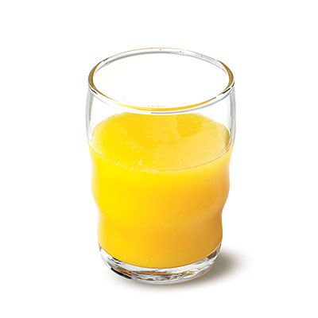
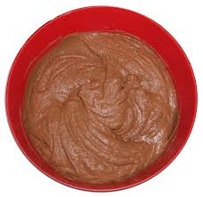
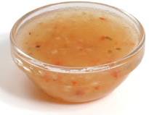
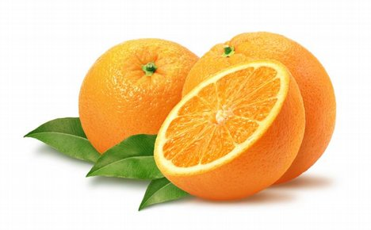
What type of mixtures are these?
Apple juice
Orange juice with pulp
Chocolate dough
Italian salad dressing

Slide 6
Apple juice is homogeneous
Orange juice with pulp is heterogeneous
Chocolate dough is homogeneous
Italian salad dressing is heterogeneous

Slide 7
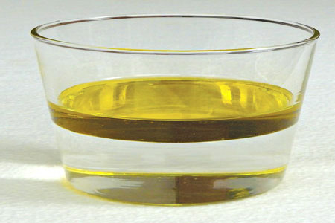
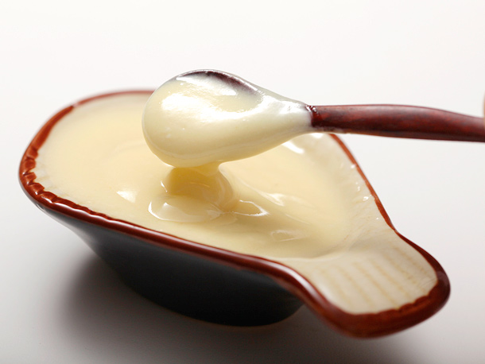
oil & water
What type of mixtures are these?
Mayonnaise, which is mainly made of oil and water
Notes:
A phase of matter is characterized by the presence in a matter of moderately uniform chemical and physical properties. Phases are different from states of matter. Matter can exist in different phases yet be in the same state of matter. For example, mixtures can exist in multiple phases, such as an oil phase and an aqueous phase, etc.

Slide 8
homogeneous
heterogeneous

Slide 9
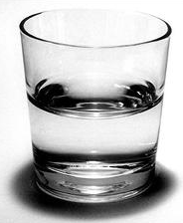
oil & water
How many components? How many phases?
water
mayonnaise, (made of oil & water)

Slide 10
How many components? How many phases?
.
water phase
water phase and oil phase
Water phase, oil phase, and many other phases

Slide 11
How would you separate mixtures?
It depends on the type of mixture, whether they are homogeneous or heterogeneous

Slide 12
Mixture Separation Techniques
Homogeneous Mixtures | Heterogeneous Mixtures
centrifugation coagulation distillation evaporation | filtration hand picking magnetic separation sieving winnowing sedimentation

Slide 13
Solution-Based Mixtures
True solution
Colloidal solutions
Suspensions
These solutions typically differ in the particle size of the solute.

Slide 14
Solution-Based Mixtures
True solution: solute size: <1 nm
Colloidal solutions: solute size: 1 nm to 100 nm
Suspensions: solute size: >100 nm
These solutions typically differ in the manner in which the solutes reside in the solvent.

Slide 15
Solution-Based Mixtures
True solutions: The solute is dissolved and is invisible
Colloidal solutions: The solute is dispersed uniformly throughout the solution; the presence of the solute is visible, but you cannot lift it out
Suspensions: The solute stays outside the solvent; that is, the solute is suspended
These solutions typically differ in the manner in which the solute can be separated from the solvent.

Slide 16
Separation Techniques for Solution-Based Mixtures
True solutions | Colloidal solutions | Suspensions
evaporation | coagulation | filtration
distillation | centrifugation | sedimentation
We will discuss coagulation, centrifugation and sedimentation

