Slide 1
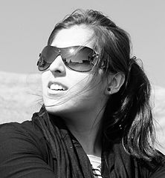
How Do SunGlasses Work?
Studying Light Polarization and Attenuation
Notes:
How Do Sunglasses Work? Presentation—Electromagnetic Waves: How Do Sunglasses Work? lesson, TeachEngineering.org
The slides are animated, so a mouse, spacebar or down arrow click reveals the next item
The slide notes provide teacher information and suggested questions to make it an interactive presentation.

Slide 2
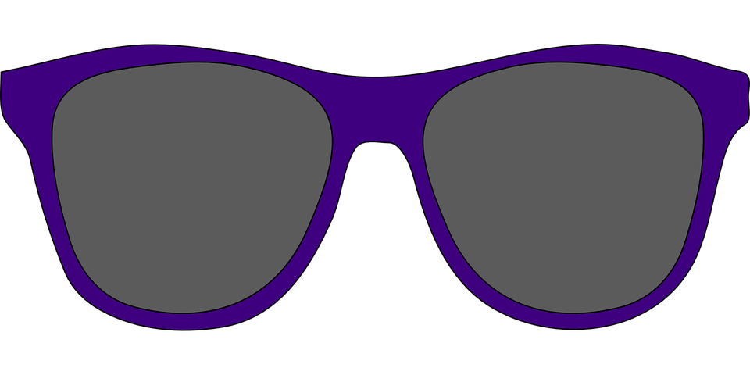
What Do Sunglasses Do?
Brainstorm in your groups: What are the key objectives of good sunglasses?
To reduce the glare such as reflections from the road, water, glass, snow
To reduce the light intensity
To block ultraviolet (UV) light and prevent eye damage
Engineers do this sort of brainstorming and analysis all the time, PLUS they also need to understand the science —so we need to study and understand the basic properties of light
Notes:
Have groups brainstorm and take notes to answer the question: What are the key objectives of good sunglasses? What are the goals/purposes/requirements of good sunglasses?
Next, call on random students to share their responses, recording them on the classroom board.
Then begin organizing them into the above three categories.

Slide 3
Light Polarization
Lesson Objectives
By the end of this lesson, you will be able to:
Explain light polarization
Describe methods to polarize light
Explain light and electromagnetic wave attenuation
Notes:
Mention the lesson objectives.

Slide 4
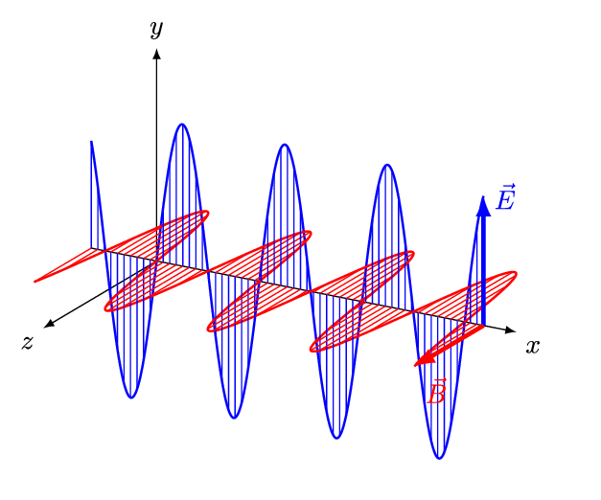
Electromagnetic Wave Structure
Review
Q: What is the cause of electromagnetic radiation?
Electromagnetic waves are caused by vibrating electric charges.
Q: What are the two distinct waves of electromagnetic waves? Are they transverse or longitudinal?
Electromagnetic waves have 2 components: electric and magnetic
This means that each EM wave (light included) has 2 distinct transverse waves -1 from the vibration of the electric field -1 due to the vibration of the magnetic field
Notes:
Expect these concepts to be a review of already learned information.
Ask the question. Listen to student responses. Then click to reveal the answer.
Clarify as needed and correct any misconceptions.

Slide 5
Light Characteristics & Polarization
Since light is an electromagnetic wave, it shares the same characteristics. What are these light properties?
Travels at 3.0 x 10⁸ m/s
Travels in straight lines
Has more than one disturbance
Since light (and all electromagnetic waves) has more than one disturbance, it also has more than one polarization > using this fact, discuss with your group the meaning of polarization
Notes:
Ask students the first question and have them share their ideas for characteristics before revealing them. Call on a few students to bring out their prior knowledge. When you call on enough students begin sharing. Before showing the first characteristic on the slide, ask students: What is the speed of light? Once students have listed all three, they may think of more, but use discretion on how many more you spend time adding to the list.
On the last click, give students five minutes to discuss in their groups what they think the meaning of polarization is based on the “fact.” Then have each group share its definition before going to the next slide.

Slide 6
Light Polarization
Polarization refers to the direction of the vibration
Since the electric charges of electromagnetic waves vibrate in multiple directions, light is unpolarized
Q: What are some ways in which the light polarization can change?
transmission
reflection
refraction
scattering
Notes:
The first bullet provides the definition of polarization. Ask students what the polarization is of various waves; draw a few transverse waves on the board. Even better, demonstrate by using two long, coiled springs (Slinkys). Do as many demonstrations as necessary to make sure they understand the concept.
Demo: Have 4 students come up to the front of classroom. Have one pair create a vertical disturbance using one spring and behind them the other pair creates a horizontal disturbance using the second spring. Ask students to explain how this “light” is polarized.
Then ask them the about the polarization of light and other electromagnetic waves.
Then go through the 4 ways to polarize light. In this lesson, we focus on transmission and reflection.

Slide 7
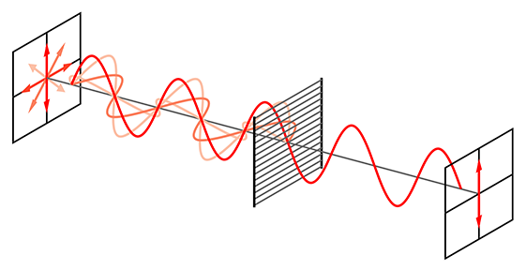
Transmission “Filter” Method
The polarization of light can change by passing it through polaroids
Polaroids are special filters that are chemically designed to let through only a specific polarization of light
As light passes through the polaroid film, it becomes polarized
Describe the polarization of the light in this diagram ➔
Notes:
Before clicking on the second item, ask: What are polaroids? Then click to reveal the definition.
Use the diagram to help students understand a little better.
Ask students to draw a horizontal polarizer in their notes, similar to the diagram, to further emphasize the concept.
The light in the diagram is vertically polarized and was polarized through a vertical polaroid.

Slide 8
Polarization by Transmission
Using the polaroid films, answer the following questions:
Q: What happens when you look at unpolarized light through the polaroid film? Explain why you think this is.
The light intensity seems to be cut in half. This is because the filter actually filters out half of the light.
Q: What happens when you look at unpolarized light through 2 polaroids? Be sure they are parallel. Explain why you think this is.
In this case, the light intensity does not look any different than before because the light is already polarized in that direction, so the light can still pass through.
Q: Now slowly begin rotating one of the polaroids until it is perpendicular to the other. Explain what happens to the light. Why do you think this is?
As the polaroid is rotated, the light intensity decreases. This is because the already polarized light is being filtered again by the second polaroid. Eventually, no light is able to pass.
Mini- Activity
Notes:
Distribute the polaroid film slides, two per group.
Have students write down their own answers to the first question on the slide, then share their answers with the class before revealing the answer.
Then go on and do the same with the next two questions.

Slide 9
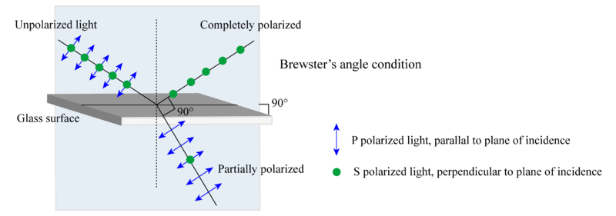
Reflection Method
Q: What happens when light strikes any surface?
The surface either absorbs or reflects the light
When light reflects off a non-metallic surface, such as a road or water, it changes its polarization
The polarization of light depends on the plane of the surface and the angle of incidence

Slide 10
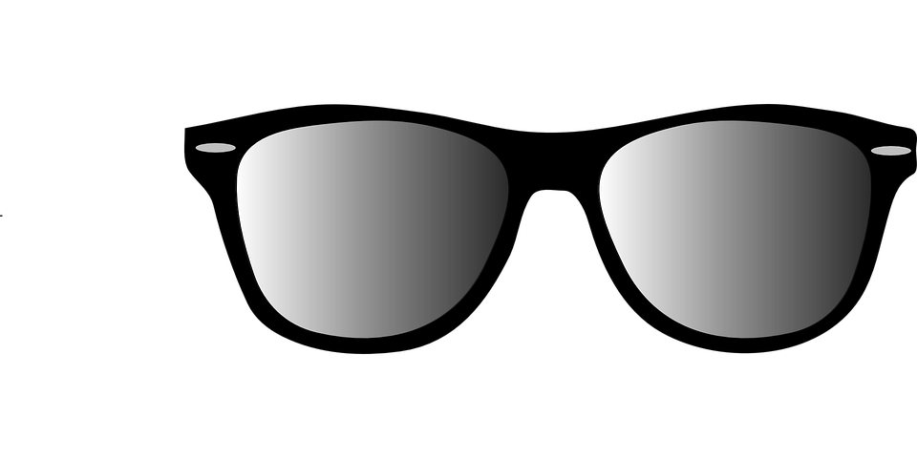
Reflection Method
Not all reflected light changes the polarization.
As light hits a non-metallic surface, the surface vibrations cause the polarization to change
For instance, the ground is flat and lies horizontally
As light strikes the ground, the horizontal wave begins to vibrate more frequently than the vertical wave, and the light becomes horizontally polarized
This causes the glare we see when driving!
We wear sunglasses to reduce the glare
Discuss in your group: What type of polarizing filter do sunglasses use to reduce glare?
Notes:
After students take notes on the slide information, the last item asks them to deduce which way sunglasses are polarized based on how light polarizes from the reflections on the ground/water.
Once they have a hypothesis, ask them how they can determine which pair of sunglasses on the table is polarized. Direct them to experiment and discuss in their groups.
To discover this, expect students to look through the sunglasses and the slide-mounted polaroid. The polaroid film must be oriented horizontally because sunglasses are vertically polarized.
By doing this, students learn that the polarized sunglasses change the light intensity. After 5-7 minutes, discuss their observations and conclusions as a class.

Slide 11
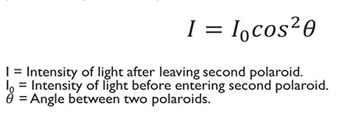
Polarizing Polarized Light??
We have an equation for light intensity when subject to different polaroids
The angle between 2 polaroids is important in determining the light intensity
Malus’ law describes how the intensity changes when polarized light passes through a second polaroid

Slide 12
Quick Check!
Notes:
Distribute to students the quick check handout.
Give them 4 minutes to complete it.
Then go over the 6 questions as a class, having students share their answers first, before providing the answers.

Slide 13
Light Attenuation
Q: What happens to light intensity as it passes through a polaroid film?
The light intensity decreases
Q: This is what we call light attenuation. What is the definition of attenuation?
The reduction of intensity or power of an electromagnetic wave All electromagnetic waves attenuate through different materials
Q: Different wavelengths/frequencies attenuate differently through different materials
For example, 60 GHz waves are completely blocked by humans, but 2 GHz waves attenuate only slightly when passing through our bodies
Notes:
Ask students to think about answers to each question before providing the answers. If needed, guide students to the answer through discussion. For the last statement, relate the 60 Hz wave to the future of data sharing in 5G; let students ponder the possibilities of these waves being used for data sharing… and the possible consequences. (Refer to the 5G discussion at the end the lesson’s Teacher Background & Concepts section.)
Then move on to ask them which portion of the electromagnetic spectrum we need to attenuate when designing sunglasses.

Slide 14
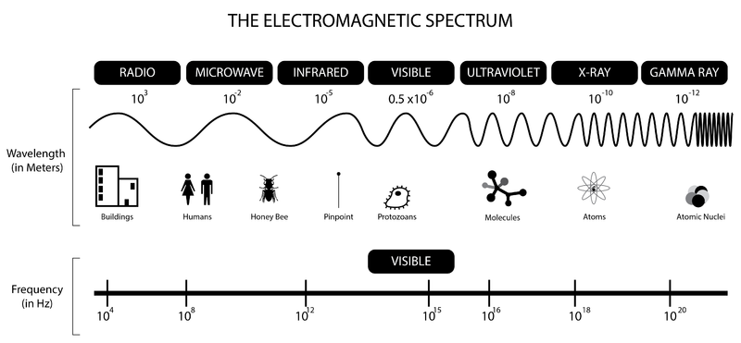
Light Attenuation
Q: When designing sunglasses, which portion(s) of the electromagnetic spectrum need(s) to be attenuated?
visible light
ultraviolet light
Q: Normally, a plastic lens does not attenuate these wavelengths/frequencies. What can we do to attenuate them?
Notes:
Give students time to answer the questions before revealing the answers. For the last question, give students 3-4 minutes to discuss options in their teams before sharing with the class.
As students share with the class, record their responses on the classroom board.

Slide 15
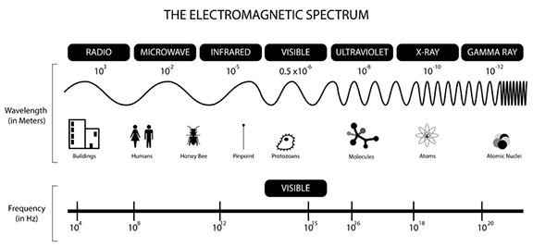
2007 Hamed Saber, Wikimedia Commons CC BY-SA 2.0
https://commons.wikimedia.org/wiki/File:B%26W_girl_portrait_with_sunglasses.jpg
Image Sources
Imgarcade
http://imgarcade.com/sunglasses-clip-art-free.html
2016 And1mu, Wikimedia Commons CC BY-SA 4.0
https://commons.wikimedia.org/wiki/File:EM-Wave.gif
2006 Bob Mellish, Wikimedia Commons CC BY-SA 1.2+
https://commons.wikimedia.org/wiki/File:Wire-grid-polarizer.svg
Wikimedia Commons
https://upload.wikimedia.org/wikipedia/commons/thumb/0/0b/Brewster%27s_angle_polarization.png/800px-Brewster%27s_angle_polarization.png
Imgarcade
http://imgarcade.com/sunglasses-clip-art-free.html
2013 Jonathan S Urie, Wikimedia Commons CC BY-SA 3.0
https://commons.wikimedia.org/wiki/File:BW_EM_spectrum.png

