Slide 1
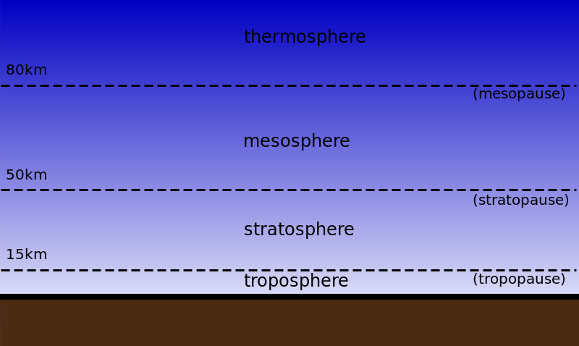
The Atmosphere
Notes:
The Atmosphere Presentation, Humidity? Build a Psychrometer! activity, TeachEngineering.org
/// image source:
Layers of the atmosphere graphic: © 2006 Henry W. Schmitt, Wikimedia Commons https://commons.wikimedia.org/wiki/File:Atmo_camadas.svg

Slide 2
How does energy move in the atmosphere?
Question 1:

Slide 3
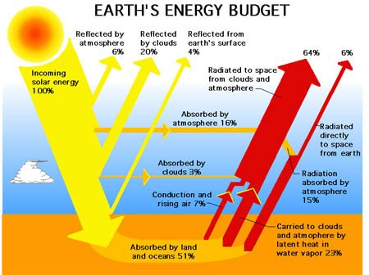
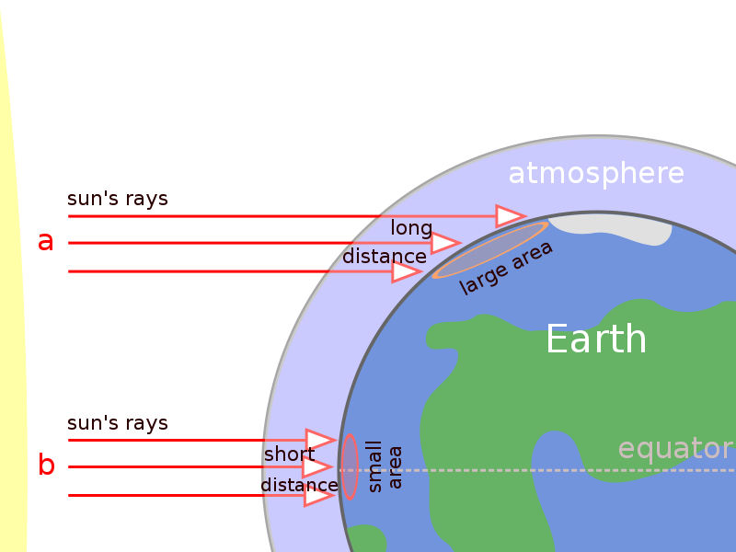
Radiation
Emitted by all substances above absolute zero
Color and type of surface affects absorption
Notes:
Image sources:
(Earth’s energy budget) 2004 NASA
(why polar regions are colder/sun’s rays) 2007 Peter Halasz, Wikimedia Commons CC BY-SA 3.0 https://commons.wikimedia.org/wiki/File:Oblique_rays_04_Pengo.svg

Slide 4
ConDuction vs. ConVection
Conduction
Occurs between Earth’s surface and the troposphere
Molecules must be in Direct contact with each other
Convection
Air expands, becomes less dense, rises, cools and sinks (What else uses the process of convection?)
Vertical movements of air lead to weather changes
This is the primary mode of heating in the atmosphere

Slide 5
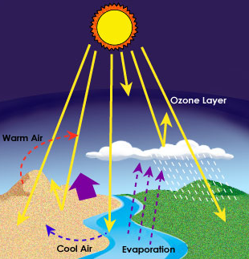
Where are conduction, convection, and radiation occurring in this image?
Notes:
Image source:
(Terrestrial radiation) © 2014 Kmecfiunit, Wikimedia Commons CC BY-SA 4.0, https://commons.wikimedia.org/wiki/File:%E0%B8%81%E0%B8%B2%E0%B8%A3%E0%B9%81%E0%B8%9C%E0%B9%88%E0%B8%A3%E0%B8%B1%E0%B8%87%E0%B8%AA%E0%B8%B5%E0%B8%84%E0%B8%A7%E0%B8%B2%E0%B8%A1%E0%B8%A3%E0%B9%89%E0%B8%AD%E0%B8%99%E0%B8%82%E0%B8%AD%E0%B8%87%E0%B8%94%E0%B8%A7%E0%B8%87%E0%B8%AD%E0%B8%B2%E0%B8%97%E0%B8%B4%E0%B8%95%E0%B8%A2%E0%B9%8C.jpg

Slide 6
From what is our atmosphere composed?
Question 2:

Slide 7
Components of the Atmosphere
1. Gases
Nitrogen 78%
Oxygen 21%
All others 1%
Argon
Hydrogen
Carbon dioxide
Water vapor
2. Solids
Dust
Salt
3. Ozone (O₃)
Exists in small quantities in a layer far above the Earth’s surface
Absorbs the suns rays

Slide 8
How is our atmosphere organized?
Question 3:

Slide 9
Structure of the Atmosphere
The atmosphere is held by the Earth’s GRAVITY
The atmosphere has five layers: from lowest to highest
1. Troposphere (0-10 km from Earth’s Surface)
Where weather takes place
Where air pollution collects
Temperature decreases from bottom to top
Earth
Notes:
/// image source:
Layers of the atmosphere graphic: © 2006 Henry W. Schmitt, Wikimedia Commons https://commons.wikimedia.org/wiki/File:Atmo_camadas.svg

Slide 10
Structure of the Atmosphere
2. Stratosphere (10-50 km from the Earth’s surface)
Composed mostly of ozone
Temperature increases
3. Mesosphere (50-80 km from the Earth’s surface)
Temperature decreases
4. Thermosphere (80-120 km from the Earth’s surface)
Temperature increases to more than 1000 ºC
5. Exosphere (above 120 km)
No clear boundary with space

Slide 11
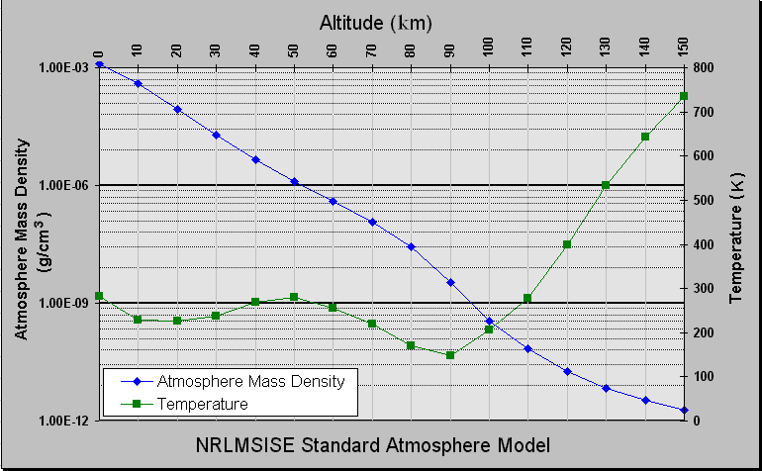
Air Pressure
Air pressure is the weight of air pushing down from above.
As you go up, pressure DECREASES.
Air pressure makes air near the Earth’s surface DENSE.
Notes:
Image source:
(Atmospheric model) © 2007 Conscious, Wikimedia Commons CC BY-SA 3.0, https://commons.wikimedia.org/wiki/File:Atmosphere_model.png

