Slide 1
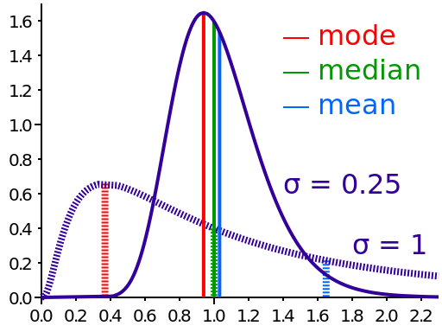
Means, Modes, and Medians
Notes:
Image URL: http://commons.wikimedia.org/wiki/File:Comparison_mean_median_mode.svg

Slide 2
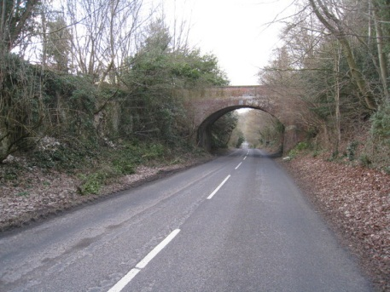
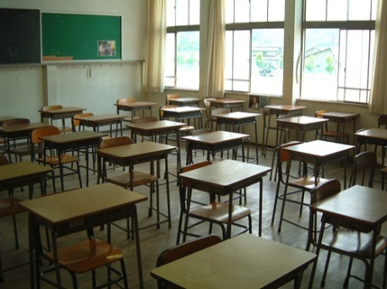
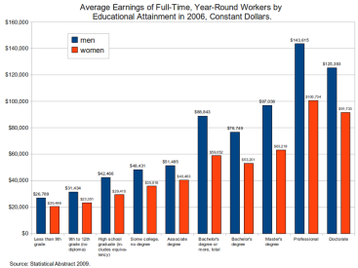
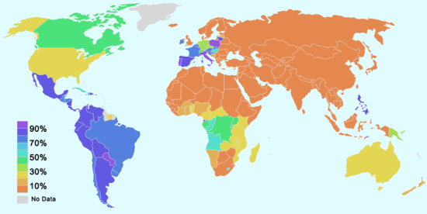
Brainstorming
Where do you find mean, mode and median being used?
What are they used for?
Notes:
For example, mean, mode and median is used to
Miles per hour your car traveled in last month
Estimate the number of trees in the park
Your term grade
Estimate of Earth’s population at any given year
Image URL: http://commons.wikimedia.org/wiki/File:Average_earnings_of_workers_by_education_and_sex_-_2006.png
http://commons.wikimedia.org/wiki/File:Catholic_population.png
http://commons.wikimedia.org/wiki/File:No_height_warning_-_geograph.org.uk_-_1743420.jpg
http://commons.wikimedia.org/wiki/File:Classroom_843785861.jpg
http://commons.wikimedia.org/wiki/File:Plastic_bottle.jpg

Slide 3
Mean value
The mean of a set of numbers is defined as a sum of these numbers divided by the size of the set of these numbers.
Example: What is mean of {6, 11, 7}?
Sum of these numbers is 6+11+7 = 24.
The size of the set of these numbers is 3.
Sum of these numbers divided by the size of the set is 24/3 = 8.
The mean value is 8.
Notes:
Introduce mean or average of a set of numbers. Go over the example.

Slide 4
Example
Matt’s daily savings during the consecutive five weekdays are $3, $-7, $5, $13, $-2.
The sum of the numbers is 3 – 7 + 5 + 13 - 2 = 12.
There are 5 numbers.
The sum divided by the size of the set 12/ 5= 2.4.
The mean saving is $2.4.
$2.4
-7
-2
0
3
5
13
Notes:
Allow a minute for students to solve the problem by themselves before giving out the answer.
Note: positive $3 represents a saving and a negative $3 represent overspending.

Slide 5
Mode value
The mode of a set of numbers is defined as the number that occurs the most frequently in the set.
Example. What is the mode of the following set?
{8, 9, 14, 6, 9, 10}
Ordering the data from least to greatest, we get: 6, 8, 9, 9, 10, 14.
The mode is 9.
Notes:
Introduce the mode of a set of numbers. Go over the example.

Slide 6
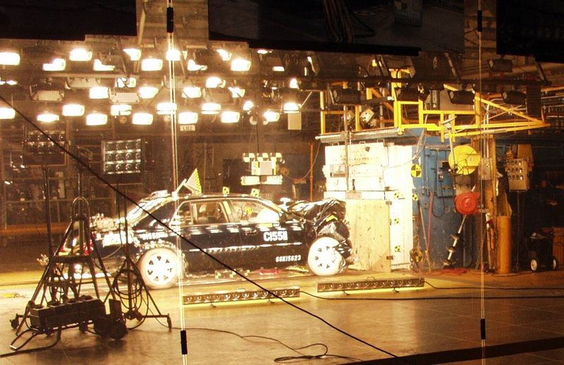
Example
In a crash test, 8 cars were tested to determine what impact speed was required to obtain minimal bumper damage. Find the mode of the speeds given in miles per hour.
24, 15, 19, 20, 18, 24, 26, 18.
Ordering the data from least to greatest, we get: 15, 18, 18, 19, 20, 24, 24, 26.
Since both 18 and 24 occur three times, the modes are 18 and 24 miles per hour.
This data set is bimodal.
Notes:
Allow a minute for students to solve the problem by themselves before giving out the answer.
Problem statement was taken from: http://www.mathgoodies.com/lessons/vol8/mode.html
Image URL: http://commons.wikimedia.org/wiki/File:Vehicle_crash_test_at_the_General_Motors_Vehicle_Safety_and_crash_Worthiness_Laboratory.jpg

Slide 7
Median value
The median is the "middle number" (in a sorted list of numbers).
To find the median, place the numbers you are given in value order and find the middle number.
Example: find the Median of {12, 3 and 5}
Put them in order: 3,5,12.
The middle number is 5, so the median is 5.
Notes:
Introduce the median of a set of numbers. Go over the example.

Slide 8
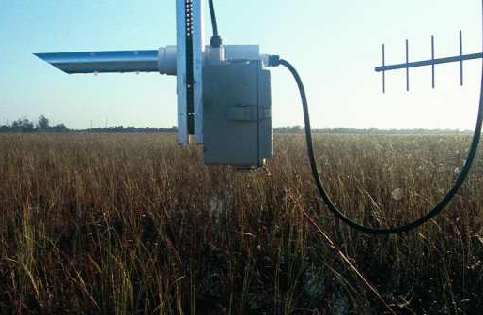
Example
A digital temperature sensor takes measurements in ˚F once an hour. During four consecutive hours it has recorded the following data : 90˚F, 89.5 ˚F, 88 ˚F, 88.2 ˚F. Find the median temperature.
Ordering the data from least to greatest, we get: 88, 88.2, 89.5, 90.
Since the size of data set is an even number (4 total), the median is the average of the two “middle numbers” 88.2 and 89.5.
The median temperature measurement is $\frac{88.2+89.5}{2}=88.85$ ˚F.
Notes:
Let students solve the problem by themselves first and then go over the answer.
Image URL: http://commons.wikimedia.org/wiki/File:Humidity_sensor.jpg

Slide 9
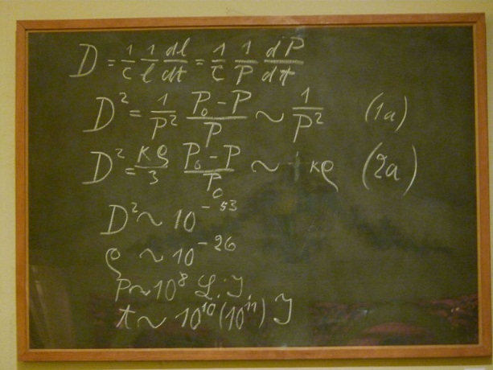
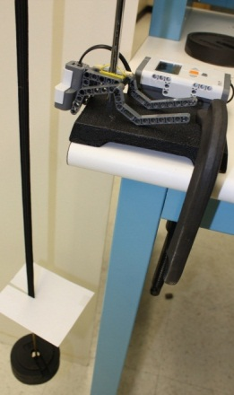
Analyzing Change: Percent error
Percent error is a technique for comparing two quantities.
$\%Error=| \frac{Experimental −Theoretical}{Theoretical}$|x100%
This measure is unit-less and assumes that one quantity is experimental and another quantity is theoretical.
Theoretical
Experimental
Notes:
Go over the definition of percent error. Clarify the difference between theoretical and experimental values as they are important for definition of percent error.
Image URL:http://commons.wikimedia.org/wiki/File:Einstein_blackboard.jpg

Slide 10
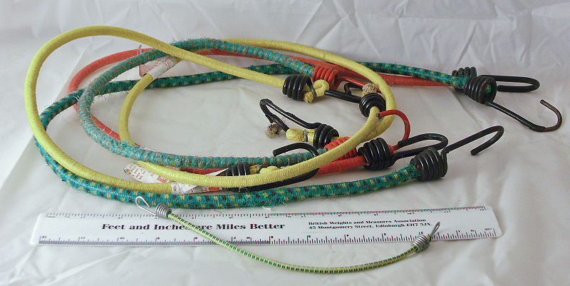
Example
Example: The average measured length of two bungee cords is 20.4cm, and the factory stated length is equal to 20cm. Find %Error.
$\%Error=|\frac{20.4−20}{20}$|x100% = 2%
There is 2% error between reported length and actual length of bungee cords. Need to keep this in mind during engineering design process.
Notes:
Building physical set up is not easy. It requires a lot of preparation, measurements and consideration for safety, and troubleshooting. For example, if one is planning to build bungee jumping set-up, one need to consider safety and reliability of the device. Hence, one will measure the length of the bungee cord during it’s oscillations and check if the set-up is safe for usage.
One can also compare the factory stated length of cord to a the sample average of the measured lengths. This is generally used to compare if the sample average or a sample mean is close to the actual mean.
Image URL: http://commons.wikimedia.org/wiki/File:Bungee_Cord_PICT6882a.jpg

Slide 11
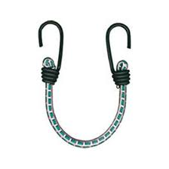
Analyzing Change: Percent difference
Percent difference is a technique for comparing two quantities.
Given two values: $x_{1}$ and $x_{2}.$
$\%Difference=| \frac{x_{1} −x_{2}}{\frac{{(x}_{1}+x_{2)}}{2}}$|x100%$=| \frac{x_{1} −x_{2}}{Average(x_{1},x_{2})}$|x100%
This measure is unit-less and does not assume either quantity to be incorrect even if a difference between them exists.
Notes:
Percent difference is slightly different from percent error. The main difference is that the two quantities that are being used are not assumed to be incorrect. For example, one can compare two bungee cords that have the same factory specified length, however, of a different color. Note that the notation Average(x1, x2) is defined as an average between x1 and x2.
Image URL: http://www.bungeeco.com/images/cat_images/bungee%20ASSMBLIES.jpg

Slide 12
Example
The length of the blue colored bungee cord was measured to be 20.4 cm. The length of the purple colored bungee cord was measured to be 20.5cm. Find the percent difference of their lengths.
$$x_{1}=20.4cm, x_{2}=20.5cm$$
$\%Difference=| \frac{20.4 −20.5}{\frac{20.4+20.5}{2}}$|x100%=0.49%
There is 0.49% difference in the lengths of two cords. Note that we do not assume either length to be wrongly measured even if difference between lengths exists.
Notes:
The example fro percent difference. Let students solve this problem by themselves first.

Slide 13
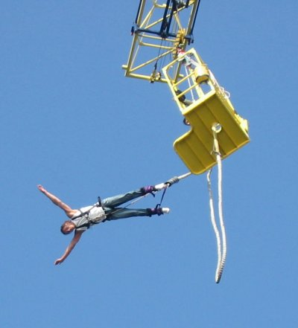
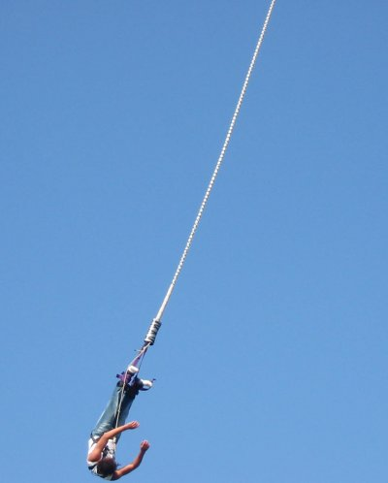
Bungee jumping
Notes:
Introductory slide to Means, Modes, and Medians activity. Since we have talked about bungee cords got the last couple of slide, it is interesting to introduce how they are used in practice. Introduce bungee jumping to students. One can show a video of a person bungee jumping( optional).

Slide 14
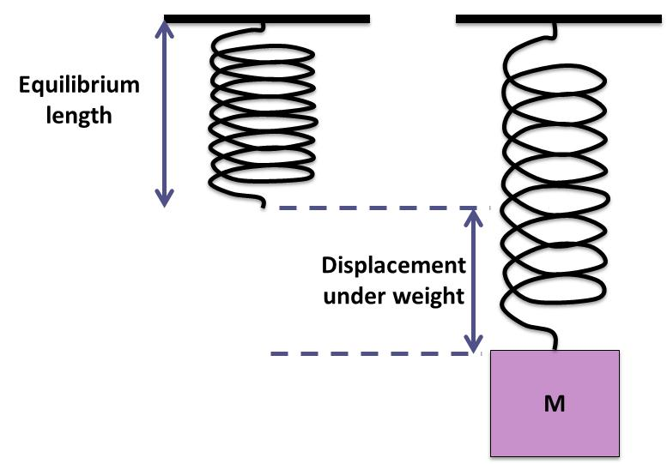
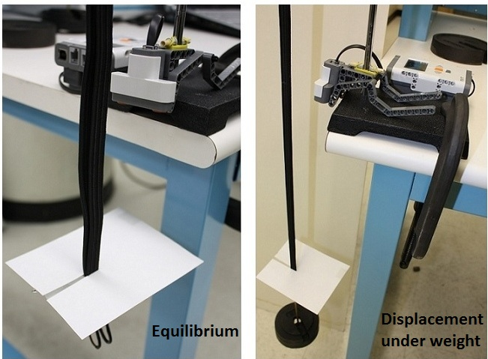
Spring-mass Activity
Notes:
Introductory slide to Means, Modes, and Medians activity. If you look at a person bungee jumping you can see that the cord tends to oscillate up and down when a weight is attached to it. In engineering vibrations theory such oscillation can be compared to the oscillations of a spring-mass. The image in the slide show a diagram of a spring mass in equilibrium and displaced under a weight. In addition, the picture of a set up that is utilized in the activity is shown.

Slide 15
Formulas and references
The mean of a set of numbers is defined as a sum of these numbers divided by the size of the set of these numbers.
The mode of a set of numbers is defined as the number that occurs the most frequently in the set.
The median is the "middle number" (in a sorted list of numbers).
$\%Error=| \frac{Experimental −Theoretical}{Theoretical}$|x100%
Percent error.
Percent difference. Given two values: $x_{1}$ and $x_{2}.$
$\%Difference=| \frac{x_{1} −x_{2}}{\frac{{(x}_{1}+x_{2)}}{2}}$|x100%$=| \frac{x_{1} −x_{2}}{Average(x_{1},x_{2})}$|x100%
Notes:
Start the activity. Keep this slide on during the activity for students to refer to.

