Slide 1
Engineering Silver Nanoparticles
Cleaning water the green way!

Slide 2
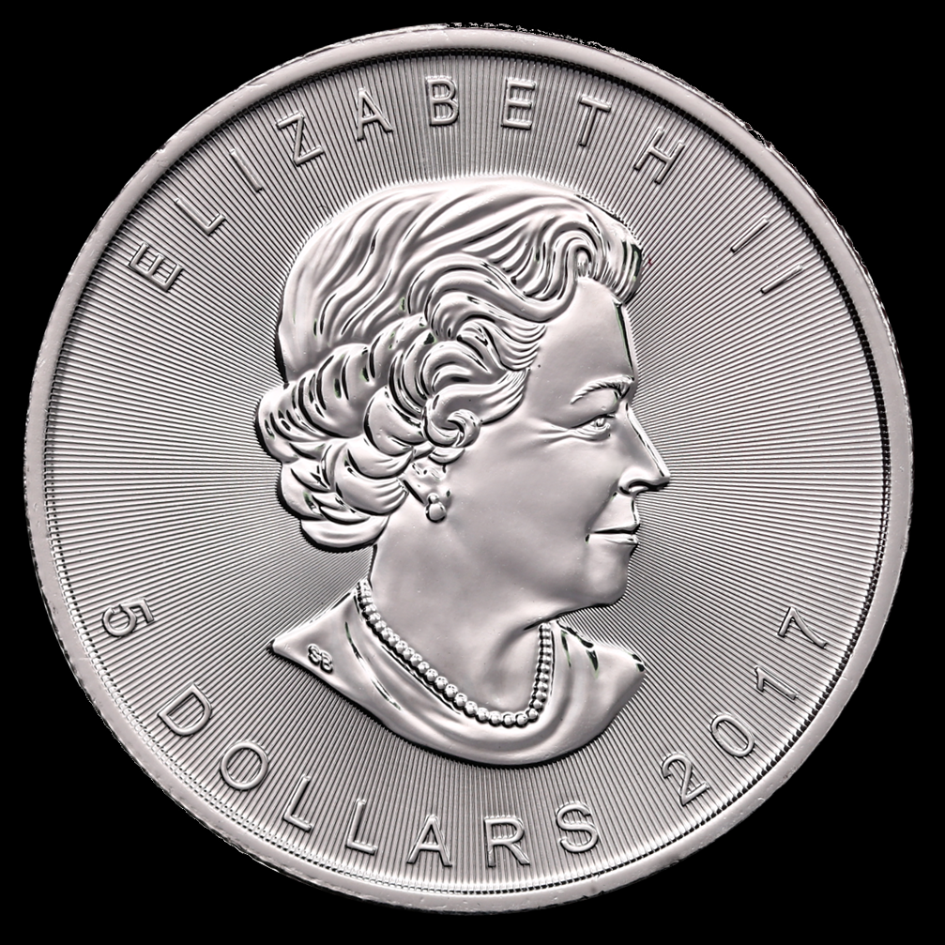
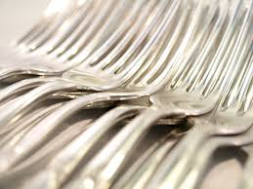
The many uses of silver
On your whiteboard, write all the different ways we use and interact with silver in our lives.
Notes:
Guiding questions to get students thinking about the uses of silver:
Relate silver to what they know (i.e. jewelry and silverware)
Explain the cost of silver
Ask them where they think silver comes from and how do we get it?
Photos retrieved from:
https://www.maxpixel.net/Fork-Forks-Silver-Cutlery-Dinner-Food-Metal-2981398
https://www.goodfreephotos.com/other-photos/silver-pendent-stock-photo.jpg.php
https://commons.wikimedia.org/wiki/File:1_oz_Maple_Leaf_Silver_2017_obverse.png

Slide 3
Silver Nanoparticles and Biofouling
Notes:
This video is an example of how we are using silver nanoparticles to prevent biofouling and filter membranes that are used for cleaning water.
Video Link: https://www.youtube.com/watch?v=f230xdSnek0

Slide 4
Individual Research
Use the internet to conduct scientific research to find out more about the following topics:
What is nanotechnology?
What classifies something as a silver nanoparticle?
How can silver nanoparticles be used to clean water?
Notes:
Use student sheet as a guide

Slide 5
Problem: Current procedure is expensive and can be toxic
Mechanical: ball milling
Chemical etching
Thermal: laser ablation
Method for Synthesis of Nanoparticles
Top to bottom
Chemical or electrochemical
Precipitation
Vapor deposition
Atomic molecular
Toxic
Bottom to top
Green Synthesis
Bacteria
Plant Extract
Fungus
Non toxic
Notes:
There are two ways of making silver nanoparticles. A traditional way of producing silver nanoparticles from top to bottom and precipitation is very expensive because it requires a lot of heat and energy. This method also produced toxic waste. An alternative to this problem is a bottom to up method where we use bacteria, fungus, and plants that have natural reducing agents to create silver nanoparticles.

Slide 6
Using plants and being green!
Notes:
This slide shows the general process for making silver nanoparticles from plants.
Website for picture: https://www.sciencedirect.com/science/article/pii/S2090123215000314

Slide 7
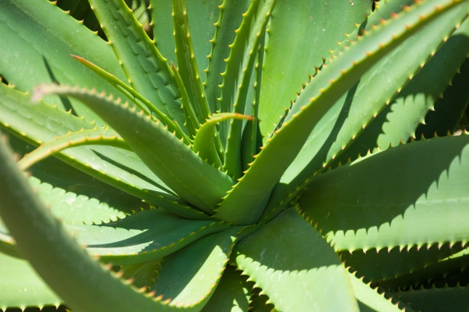
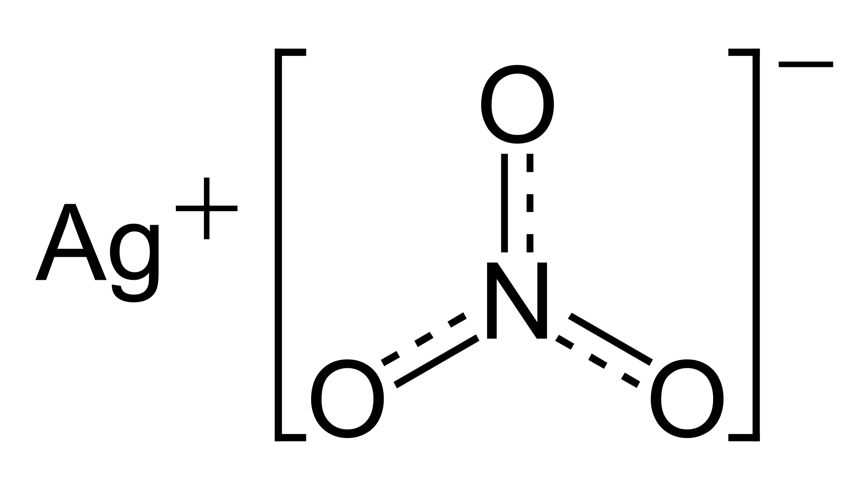
Making silver NPs
Plants act as a reducing agent to add electrons to the silver and change silver ions (Ag+) to nanosilver Ag⁰
+
=
Silver Nanoparticles!
Notes:
Image retrieved from: https://www.publicdomainpictures.net/en/view-image.php?image=202882&picture=aloe-vera-plant
https://commons.wikimedia.org/wiki/File:Silver-nitrate-2D.svg

Slide 8
Procedure for making Ag NPs using plants
Wash it with distilled water
Cut up plant material
Take a plant’s part
Boil plant in distilled water and filter It
Separate silver nanoparticles
Color of solution changes to yellow/brown
Add AgNO3

Slide 9
The end product!
Notes:
Samples from each step where taken. The Ag Nanoparticles will range from a yellow to brown color.

Slide 10
Class results
Group Names | Plant Name | Observations
Notes:
One representative from each lab group will talk about what they did in the lab and their results. Students will evaluate the results to decide which plant they believe worked the best for producing silver nanoparticles. The less color change, the smaller the nanoparticles. The more the color change, the larger the nanoparticles. It is ideal to have smaller nanoparticles because they take up less space and you can have more of them on a water filter or column.

Slide 11
Retest
Talk with group on how you want to retest
Options:
Same plant- use different part of plant, use a different amount of plant, cut up differently
Different plant
Multiple plants
Goal: To make smaller nanoparticles so that there can be more added to a water filter or water filtration column.
Notes:
Tell students to work within their group to come up with a a game plan for how they want to retest to produce the best silver nanoparticles

Slide 12
Letter to Water Plant
Write a letter to the foreman of your local water plant.
Explain what a silver nanoparticle is and how it can be used to clean water.
Describe the problem with the current method with making silver nanoparticles and why doing it the green way with plants is better.
Describe the process of how to get silver nanoparticles from plants.
Include your suggestion for what plant should be used and justify your recommendation using data.

