Slide 1
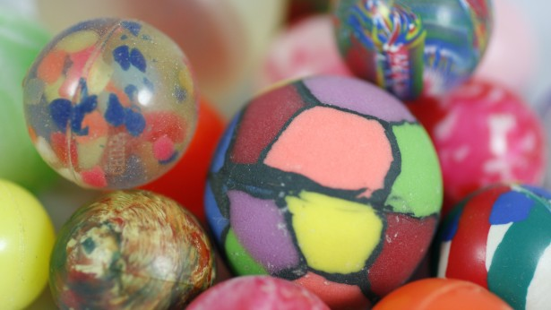
Having a ball with chemistry

Slide 2
Real toy company
The Precision Plastic Ball Company Ltd
https://www.youtube.com/watch?v=4h6m_wrOpm4

Slide 3
Kickoff
Companies are in constant competition to create the best products possible, whether it’s food, cars, video games, or even toys.
Toy companies want products that are cheap to make but are worthwhile to sell. For our class, we will take on the role of engineers for the [insert your own toy company name]. This brand-new company wants materials and chemical engineers to design a new bouncy ball that they can produce at the lowest cost possible.

Slide 4
The challenge!
Create the bounciest ball out of a select number of materials.
Work with one other team member to create your product.
Use as much or as little of any product possible, but keep in mind that you must create the most cost-effective product.
Once you create your product, measure the width of your ball and how far your ball bounces.

Slide 5
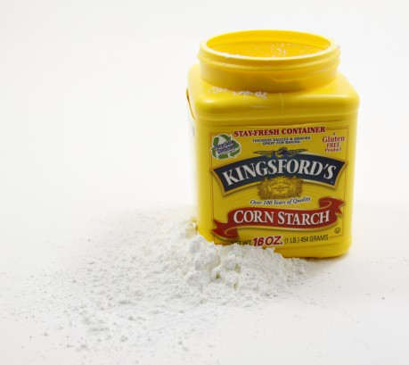
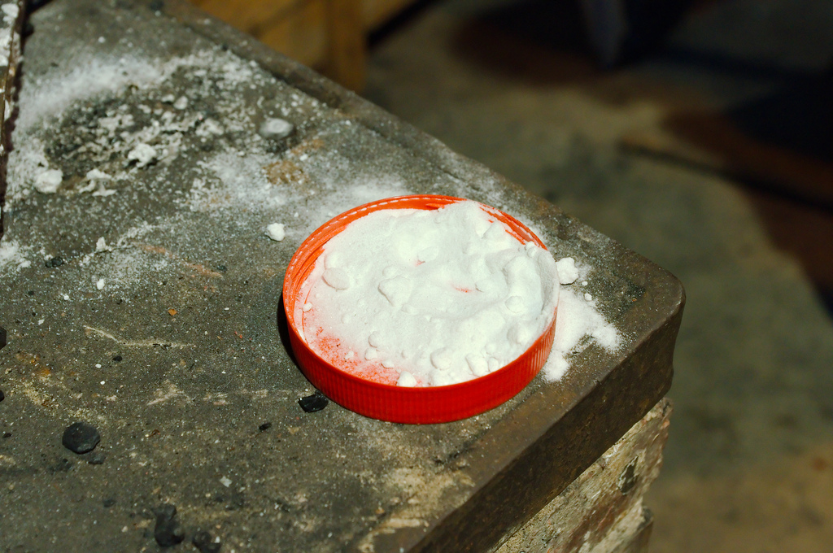
Materials
cornstarch
salt
sugar
borax
glue
water (at room temperature)
hot plate
wooden sticks (to stir)

Slide 6
Observe
Observe the materials available to you. Ask yourself: What reagents (solids or liquids) can I combine to make my bouncy ball? You can look at the physical properties of the materials.

Slide 7
Keep up with the costs!
Supplies Used | Amount | Cost | Total Cost
water |  | $0.30 / tablespoon
glue stick |  | $1.00 / stick
cornstarch |  | $0.20 / tablespoon
Elmer’s glue |  | $0.40 / tablespoon
baking soda |  | $0.25 / teaspoon
salt |  | $0.10 / teaspoon
sugar |  | $0.20 / teaspoon
borax |  | $0.15 / teaspoon
yellow wood glue |  | $0.50 / teaspoon
Total

Slide 8
Maker time - Brainstorm
Divide into pairs.
Brainstorm ideas on how to create your prototype.
Look at materials and touch, if desired, but do not start yet.
Sketch out a detailed plan with quantities.
For example: “We will combine one tablespoon of borax and one tablespoon of glue”.
Show your instructor your plan and begin synthesizing.

Slide 9
Maker Time - Synthesizing
Start synthesizing your ball.
If you succeed, proceed in your lab.
If you fail…that’s ok!
Modify your procedures.
Make sure to write down exactly what you changed.
Notes:
FlipGrid

