Slide 1
What Makes an Eruption Explosive?
Notes:
Volcano Presentation, What Makes an Eruption Explosive? Activity, TeachEngineering.org

Slide 2
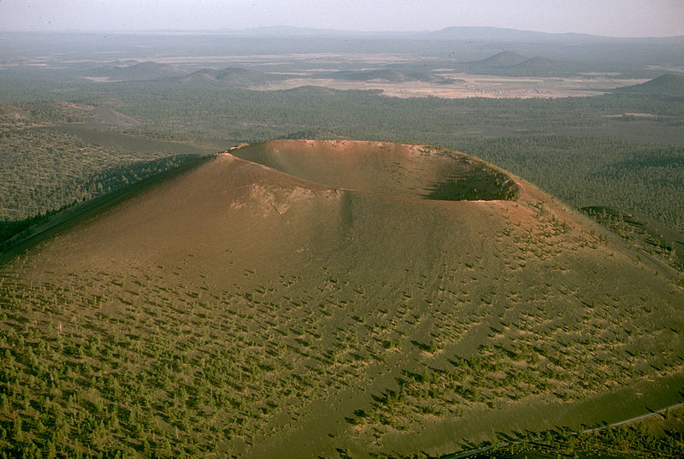
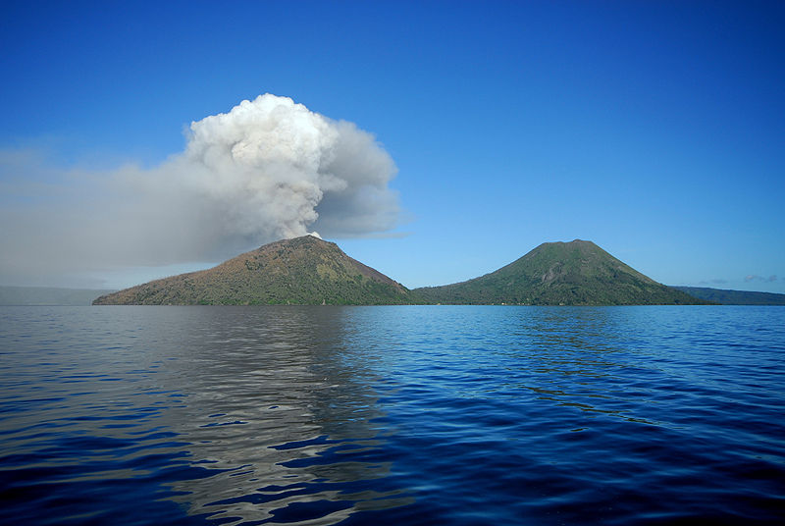
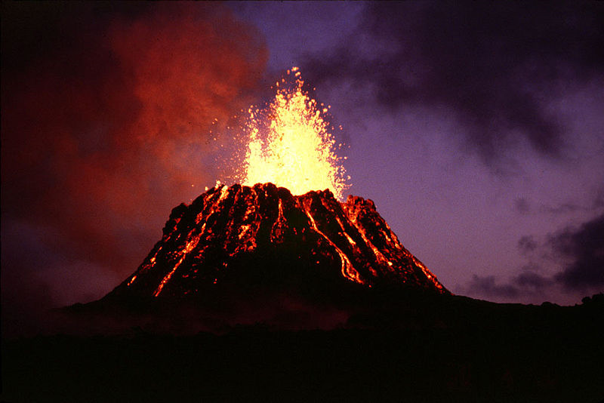
Volcanoes
What are they?
Notes:
(top) Volcano crater in Arizona: 2005 National Park Service, Wikimedia Commons https://commons.wikimedia.org/wiki/File:Sunset_Crater10.jpg
(left) Volcano and water in Papua New Guinea: 2008 Taro Taylor, Wikimedia Commons
https://commons.wikimedia.org/wiki/File:Tarvurvur.jpg
(right) Glowing magma from volcano cone in Hawaii: 1983 G.E. Ulrich, USGS, Wikimedia Commons https://commons.wikimedia.org/wiki/File:Puu_oo.jpg

Slide 3
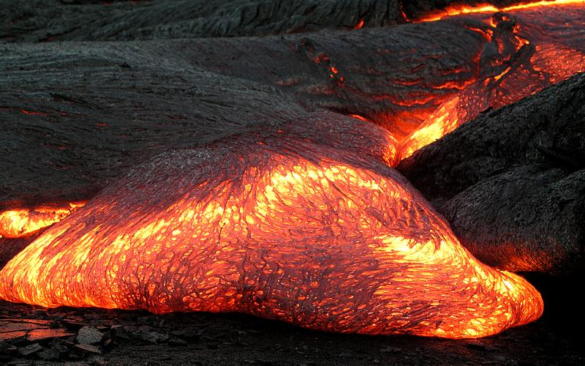
Would you want to live near one?
Notes:
(left) Fiery lava: 2004 National Park Service, Wikimedia Commons https://commons.wikimedia.org/wiki/File:Volcano_q.jpg
(right) Flowing lava: 2003 Hawaii Volcano Observatory (DAS), USGS, Wikimedia Commons
https://commons.wikimedia.org/wiki/File:Pahoehoe_toe.jpg

Slide 4
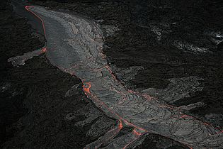
The truth is…
Many types of eruptions are not the “explosive type” we imagine…
Notes:
(left) Flowing open lava channel in Hawaii: 2009 Brocken Inaglory, Wikimedia Commons https://commons.wikimedia.org/wiki/File:Lava_channel_with_overflows_edit_4.jpg
(right) Lava dome with steam in the Mt. St. Helens dome: USGS http://geology.com/volcanoes/types-of-volcanic-eruptions/

Slide 5
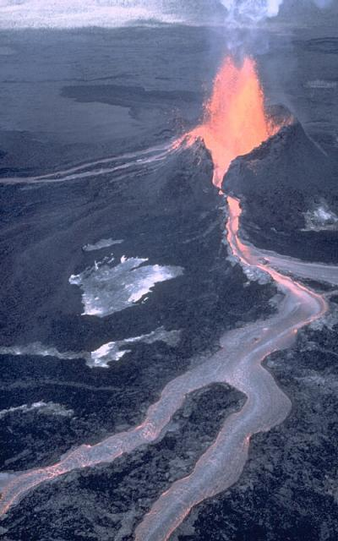
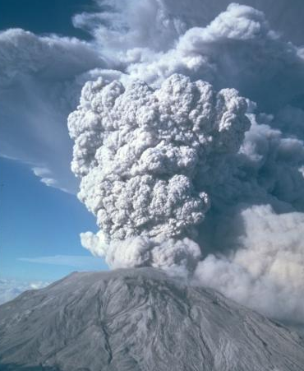
Effusive eruption ➔
⬇ Explosive eruption
Notes:
(left) Mount St. Helens explosive eruption; pumice and ash sent 11 miles into the air and visible 100 miles away; 1980 USGS http://volcanoes.usgs.gov/vsc/glossary/explosive_eruption.html
(right) Kilauea Volcano effusive eruption in Hawaii; lava spills into channels and flows: USGS http://volcanoes.usgs.gov/vsc/glossary/effusive_eruption.html

Slide 6
But when they are explosive…
Plinian eruption: The largest and most violent of all types of volcanic eruptions
Gas and ash can rise up to 50 km and can spread for hundreds of miles from the volcano
Mount St. Helens (1980)
57 people killed
Notes:
Plinain eruptions are the largest and most violent of all explosive eruptions.
Like the Mount St. Helens 1980 eruption (shown here), they eject columns of pulverized rock, ash, and gases that rise miles into the atmosphere in a matter of minutes.
Mount St. Helens in Washington state experienced a Plinian eruption following a major flank collapse in 1980.
Photo of Mount St. Helens by Austin Post, USGS, May 18, 1980
http://geology.com/volcanoes/types-of-volcanic-eruptions/

Slide 7
What contributes to violent eruptions?

Slide 8
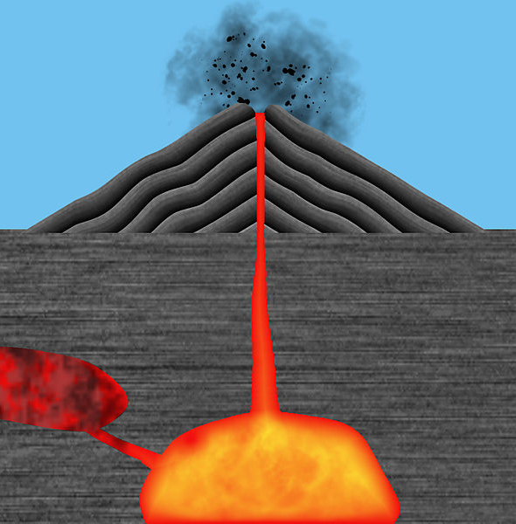
Extreme temperatures and pressures
Volcanic ash, gas, rock fragment expulsion
Notes:
(left) Tavurvur belches ash and pumice in Papua New Guinea: 2008 Taro Taylor, Wikimedia Commons https://commons.wikimedia.org/wiki/File:Dark_Days_Are_Coming.jpg
(right) Cutaway diagram shows view of magma chamber and conduit to vent at top of volcano: 2013 Jasmin Ros, Wikimedia Commons https://commons.wikimedia.org/wiki/File:Igneous_rock_letters,_language_neutral,_no_text,_no_letters.jpg

Slide 9
But also these:
Notes:
Bubbles clipart by Megan 3-29-2014 http://www.clker.com/clipart-bubbles-31.html

Slide 10
Time to Explore Two Main Concepts:
Viscosity: A fluid’s resistance to flow or movement. Describes internal friction of a fluid. A bubble encounters more resistance as it rises through honey than through water.
Degassing: The process of freeing gas from a solution. In this case, freeing gas from magma.

