Slide 1
Life-Cycle Assessment
Collect and calculate data for all input and output of a product’s cradle-to-grave life cycle
Examine data to determine environmental impact
Energy used?
Emissions released?
Compare options
Interpret results and make recommendations that alter life-cycle decisions & processes to reduce a product’s environmental impact
AKA accounting stage
Notes:
LCA Visual Aids, Mmm Cupcakes: What’s Their Impact? Activity, TeachEngineering.org
///
Three main parts of a life-cycle assessment:
1. inventory analysis or accounting stage (collect and calculate data that summarizes all life-cycle inputs and outputs, such as raw materials, supplies, energy, labor, shipping, emissions, etc.)
2. impact analysis (examine life-cycle data to determine the environmental impact, such as energy used and emissions released; compare environmental costs of alternate processes)
3. improvement analysis (interpret impact analysis results and make recommendations that alter the life-cycle decisions and processes in order to reduce a product’s environmental impact)
Image source: 2017 Denise W. Carlson, ITL Program, College of Engineering and Applied Science, University of Colorado Boulder

Slide 2
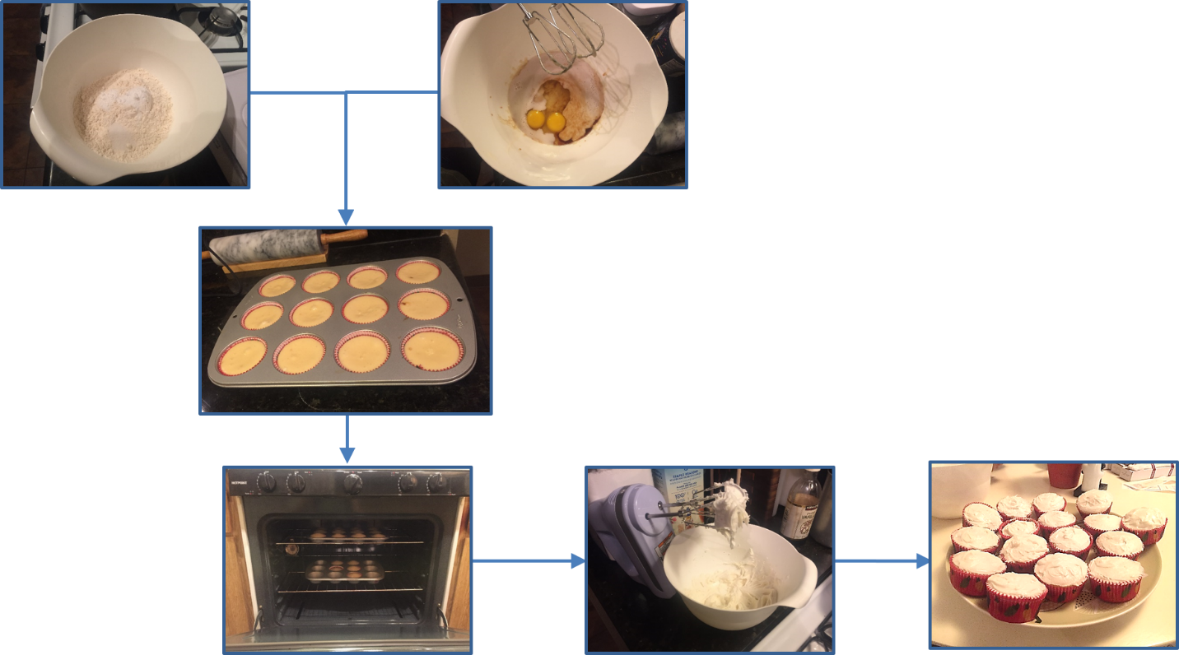
Six Steps to Make Cupcakes
1
2
3
4
5
6
Notes:
What are the steps to make cupcakes?
This flow diagram shows the steps.
The dry ingredients, flour and sugar, are combined with the wet ingredients, eggs and milk, to form a batter that is spooned into paper liners in a cupcake tin, which is placed into an oven for baking. Frosting is mixed and applied to the top of the baked cupcakes.
///
Image sources: 2016 Sara Pace, University of California Davis

Slide 3
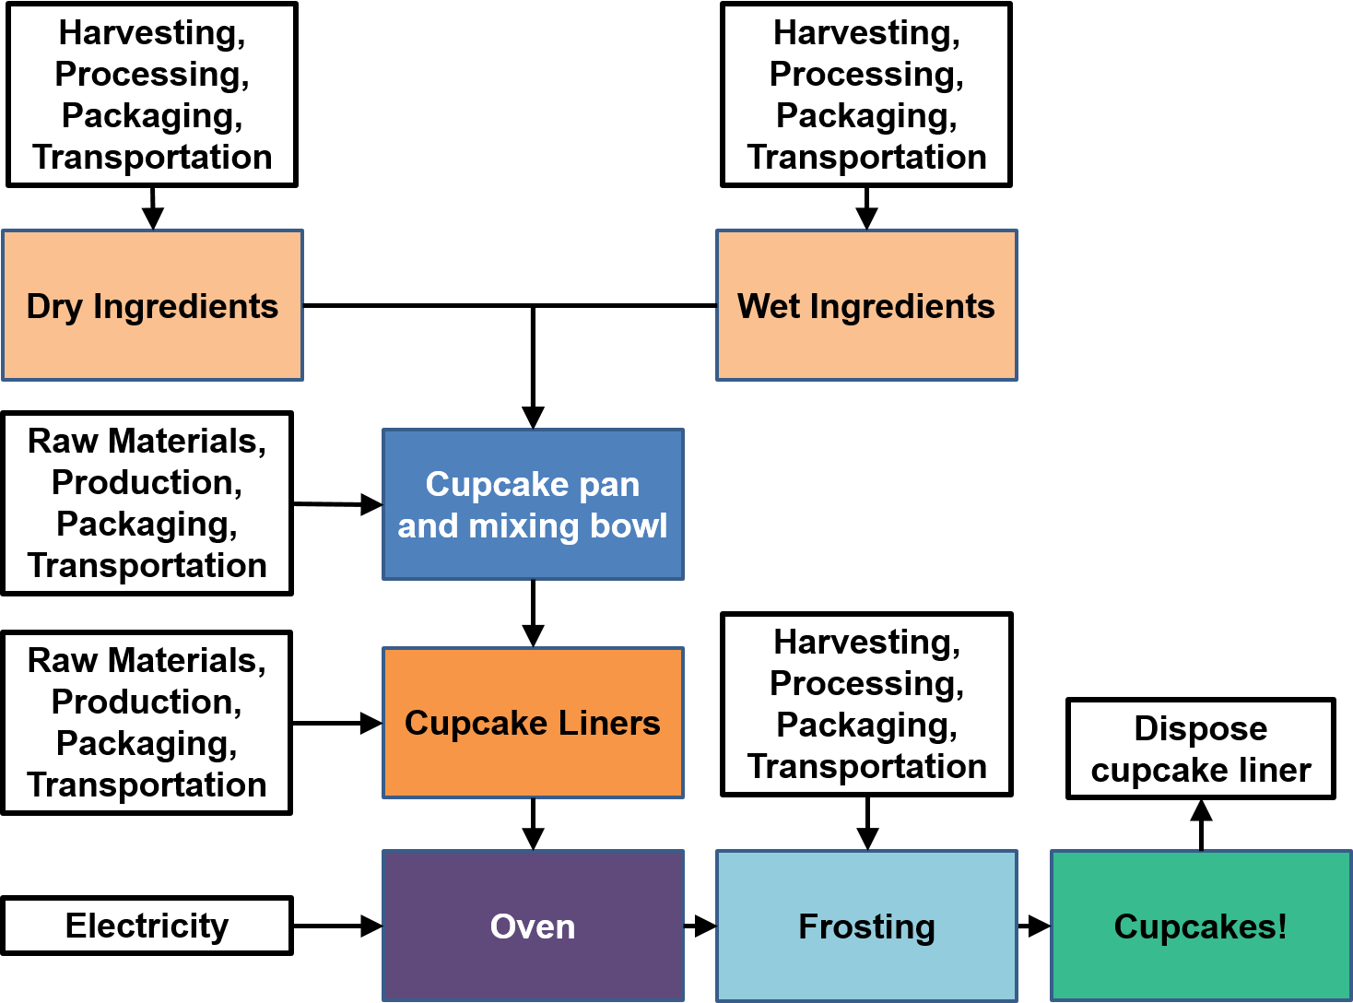
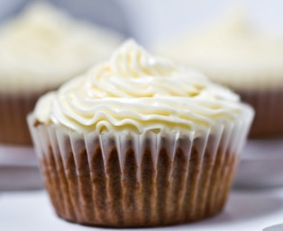
Cupcake Life-Cycle Flow Diagram
Notes:
What are the environmental impacts in the life cycle of a cupcake?
This flow diagram shows all of the inputs for each step of the cupcake-making process. Both wet and dry ingredients and the frosting require energy and generate greenhouse gas emissions from harvesting, processing, packaging and transportation. The cupcake pan, mixing bowl and cupcake liners require energy and emit greenhouse gas from the raw materials, production, packaging and transportation. The oven needs electricity to bake the cupcakes and after eating, the liner needs to be disposed of.
///
Image sources:
(flow chart) 2016 Sara Pace, University of California Davis
(cupcake photo) 2008 Kim Siciliano, Wikimedia Commons CC BY-SA 2.0 https://commons.wikimedia.org/wiki/File:Chai_white_chocolate_cupcakes_(2).jpg

Slide 4
Life-Cycle Assessment ~summary table~
Table 1
Cupcake Life Cycle Stage | Energy Use (kJ) | GHG Emissions (g CO_{2e})
1. Wet ingredients
2. Dry ingredients
3. Baking materials
4. Oven baking
5. Frosting
6A. Disposal (landfill)
6B. Disposal (compost)
Notes:
Use this blank table (or draw one on the classroom board) for groups to record/share their calculations. Alter as necessary to reflect any additional life-cycle stage options being compared.

