Slide 1
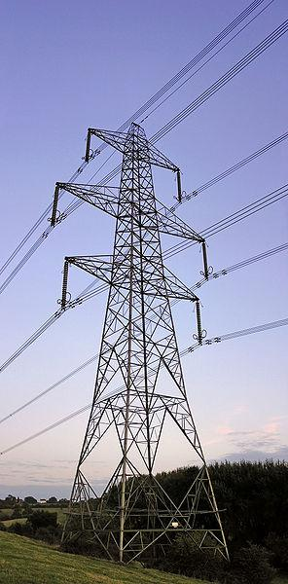
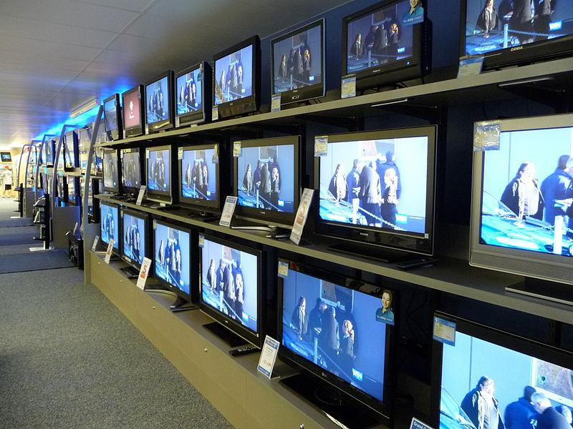
Electricity
How would YOUR LIFE be different with no electricity?
Notes:
As a hook, refer to these images and ask students: How would your life be different with no electricity?
~
What Is Electricity? Presentation > What Is Electricity? Lesson > TeachEngineering.org Image sources:
(electricity transmission tower in UK) 2006 Yummifruitbat, Wikimedia Commons http://commons.wikimedia.org/wiki/File:Pylon_ds.jpg
(televisions for sale in a store) 2008 Wags05, Wikimedia http://en.wikipedia.org/wiki/File:Cptvdisplay.jpg

Slide 2
A power outage has just happened in your city…
Question:
What actions from your daily life would not be possible without electricity?
Notes:
Use the prompt on this slide to start a class discussion or creative writing exercise. For example, brainstorm as a class and then give students 15-20 minutes to write on their own.
Why do we bother learning about electricity? The point of the hook is to emphasize that we constantly use electricity and that our lives would be dramatically different if we did not have access to electricity.

Slide 3
Topic Preview
Electricity
Conductors
Insulators
Current
Static charge

Slide 4
What Are Atoms?
The basic unit of all elements of matter
Made of electrons, protons and neutrons
The nucleus of an atom is in the center, which is where the protons and neutrons are located
-
-
+
+
-
+
+
-
Notes:
Expect the structure of an atom to be a review for students. If not, spend more time on this topic.

Slide 5
What Are Electrons (e⁻)?
-
proton (+)
-
+
+
-
+
+
-
electron (-)
Have a negative electric charge
Are attracted to protons
Notes:
Electric charge is the physical property of matter that causes it to experience a force when near other electrically charged matter. Two types of electric charges exist—positive and negative. Positively charged substances are repelled from other positively charged substances, but attracted to negatively charged substances; negatively charged substances are repelled from negative and attracted to positive. An object is negatively charged if it has an excess of electrons; otherwise, it is positively charged or uncharged.

Slide 6
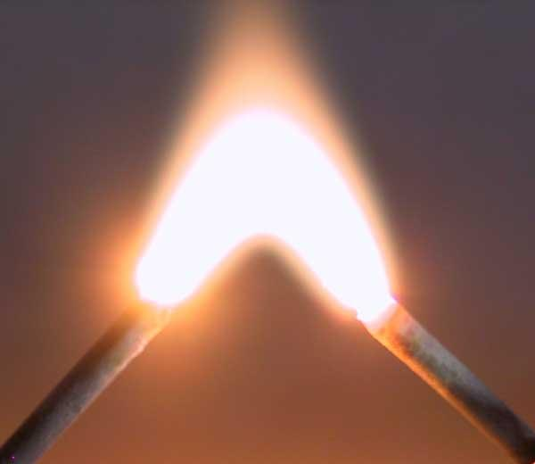
Electricity is…
…the presence or flow of electrons
Notes:
Students may not have an understanding of flow. As necessary, clarify with a simple demo: Have students pour water from one container to another to provide a tangible understanding of the concept of flow. The key point is that flow is movement!
Technically, electricity is the flow of any charged particles. The mnemonic device of ELECTRicity and ELECTRons may help students remember.
~
Image source: (arc between two nails) 2008 Achim Grochowski, Wikimedia Commons http://commons.wikimedia.org/wiki/File:Lichtbogen_3000_Volt.jpg

Slide 7
Conductors
Materials in which electricity (electrons) can easily flow
When current is applied, electrons move in the same direction
Metals make good conductors
Notes:
Conductors are materials that are good at conducting electricity! In conductors, electrons are free to move around and flow easily. This is not true for insulators, in which the electrons are more tightly bound to the nuclei (which we’ll discuss next). When current is applied, electrons move in the same direction.
In preparation for review questions, ask students to think of other metals they know about. You may want to discuss the properties of metals (bendable/ductile, metallic in color) to review students’ knowledge of materials.

Slide 8
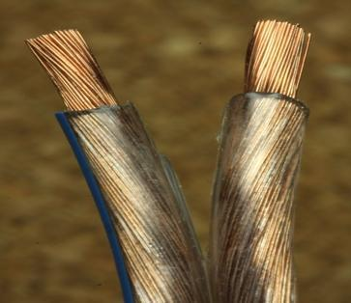
Example: Copper
Conducts electricity
Notes:
Metals, such as copper, are conductors. Copper is an excellent conductor of electricity.
Critical thinking question: How would we test whether something is a good conductor? Answer: By connecting a wire of the material we want to test to a low-voltage battery with a light bulb connected to it. (It may be helpful to draw a sketch of this setup on the classroom board.) If the tested wire is a good conductor, the bulb lights up.
~
Image source: (copper wire) 2011 Robert Kuhlmann, Wikimedia Commons http://commons.wikimedia.org/wiki/File:Lautsprecherkabel_Makro_nah.jpg

Slide 9
Insulators
A material in which electricity can not easily flow
Glass, wood and rubber make good insulators
Often used for safety purposes, such as covering electrical wires
Notes:
In insulators, the electrons are more tightly bound to the nuclei (plural for nucleus) of the atoms. So in these materials, the electrons do not flow easily. For example, most of our homes have fiberglass insulation that prevents inside heat from FLOWING outside through the walls of our houses.
Think about safety measures for electricians. Where would you want to put insulators? (Answer: Anywhere around conductors that you might touch, like wires that carry electricity.)
Are the words “conductor” and “insulator” antonyms or synonyms? (Answer: Antonyms.)
Are insulators such as glass, wood and rubber considered metals or nonmetals? Think of the periodic table and the primary elemental components of these materials (silicon for glass, carbon for wood, and carbon and oxygen for rubber). (Answer: Nonmetals.)

Slide 10
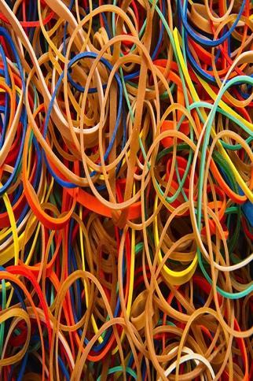
Example: Rubber
A good insulator
and a poor conductor
Notes:
Critical thinking question: We know that insulators and conductors are opposites. Do you think rubber is a good or poor conductor? Why? (Answer: Rubber is an example of a good insulator. Since rubber is a good insulator, it must be a poor conductor because they are opposite properties.) When students answer correctly, click to reveal the “good insulator” bullet, and again for the “poor conductor” bullets.
~
Image source: (rubber bands) 2011 Bill Ebbesen, Wikimedia Commons http://commons.wikimedia.org/wiki/File:Rubber_bands_-_Colors_-_Studio_photo_2011.jpg

Slide 11
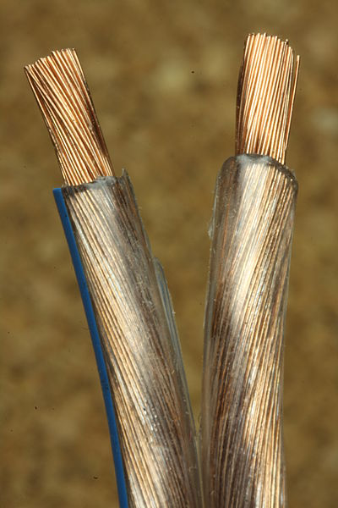
Electrons travel easily through conductors and poorly through insulators
conductor freely move electrons
insulator hold onto their electrons
Notes:
Is the photograph labeled correctly with which is the conductor and which is the insulator? (Answer: Yes, this picture is labeled correctly. Copper is a metal; most metals make good conductors. Current does not flow easily through rubber, which makes it a good insulator to wrap around the copper wire.)
~
Image source: (copper wire) 2011 Robert Kuhlmann, Wikimedia Commons http://commons.wikimedia.org/wiki/File:Lautsprecherkabel_Makro_nah.jpg

Slide 12
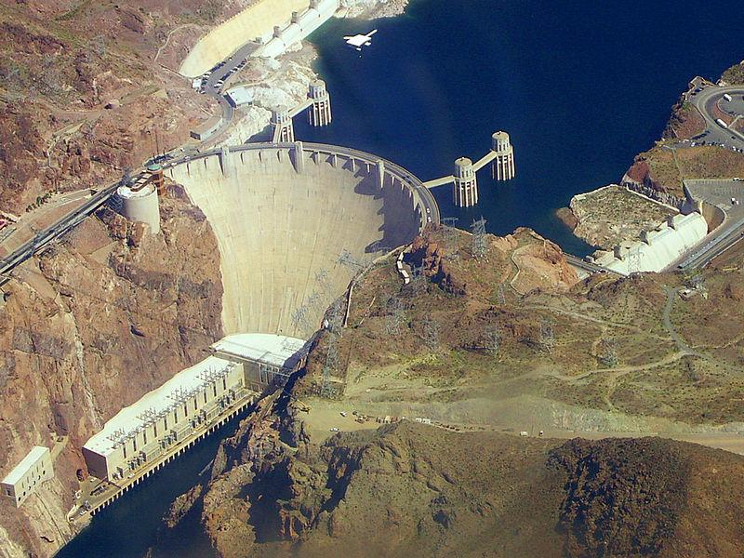
Current
Similarities between water and electrical systems
We often use well-known systems to better understand more complex systems.
Nile River
Hoover Dam
Electrons act like water molecules in that they can flow like rivers or collect in dams.
Notes:
Next we’ll discuss current, which is the flow of electricity/electrons. We often use water to understand electrical systems because of their similarities. For example, water can build up pressures, like in a dam, and flow like in a river. Electricity acts the same way.
Critical thinking question: What are some examples of how we use analogies to explain more complex scientific phenomena? Examples: Humans use stories like the Greek myths to explain seasons and sunrise/sunset. We often think of materials and animals as having human “personalities” and behaviors, like saying that conductors “direct” and move electrons.
~
Image sources:
(Nile River) 2003 Marcell Katona, Wikimedia Commons http://commons.wikimedia.org/wiki/File:Nile2.jpg
(Hoover Dam) 2005 snakefisch, Wikimedia Commons http://commons.wikimedia.org/wiki/File:Hoover_dam_from_air.jpg

Slide 13
Current
In water systems, current is the flow of water.
e-
e-
e-
e-
e-
In electrical systems, current is the flow of electrons.
e-
e-
e-
Notes:
Relate back the water flow demo

Slide 14
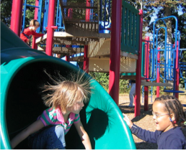
Static Charge
Dammed water collects,
but cannot flow
Static charge, or static electricity, collects charge, but cannot flow
Notes:
Let’s consider static charge. How can it be explained in our water system analogy?
It may help to think of the mnemonic device of: “STATIc electricity is STATIonary”—it does not move. Electrons cannot move between atoms. Therefore, charge collects; this is similar to how water collects behind a dam.
~
Image sources:
(Hoover Dam) 2005 snakefisch, Wikimedia Commons http://commons.wikimedia.org/wiki/File:Hoover_dam_from_air.jpg
(static on the playground) 2005 Ctd 2005, flickr http://www.flickr.com/photos/49196923@N00/48616367/
Caption: Contact with the slide has left this child's hair positively charged so that individual hairs repel one another. The hair may also be attracted to the negatively charged slide surface.

Slide 15
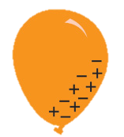
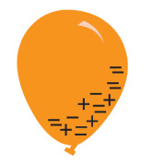
Static Charge
Think positive (+) and negative (+)
Objects may gain or lose electrons (-).
Rubbing the balloon on hair causes more electrons(-) to go onto the balloon from the hair.
neutral (0)
neutral (0)
The hair loses electrons, thus becoming positively charged (+). The balloon becomes negatively charged (-)
net negative charge (-)
net positive charge (+)
Notes:
While showing this slide, direct students to rub inflated balloons on the hair on their heads. Ask them: What makes your hair stand up?
What does the term “net” mean? (Answer: “Net” means “total.”)

Slide 16
Review Questions
Do you think electrical current flows
more easily in conductors or insulators?
Electrical current flows more easily in conductors because electrons move better in conductors.
Static electricity builds up more easily in insulators because electrons cannot move well in insulators.
Notes:
Click to reveal the answer.

Slide 17
Review Questions
What do we call the flow of charged particles?
Electricity!
Does it matter if they are a positive or negative?
No, but typically electricity is the flow of electrons (negative charge)
Notes:
Click to reveal the answers.

Slide 18
Review Questions
We have shown that copper is a conductor.
Name three more conductors.
Gold, silver, aluminum
Where would an electrician use an insulator?
What type of material would it be?
Why would an electrician use an insulator?
An electrician would use insulator material either around electrical wires or around the handles of the electrician’s tools. Usually, electricians use rubber. Insulators help to protect the electrician because current does not travel very well through insulators.
Notes:
Click to reveal the answers.

Slide 19
Review Questions
If you wanted to design an electrical system that stored static electricity, would you use a conductor or an insulator? Why?
To build an static electricity storage system, you would want to use an insulator, because insulators reduce electron flow.
Finish the analogy:
River IS TO water molecules AS wire is to ___________
electrons
Notes:
Click to reveal the answers.
(If students have had exposure to analogies, which is part of the sixth-grade curriculum in many states, use the analogy question. If not, students may need assistance on how analogies work.)

