Slide 1
Energy Conversion
Exploring Energy
Notes:
Energy Conversion Presentation
Exploring Energy: Energy Conversion lesson > TeachEngineering.org

Slide 2
What Did We Learn Last Time ?
Concept Review:
kinetic
Motion energy is called ___________________ energy
It depends on the ________ and _______ of an object.
Stored energy is called ___________________ energy.
Energy can be stored in many forms, such as:
mass
speed
potential
gravitational energy
chemical energy
heat/thermal energy
elastic energy
Notes:
Review the concepts students learned in the previous lesson in the unit.

Slide 3
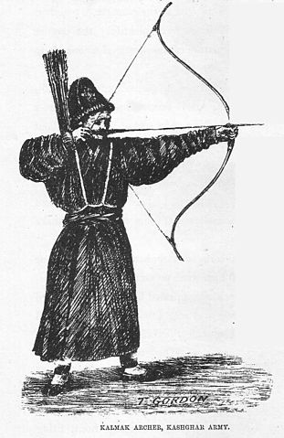
Energy Transfer
Energy can be transferred from one form to another, from one object to another, or even from one place to another.
Energy can be transferred in many ways.
potential ➔ kinetic
potential ➔ potential
kinetic ➔ potential
kinetic ➔ kinetic
Notes:
Image sources:
(Kalmak archer) 1876, Thomas Edward Gordon, Wikimedia Commons http://commons.wikimedia.org/wiki/File:Kalmak_archer.jpg
(arrow) 2008 Pearson Scott Foresman, Wikimedia Commons http://commons.wikimedia.org/wiki/File:Arrow_(PSF).png

Slide 4
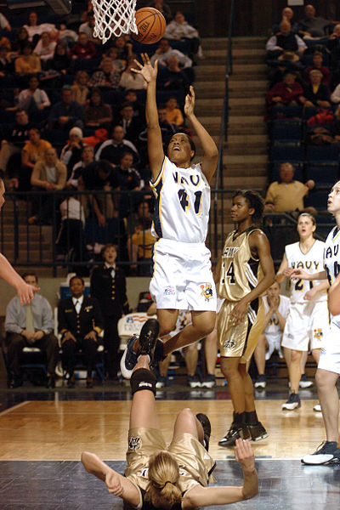
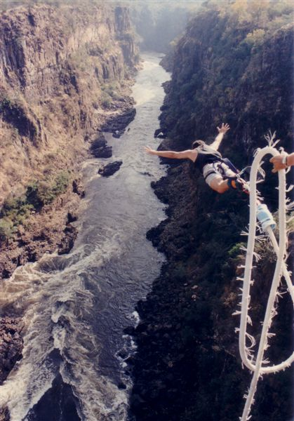
Energy can be transferred from one object to another by a force (by the objects pushing or pulling on each other).
A force can also transfer energy from one form to another.
Force
Notes:
Image sources:
(player shooting a basketball) 2004 Mark Rebilas, Wikimedia Commons http://commons.wikimedia.org/wiki/File:Basketball_shot.jpg
(bungee jumper over a river canyon) 1996 Spy007au, Wikipedia http://en.wikipedia.org/wiki/File:Bill%27s_Bungy_Jump.jpg

Slide 5
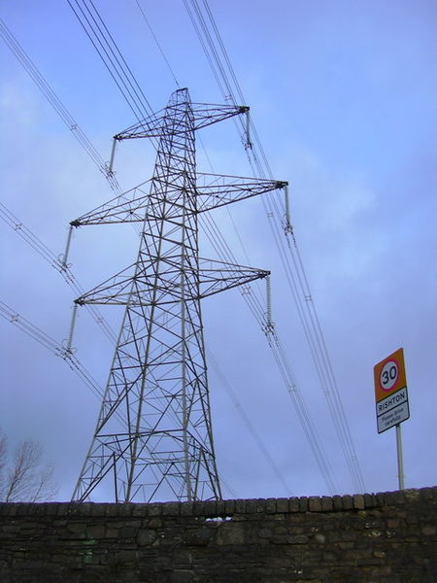
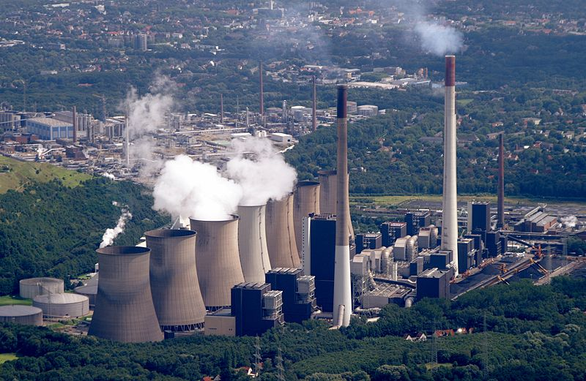
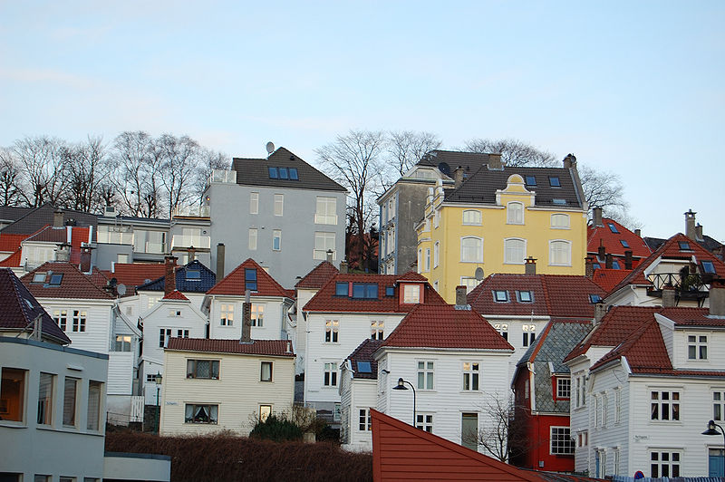
Electricity is the flow of electric charge through a conductor. Energy can be transferred from one place to another and from one form to another by electricity.
Electricity
power plant
houses
electricity towers
Notes:
What does it mean when a teacher says, you have a lot of potential? It means that you can do something that you are not currently doing.
Image sources:
(Scholven Powerplant) 2007 Sebastian Schlüter, Wikimedia Commons http://commons.wikimedia.org/wiki/File:Scholven_Powerplant.jpg
(electricity pylon tower) 2005 Robert Wade, Wikimedia Commons. http://commons.wikimedia.org/wiki/File:Electricity_Pylon-Tower_at_Norden_Bridge_-_geograph.org.uk_-_1601275.jpg
(residential buildings in Norway) 2009 Sveter, Wikimedia Commons http://commons.wikimedia.org/wiki/File:Residential_Buildings_Bergen_Norway_2009_1.JPG

Slide 6
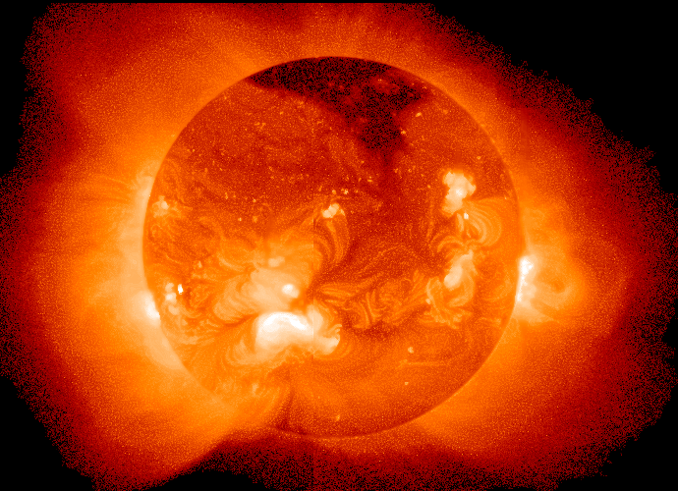
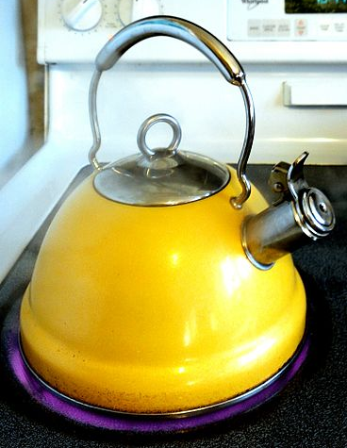
Energy Can Also Be Transferred in Other Ways
light
heat
sound
Notes:
Image sources:
(glowing orange sun) 2006 NASA Goddard Laboratory for Atmospheres, Wikimedia Commons http://commons.wikimedia.org/wiki/File:Sun_in_X-Ray.png
(guitar) 2007 PJ, Wikimedia Commons http://commons.wikimedia.org/wiki/File:Guitar_1.jpg
(yellow kettle on stove burner) 2013 Sage Ross, Wikimedia Commons http://commons.wikimedia.org/wiki/File:Yellow_kettle_with_boiling_water_on_stovetop.jpeg

Slide 7
Energy Transfer
Energy transfer is very useful…
Notes:
Image source: (pizza and wood fire) Microsoft clipart http://office.microsoft.com/en-us/images/results.aspx?qu=fire&ex=1#ai:MP900407468|mt:2|

Slide 8
Energy Transfer
Energy transfer is very useful… but the transfer is never perfect.
Some energy always goes places we don’t want it to go.
Notes:
Image source: (pizza and wood fire) Microsoft clipart http://office.microsoft.com/en-us/images/results.aspx?qu=fire&ex=1#ai:MP900407468|mt:2|

Slide 9
Energy Transfers Are Not Perfect
Remember:
When energy is transferred, some energy is usually “lost” as __________ , ___________ or __________.
heat
sound
light
Notes:
Explain that “lost” energy doesn’t disappear, it just gets converted to a form that may not be desired or useful to us. Energy is never created or destroyed, it just changes form.
Energy transfer demonstrations:
Bounce a tennis ball. Note the changes in gravitational potential energy and kinetic energy. Note that each time it hits the floor some of the energy is converted to sound and heat (although the increase in heat in the tennis ball isn’t really noticeable). Because of the energy lost to sound and heat each bounce is lower than the last.
Hit large steel ball bearings (~2” diameter works well) together with a piece of paper between them. The heat of collision is enough to char the paper. Students will be able to see and smell that the paper has been burned where the bearings collided.
~
Image source (movement track of a bouncing basketball) 2007 Michael Maggs, Wikimedia Commons http://commons.wikimedia.org/wiki/File:Bouncing_ball_strobe_edit.jpg

Slide 10
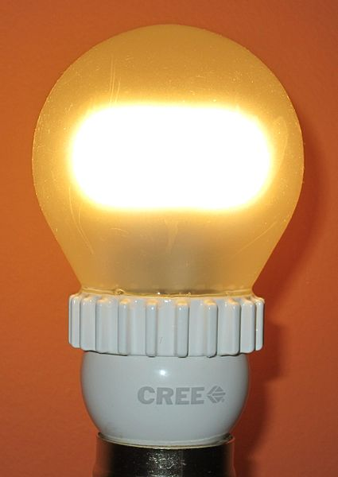
Energy Transfer Example 1: Light Bulb
houses
power plant
60-watt light bulb
electricity towers
Notes:
Image sources:
(Scholven Powerplant) 2007 Sebastian Schlüter, Wikimedia Commons http://commons.wikimedia.org/wiki/File:Scholven_Powerplant.jpg
(electricity pylon tower) 2005 Robert Wade, Wikimedia Commons. http://commons.wikimedia.org/wiki/File:Electricity_Pylon-Tower_at_Norden_Bridge_-_geograph.org.uk_-_1601275.jpg
(residential buildings in Norway) 2009 Sveter, Wikimedia Commons http://commons.wikimedia.org/wiki/File:Residential_Buildings_Bergen_Norway_2009_1.JPG
(light bulb) 2013 Wtshymanski, Wikimedia Commons http://commons.wikimedia.org/wiki/File:Cree_800_lumen_LED_2700K.jpg

Slide 11
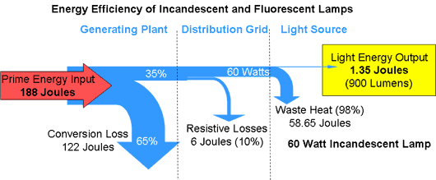
“Lost” Light Bulb Energy
Source: Woodbank Communications Ltd.
Notes:
At this point in the lesson, discuss the broader implications of energy conversion and energy efficiency. If we had a more efficient power plant, distribution grid, or light bulb we could do more with less and we wouldn’t need 188 joules of energy to create 900 lumens of light. We already have more efficient light bulbs than the incandescent bulb used in this example (compact fluorescent and LED bulbs) and engineers are always working on ways to make power plants and distribution grids more efficient. This discussion could be used to foreshadow future lessons on energy consumption, or energy efficiency.
~
Image source (diagram shows inefficiencies involved in converting a primary energy supply into useful light) Woodbank Communications Ltd http://www.mpoweruk.com/images/fluorescent.gif for educational use ==> http://www.mpoweruk.com/legal.htm (terms & conditions)
(light bulb) 2013 Wtshymanski, Wikimedia Commons http://commons.wikimedia.org/wiki/File:Cree_800_lumen_LED_2700K.jpg

Slide 12
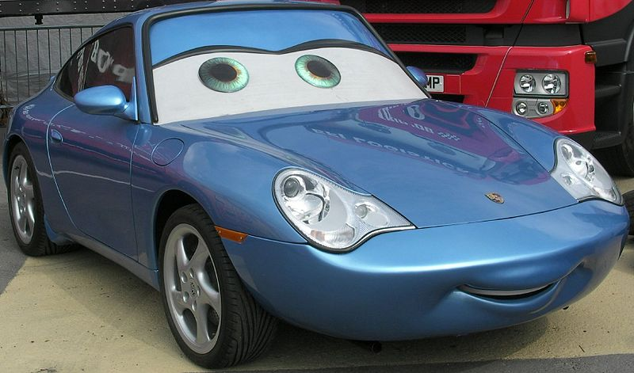
Energy Transfer Example 2: Car
chemical➔ kinetic
Notes:
Image source (blue sports car) 2008 foshie, Wikimedia Commons http://commons.wikimedia.org/wiki/File:Cars_movie%27s_car.jpg

Slide 13
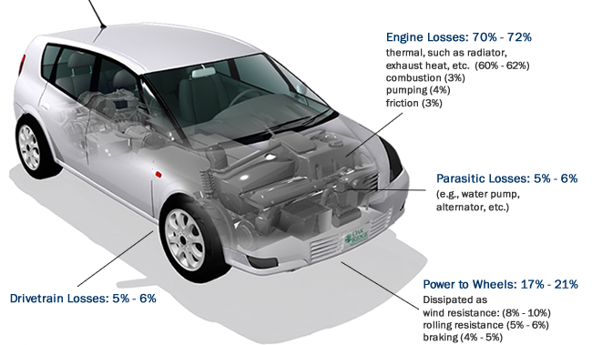
“Lost” Car Energy
Notes:
Like the “Lost” Light Bulb Energy slide, talk about energy efficiency. Automotive engineers try to minimize these losses so a car can go further on a gallon of gas.
~
Image source (diagram of energy losses in a typical car) Oak Ridge National Laboratory (U.S. Government) http://www.fueleconomy.gov/feg/images/energy_requirements_combined.jpg http://www.fueleconomy.gov/feg/ORNL-disclaimer.htm (disclaimers; educational purposes)

Slide 14
Assignment
Write about something you saw today that would not be possible without energy transfer.
Include your observations about:
What was the original source of energy?
What was the final use of the energy?
How was energy transferred?
How was energy “lost”?
Notes:
As an alternative, assign students to explain the exploding water heater video (or other demonstration) from the beginning of the first lesson of this unit, writing about it in more detail than they did after the first lesson. See the four-minute video, MythBusters-Exploding Water Heater, at https://www.youtube.com/watch?v=jbreKn4PoAc.

