Slide 1
Oh Baby! Calculations and Contractions / Activity Overview

Slide 2
The Phenomenon of Childbirth
Everyone knows that a typical pregnancy lasts about 40 weeks and that for a full-term pregnancy, the onset of regular contractions is a sign of labor. In the majority of pregnancies the process is fairly straightforward:
The hormone oxytocin is released from the mother’s pituitary gland.
The cervix dilates.
Contractions, along with pushing, force the baby out of the uterus and into the birth canal.
The placenta is delivered about 20 minutes after the baby.
Copyright © 2021 Megan Kavanaugh, used with permission by Diane Walsh, RET, University of Connecticut

Slide 3
The Force of Contractions
The uterus is the strongest muscle in a woman’s body. So how do contractions help during childbirth? The upper part of the uterus (the fundus) tightens while the cervix and lower uterus stretches and relaxes. This periodic tightening and relaxing propels the baby down and out of the uterus into the birth canal.
The most common method of measuring contractions is with a tocotransducer strapped to the mother’s abdomen. The tocotransducer has a pressure-sensitive gauge that measures displacement.
Copyright © 2021 Megan Kavanaugh, used with permission by Diane Walsh, RET, University of Connecticut

Slide 4
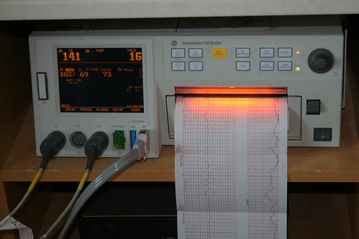
Introduction to Fetal Monitoring
A typical fetal monitor measures maternal heart rate, fetal heart rate, along with relative measurements (duration and frequency) of uterine contractions during labor. Some devices also monitor maternal temperature, blood oxygenation, and/or blood pressure. Obstetricians are particularly interested in the response of the fetus during contractions.
Photos should be a
square like this.
"Fetal Monitor" by ahhyeah is licensed under CC BY-NC-ND 2.0

Slide 5
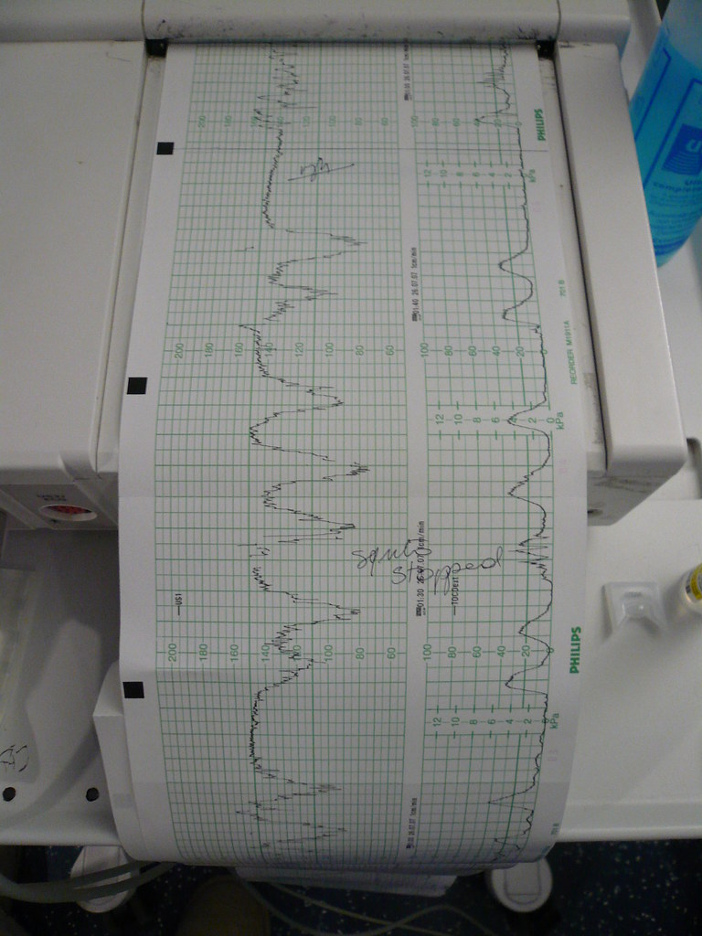
Signs of Fetal Distress
An abnormal fetal heart rate pattern may signal fetal distress. The monitor helps detect the possibility of an underlying problem allowing a physician to intervene. FHR deceleration along with a contraction followed by a rapid return may indicate a compressed umbilical cord which can block oxygen to the fetus. A physician may be able to correct the situation by recommending the mother change positions. In other cases, an immediate Cesarean delivery may be necessary.
"Decision points" by Lars Plougmann is licensed with CC BY-SA 2.0.

Slide 6
Free the Moms
Traditional fetal monitors require a laboring mother to be tethered to the monitor, which means resting in a bed. In recent years, researchers are developing smaller flexible sensors and wireless communication which would allow a mother to be ambulatory.
Copyright © 2021 Kendra Haves-McColgan, used with permission by Diane Walsh, RET, University of Connecticut

Slide 7
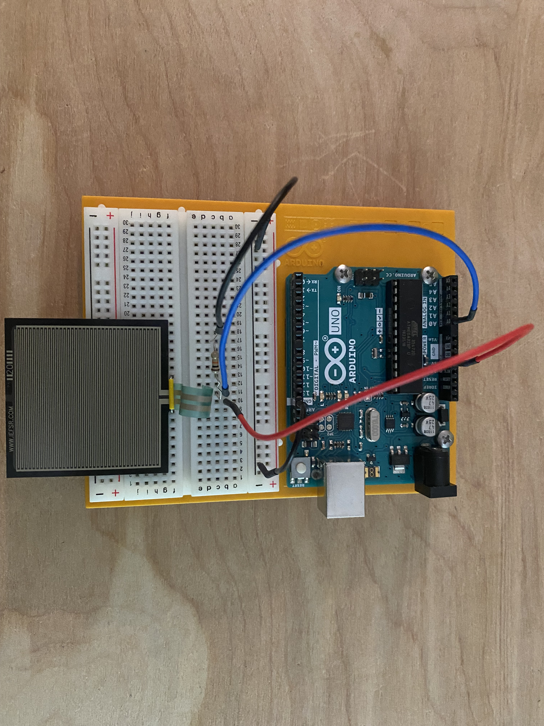
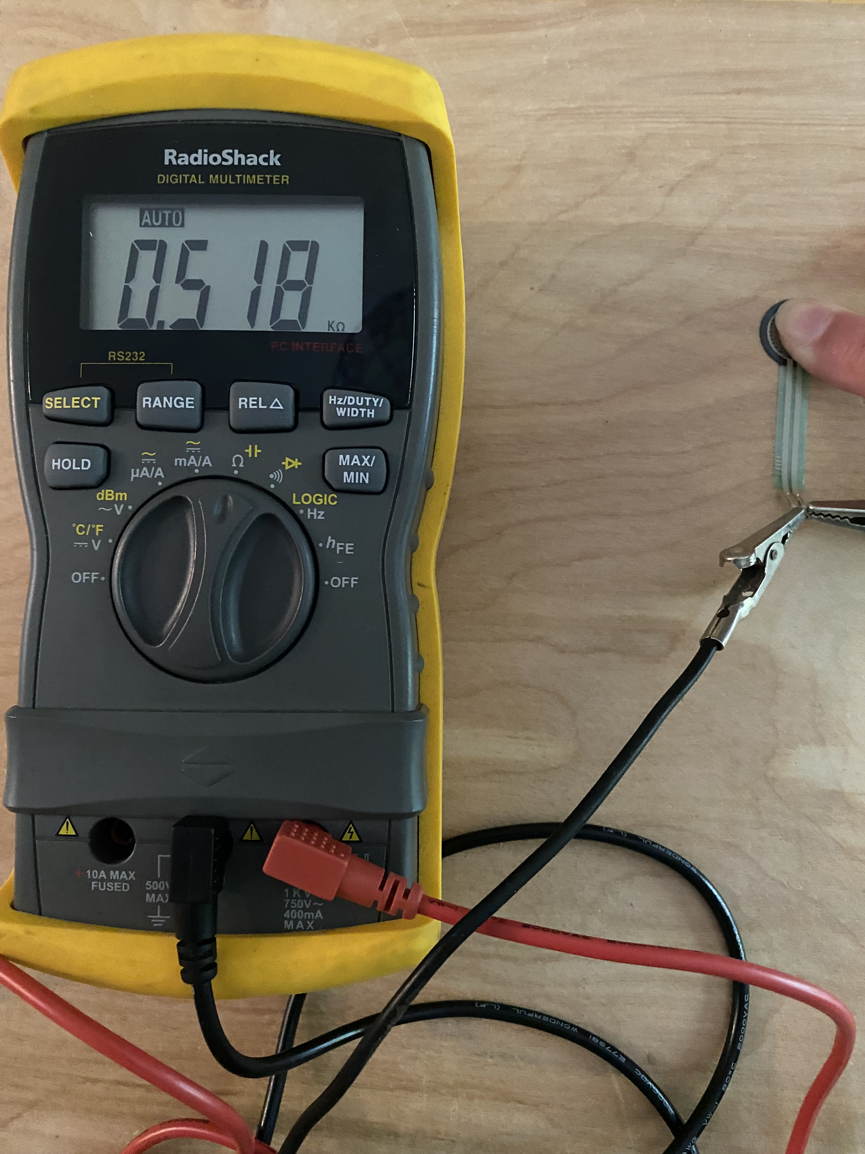
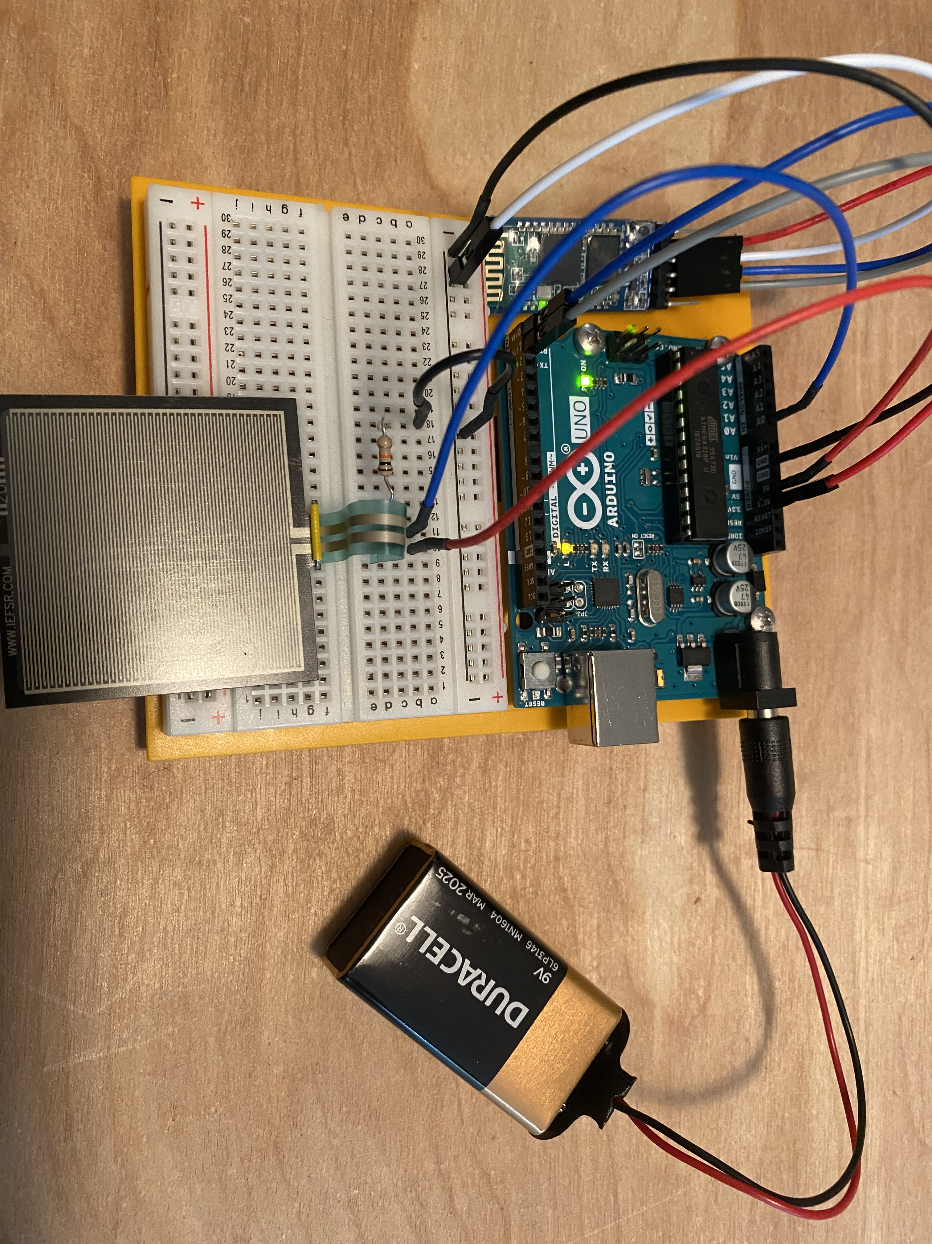
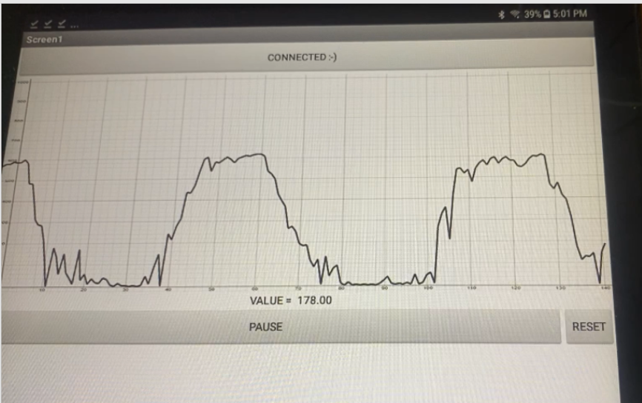
Activity Sections
Part 1: Introduction to Force-Sensitive Resistors Discover the relationship between physical pressure and resistance. | Part 2: Voltage- Divider Circuit Learn about pull-up resistors and how a voltage divider circuit helps measure the resistance across the FSR in proportion to the voltage.
Part 3: Serial Communication between Arduino and Android App Add Bluetooth and learn about serial communication between an Arduino microcontroller and an Android device. | Part 4: Scrolling Chart Code an algorithm to plot the (simulated) uterine contractions (physical pressure versus time) on a scrolling graph. Develop an algorithm that uses sequencing, selection, and iteration.

Slide 8
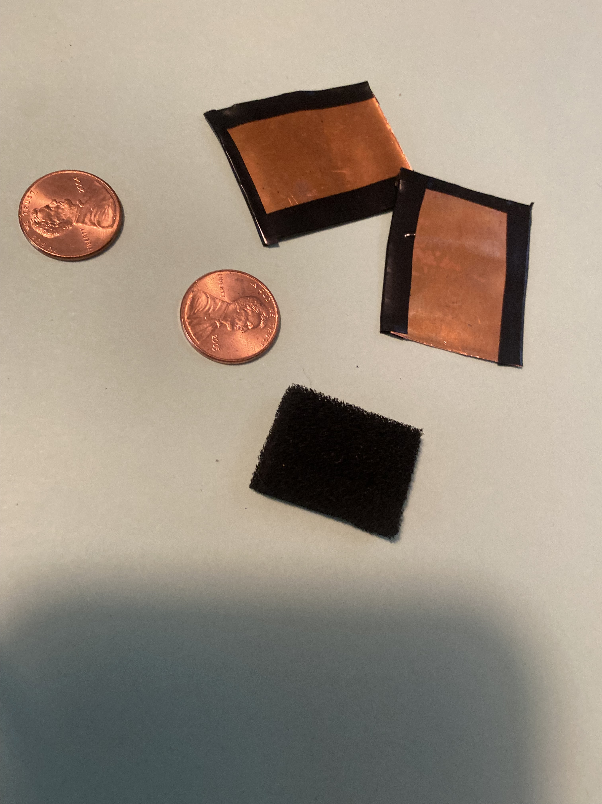
Activity Extensions
Extension 1: DIY FSR Build a homemade force- sensitive resistor out of conductive foam and copper flashing or pennies! | Extension 3: Add a simulated FHR with alarms to the code. Use a random number generator to create a simulated FHR that is within normal range. Then when a contraction reaches a certain pressure, drop the FHR out of normal range, triggering an alarm.
Extension 2: Design a strapless sensor Design a way to attach the sensor to the mother’s abdomen without using straps.


