Slide 1
Oh Baby! Calculations and Contractions / Activity Part 4

Slide 2
Units of Measure
Heart rate (maternal and fetal) is measured in beats per minute (BPM). External uterine contractions are only relative measurements and do not have units. Internal monitoring of contractions is measured in mmHg. However, the external uterine contractions sensor still shows a pattern to indicate the duration and frequency of the contractions. The x-axis is an indicator of time.
“Spikes" by Lateral Support is licensed with CC BY 2.0. To view a copy of this license, visit https://creativecommons.org/licenses/by/2.0/

Slide 3
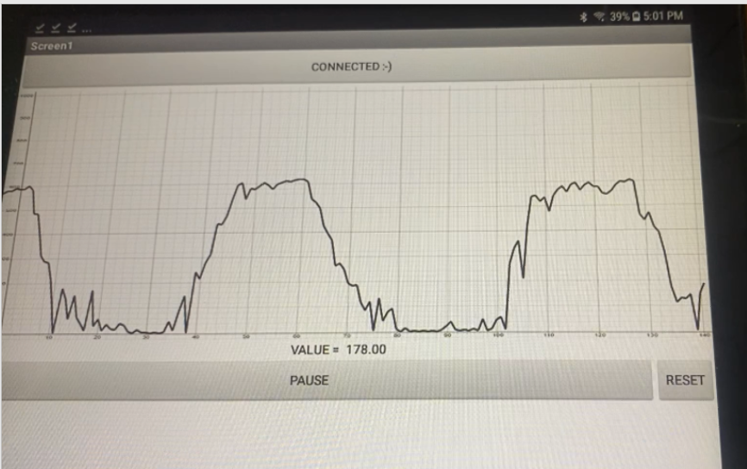
Scrolling Graph
In this activity you will plot the incoming sensor values by connecting sequential points using the DrawLine command in MIT App Inventor 2. When the screen width limit is reached, the graph should scroll to the left with each successive new sensor value.
The computer science skills you will practice in this activity are:
Sequencing: creating an algorithm as a step-by-step process where the order of the steps matter.
Selection: creating conditional statements that determine which parts of the algorithm will run such as IF, THEN, ELSE.
Iteration: loops that repeat a given number of times or until a condition is met.
X
Android app showing a graph of uterine contractions (pressure versus time).

Slide 4
Designing a Better Monitor
Extension: You will be making a wireless uterine contractions monitor that allows the mother to get up and walk around the room. How can you attach the force sensor to the mother’s abdomen? Where will the Arduino board and circuit be? How far can the patient walk away from the Android device?
For advanced learners: Can you add a simulated fetal heart rate that drops during contractions and displays and/or sounds an alarm?

