Slide 1
Analyze Brain Waves

Slide 2
Brain Wave Review

Slide 3
EEG, EKG, and EMG
We can measure the electrical activity of our nervous system, heart, and muscles using EEG, EKG, and EMG, respectively
EEG stands for electroencephalogram, and it is used to measure brain waves
EKG (or ECG) stands for electrocardiogram, and it is used to measure electrical signals in the heart muscle
EMG stands for electromyogram, and it is used to measure electrical signals in the muscles
In this lecture, we will focus on EEG, and how we can analyze the measured waves

Slide 4
Our Toolbox
Now that we know about the different types of brain waves, how do we take a brain wave dataset and determine which waves are present?
We can use the following mathematical processes to “break down” a raw EEG signal and analyze it:
Fast Fourier Transform (FFT)
Power Spectral Density (PSD)
Bandpass Filter

Slide 5
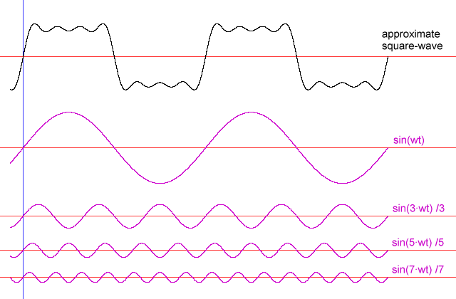
Fast Fourier Transform (FFT)
Sinusoids observed in the real world are not “perfect,” but they can be modeled using combinations of sinusoids
Example: The black signal below is modeled using a combination of the pink signals below it

Slide 6
Fast Fourier Transform (FFT)
A Fast Fourier Transform (FFT) may be used to visualize the different frequencies of a signal’s component sinusoids
When we measure the raw EEG of a brain wave, we use the FFT to plot all the component frequencies observed in the wave
Using the FFT output, we can see which frequencies are “dominant” (appear the most) in the raw signal
If we notice that a frequency of ~ 1 Hz is dominant, we can conclude that the person is likely in a deep sleep since this frequency is representative of the delta wave
We won’t worry about the details of the FFT—just know what it’s used for!

Slide 7
Fast Fourier Transform (FFT) Example

Slide 8
Example of a Real-Time EEG with FFT
Notes:
Make note of the FFT in the top right—this shows the distribution of frequencies (types of brain waves)

Slide 9
Power Spectral Density (PSD)
The power spectral density (PSD) is the distribution of the signal’s power over the frequency
When we want to analyze which types of brain waves are dominant in a raw EEG signal, we can calculate and plot the PSD of the signal to visualize which waves “occur” most often in the signal

Slide 10
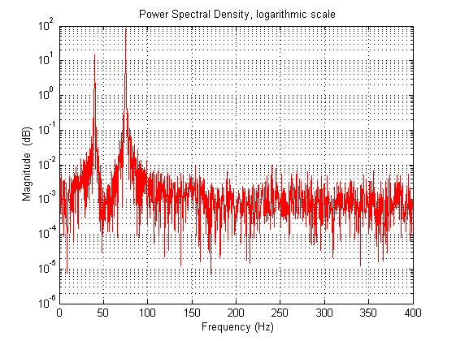
Power Spectral Density (PSD) Example
In the example below, there are two peaks at f = 40 Hz and f = 75 Hz
These peaks show us that most of the original signal’s power comes from waveforms with frequency 40 Hz and 75 Hz

Slide 11
Bandpass Filter
A bandpass filter may be used to “filter out” parts of the original signal that are not within a range (or band) of specified frequencies
When we are analyzing an EEG signal, we can choose to only view wave components that are within the frequency range of a specific type of brain wave
Example: We can choose the band 9 Hz – 13 Hz if we wish to view the alpha wave components

Slide 12
Bandpass Filter

Slide 13
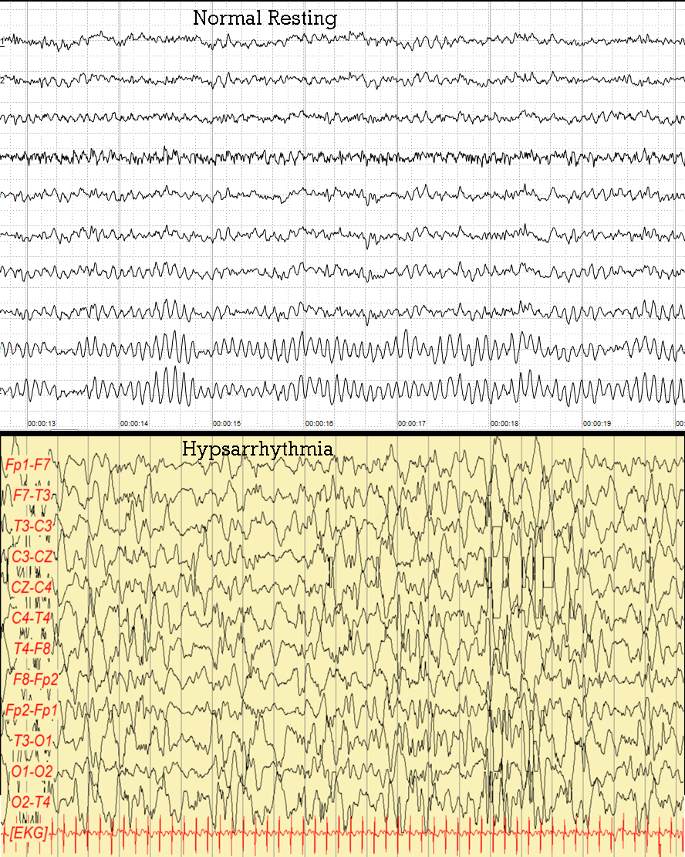
Compare EEG Results
Notes:
Note: Hypsarrhythmia is the term for a very chaotic and disorganized brain electrical activity with no recognizable pattern,
Optional: Have students compare other EEG results, such as: https://www.ncbi.nlm.nih.gov/books/NBK499867/figure/article-28842.image.f2/

