Slide 1
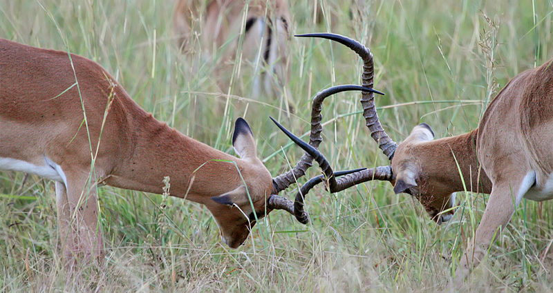
Sumobot Challenge
Notes:
Sumobot Challenge Activity > TeachEngineering.org
Image source: 2011 Muhammad Mahdi Karim, Wikimedia Commons http://en.wikipedia.org/wiki/File:Fighting_impalas_edit2.jpg

Slide 2
Pre-Activity Quiz
What must you keep in mind when building a robot to fight another robot by trying to push it out of a ring?
How can you use gears to your advantage in the competition?

Slide 3
Pre-Activity Quiz Answers
What must you keep in mind when building a robot to fight another robot by trying to push it out of a ring?
Robot structure, that is, to scoop the other robot, pushing mechanism, etc.
Robot weight
Robot gear ratio: power vs. speed
How can you use gears to your advantage in the competition?
Use a low gear ratio (small gear turning a big gear) and focus on a powerful attack.
Use a high gear ratio (large gear turning a small gear) and focus on a speedy attack.
Use a medium gear ratio and balance between both power and speed.

Slide 4
Sumobot Challenge
75 minutes
To build and program a robot to battle another robot.
Two robots are placed on opposite sides of a square ring facing each other. See diagram on next slide ➔
The teacher, who will judge the challenge, counts down from 3 and says, “Go!”
At Go!, students press their NXT brick buttons to activate their programs for the challenge.
The robot that first has both of its tires outside the ring at once is declared the loser; the other robot is the winner of the match and moves on to the next round.

Slide 5
Battleground Setup & Rules
3 ft
The “ring” consists of a 3 x 3 foot square area.
The robots start at opposite sides of the challenge ring.
start
3 ft
3 ft
start
3 ft
After the battle begins, students may not touch their robots unless the teacher deems it necessary.

Slide 6
Battleground Materials List
Ruler or tape measure (to measure out the “ring”)
Black electrical tape (to mark the square area)
Little stickers or signs to signify the robot starting points
3 ft
start
3 ft
3 ft
start
3 ft

Slide 7
Engineering Design Process
Follow these steps...
Brainstorm ideas!
Test & re-design
Notes:
Source: Museum of Science, Boston, at http://www.mos.org/doc/1559 or http://legacy.mos.org/designchallenges/

Slide 8
Post-Activity Quiz
What type of gear ratio did you use for your Sumobot? How did that affect the fight?
How did you design your robot and/or your program to help you complete the task?

Slide 9
Post-Activity Quiz Answers
What type of gear ratio did you use for your Sumobot ? How did that affect the fight?
If a large gear ratio was used (big gear turning small gear), the robot was faster but sacrificed power.
If a small gear ratio was used (small gear turning big gear), the robot had a lot of power while sacrificing speed.
If the gear ratio used was close to 1 (similar-sized gears turning each other), the robot maintained a balance of both power and speed.
How did you design your robot and/or your program to help you complete the task?
Possible answers:
Changing gear ratio (power vs. speed)
Designing different structures to help fight the other robot
Designing a program so the robot moves directly towards the robot opponent

Slide 10
Vocabulary
design: Loosely stated, the art of creating something that does not exist.
gear: A rotating machine part with cut teeth that mesh with another toothed part in order to transmit torque; in most cases, the teeth on both gears are identical in shape.
torque: The tendency of a force to rotate an object about its axis or pivot.
Notes:
Image source (spur gears on farm equipment): 2002 Jared C. Benedict, Wikimedia Commons: http://commons.wikimedia.org/wiki/File:Gears_large.jpg

