Slide 1
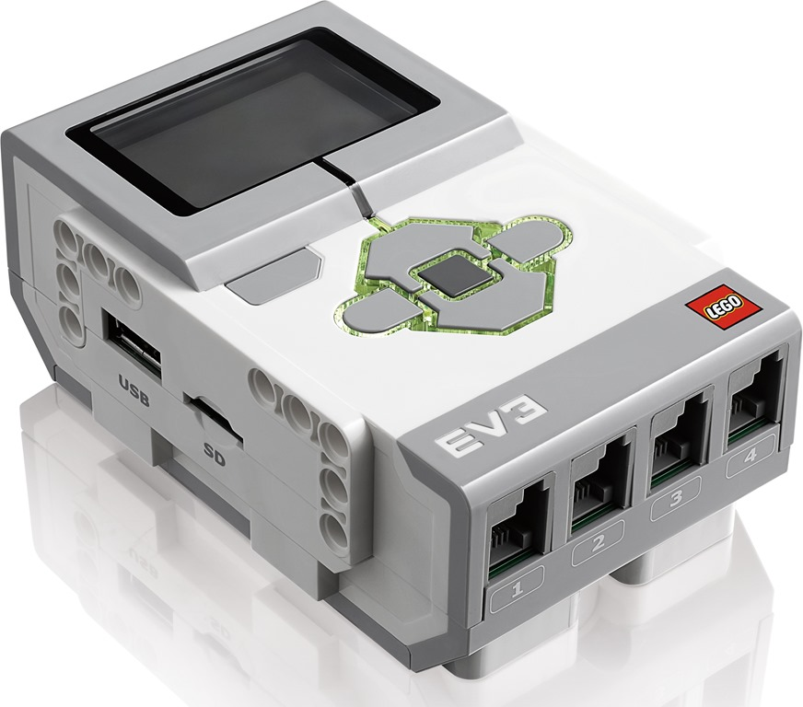
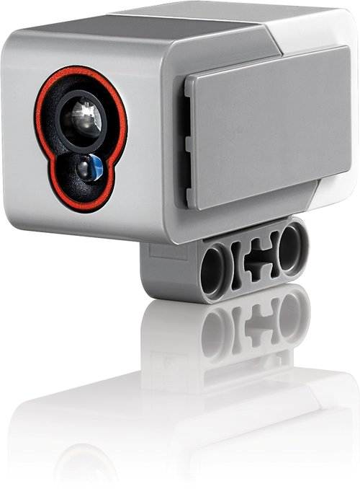
Follow the Light
Notes:
Follow the Light Presentation > TeachEngineering.org

Slide 2
Follow the Light Pre-Quiz
Provide a “stimulus-sensor-coordinator-effector-response” framework using human eyes as the color sensor.
Provide the logic for a program for a LEGO robot that enables it to follow a flashlight.
Notes:
Follow the Light Presentation > TeachEngineering.org

Slide 3
Follow the Light Pre-Quiz Answers
Provide a “stimulus-sensor-coordinator-effector-response” framework using human eyes as the color sensor.
Humans have two eyes that collect light that falls on objects in front of them, and helps them “see” the objects.
Stimulus-to-response framework: sight of a scary object such as a wasp > two eyes > human brain > signal to leg muscles > run to safety
Provide the logic for a program for a LEGO robot that enables it to follow a flashlight.
Use two color sensors attached to the front of the taskbot.
Turn the taskbot towards the sensor (of the two) that reads the higher intensity of light.

Slide 4
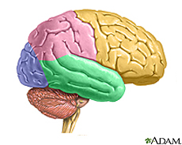
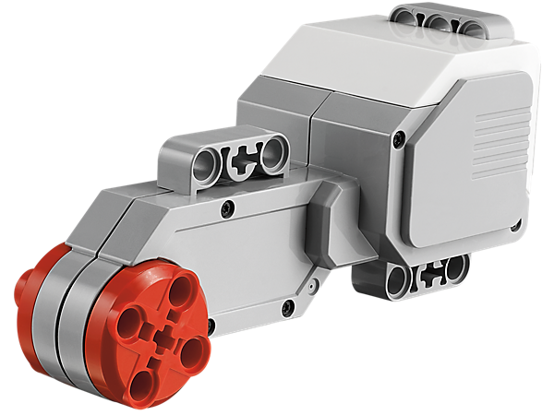
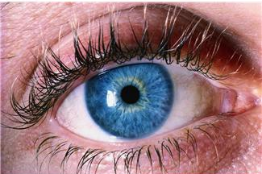
Human-Robot Similarities
Your brain commands your hand to perform a task, depending on what it has seen.
Similarly, the EV3 brick can command its motor to move the taskbot, as we will now do in an activity.

Slide 5
Follow the Torch Light Activity
Objective – Your Engineering Challenge
Build a LEGO taskbot with a color sensor, and program it to make the robot follow a flashlight as the light beam is moved around by a person.
Notes:
Expect the activity to take 50 minutes.

Slide 6
Engineering Design Process
What is the engineering design process?
A series of steps used by engineering teams to guide them as they develop new solutions, products or systems.
Steps
Identify criteria and constraints
Research the problem
Brainstorm possible solutions
Select a promising solution
Create a prototype
Test and evaluate the prototype
Improve and redesign
➔ The process is cyclical — it is usually necessary to test and modify many times to improve your design and get it right!
Notes:
A constraint is a limitation or restriction. For engineers, constraints are the limitations and requirements that must be considered when designing a workable solution to a problem.

Slide 7
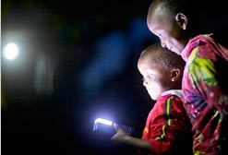
Follow the Torch Light Activity
Let’s get started:
Divide the class into groups of three students each.
Distribute the LEGO taskbots and the parts necessary to attach the color sensors to them.
Have each group attach a color sensor to its taskbot following the instructions in the LEGO base set.
Discuss as a group the logic of the program.
Write down your programming design.
Create, test and debug your program.

Slide 8
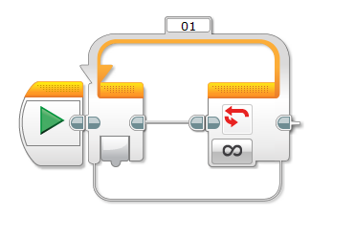
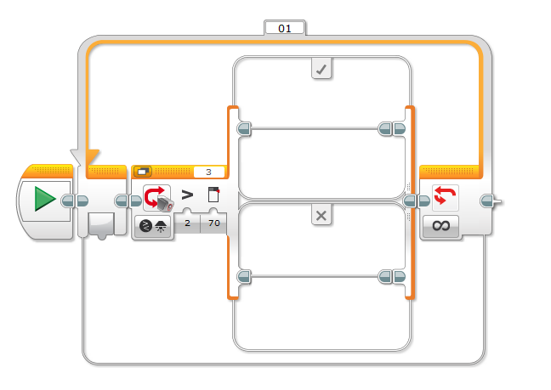
Click the “loop” icon and drag and drop the loop command onto the sequence beam. Verify the loop control is set to forever in the control panel.
Click the “switch” icon and drag the switch inside of the loop command.
Answers: Follow the Torch Light Activity

Slide 9
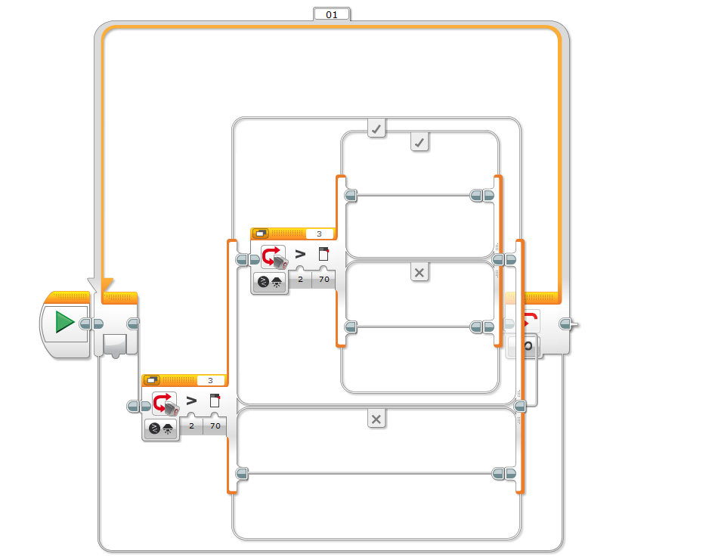
3. Click the “switch” icon and drag the switch inside of the top of the previous switch. Verify the following setting in the control panel.
Control: sensor
Sensor: Color sensor
Display: Flat view Checked
Port: 2
Compare: Light > 70
Function: Generate light checked
Answers: Follow the Torch Light Activity

Slide 10
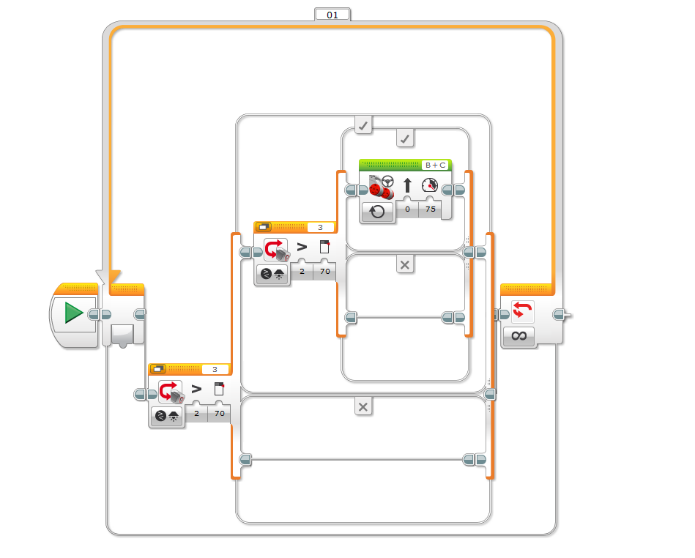
4. Click the “move” icon and drag and drop the move block in the top of the new switch. Verify the following settings in the control panel.
Port: B and C
Direction: Forward
Steering: In the middle
Power: 75
Duration: Unlimited
Answers: Follow the Torch Light Activity

Slide 11
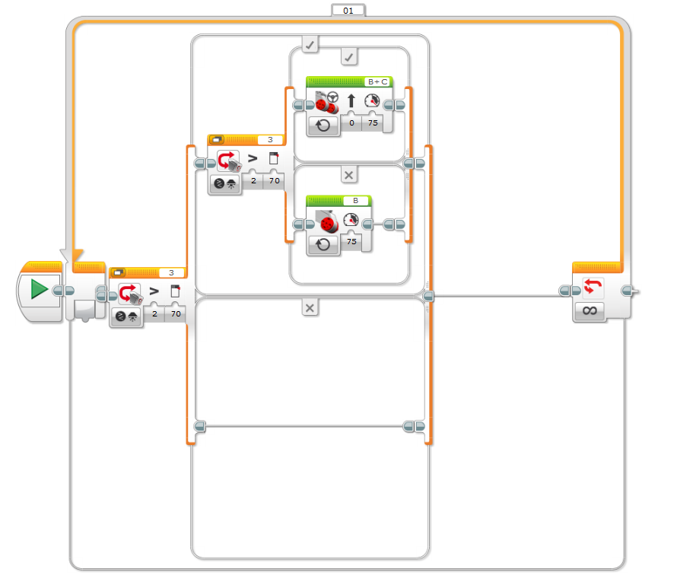
5. Click the “move” icon and drag and drop the move block in the bottom of the new switch. Verify the following settings in the control panel.
Port: B
Direction: Forward
Power: 75
Duration: Unlimited
Answers: Follow the Torch Light Activity

Slide 12
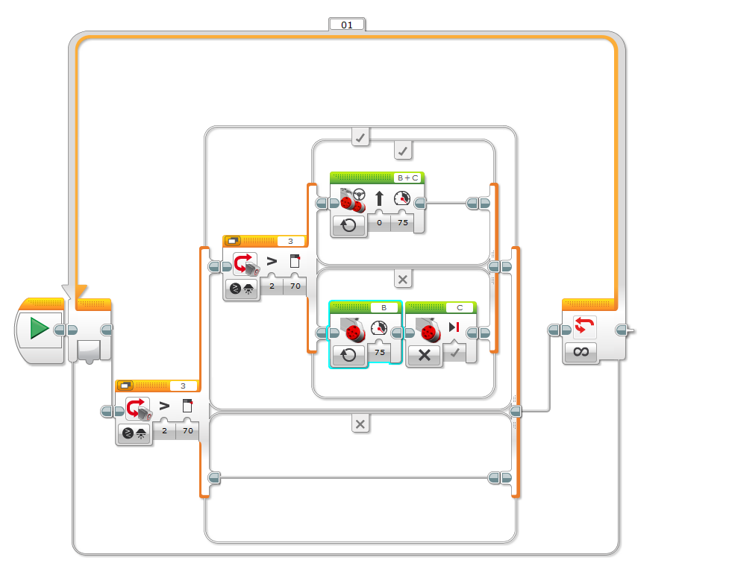
6. Click the “move” icon and drag and drop the move block in the bottom of the new switch. Verify the following settings in the control panel.
Port: C
Direction: Stop
Answers: Follow the Torch Light Activity

Slide 13
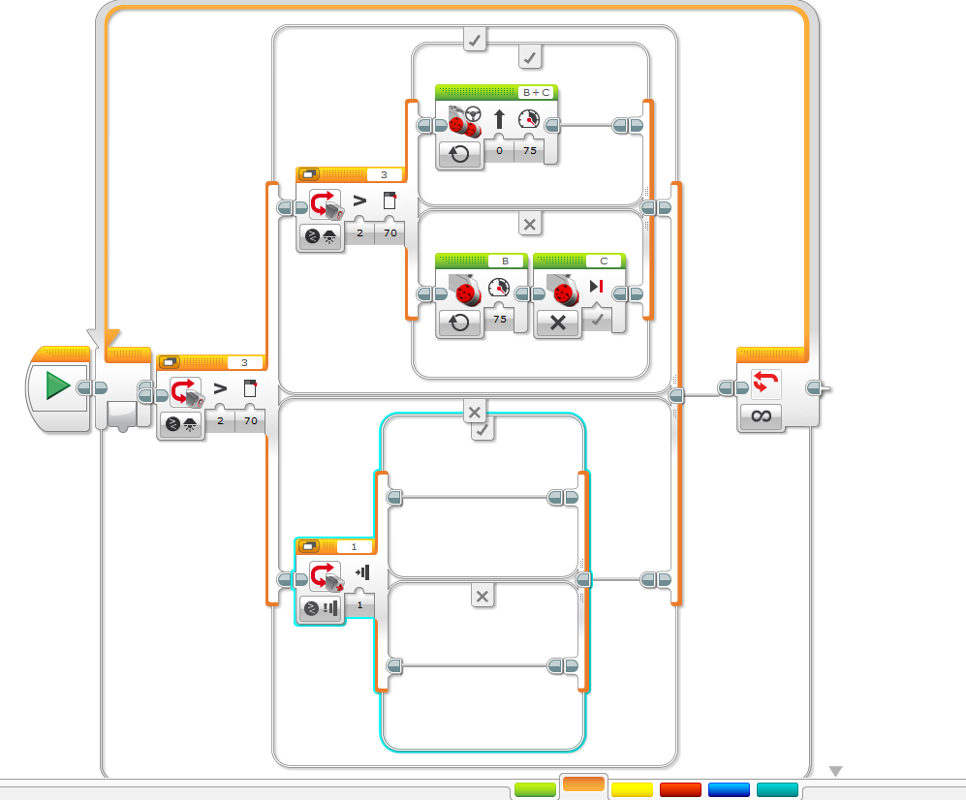
7. Click the “switch” icon and drag and drop the switch inside the bottom of the original switch. Verify the following settings in the control panel.
Control: sensor
Sensor: Color sensor
Display: Flat view Checked
Port: 2
Compare: Light > 70
Function: Generate light checked
Answers: Follow the Torch Light Activity

Slide 14
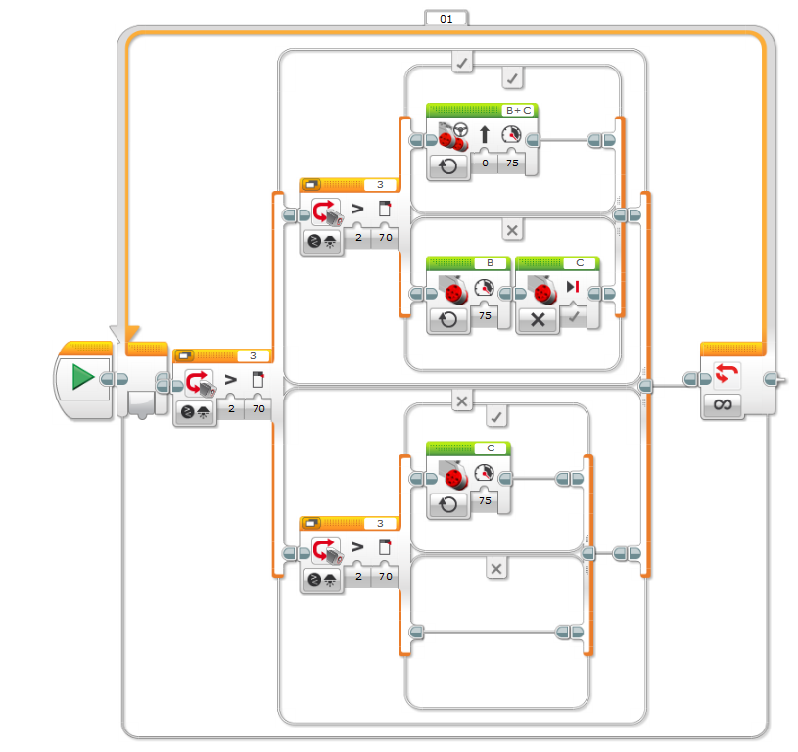
8. Click the “move” icon and drag and drop the move block in the top of the new switch. Verify the following settings in the control panel.
Port: C
Direction: Forward
Power: 75
Duration: Unlimited
Answers: Follow the Torch Light Activity

Slide 15
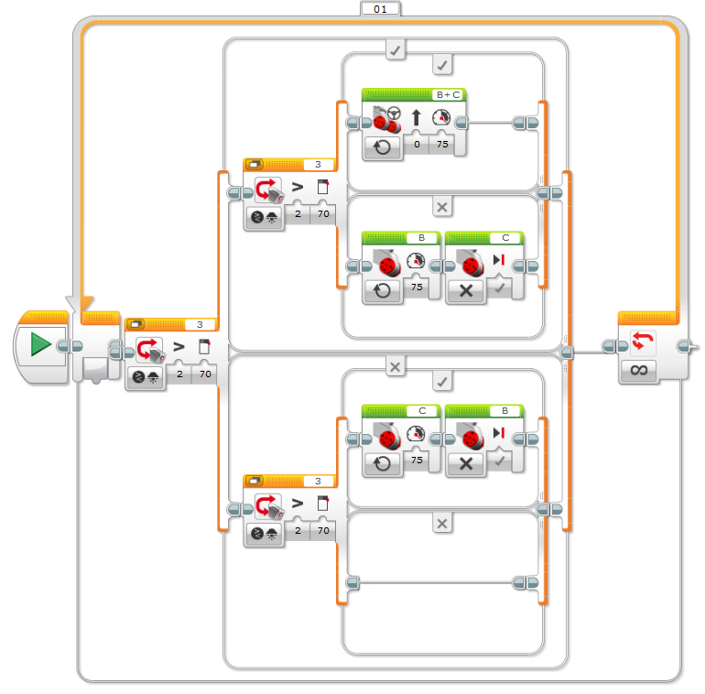
9. Click the “move” icon and drag and drop the move block in the top of the new switch. Verify the following settings in the control panel.
Port: B
Direction: Stop
Answers: Follow the Torch Light Activity

Slide 16
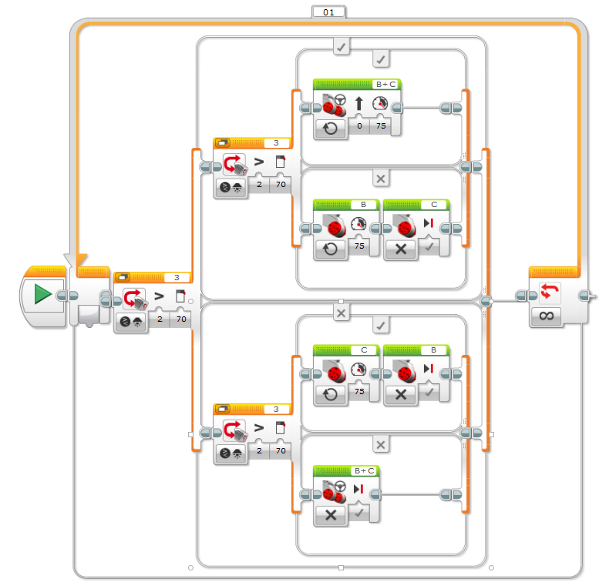
10. Click the “move” icon and drag and drop the move block in the bottom of the new switch. Verify the following settings in the control panel.
Port: B and C
Direction: Stop
Answers: Follow the Torch Light Activity

Slide 17
Follow the Light Post-Quiz
Compare the “stimulus-sensor-coordinator-effector-response” framework of the human eye to the framework using a color sensor for a LEGO robot.
Provide the logic for a program for a LEGO robot that enables it to follow a flashlight.

Slide 18
Follow the Light Post-Quiz Answers
Compare the “stimulus-sensor-coordinator-effector-response” framework of the human eye to the framework using a color sensor for a LEGO robot.
Stimulus-to-response frameworks:
For the human eye: sight of a scary object such as a wasp > two eyes > human brain > signal to leg muscles > run away from wasps
For the LEGO color sensor: light > EV3 color sensor > (transmission to coordinator) value sent to EV3 brick via wire > brick sends a signal to the EV3 motors > robot moves
Provide the logic for a program for a LEGO robot that enables it to follow a flashlight.
Use two color sensors attached to the front of the taskbot.
Turn the taskbot towards the sensor (of the two) that reads the higher intensity of light.

Slide 19
Vocabulary
peripheral: Surrounding.
sensor: A device that converts one type of signal to another; for instance, the speedometer in a car collects physical data and calculates and displays the speed the car is moving.
visual: Related to seeing.

Slide 20
Image Sources
Slide 1; ghost with flashlight, source: Microsoft® clipart at http://office.microsoft.com/en-us/images/special-occasions-CM079001933.aspx?qu=flashlight&ex=1
Slides 1, 4: LEGO parts; source: LEGO MINDSTORMS EV3 User’s Guide
Slide 4: brain; source: ADAM, Medline Plus, U.S. National Library of Medicine, National Institutes of Health: http://www.nlm.nih.gov/medlineplus/braindiseases.html
Slide 4: eye; source: Microsoft® clipart: http://office.microsoft.com/en-us/images/results.aspx?qu=eye&ex=1#ai:MP900406700|mt:2|
Slide 4: pointing finger; source: Microsoft® clipart: http://office.microsoft.com/en-us/images/results.aspx?qu=pointing+finger&ex=1#ai:MC900233154|
Slide 6: two kids with flashlight; source: US Embassy: http://iipdigital.usembassy.gov/st/english/article/2013/11/20131125287867.html#axzz2ll0npPnd
Slides 7-15: Screen capture images by the author.

