Slide 1
What Is an Electric Motor? How Does a Rotation Sensor Work?
Notes:
What Is an Electric Motor? How Does a Rotation Sensor Work? Presentation > TeachEngineering.org

Slide 2
Electric Motors Pre-Quiz
What is an electric motor?
Name two applications (things) you use every day that use electric motors.
How does the speedometer in your car work?
Notes:
A speedometer is a gauge that measures and displays the real-time speed of a vehicle.

Slide 3
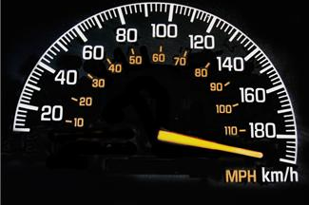
Electric Motors Pre-Quiz Answers
What is an electric motor?
An electric motor is a device that converts electricity into motion.
Name two applications you use everyday that use electric motors.
A few examples: Electronic car windows go up and down using motors. Microwave bases rotate using electric motors. Automatic pencil sharpeners use motors.
How does the speedometer in your car work?
A speedometer is a gauge that measures and displays the real-time speed of a vehicle. To do this, a sensor near the wheel measures how many times the wheel rotates per minute (rpm = revolutions per minute). Then the number of rotations of the wheel per minute is converted to miles per hour (or kilometers per hour) and displayed on the car’s speedometer dial.

Slide 4
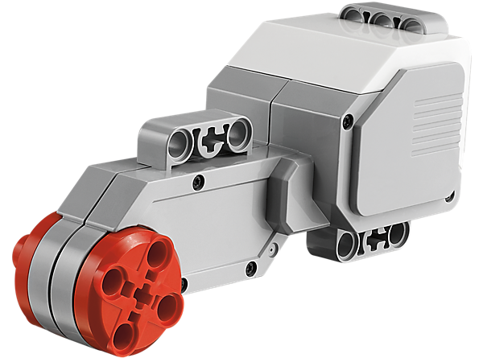
What is an electric motor?
An electrical motor is a device that converts electricity into motion.
You will learn later in physics that it converts electrical energy (like that supplied from wall outlets) into mechanical energy (in the form of motion). This involves the principles of electricity and magnetism.
Your LEGO kits come with two electric motors, one of which is shown below.
This motor has lots of gears within it, which explains its size and shape.
On the next slide, you can see what the gears look like inside➔
electricity
or
electrical energy
electrical motor
motion
or
mechanical energy

Slide 5
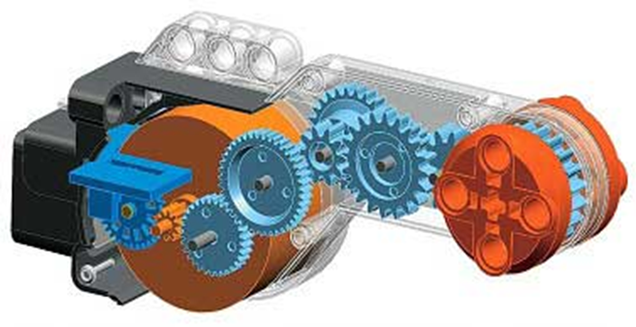
What is inside a LEGO motor?
Inside the LEGO motor casing is a motor, a rotation sensor (which you will soon study) and lots of gears, as shown below. ⬇
Gears are the round blue discs in the picture. ⬇
Gears help to make the motion faster or slower, as you will learn later in this lesson, and when you study physics.

Slide 6
What are real-world motor applications?
Electric motors are used for many applications that involve moving things. What examples of mechanical movement can you think of?
Example: For manually operated pencil sharpeners, a hand crank turns blades around an inserted pencil and sharpens it. In electric sharpeners, the turning is done by an electric motor that gets mechanical energy (motion) from electrical energy (electricity from the outlet it is plugged into).
Example: Consider moving a car window up and down. Where does the electrical energy for the motor come from?
More examples? Take a moment to think of other examples. Once you have thought of your example, we’ll list them on the classroom board.
Notes:
Additional example electric motors: electric can openers, fans, refrigerators, washing machines, vacuum cleaners.

Slide 7
What is the role of motors in taskbots?
The LEGO robot kit comes with 2 motors that serve as the “muscles” for the robot. The computer (brick) commands the motors to move via electrical signals passed through the cables, which make the motors move. That motion moves the wheels move, which moves the taskbot.
This process is similar to your brain commanding your arm to move. In this case, your brain (similar to the robot’s computer) decides to move the arm. To do this, it sends electrical signals through your nervous system to the muscles in your arm, and those muscles make your arm move.
So, motors are similar to muscles.

Slide 8
Using motors to make taskbots turn
Your taskbot has 2 electric motors. These are attached to the wheels on each side.
Engineering Challenge
Do This: Examine them and predict how you would make the robot turn right or left using the 2 motors. Write down your ideas on a separate sheet of paper.
Do This: Develop a LEGO program to make the robot go forward 1 foot and then turn left and then move forward 1 foot.
Do This: Implement it on the robot and show that it works.
(Answer on slide 17)

Slide 9
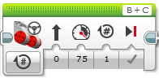
Control of a LEGO Motor
Here you can select a gate on the EV3
and make the EV3 turn under a well defined angle
Here you can define the next action
the EV3 has to take
Here you can define the distance the EV3 has to cover
Here you can define the power of an engine
Here you can define the direction: forward, backward or stop
Read the EV3 User’s Guide for additional information

Slide 10
How does a LEGO rotation sensor work?
The LEGO motor has a built-in rotation sensor. This sensor provides information about the rotational position in degrees, seconds or number of rotations of the hub where the wheel is attached. (1 rotation = 360 degrees)
The LEGO brick uses this information (3 measurements) to turn the motor. The computer can also turn the motor continuously using yet another “unlimited” option.
Thus, the LEGO brick can make the taskbot move forward or backward precisely using info from the rotation sensor.
Do This: Write down the elements of the “stimulus-sensor- coordinator-effector-response” framework for this activity. (Answer on slide 18)
Go to the next slide to start an activity that shows you how this sensor works. ➔

Slide 11
How does the rotation sensor work?
Mini-Activity (10 minutes)
Objective
Test the rotation sensor’s ability to measure distance in rotations.
Program Description
Use the View feature of the brick to see how the rotation sensor displays the number of rotations. Then convert this number of rotations into distance as we show you later in an activity. Remember: A car speedometer uses the same idea to calculate speed.

Slide 12
Facts about LEGO motors
The LEGO servomotor uses a series of gears called a gear train.
A gear train enables you to spin different gears at different speeds.
For example, a gear ratio of 10:1 is 10 rotations of a small gear resulting in 1 rotation of a big gear, although some imperfection in the meshing of gears reduces the precision of rotations (+/- 1 degree accuracy)

Slide 13
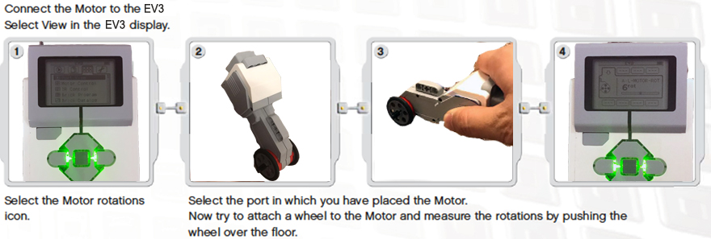
How does a rotation sensor work?
Mini-Activity
Follow the instructions in the pictures below.
Keep track of your results using a chart like the one on the next slide ➔

Slide 14
How does a rotation sensor work?
Mini-Activity Worksheet
Number of times I rotated the wheel | Number of times the rotation sensor said I rotated the wheel
1
2
3
4
5
6
7
Write your observations about the sensor accuracy.

Slide 15
Electric Motors Post-Quiz
(Do this after conducting the associated activity: Master Driver)
What is an electric motor?
List three applications in which electric motors are used.
In the activity, why were you not able to calculate the rotations correctly in some cases?
Notes:
Administer this post-quiz AFTER completion of the associated activity!

Slide 16
Electric Motors Post-Quiz Answers
What is an electric motor?
A motor is an electrical machine used to create motion. The device converts electricity (electrical energy) into motion (mechanical energy). Typically performed by rotating an object.
Name three applications in which electric motors are used.
A few examples: Moving a tape in a tape drive player. Running the motor in a vacuum cleaner. Throwing tennis balls by a ball thrower.
In the activity, why were you not able to calculate the rotations correctly in some cases?
Gears don’t mesh perfectly in general and that causes errors. Also, positioning the wheel accurately is difficult and if not perfect could lead to errors. All these add up and cause differences between mathematical calculations (assuming calculations are correct!) and actual measurements.

Slide 17
Answer for Slide 8 Challenge
LEGO program to make a robot move forward and then left:
⬇ The complete program should look like this, with the details also provided below. ⬇
Notes:
Programming answer to challenge on slide 8

Slide 18
Answer for Slide 10 Question
stimulus > sensor > coordinator > effector > response
robot motion > rotation sensor > brick > EV3 motor > continue moving or stop

Slide 19
Image Sources
Slides 1 and 7, EV3 robot: 2006 Eirik Refsdal, Wikimedia Commons: http://commons.wikimedia.org/wiki/File:Lego_Mindstorms_EV3-FLL.jpg
Slide 3, speedometer gauge; source: Microsoft® clipart: http://office.microsoft.com/en-us/images/results.aspx?qu=speedometer&ex=1#ai:MP900448291
Slide 4, EV3 servo motor; source: LEGO Education: http://education.lego.com/en-gb/lego-education-product-database/mindstorms/9842-interactive-servo-motor
Slide 5, EV3 motor internal workings and gears; source: LEGO Education via Philo’s Home Page: http://www.philohome.com/EV3motor/EV3motor.htm
Slide 6: electric pencil sharpener; source: Microsoft® clipart: http://office.microsoft.com/en-us/images/results.aspx?qu=pencil+sharpener&ex=1#ai:MP900385262|mt:2|
Slides 9 and 17: screen captures by author
Slide 12: EV3 motor internal workings and gears; source: LEGO Education: http://www.philohome.com/EV3motor/EV3motor.htm
Slide 13: instructions, LEGO MINDSTORMS EV3 User’s Guide

