Slide 1
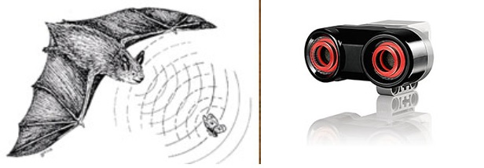
How Does an Ultrasonic Sensor Work?
Notes:
How Does an Electronic Sensor Work? Presentation > TeachEngineering.org

Slide 2
Ultrasonic Sensor Pre-Quiz
How do humans sense distance?
How do bats sense distance?
Provide an example “stimulus-sensor-coordinator-effector-response” framework using the bat.

Slide 3
Ultrasonic Sensor Pre-Quiz Answers
How do humans sense distance?
Humans estimate distance using their eyes, which is usually not a very accurate method.
How do bats sense distance?
Bats sense distance using sound. They emit sound waves and receive back reflected waves. The time it takes to receive the waves back provides them with a very good estimate of the distance. This is exactly how ultrasonic sensors estimate distance.
Provide an example “stimulus-sensor-coordinator-effector-response” framework using the bat.
Example for bats: calls made by mouth > ears hear reflected waves > brain decides what to do > wing muscles move > flight path changed, as needed. Bats use this same method to catch mosquitoes, too!

Slide 4
Ultrasonic Sensor
An ultrasonic sensor has two parts:
A transmitter that sends out a signal that humans cannot hear
A receiver that receives the signal after it has bounced off nearby objects
The sensor sends out its signal and determines how long the signal takes to come back.
If the object is very close to the sensor, the signal comes back quickly
If the object is far away from the sensor, the signal takes longer to come back
If objects are too far away from the sensor, the signal takes so long to come back (or is very weak when it comes back) that the receiver cannot detect it
The sensor sends a message back to the computer brick telling it the time taken for the signal to return. Then the brick uses this info to compute how far away the object is.
Can you name a similar sensing performed by a bird that works like this?
Notes:
Bats, dolphins, porpoises and some whales use echolocation, sometimes called biosonar.

Slide 5
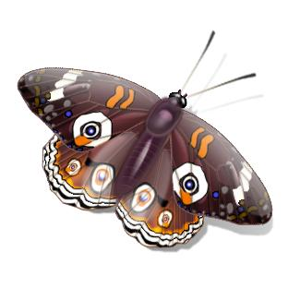
Neuro-Distance Sensor
How does a bat locate its prey in the dark?
Robotic Distance Sensor

Slide 6
Echolocation
Bats use a process called “echolocation” to locate prey or other objects.
What is echolocation?
Bats produce a very high-pitch sound (ultrasonic, beyond the human hearing range). Those sound waves travel through air and bats listen carefully to any echoes that return.
By determining how long echoes take to return, bats estimate the distances of the objects. Bats also determine how big objects are and in which direction they are located.
The bat brain processes the echoes similarly to human brains.

Slide 7
Echolocation (continued)
During the processing of echoes in a bat brain, it forms an image in its head similar to how humans use both visual and aural (hearing) information to identify objects.
Bats also process visual information as humans do, contrary to popular belief.
How does an ultrasonic sensor work?
The ultrasonic sensor uses a pair of transducers. The sensor emits a sound pulse and measures the distance of the object depending on the time taken by the echo to return back to the other side.
Electrical energy is converted to sound to send the pulse, and then the sound received back is converted to electricity, which is what the brick understands.

Slide 8
Review:
Robot Sensors
(As stated in an earlier activity,) robot sensors:
Gather information from the surroundings and send it to the computer brick
Robot sensors can only be used if the robot’s program asks for information from them!
Similarly, the robot can only act on information from the sensors if its program tells it to do so!
How do sensors send signals to the LEGO brick/computer?
The sensors send information through the wires (similar to the nervous system in your body) that connect them to the LEGO brick, which uses the information if its program requires it.

Slide 9
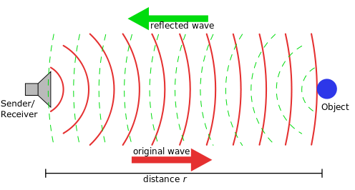
How Can We Measure Distance?
The ultrasonic sensor sends out sound from one side and receives sound reflected from an object on the other side.
The sensor uses the time it takes for the sound to come back from the object in front to determine the distance of an object.
Bats use the same principle!
The “sonic” in ultrasonic refers to sound, and “ultra” means that humans cannot hear it (but bats and dogs can hear those sounds).
The ultrasonic sensor can measure distances in centimeters and inches. It can measure from 0 to 2.5 meters, with a precision of 3 cm.
It works very well and provides good readings in sensing large-sized objects with hard surfaces. But, reflections from soft fabrics, curved objects (such as balls) or very thin and small objects can be difficult for the sensor to read.
Note: Two ultrasonic sensors in the same room may interfere with each other’s readings.

Slide 10
How Are Ultrasonic Sensors Made?
The LEGO ultrasonic sensor sends an ultrasonic sound (which you cannot hear) from one of the “eyes” shown to the right ➔, and receives the reflection in the other “eye,” which acts like a microphone.
The air pressure vibrations makes the diaphragm move in that microphone, and this diaphragm motion is sensed and converted into an electrical signal (like the sound sensors you have studied). The time lag between the sent and received sound is used by the brick to estimate the distance to the object. As mentioned before, this is how bats also estimate distance.

Slide 11
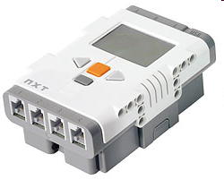
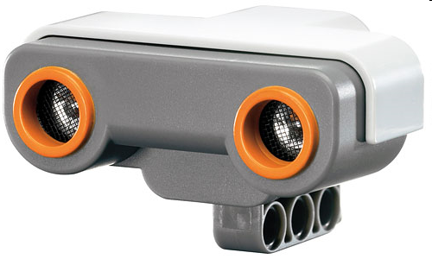
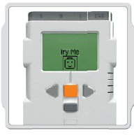
Mini-Activity 1: Let’s Investigate
How does the brick read the signal from the ultrasonic sensor?
Do This: Attach the sensor to the LEGO brick as shown below. 
Use the VIEW command to go the ultrasonic sensor.
Then place your hand in front as shown below. The display should show distance of your hand from the sensor. 
Check the working of the ultrasonic sensor using the “Try Me” option. ➔
Note your observations from your experimentation and show to the teacher.
Notes:
10 minutes for Mini-Activity 1

Slide 12
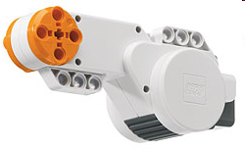
Mini-Activity 2
Do This: Connect the LEGO brick to the ultrasonic sensor and a motor, as shown to the left. 
Use the computer to program the NXT brick so that it plays one music when an object is close to it (less than 10 inches), and keeps the motor turning.
If the object is farther than 10 inches, have the program stop.
On a separate sheet of paper, provide a step-by-step explanation describing how the program works.
Notes:
15 minutes for Mini-Activity 2; answers on slides 15-18 for the teacher.

Slide 13
Mini-Activity 2 Answer for the Teacher

Slide 14
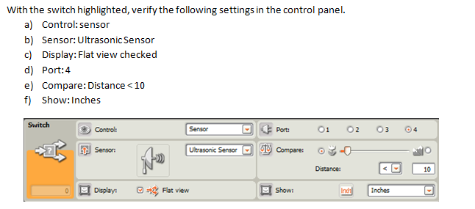
Mini-Activity 2 Answer for the Teacher (continued)

Slide 15
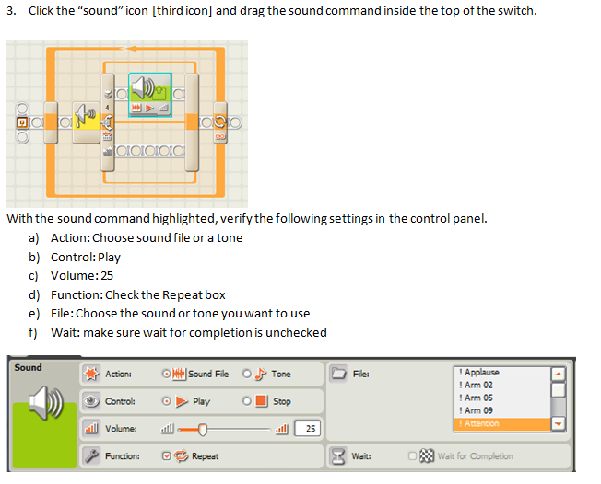
Mini-Activity 2 Answer for the Teacher (continued)

Slide 16
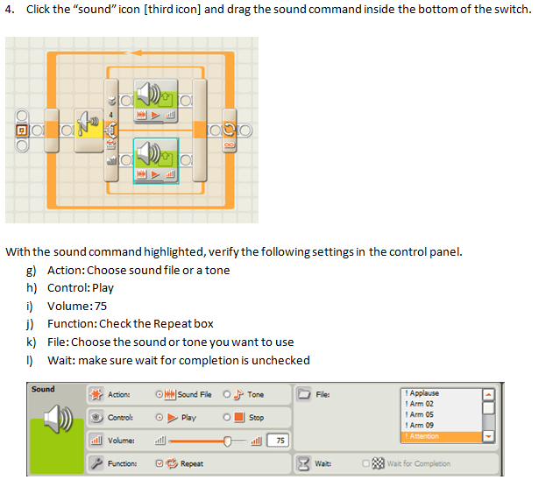
Mini-Activity 2 Answer for the Teacher (continued)

Slide 17
Ultrasonic Sensor Post-Quiz
How do humans sense distance?
How do bats sense distance?
Provide an example “stimulus-sensor-coordinator-effector-response” framework using an EV3 ultrasonic sensor.

Slide 18
Ultrasonic Sensor Post-Quiz Answers
How do humans sense distance?
Humans estimate distance using their eyes, which is usually not a very accurate method.
How do bats sense distance?
Bats sense distance using sound. They emit sound waves and receive back reflected waves. The time it takes to receive the waves back provides them with a very good estimate of the distance. This is exactly how ultrasonic sensors estimate distance.
Provide an example “stimulus-sensor-coordinator-effector-response” framework using an NXT ultrasonic sensor.
Example: object in front of the ultrasonic sensor > ultrasonic sensor > LEGO brick/computer > robot motor > robot moves

Slide 19
Vocabulary
sensor: A device that converts one type of signal to another; for instance, the speedometer in a car collects physical data and calculates and displays the speed the car is moving.
auditory: Related to hearing.
peripheral: Surrounding.
ultrasonic: A sound of a frequency that humans cannot hear, but dogs and bats can.
transducer: Another term for a sensor (see above).
echolocation: Biological sonar used by animals such as bats and dolphins, in which the animal sends out a call and uses the echo to locate and identify surrounding objects.

Slide 20
Images Sources
Slides 1, 4, 5, 8, 10, 11, 12: LEGO device images; source: LEGO MINDSTORMS NXT User’s Guide
Slide 1: blue bat: source: Microsoft® clipart: http://office.microsoft.com/en-us/images/results.aspx?qu=bat&ex=1#ai:MC900319526|
Slide 5: moth; source: Microsoft® clipart: http://office.microsoft.com/en-us/images/results.aspx?qu=moth&ex=1#ai:MC900438026|
Slide 5: bat; source: Microsoft® clipart: http://office.microsoft.com/en-us/images/results.aspx?qu=bat&ex=1#ai:MC900354219|
Slide 5: chair; source: Microsoft® clipart: http://office.microsoft.com/en-us/images/results.aspx?qu=chair&ex=1#ai:MC900030372|mt:1|
Slide 5: composite image by author
Slide 9: diagram of sonar/radar principle for distance measurement; source: 2005 Georg Wiora, Wikimedia Commons: http://commons.wikimedia.org/wiki/File:Sonar_Principle_EN.svg
Slides 13-16 : Screen capture images by the author.

