Slide 1
Printing Flexible Circuits

Slide 2
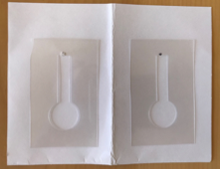
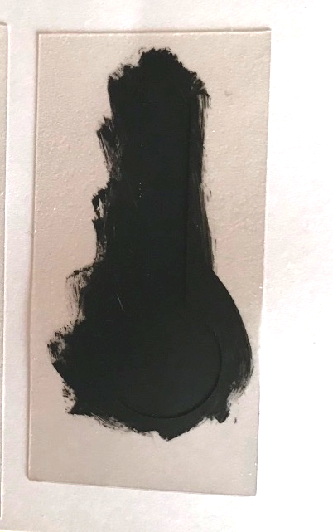
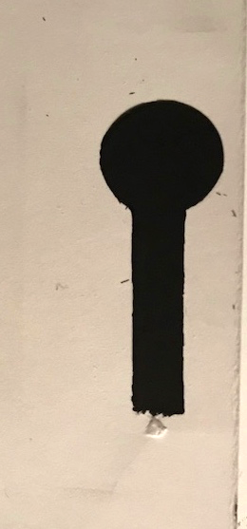
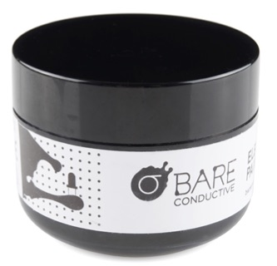
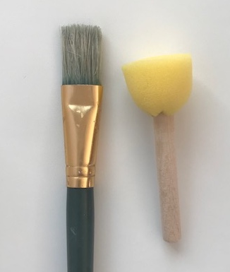
Stencils
what you did
Brushes
Carbon (graphene)
paint
Notes:
You painted circuit lines on (flexible) paper by brushing conductive paint on the paper by hand through a stencil.
Images: Stefi Weisburd

Slide 3
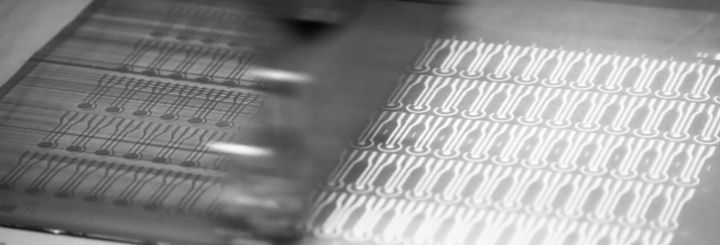
Electronic Printing in Industry
Notes:
Here is a video showing how one company prints a lot of different kinds of electric circuits using conductive inks and stenscils on flexible plastic-like materials.
https://www.youtube.com/watch?v=cc4IWtaOx_s
Permission granted from CSEM

Slide 4
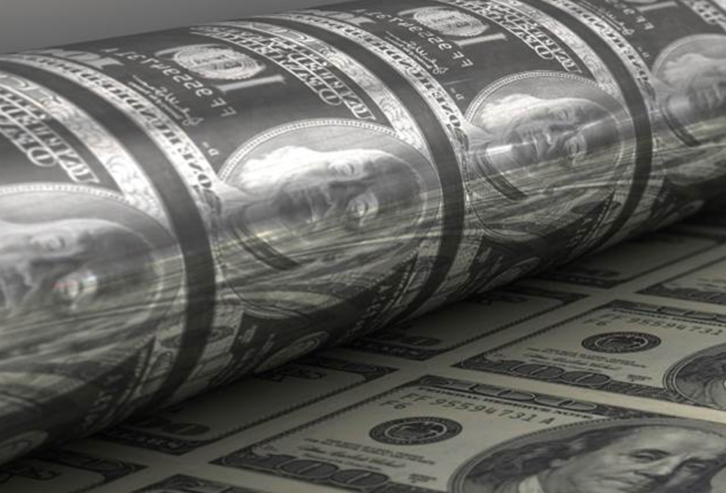
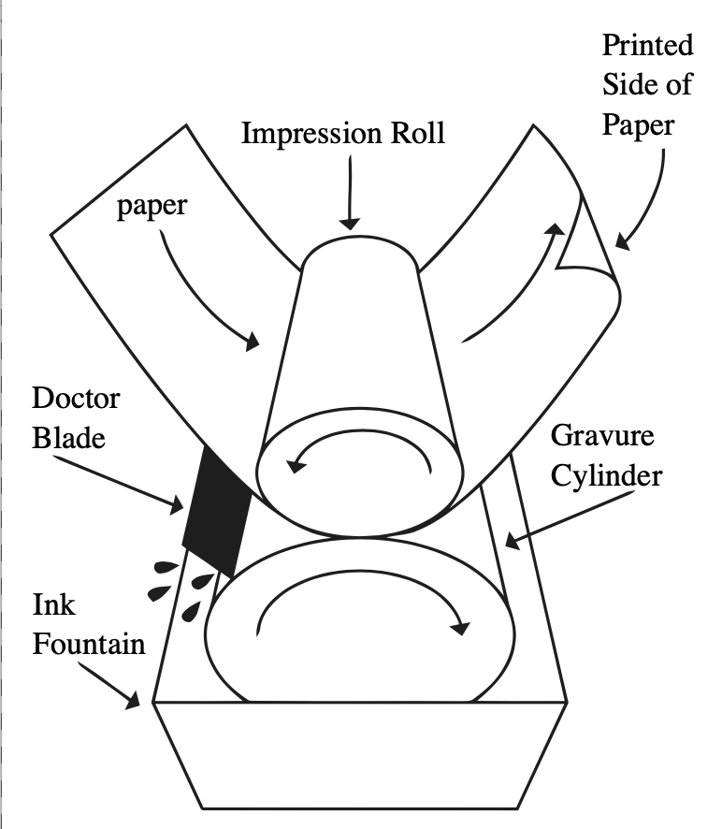
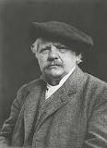
Research is marrying 600 year old Gravure printing
Newspaper
U.S. Bureau of engraving and Printing
Karel Václav Klíč
Invented photogravure
Notes:
This in an area of intense research. At the Universities of Texas, New Mexico and Berkeley, engineers are combining centuries-old printing techniques like Gravure printing used to print currency,,,,
Photo of Karel Václav Klíč
Attribution: AnonymousUnknown author [Public domain], via Wikimedia Commons
File URL:https://commons.wikimedia.org/wiki/File:Karel_Václav_Kl%C3%ADč_(1841-1926).jpg
Money and plates: https://www.schroders.com/en/us/insights/equities/is-a-shortage-of-dollar-funding-behind-recent-stockmarket-weakness/
Cartoonof Rotogravure: Creative Commons Attribution-Share Alike 3.0 Unported license. Attribution: The original uploader was Parktravelling at English Wikipedia. [CC BY-SA 3.0 (http://creativecommons.org/licenses/by-sa/3.0/)], via Wikimedia Commons
File URL: https://upload.wikimedia.org/wikipedia/commons/5/5b/Rotogravure_PrintUnit.jpg
Silver nano particles
File: https://upload.wikimedia.org/wikipedia/commons/a/a4/Impressive_Silver_Nanoparticles.jpg
Attribution: Theivasanthi [CC BY-SA 4.0 (https://creativecommons.org/licenses/by-sa/4.0)], from Wikimedia Commons

Slide 5
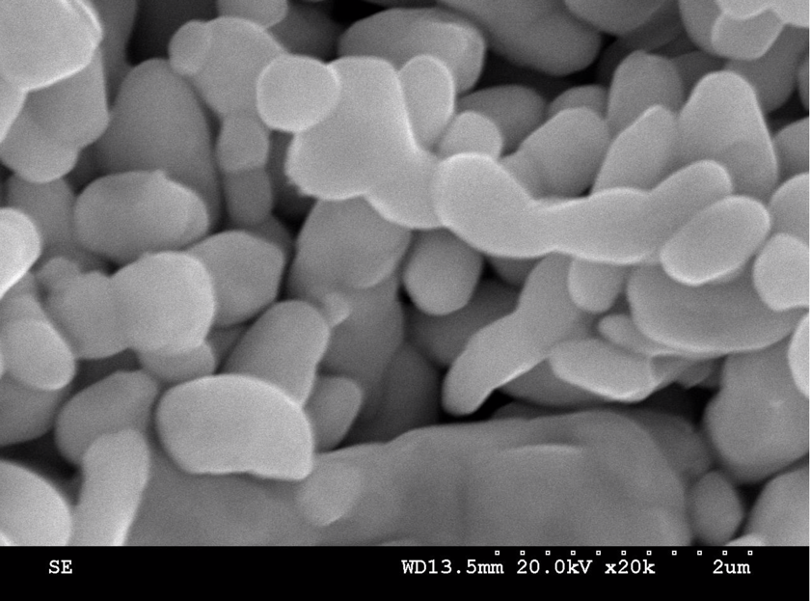
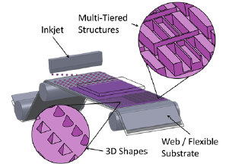
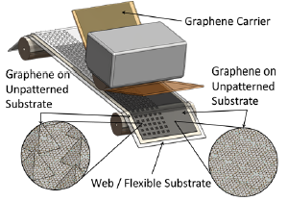
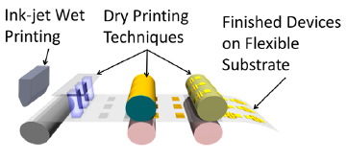
to 21 Century conductive nano-inks, nano-lithography and nano-imprints to make flexible circuits using roll-to-roll manufacturing.
Scanning electron micro-scope image of silver nano-particles in a conductive ink
A nanometer is a billionth of a meter!
Printing tiny features on a big scale!
Notes:
Modern techniques for making nano-sized features on circuits on a big, industrial-sized scale. These features can be as small as 50 atoms across!
Images:
Cartoons: Permission from NASCENT
Silver nano particles
File: https://upload.wikimedia.org/wikipedia/commons/a/a4/Impressive_Silver_Nanoparticles.jpg
Attribution: Theivasanthi [CC BY-SA 4.0 (https://creativecommons.org/licenses/by-sa/4.0)], from Wikimedia Commons

Slide 6
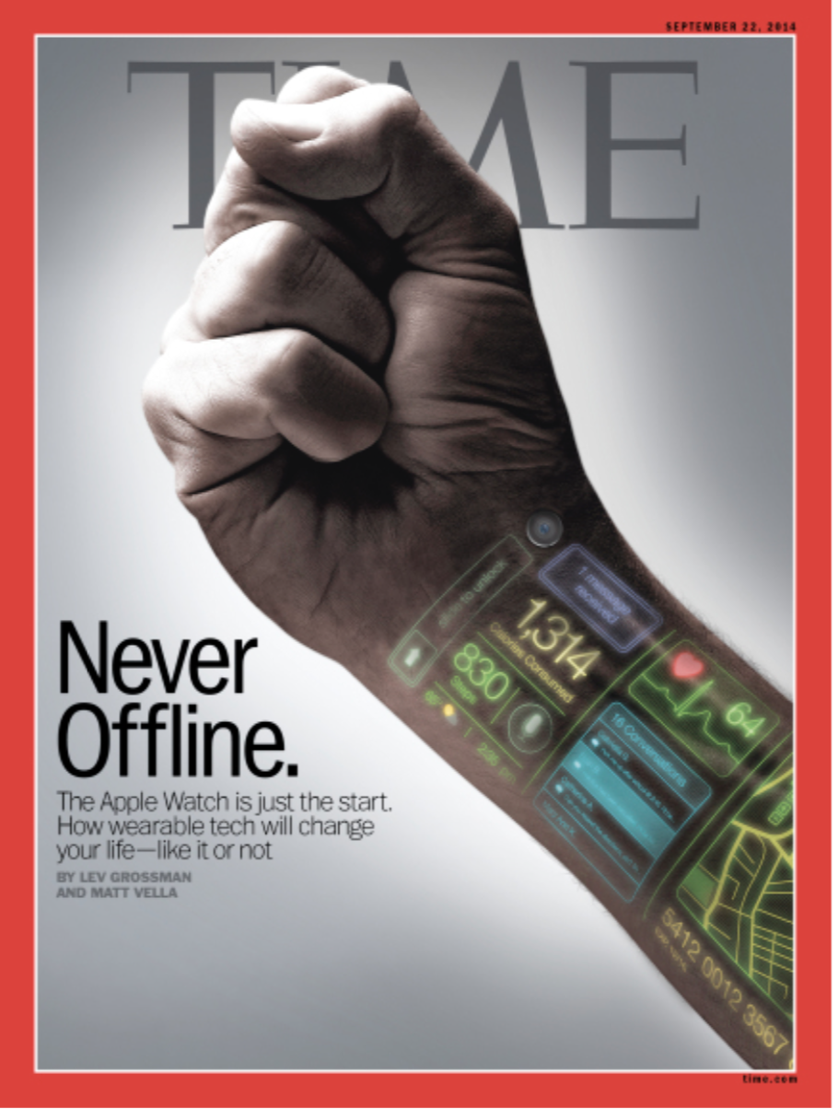
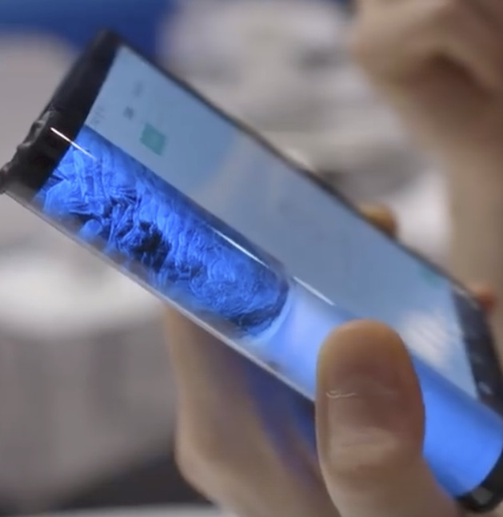
Notes:
This research is being driven by phones, consumer electronics, health and other industries. Phone makers say are making foldable and flexible screens because they believe that people will want the larger screens required for virtual and augmented reality, but they don’t want to carry around tablets and computers.
https://www.theverge.com/2018/11/8/18074838/samsung-foldable-phone-infinity-flex-display-technology-report
https://time.com/3326576/never-offline/

Slide 7
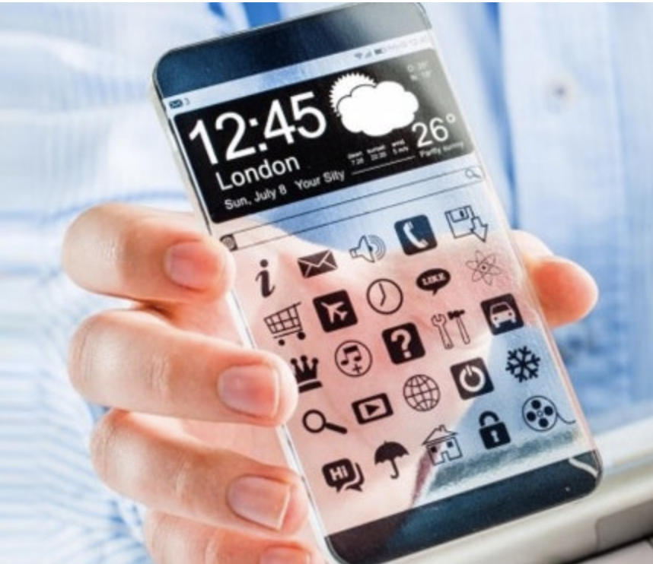
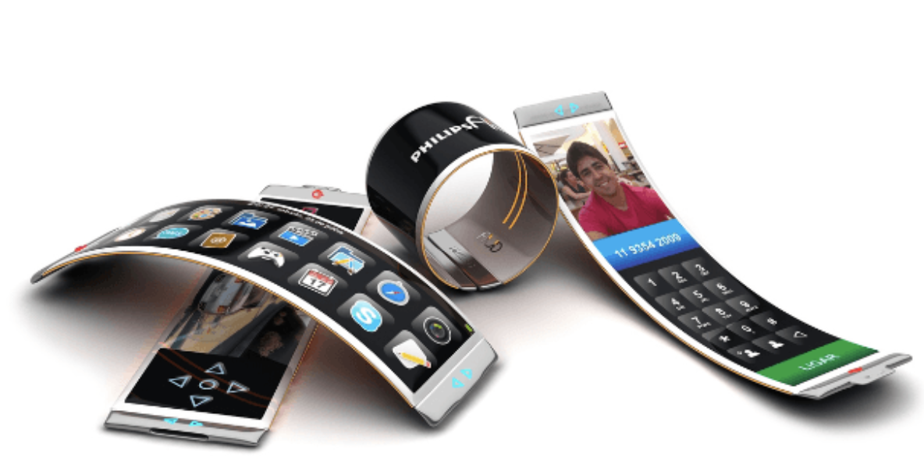
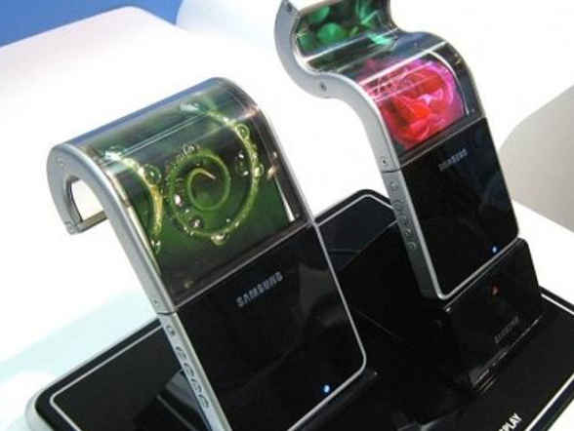
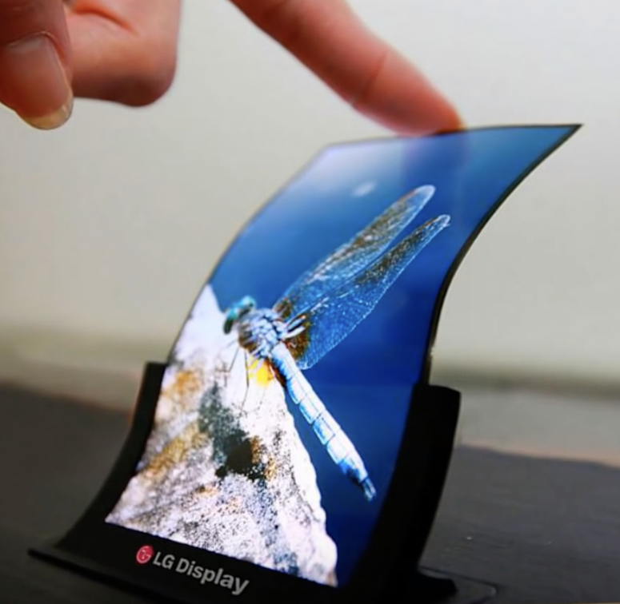
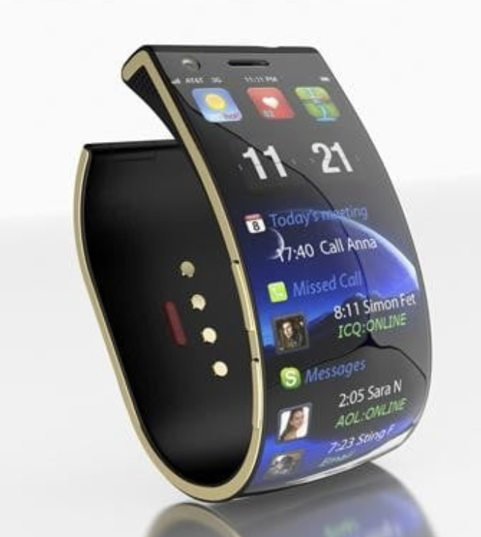
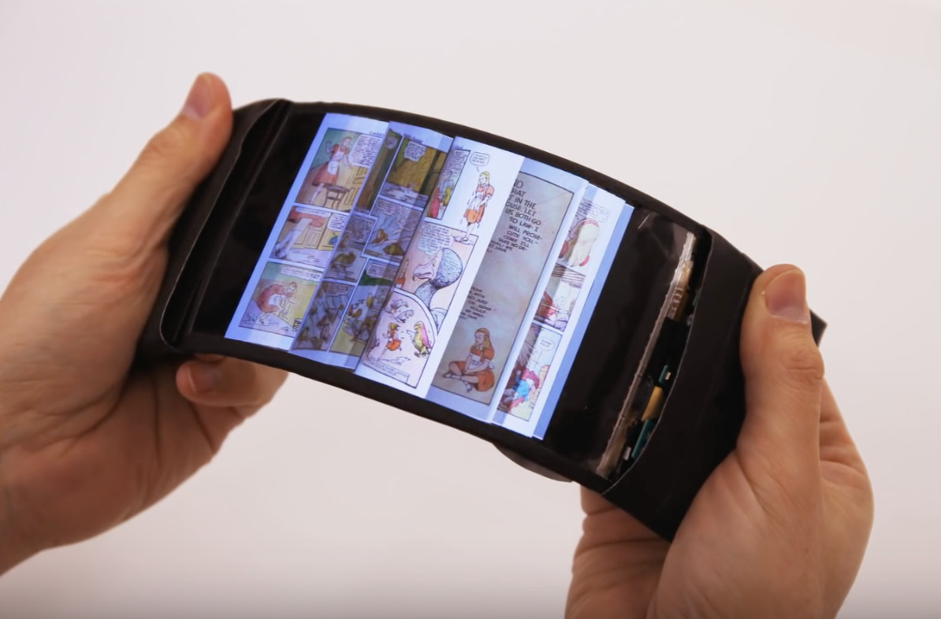
Notes:
What will your future phone look like?
Image Sources:
Top Row starting with upper left:
1. Transparent phone: https://www.uswitch.com/mobiles/guides/future-of-mobile-phones/
2. Two black curled phones are a still from: https://www.youtube.com/watch?v=82bgLliQOHs
3. Philips are from https://www.digitaltrends.com/mobile/10-awesome-future-phone-concepts/
Bottom row (L to R):
1:https://www.digitaltrends.com/mobile/10-awesome-future-phone-concepts/
2: https://www.maxim.com/gear/reflex-bendable-smartphone-prototype-2016-02
3. Still from: https://www.youtube.com/watch?v=82bgLliQOHs

Slide 8
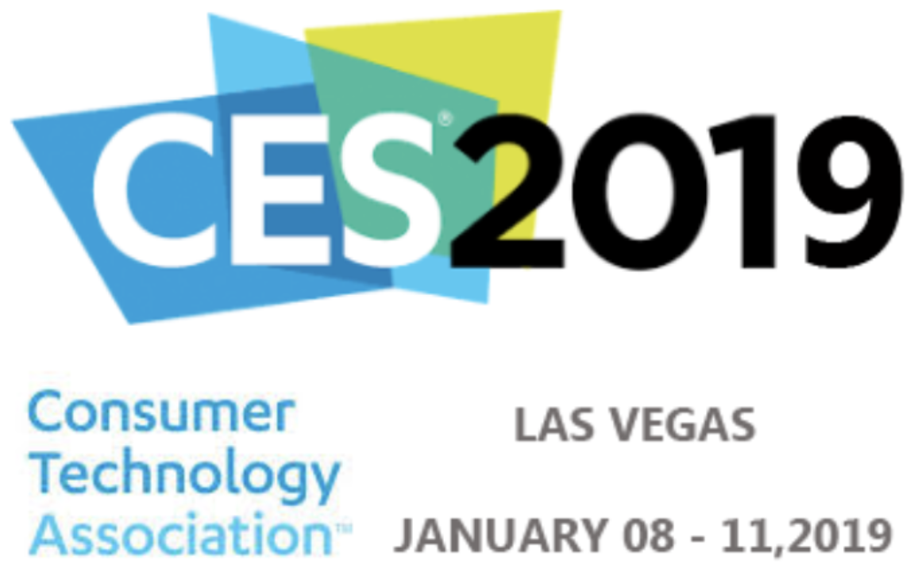
Notes:
Here are a few photos and videos from a recent Consumer Electronics Show showing flexible displays.
Credit: Neal Wostbrock

Slide 9
Notes:
Credit: Neal Wostbrock

Slide 10
Notes:
Credit: Neal Wostbrock, NASCENT, UNM

Slide 11
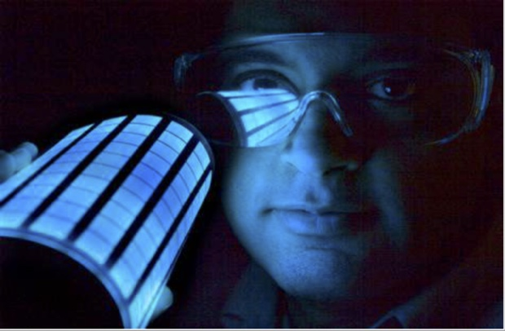
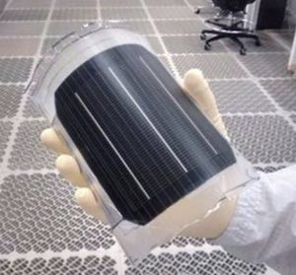
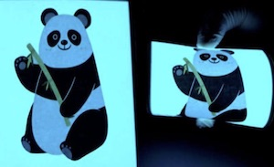
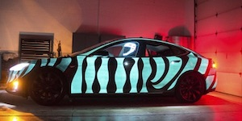
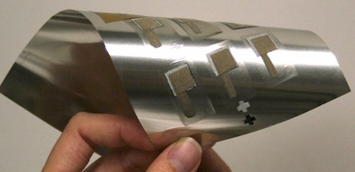
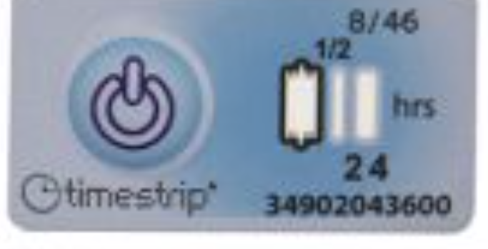
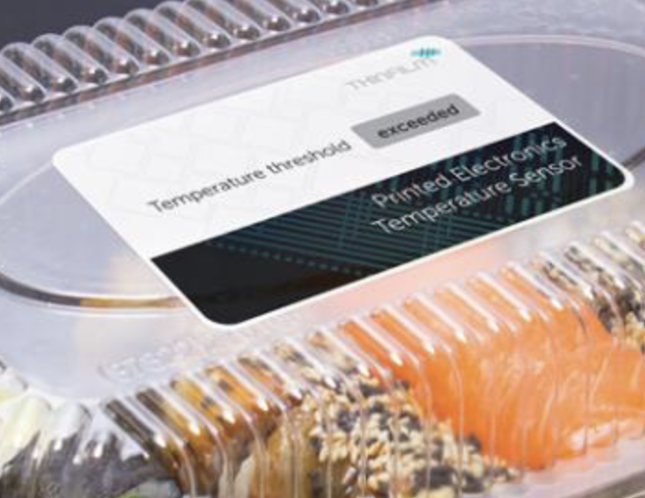
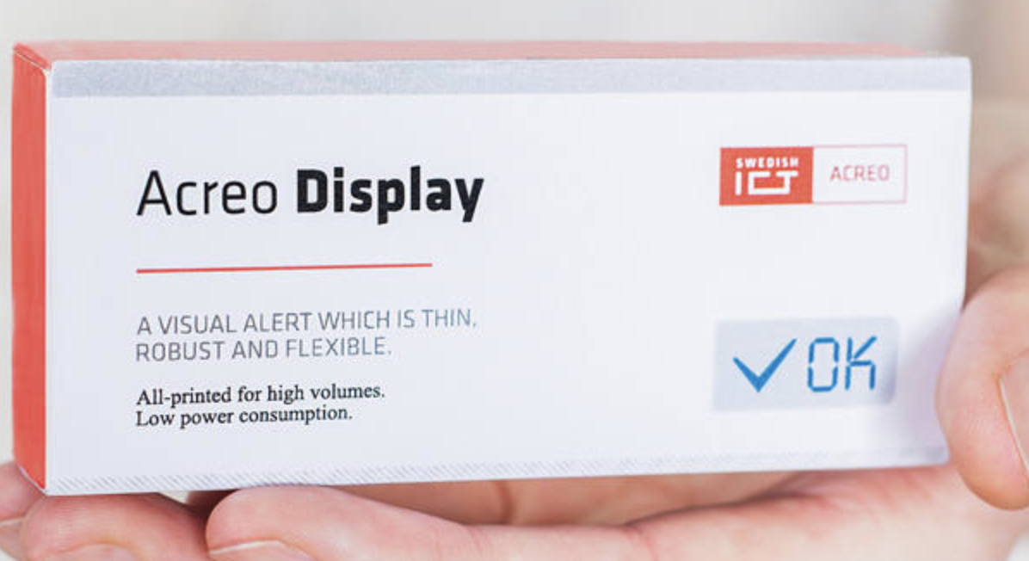
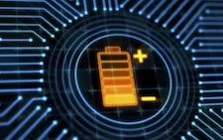
Arizona State University
Lighting (organic LEDs)
Solar Cell
Electroluminescent panels
Smart packaging
Batteries
Notes:
Here are some other applications of flexible electronics.
Images:
Electroluminescent panel:https://techxplore.com/news/2018-03-electronics-yarn-batteries.html
Smart packaging: https://www.packworld.com/article/trends-and-issues/smartactive-packaging/putting-power-printed-electronics-packaging
Timestrip: https://www.aipia.info/news-Simple-temperature-indicators-add-value-to-transit-packs-1083.php
Lighting-http://www.nbcnews.com/id/27116343/ns/technology_and_science-innovation/t/plastic-film-could-make-house-lights-obsolete/#.XYObxC3MzGI
Solar Cell:http://erc-assoc.org/content/qesst-solar-cell
Batteries-https://gigaom.com/2013/01/08/a-new-battery-that-could-revolutionize-wearables/
https://www.uq.edu.au/news/article/2017/07/screen-printed-batteries-renewables-way

Slide 12
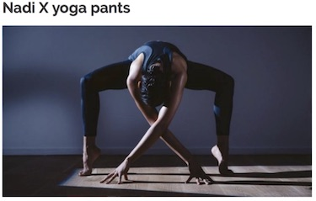
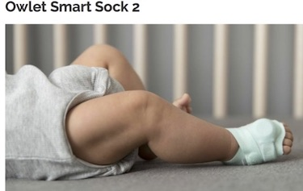
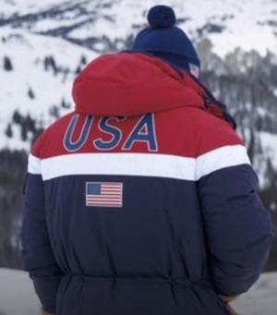
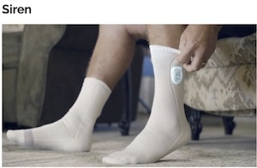
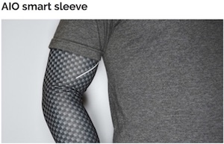
Haptic vibrations pulse at knees, ankles hips to move or hold positions
Hospitals monitor baby’s pulse oximetry
Ralph Lauren
Heated jackets 2018 Olympics;
Flag: carbon and silver paint inside,
Temperature set with cell phone.
Wearables
Diabetes socks monitor temperature, an indicator of inflammation
Heart rate data, sleep and fitness, body temperature, air quality, UV rays
Notes:
https://www.wareable.com/smart-clothing/best-smart-clothing
Yoga: built-in haptic vibrations that gently pulse at the hips, knees and ankles to encourage you to move and/or hold positions
cadence, ground contact time, pelvic rotation and stride length. The smart running gear supports real time coaching, with feedback
Baby: pulse oximetry technology used in hospitals to monitor the little one's heart rate, making sure his or her sleeping and breathing haven't been interrupted. Connected Care platform, which will help you identify potential health issues like sleep irregularities, RSV, pneumonia, bronchiolitis, chronic lung disorders and heart defects.
Sleeve: heart rate data, it monitors sleep, workout intensity monitor body temperature, air quality and UV rays.
Diabetic socks: prevent diabetics' foot injuries. The socks feature microsensors woven into the fabric to continuously monitor temperature, and when they detect a rise in heat – a possible sign that inflammation is occurring – they'll alert the user with a smartphone notification or text message.
Jackets for US Olympics: https://www.usatoday.com/story/life/2018/01/22/exclusive-ralph-laurens-olympic-opening-ceremony-uniforms-wearable-mini-heaters/1045189001/
“
The electronic-printed inks, printed in the shape of an American flag in carbon and silver and bonded to the interior of the jackets, are flexible and stretchable. . The athletes can set the temperature (there are three settings) via their cellphones. The heat can last up to five hours on the high setting and 11 hours on the low setting, fully charged.
“

Slide 13
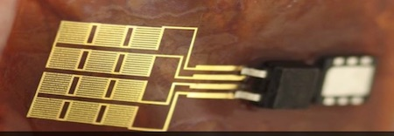
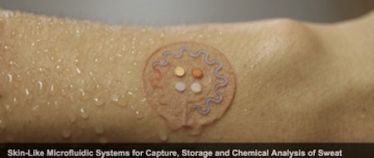
Medical Devices
Energy harvester from heart to replace batteries in pacemaker
3D printed stretchy, flexible monitor that wraps around the heart
John Rogers’ Group at Northwestern
Tattoo that analyses sweat
Notes:
One of the most innovative labs especially in merging flexible electronics and medicine is John Rogers lab at Northwestern.
Video: https://www.youtube.com/watch?time_continue=6&v=rQACQiwEEHc
https://www.technologyreview.com/s/525221/heart-implants-3-d-printed-to-order/
sensors, oxygenation detectors, strain gauges, electrodes, and thermometers made to wrap perfectly around a particular heart.
I wrote Rogers lab for permission on 1/13/19 got permission.

Slide 14
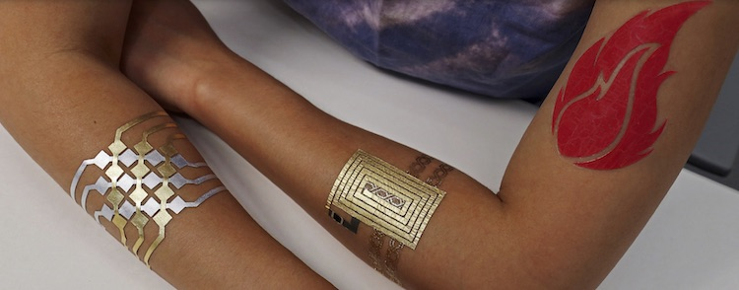
Gold leaf tattoos
Touchpad for your computer
Communication
Display responsive to body temperature
Notes:
Here some students at MIT created electronic tatooes.
http://duoskin.media.mit.edu

Slide 15
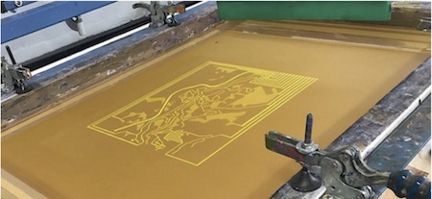
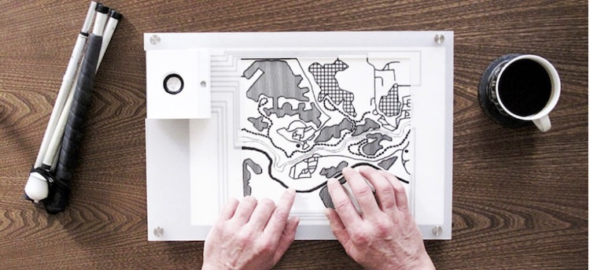
Foresight: printed tactile, conductive, interactive maps for blind people
Notes:
Using the same carbon paint that you did, here is a map that tells blind people about a walk through a park.
https://www.bareconductive.com/news/conductive-interactive-map-visually-impaired/

Slide 16
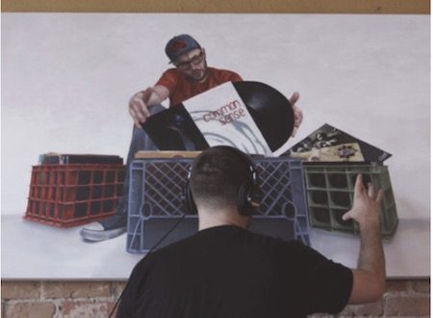
Other uses
Detour’s (Thomas Evans) interactive sound paintings use Bareconductive paint
Notes:
And here is an artist in Denver who works with hip-hop artists. When the DJ (inset) touches the paint, different songs play.
https://www.bareconductive.com/news/qa-art-and-decibels-by-thomas-evans/

Slide 17
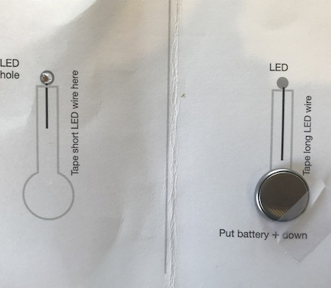
Put your circuit together
Open the card
Check the paint is dry
Carefully take off stencils
Place the battery with the POSITIVE SIDE DOWN on the RIGHT battery pad
Tape it down, but LEAVE as much of the battery exposed as possible

Slide 18
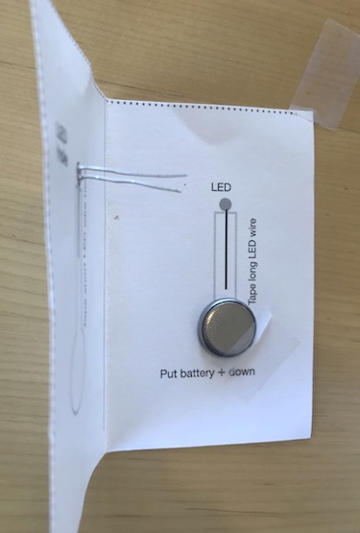
Put your circuit together
Check the paint is dry
Carefully take off stencils
Hold the LED horizontally, with the LONG wire on top
Stick the wires ONLY (not the bulb) through the hole to the inside of the card

Slide 19
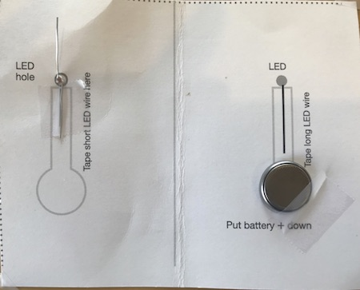
Put your circuit together
Bend the SHORT wire DOWN flat
Cut a piece of tape the length of the short wire and cover the wire
Leave as much of the rest of the paint line exposed as possible.

Slide 20
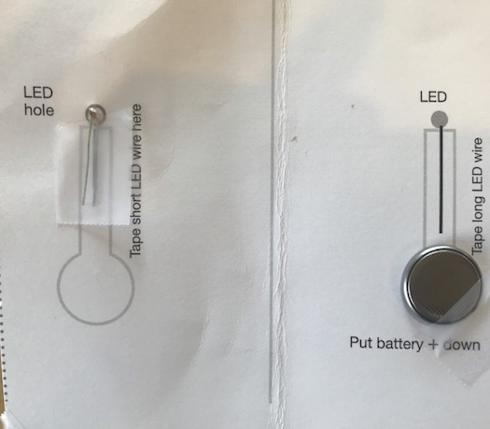
Put your circuit together
Cut a piece of tape the length of the long wire.
Place the piece of tape STICKY SIDE UP on top of the SHORT wire
Bend the LONG wire DOWN on top of the short wire.
Carefully close the card

