Slide 1
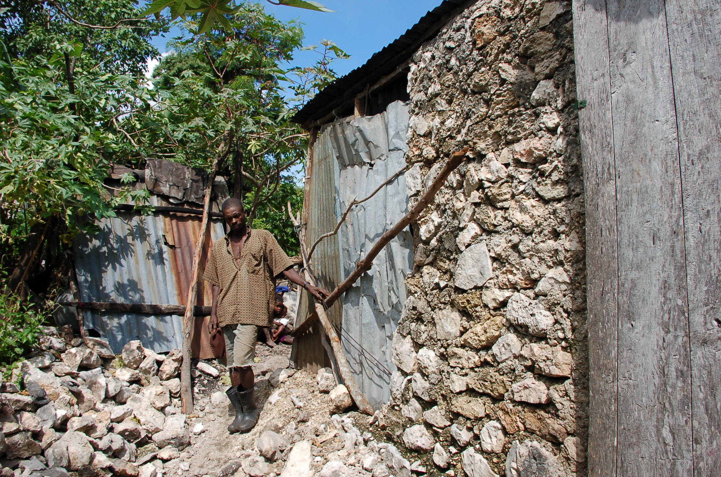
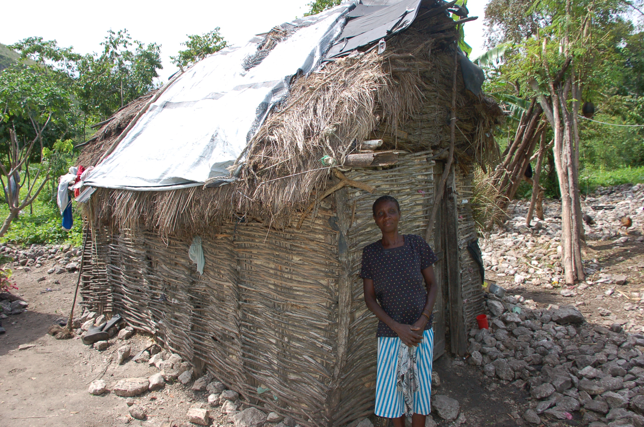
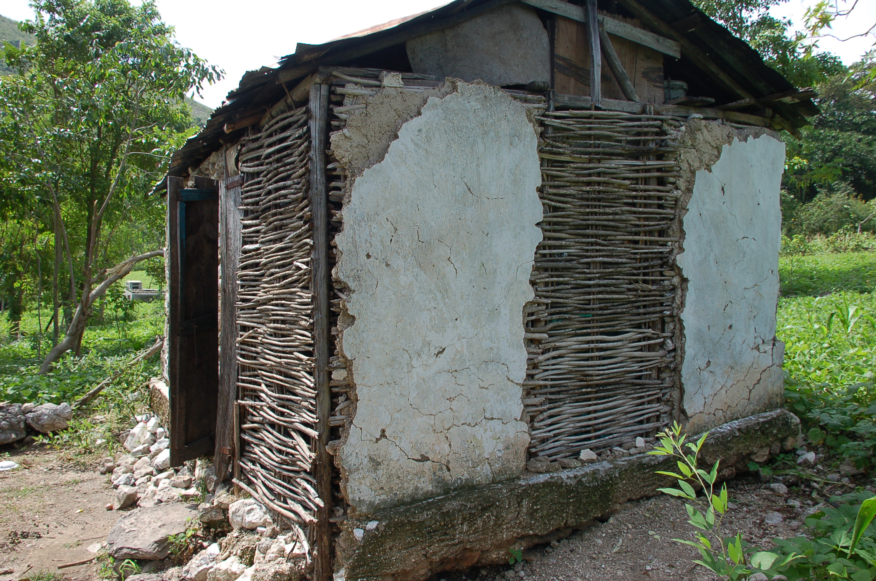
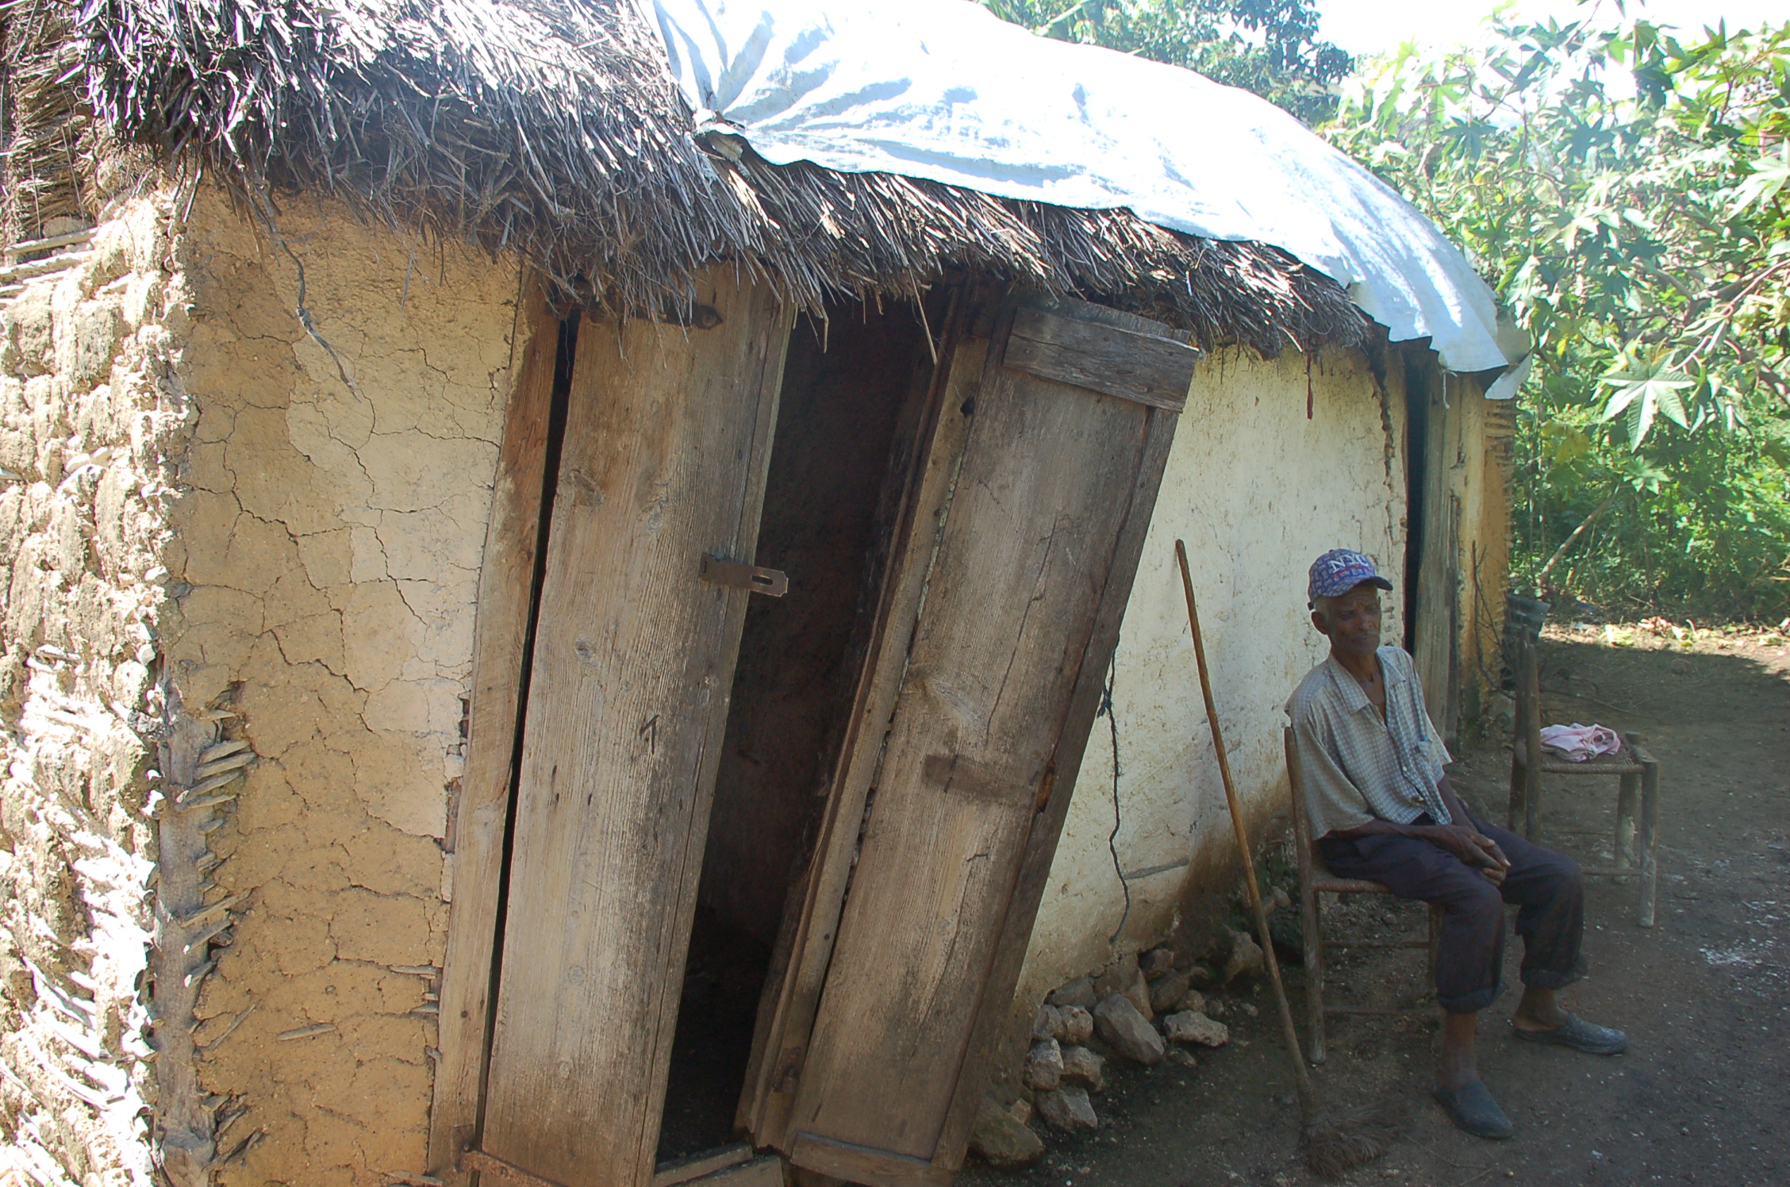
SHANTYTOWN REDESIGN Teacher Presentation
Notes:
Title Slide
Nicholas Kaufman’s pictures used with permission

Slide 2
Intro to STEM Education
Integrated Problem-Based Learning:
Solving real-world problems through engineering
Your challenge:
Integrate information you’ve already learned
Read and analyze new information
Research and ask questions; recognize all of your resources
Try various strategies—think creatively and critically
Discuss, design, explain, iterate
Habits of Mind

Slide 3
Engineering Design Process

Slide 4
Questions to Consider
An important part of
Consider the following questions as we look at the next couple of slides:
What do you notice in these pictures?
What questions do these images raise?
What does that make you wonder about?
What do we need to find out in order to solve any problems we see?
What do you feel is absent in this picture? How would we find that out? What specifically do you want to ask these people?

Slide 5
2016 Al Jazeera, “Horrors left by Hurricane Matthew become clear in Haiti” http://www.aljazeera.com/news/2016/10/horrors-left-hurricane-matthew-clear-haiti-161008094813244.html
Notes:
Teacher Notes:
Play the video.
Show students the pictures on the following slides, the Driving Question, and the Engineering Design Challenge.
Create a class Know/Need to Know Chart starting with the Engineering Design Challenge Slide. Ask students what they know and what they need to know (what questions they have to get answered) in order to solve the Challenge. Write/Type them on the chart.
Come back to the video and each of the photos on the following slides (or other photos you wish to use).
You can ask the following questions to ask to draw questions out of students when rewatching the video and when looking at the photos the second time: What do you notice a lot (or a little) of here? What does that make you wonder about? What do you notice is missing? Do you think it is there but just not in the picture or do you think it is not present? What does that make you wonder about? How would we find that out? So what specifically do you want to ask those people/that agency? What might we need to ask (to gain more info) to solve this? Who might we need to ask? How does this compare to your experience? What does that make you wonder about?

Slide 6
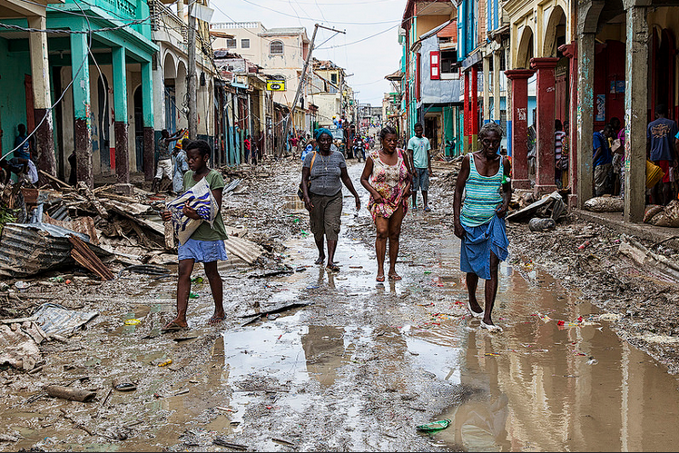
2016 United Nations (Logan Abassi), “Haiti hit by Hurricane Matthew” https://www.flickr.com/photos/un_photo/31569587301/in/album-72157674071957903/
Notes:
Teacher Notes: Show students the pictures (on this and the following slides or others than you have chosen) after showing the video but before introducing the Driving Question, and the Engineering Design Challenge. Follow the Teacher Notes below the slide with the video.

Slide 7
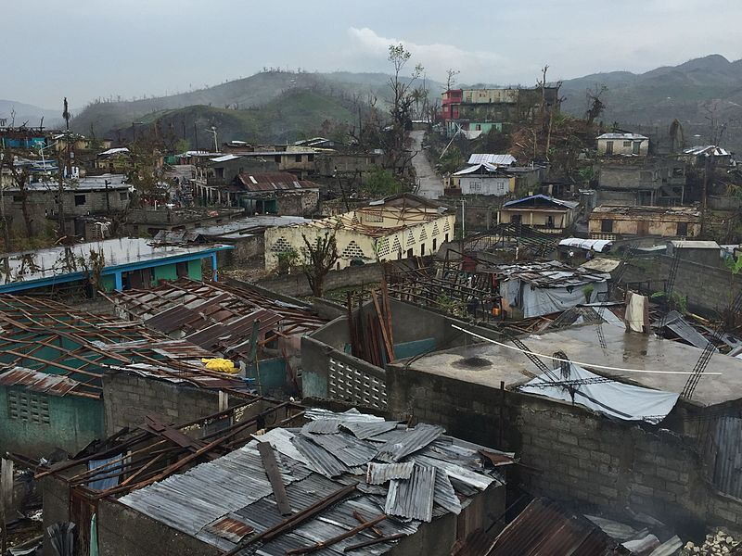
2016 CDC Global (Avi Hakim), “Moron, Haiti after Hurricane Matthew” https://www.flickr.com/photos/89075068@N07/31018500283
Notes:
Teacher Notes: Show students the pictures (on this and the following slides or others than you have chosen) after showing the video but before introducing the Driving Question, and the Engineering Design Challenge. Follow the Teacher Notes below the slide with the video.

Slide 8
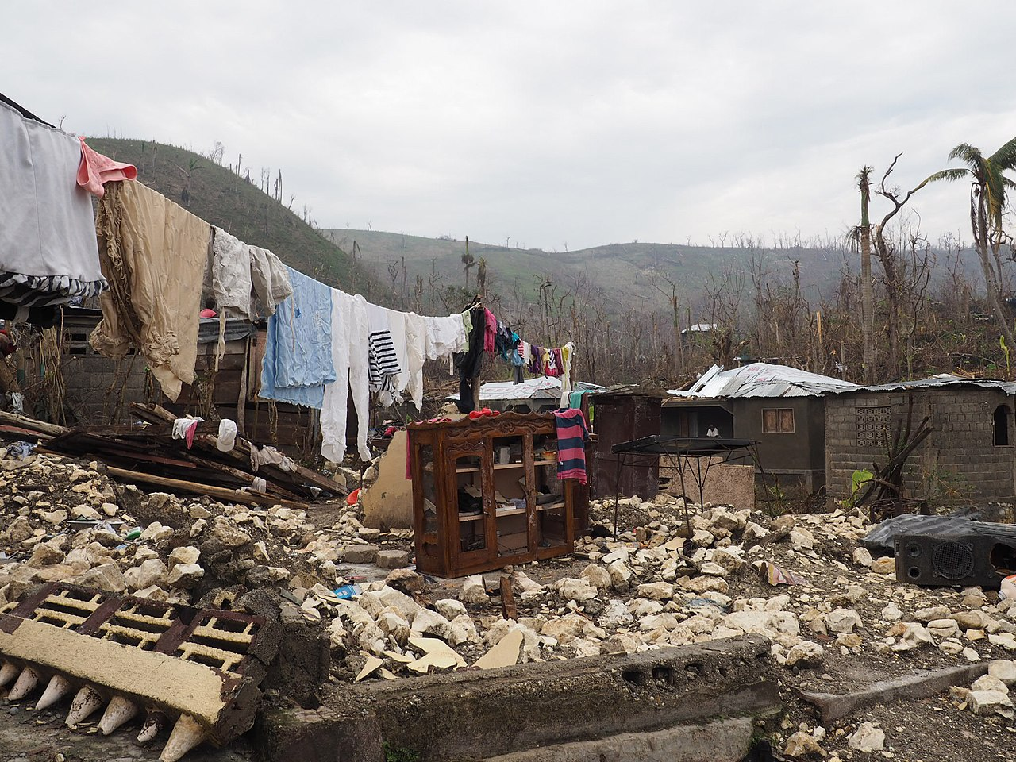
2016 CDC Global (Coralie Giese), Damage to a house in Haiti after Hurricane Matthew https://flickr.com/photos/89075068@N07/30988304274
Notes:
Teacher Notes: Show students the pictures (on this and the following slides or others than you have chosen) after showing the video but before introducing the Driving Question, and the Engineering Design Challenge. Follow the Teacher Notes below the slide with the video.

Slide 9
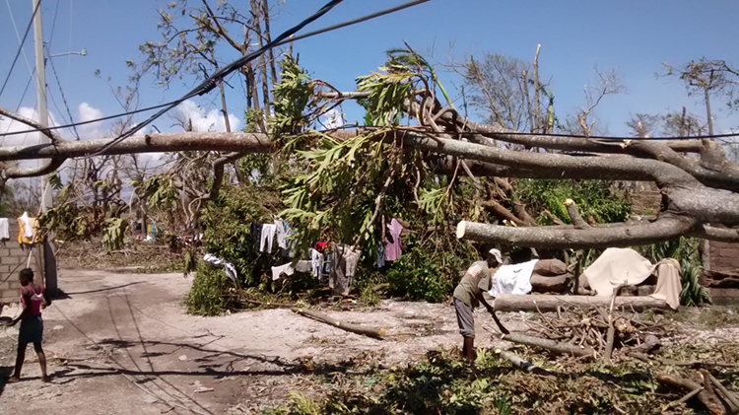
2016 UK Department for International Development (Julien Mulliez), https://www.flickr.com/photos/dfid/29561570953
Notes:
Teacher Notes: Show students the pictures (on this and the following slides or others than you have chosen) after showing the video but before introducing the Driving Question, and the Engineering Design Challenge. Follow the Teacher Notes below the slide with the video.

Slide 10
Driving Question:
Playing the part of engineers, how can we improve the quality of life of shantytown dwellers by improving the homes they live in with readily accessible and repurposed materials?

Slide 11
Engineering Design Challenge
Using the engineering design process, you will create a cement-based composite to be used for wall or roof construction that is lightweight, durable, chemical resistant, weather resistant, and aesthetically pleasing. Your substrate must be made of materials that are readily available to shantytown residents. Other guiding considerations for your constructions may include the material’s ability to meet a resident’s:
physical needs (temperature and health)
social needs (sense of community)
emotional needs (safety and security)
environmental consequences (sustainability)
Your task: use a cement matrix and found materials that are readily available to residents. Your test piece must be 26 cm long x 10 cm wide x 8 cm deep.

Slide 12
Science Background
Material Science classifies all materials into four categories: metals, polymers, ceramics, and composites. Metals are materials that, when freshly prepared, polished, or fractured, have a lustrous appearance, and conduct electricity and heat. They are typically malleable or ductile (can be drawn into wires). Polymers are carbon- based compounds with covalent bonds. They tend to be pliable and flexible when in the solid phase. They include rubber, plastic, elastic, wood, wax, and many fabrics. Ceramics generally contain very strong, rigid ionic bonds. They include substances like brick, bone, teeth, glass, cement, and ceramic, of course. Though they can be strong, they can also be fragile. Composites are a combination of materials of differing chemical and physical properties that, when combined, create a substance with properties that are different than the component parts. Materials scientists also deal with the chemical properties and physical properties of a substance.
Chemical properties are the qualities of a material that can be established only by changing a substance’s chemical identity. Examples include if a material is flammable, prone to rust or oxidization, reacts with acids, etc.
Physical properties concern qualities such as density, hardness, color, or flexibility that can be determined without changing the identity of the substance; that is, these qualities can be observed without a chemical reaction.

Slide 13
Vocabulary
Word | Definition
ceramic | An inorganic non-metallic solid made up of either metal or non-metal compounds that have been shaped and then hardened by heating to high temperatures.
composite | Materials with significantly different chemical and physical properties that, when combined, create a substance with properties that are different than the component parts.
cement | Substances often made with lime and clay, that is used to bind sand and gravel, or aggregate, together. It is mixed with water to form mortar or mixed with sand, gravel, and water to make concrete.
chemical property | A quality of a material that can be established only by changing a substance’s chemical identity. Examples include if a material is flammable, prone to rust or oxidization, reacts with acids, etc. (See “physical property.”)

Slide 14
Vocabulary
Word | Definition
metal | A material that, when freshly prepared, polished, or fractured, has a lustrous appearance, and conducts both electricity and heat.
physical property | Density, hardness, color, or flexibility that can be determined without changing the identity of the substance. (See “chemical property.”)
polymer | A substance that has a molecular structure consisting chiefly or entirely of a large number of similar units bonded together; for example, many synthetic organic materials used as plastics and resins.
strength of material | Dealing with the behavior of solid objects subject to stress and strain; also known as mechanics of materials.
stress | A physical quantity that expresses the internal forces that neighboring particles of a continuous material exert on each other. For example, one can model different types of stresses using clay: compressive strength (pushing down), tensile strength (pulling apart), shear strength (tearing in different directions), and bending strength.

Slide 15
Know/Need to Know Chart
What We Know
What We Need to Know
Notes:
Questions to ask to draw questions out of students:
Sample Student Generated Questions
What is the engineering design process?
What a a composite?
What is a substrate?
What materials are readily available?
How can they be repurposed?
What does “emotional needs” mean?
Are their everyday chemicals similar to ours?
Why were some buildings left standing and others weren’t?
Where does the trash come from?
Is there a trash clean up system?
Is the trash picked up by the government like here? If so, how often?
Where does their water come from--wells, the water company, etc.?
Is the water clean? Do we need to clean the water?
How do we clean it?
What type of medical treatment is available?
Do we need to build roads?
What type of vehicles are there?
Do their homes have reliable electricity?
How many people live in each house?
How do they decide how many people live in one house?
What are the cultural preferences with regard to the number of people in a home?
Is that the road? If so, why is that so dirty?
Are most people religious? If so, what religion are they?
How does that affect their lifestyle? Their housing structure?
Where did the tire come from?
What type of technology is there?
Did they use a filter to clean the water?
How far do they have to travel to get the water?
Is it by foot?
How big are the houses? What are the sizes of the walls?
Do they have windows? If so, how many and what size?
How many people usually live in a house?
Does one (nuclear) family or two or more live in a home?
Do others who typically live in home?
What cultural or other things inside/relating to a home are important to Haitians?
What are the typical homes like on the inside?
What are the current shanty homes made of?
What material is available for use as a substrate?
What kind of art do Haitians enjoy/create?
What are well-liked colors?
What are the roles of men in this culture?
Where is Haiti?
Are they independent?
Did another country used to control them?
What language do they speak?
What major health concerns do they have?
What type of political system do they have?
What is their climate like?
How often do they have hurricanes?
Do they have any other natural disasters? If so, how often?
What is their culture like?
What types of crops do they grow?
What type of food do they eat?
What is their major religion?
What do they do for fun?
What is their average life expectancy?
Do children go to school? If so, for how long?
What type of jobs do people have?
What do they live in?
What else do the children do?
How many children do they have per household?
What are the women’s roles?

