Slide 1
Save the Snails!

Slide 2
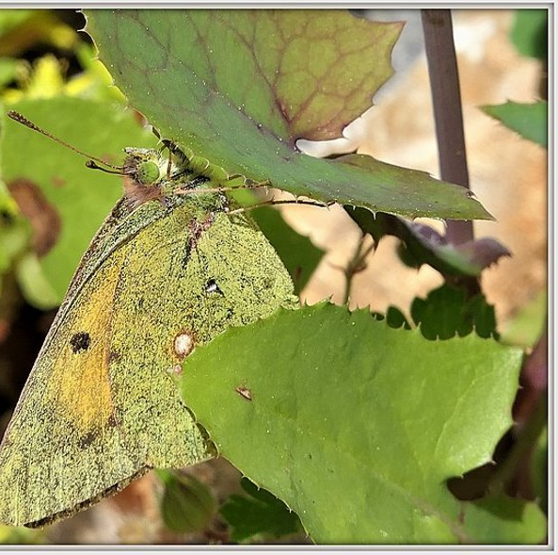
Find the animal
Notes:
Image source: https://commons.wikimedia.org/wiki/File:Camouflage_III_(34737320522).jpg

Slide 3
Did you find it?

Slide 4
Find the animal
Notes:
Image source: https://commons.wikimedia.org/wiki/File:Camouflage_III_(34737320522).jpg

Slide 5
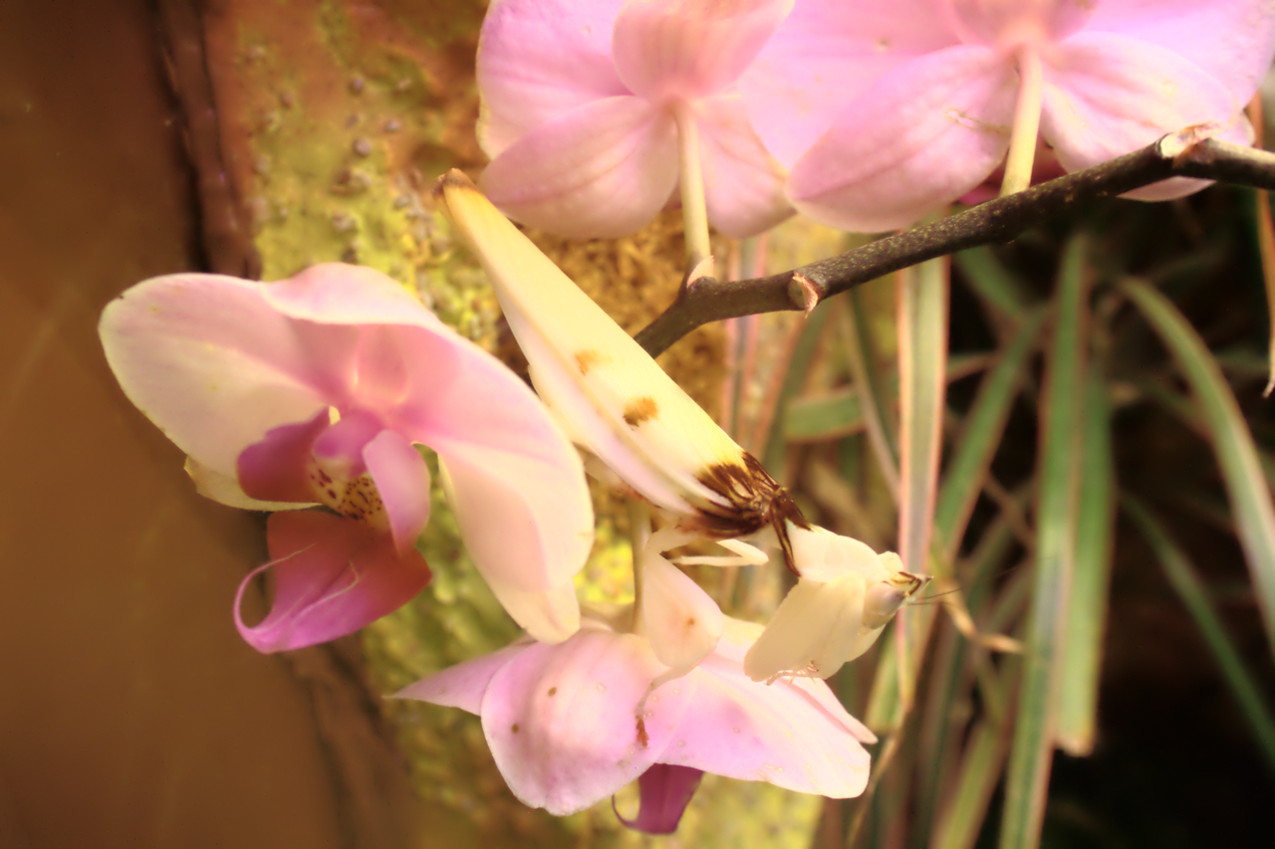
Find the animal
Notes:
Image source: https://commons.wikimedia.org/wiki/File:Insect_camouflage_PP08338.png

Slide 6
Did you find it?

Slide 7
Find the animal
Notes:
Image source: https://commons.wikimedia.org/wiki/File:Insect_camouflage_PP08338.png

Slide 8
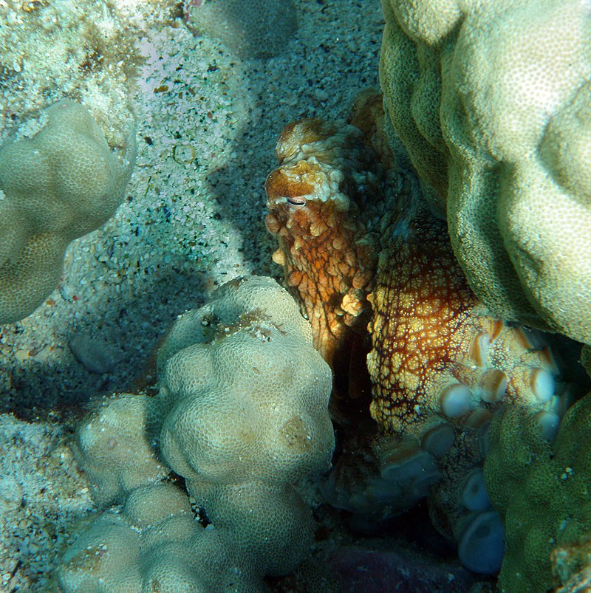
Find the animal
Notes:
Image source: https://commons.wikimedia.org/wiki/File:Octopus_cyaneain_Kona.jpg

Slide 9
Did you find it?

Slide 10
Find the animal
Notes:
Image source: https://commons.wikimedia.org/wiki/File:Octopus_cyaneain_Kona.jpg

Slide 11
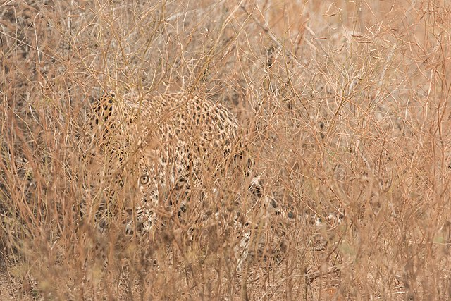
Find the animal
Notes:
Image source: https://commons.wikimedia.org/wiki/File:Camouflaged_Sri_Lankan_leopard_(Panthera_pardus_kotiya).jpg

Slide 12
Did you find it?

Slide 13
Find the animal
Notes:
Image source: https://commons.wikimedia.org/wiki/File:Camouflaged_Sri_Lankan_leopard_(Panthera_pardus_kotiya).jpg

Slide 14
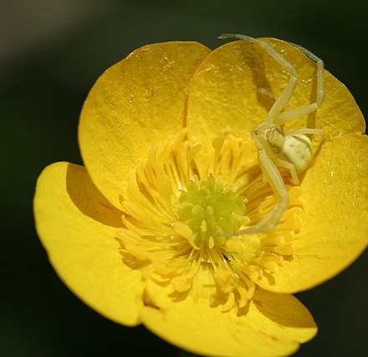
Find the animal
Notes:
Image source: https://commons.wikimedia.org/wiki/File:Camouflaged_Spider_(666406266).jpg

Slide 15
Did you find it?

Slide 16
Find the animal
Notes:
Image source: https://commons.wikimedia.org/wiki/File:Camouflaged_Spider_(666406266).jpg

Slide 17
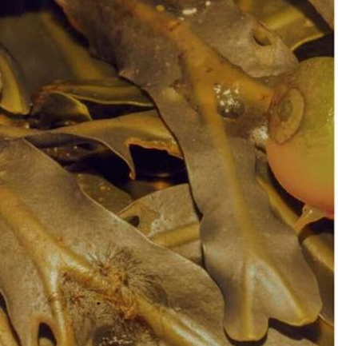
Find the animal
Notes:
Image link: https://www.plymouth.ac.uk/news/losing-the-cover-of-darkness

Slide 18
Did you find it?

Slide 19
Find the animal
Notes:
Image link: https://www.plymouth.ac.uk/news/losing-the-cover-of-darkness

Slide 20
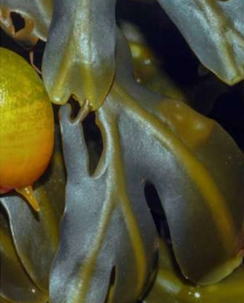
Find the animal
Notes:
Image link: https://www.plymouth.ac.uk/news/losing-the-cover-of-darkness

Slide 21
Did you find it?

Slide 22
Find the animal
Notes:
Image link: https://www.plymouth.ac.uk/news/losing-the-cover-of-darkness

Slide 23
Camouflage
Photos should be a
square like this.

Slide 24
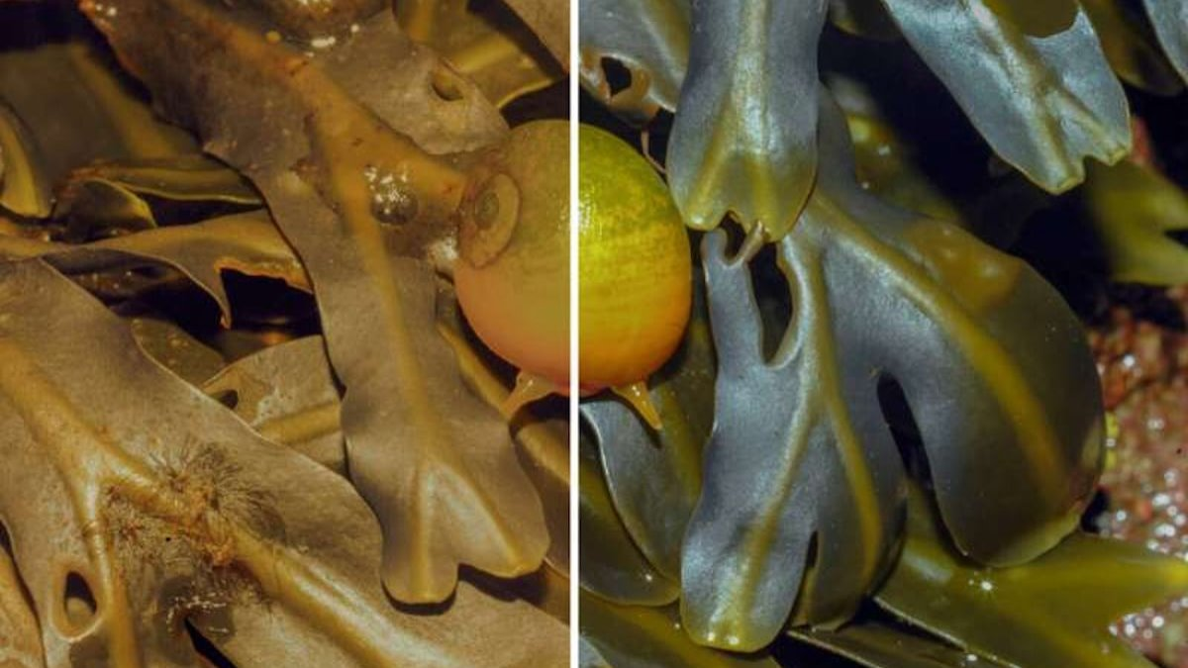
Littorinid Snails Need Our Help!
Notes:
Image link: https://www.plymouth.ac.uk/news/losing-the-cover-of-darkness

Slide 25
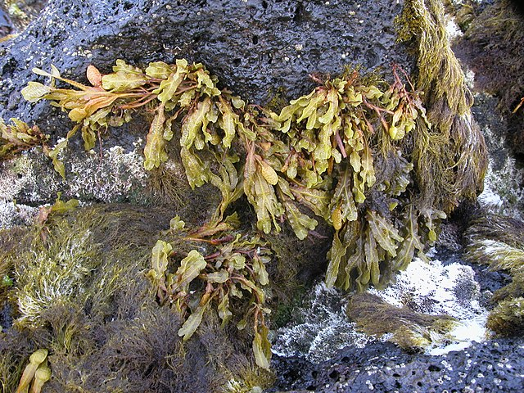
Littorinid Snails Habitat
Notes:
Image source: https://commons.wikimedia.org/wiki/File:Fucus_spiralis_and_Gelidium_microdon_(10.3897-BDJ.8.e57461)_Figure_2.jpeg

Slide 26
Collapsible Barrier
Let's find some examples of collapsible barriers! We can look around our classroom or search online!
Photos should be a
square like this.

Slide 27
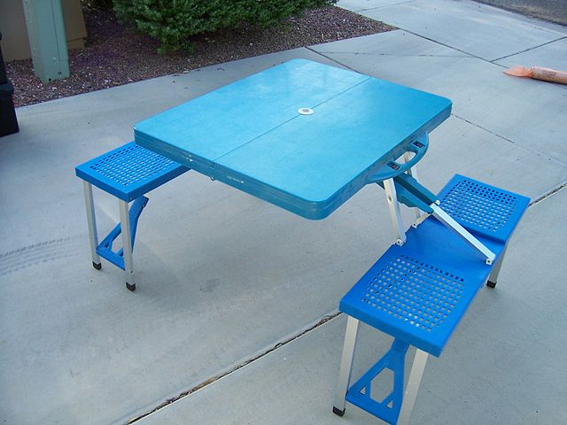
Collapsible Objects
Photos should be a
square like this.
Notes:
Book image source: https://commons.wikimedia.org/wiki/File:Books-book-pages-read-literature-159866.jpg
Umbrella image source: https://commons.wikimedia.org/wiki/File:Red_Umbrella_1.jpg
Table image source: https://commons.wikimedia.org/wiki/File:Folding_Picnic_Table_2.jpg

Slide 28
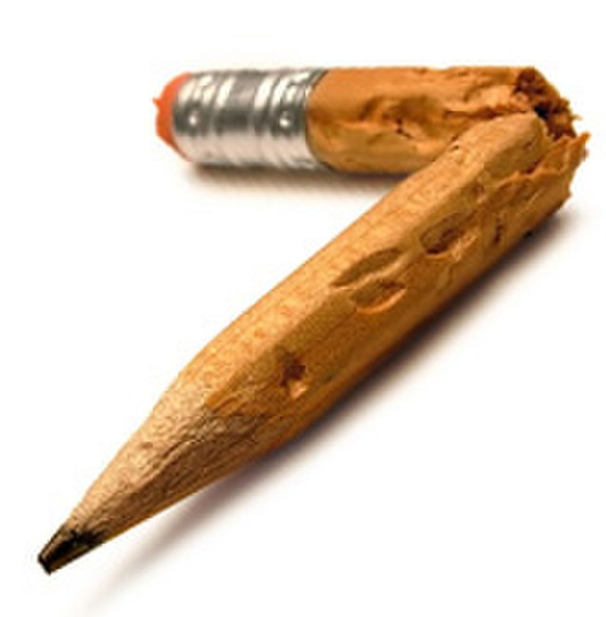
Breaking is NOT collapsing!
Notes:
Pencil image source: https://commons.wikimedia.org/wiki/File:A_broken_pencil.jpg
Paper image source: https://commons.wikimedia.org/wiki/File:Wrinkled_paper.jpg

