Slide 1
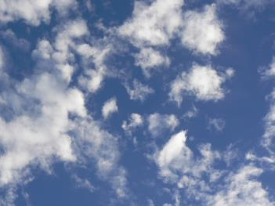
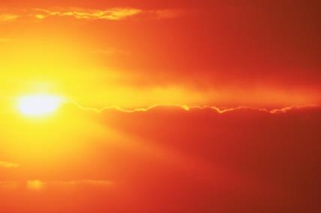
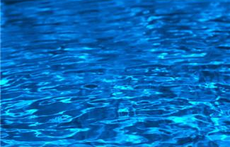
Dome It Challenge Cards & Cycles
Page 1
Print and cut out the cards on slides 1-4, making one card set per group.
Slides 5-8 provide example connections (solutions) made with the cards.

Dome It Challenge
Card Set
Atmosphere Reservoir
Some elements and compounds available in the atmosphere:
nitrogen (N)
oxygen (O₂)
carbon dioxide (CO₂)
water vapor
Sunlight Reservoir
Some scenarios may not have access to natural sunlight.
Water Reservoir
Potential sources of clean water:
river
lake
aquifer
groundwater
rainwater
Not all are available for all scenarios.
Images sources: Microsoft clipart or by author, unless otherwise noted
Notes:
Dome It Challenge Scenario Cards activity > TeachEngineering.org
Print and cut out the cards on slides 1-4, making one card set per group.
Slides 5-8 provide example connections (solutions) made with the cards.

Slide 2
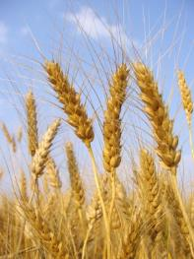
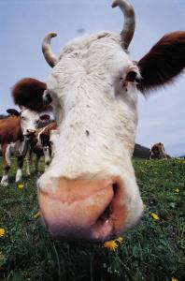
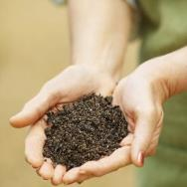
Dome It Challenge Cards & Cycles
Page 2
Food waste
Sunlight
Food
Biomass (organic waste)
Human waste
Fertilizer (nutrients)
Water
Food
Wastewater
Water
Oxygen (O₂)
Oxygen (O₂)
Carbon dioxide (CO₂)
Carbon dioxide
(CO₂)
Person
Plants
Food
Food (from plants)
Food waste
Biomass (organic waste)
Heat
Water
Animal waste
Oxygen (O₂)
Fertilizer (nutrients)
Oxygen (O₂)
Wastewater
Compost
Carbon dioxide (CO₂)
Animals
Images sources: Microsoft clipart or by author, unless otherwise noted

Slide 3
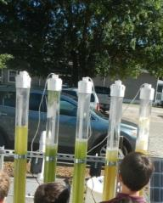
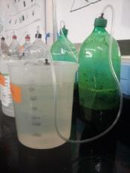
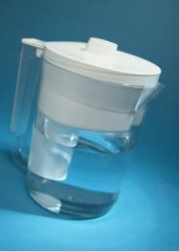
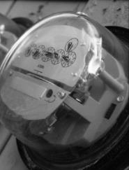
Dome It Challenge Cards & Cycles
Page 3
Sunlight
Biofuel
Heat
Biogas
Water
Organic waste (biomass)
Organic waste (biomass, human, animal)
Liquid nutrients (fertilizer)
Carbon dioxide (CO₂)
Wastewater
Liquid nutrients (fertilizer)
NO oxygen
Solid nutrients (fertilizer)
Oxygen
Algae Photobioreactor
Anaerobic Digester
Biogas
Electricity
Electricity
Water resource (seawater, groundwater, etc.)
Drinking water
Biofuel
Heat
(Energy)
Water Producer
(Treatment or Desalination)
Power Producer
Images sources: Microsoft clipart or by author, unless otherwise noted

Slide 4
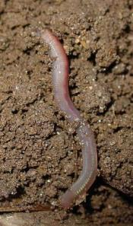
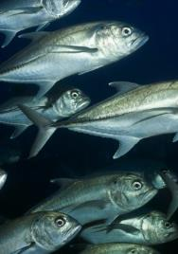
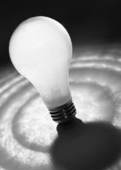
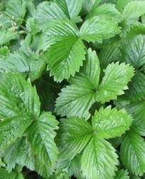
Dome It Challenge Cards & Cycles
Page 4
Optional Aquaponics Card
Optional Aquaponics Card
Soil (from compost)
Biomass (organic waste)
Worms
Food (for fish)
Food
Oxygen (O₂)
Fertilizer (nutrients)
Water
Animal waste
Water
Oxygen (O₂)
Wastewater (with nutrients)
Worm Bed
Fish
Image: 2005 Luis Miguel Bugallo Sánchez http://commons.wikimedia.org/wiki/File:Mi%C3%B1oca066eue.jpg
Sunlight
Biomass (organic waste)
Water and Nutrients (from fish)
Electricity
Light
(artificial sunlight)
Food
Carbon dioxide
(CO₂)
Oxygen (O₂)
Light bulb
Plants
Optional Aquaponics Card
Images sources: Microsoft clipart or by author, unless otherwise noted

Slide 5
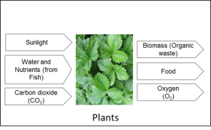
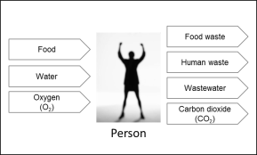
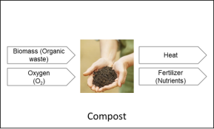
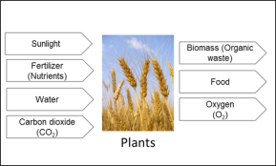
Dome It Challenge Cards & Cycles
Page 5
Example Respiration Cycle (Blue)
People intake oxygen and exhale carbon dioxide. Plants intake carbon dioxide and emit oxygen.
Example Respiration Cycle (Blue) and Food Cycle (Red)
People intake oxygen and exhale carbon dioxide. Plants intake carbon dioxide and emit oxygen. Compost uses oxygen.
People eat food and produce food waste. Food waste can be composted into fertilizer used to grow plants. Plants provide food to people and biomass waste can be composted.
Images sources: Microsoft clipart or by author, unless otherwise noted

Slide 6
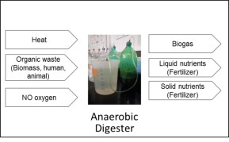
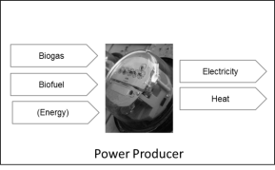
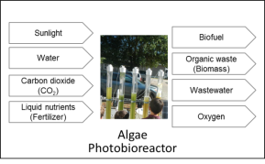
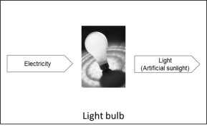
Example Energy Cycle (Orange) and Nutrient Cycle (Green)
Anaerobic digester and algae photobioreactor (PBR) produce biogas and biofuel that can be turned into electricity. Electricity powers light bulbs for light to grow algae.
Organic waste from the algae photobioreactor can be used in the anaerobic digester. Liquid nutrients from the anaerobic digester feed the algae in the PBR.
Dome It Challenge Cards & Cycles
Page 6

Slide 7
Dome It Challenge Cards & Cycles
Page 7
Aquaponics Example
Water is circulated between the plants and fish pond. The fish waste in the water provides nutrients for the plants. The plants (and associated microroganisms) treat the water that returns to the fish.
Both the fish and plants provide food for humans and animals.
Worms are grown for fish food using compost from composting and some food waste as food for the worms. The worm bed produces worms (fish food) and additional fertilizer (for growing plants)

Slide 8
Dome It Challenge Cards & Cycles
Page 8
Biorecycling Example
Sunlight, atmosphere components and water can be pulled from the reservoir cards. However, many opportunities exist for recycling of CO₂ and O₂.
***If using the “underground” scenario, natural sunlight is not available. Students will have to make energy to power artificial light to mimic sunlight.

Slide 9
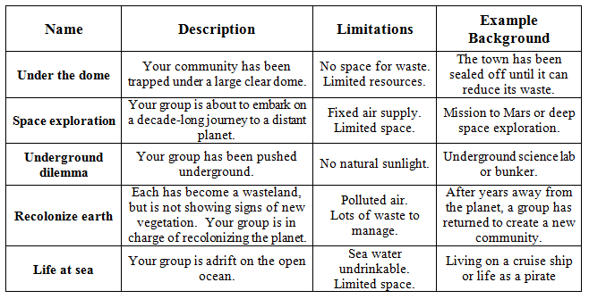
Scenarios & Limitations
Notes:
Information for teacher to show students or not.

