Slide 1
Green Infrastructure and Low-Impact Development Technologies Design Scenarios
Notes:
GI and LID Technologies Design Scenarios (a PowerPoint presentation)
Green Infrastructure and Low-Impact Development Technologies Lesson, TeachEngineering.org

Slide 2
Your Challenge
Instructions: As a class, analyze the pictures of the real-world urban environment scenarios and draw in your site plans for stormwater management based on the green infrastructure (GI) and low-impact development (LID) technologies.
Consider and discuss the following topics in determining your site plans.
Traffic concerns
Aesthetics
Safety of people, plants and animals
Vegetation types, size, sun requirements and soil depth
What type of vegetation should be excluded from your design?
Stormwater flow
Drainage media
Incorporate other GI and LID technologies
Be BOLD, be creative, but realistic and practical. Have fun!

Slide 3
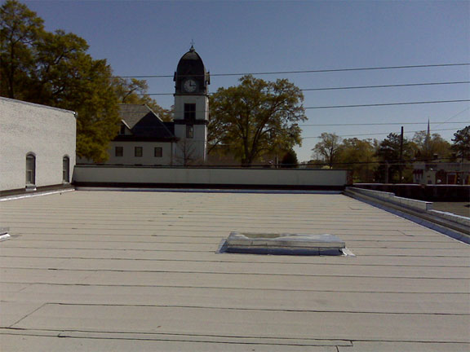
Green Roofs and Vegetative Walls
Image source: City of Fayetteville GA http://www.fayetteville-ga.gov/vertical/sites/%7B7C2ED344-BB55-4347-B057-121AA147A84D%7D/uploads/%7BE907E794-A6A7-4542-BCE0-8C197303A64A%7D.JPG
Notes:
Instructions: Have groups discuss and free draw ideas for possible solutions to each real-world scenario and come to a consensus on the best solution. Have the students debate the pros and cons of their design solutions to form a class consensus and sketch on the board the GI and LID solution they would use for each of the 10 urban environment scenarios. Ask and discuss why students would choose to use certain plant types over others and where they would place them. Example plant options might include native vs. non-native, wetland vs. upland or terrestrial, tree vs. shrub, vegetables vs. bees and butterflies). Also, discuss the benefits of each green infrastructure and low-impact development improvement and how it relates to the three pillars of sustainability (environment, economy, society).
~
To find the original image: choose “rooftop view” at http://www.fayetteville-ga.gov/index.asp?Type=B_LOC&SEC=%7B26D2E341-9122-4AF6-B4BF-9F20EB5A267B%7D&DE=%7BB2A085DF-6BF5-46C5-BBFD-B335C54FD0C9%7D

Slide 4
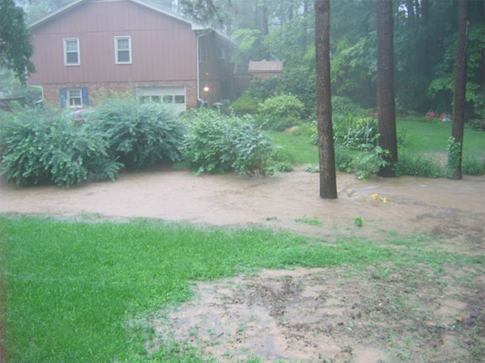
Bioretention or Rain Gardens
Image source: http://www.raleighnc.gov/home/content/PWksStormwater/Articles/WesternNorthRidge.html

Slide 5
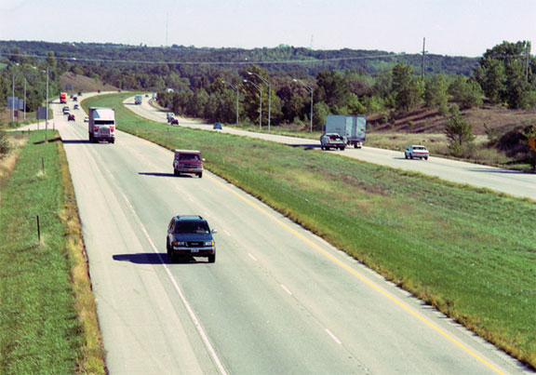
Bioswales
Image source: Nebraska Transportation http://www.transportation.nebraska.gov/roadrunner/docs/archives/oct-nov05-cover.jpg
Notes:
“Divided Highway” at http://www.transportation.nebraska.gov/roadrunner/rrarchives.htm

Slide 6
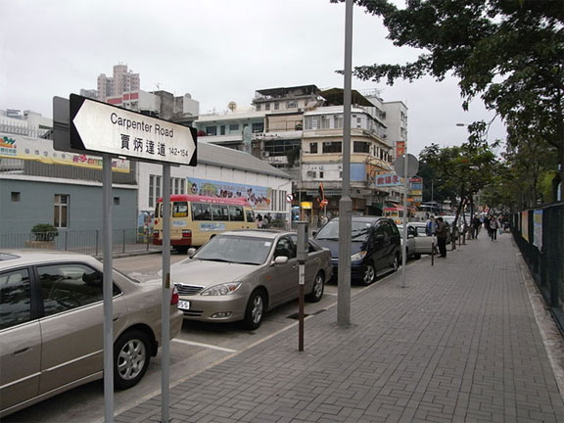
Planter Boxes
Image source: http://commons.wikimedia.org/wiki/File:HK_Kln_City_Carpenter_Road_sign_%E8%B3%88%E7%82%B3%E9%81%94%E9%81%93_sidewalk_car_park.jpg

Slide 7
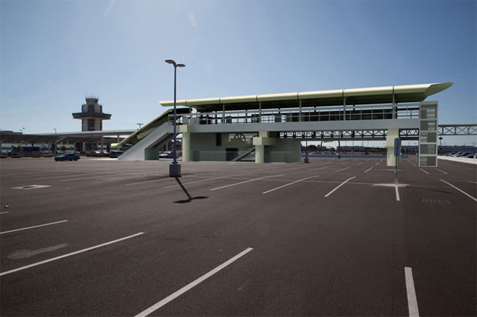
Permeable Pavement
Image source: http://www.mtc.ca.gov/news/info/oakconnector.htm

Slide 8
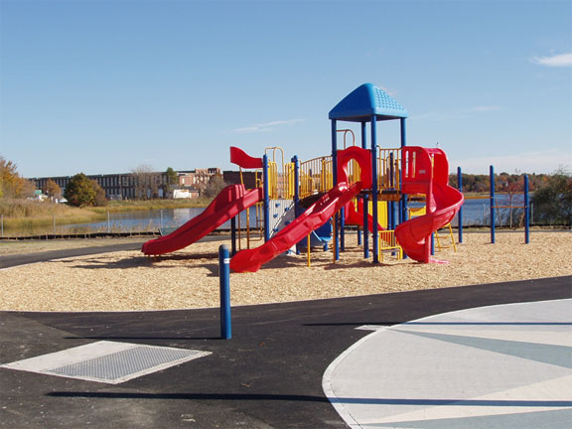
Urban Tree Canopy
Image source: http://www.noaa.gov/features/economic_0309/restoration.html

Slide 9
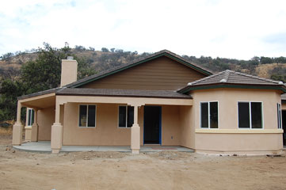
Rainwater Harvesting
Image source: U.S. Dept. of Housing and Urban Development http://www.disasterhousing.gov/offices/pih/ih/codetalk/onap/swonap/feature.cfm

Slide 10
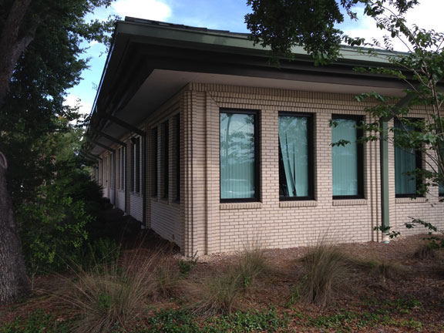
Downspout Disconnection
Image source: Ryan Locicero, University of South Florida (author)

Slide 11
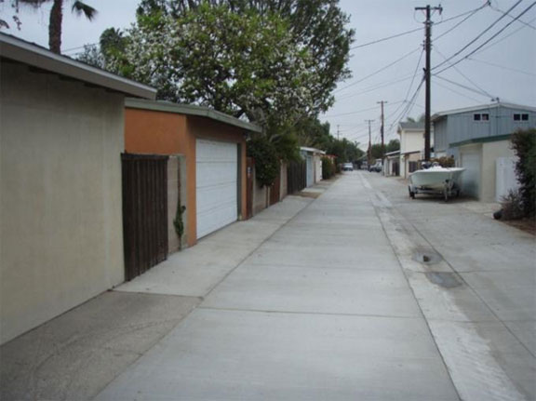
Green Streets and Alleys
Image source: http://www.costamesaca.gov/index.aspx?recordid=1320&page=40

Slide 12
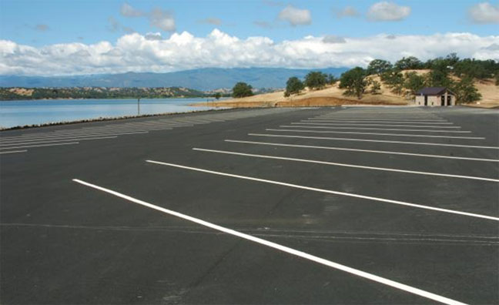
Green Parking
Image source: U.S. Army http://www.army.mil/article/56831/New_boat_ramp_opens_at_Corps__039__Black_Butte_Lake/

