Slide 1
Examples of Bioplastic Toys and Silicone Molds
Optional Extension Activity
Notes:
Examples of Bioplastic Toys and Silicone Molds, Lab Research to Engineer a Phosphorescent Bioplastic activity, TeachEngineering.org
///
All images: 2016 Jamie Sorrell, RET Program, School of Polymers and High Performance Materials, University of Southern Mississippi (author)

Slide 2
Best Molds
After doing this experiment: The reaction scheme with more corn starch makes the best molded bioplastic toys.
The molds that work best are small in size and have little-to-no small side details such as arms, wings, antenna, etc.

Slide 3
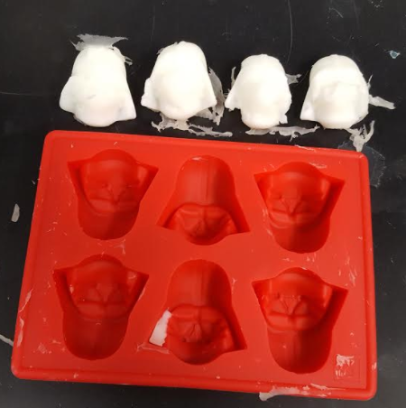
This mold worked well

Slide 4
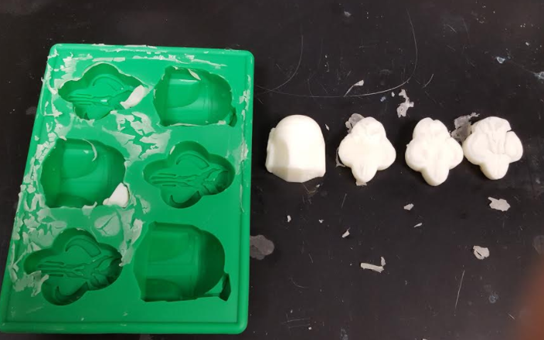
This mold worked well

Slide 5
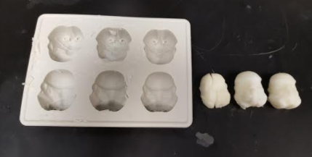
This mold worked well

Slide 6
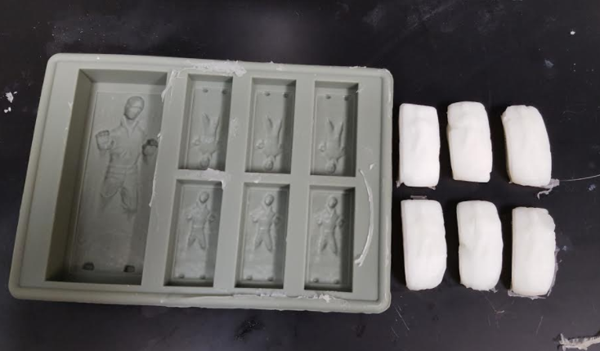
The smaller section of this mold worked well

Slide 7
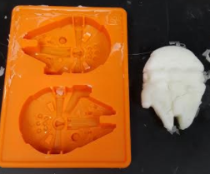
This mold was too large and had some issues

Slide 8
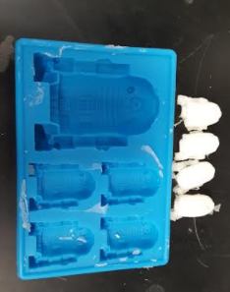
In this mold, the feet came off

Slide 9
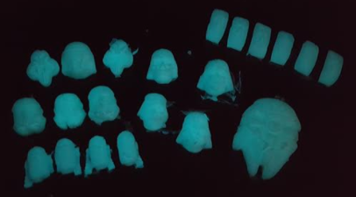
All the toys that were created

Slide 10
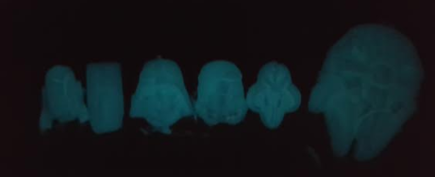

Slide 11
