Slide 1
Engineering the Efficiency of Alcoholic Fermentation

Slide 2
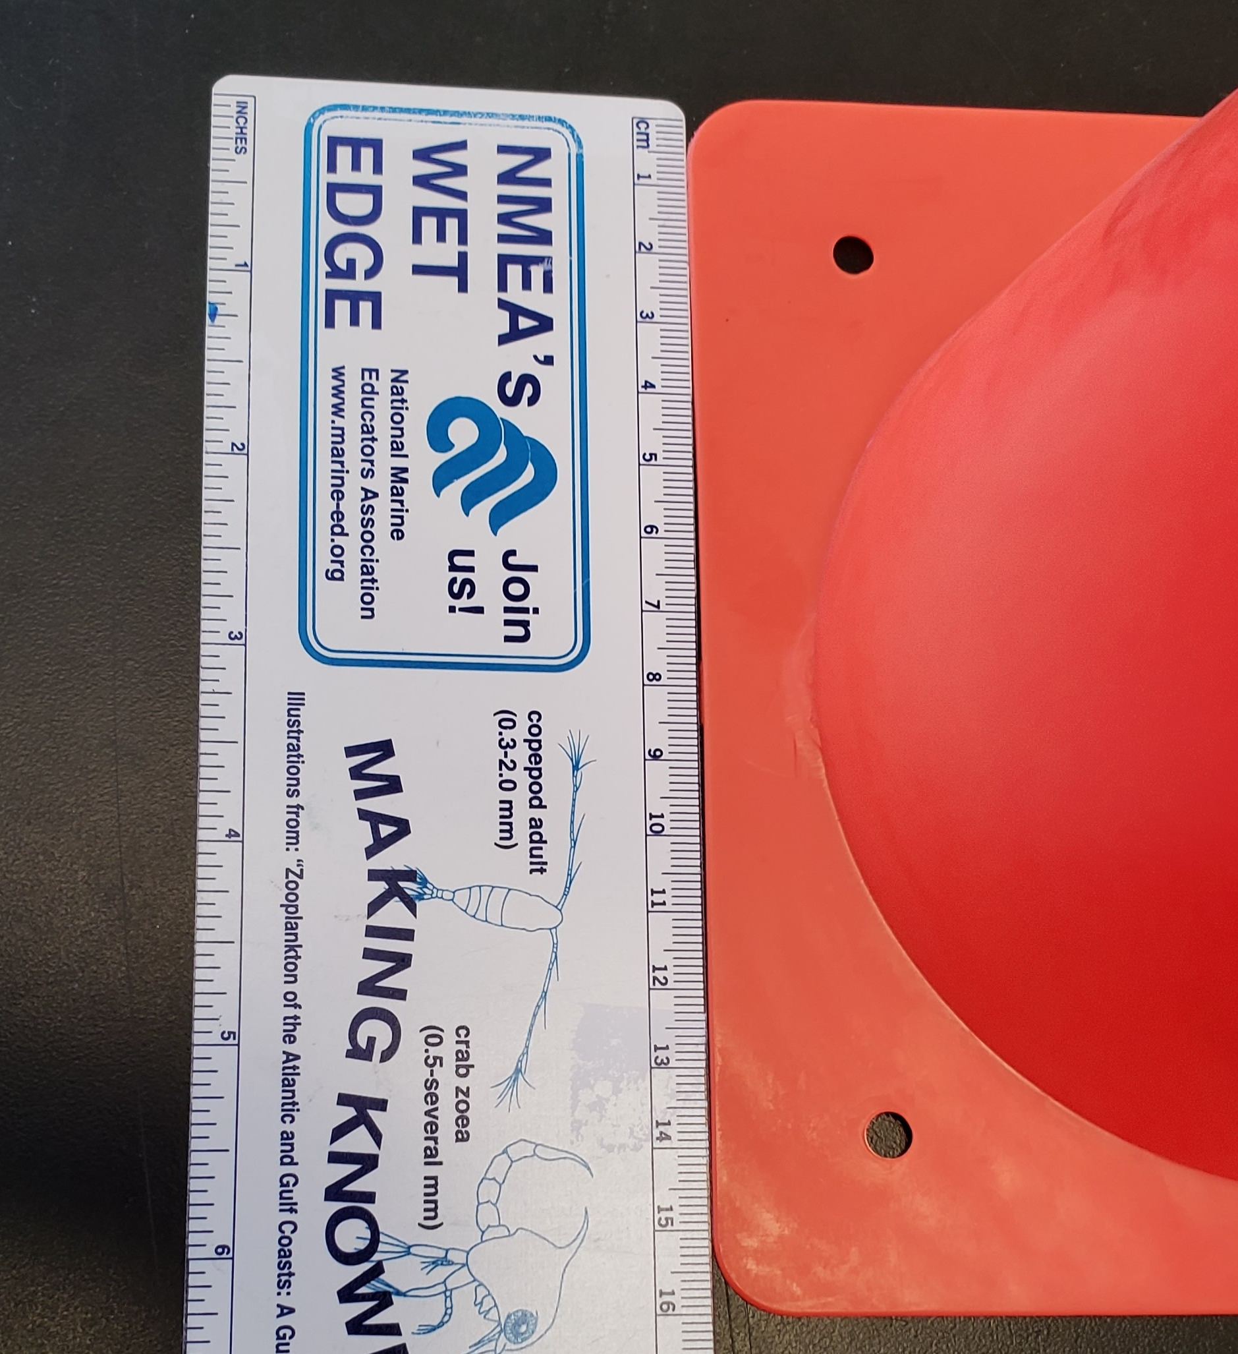
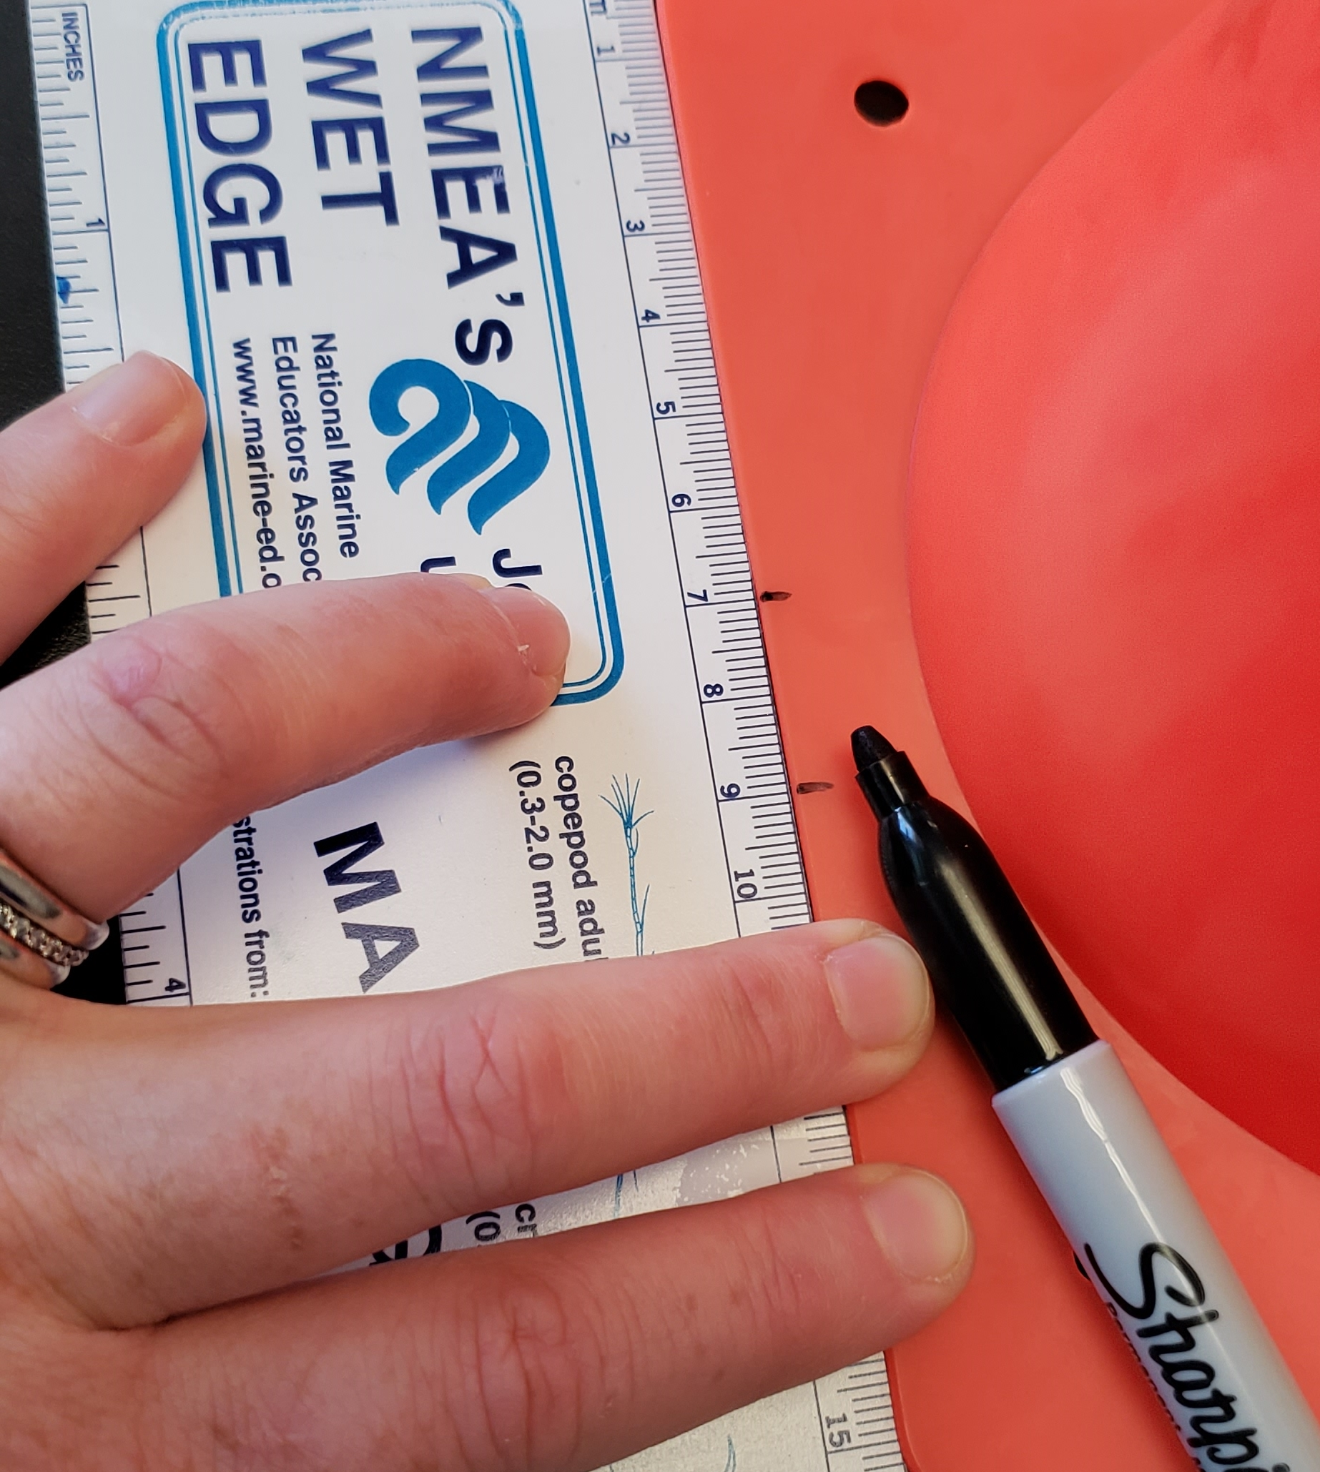
Water Displacement Apparatus
Option 1: Assemble Directions
1. Using a permanent marker and a ruler make two dots on the lip of the traffic cone at 7 and 9 cm markers. **Repeat on opposite side of cone.**
Photos should be a
square like this.
#6091ba
#9fcc3b
#8d64aa
#f8a81b

Slide 3
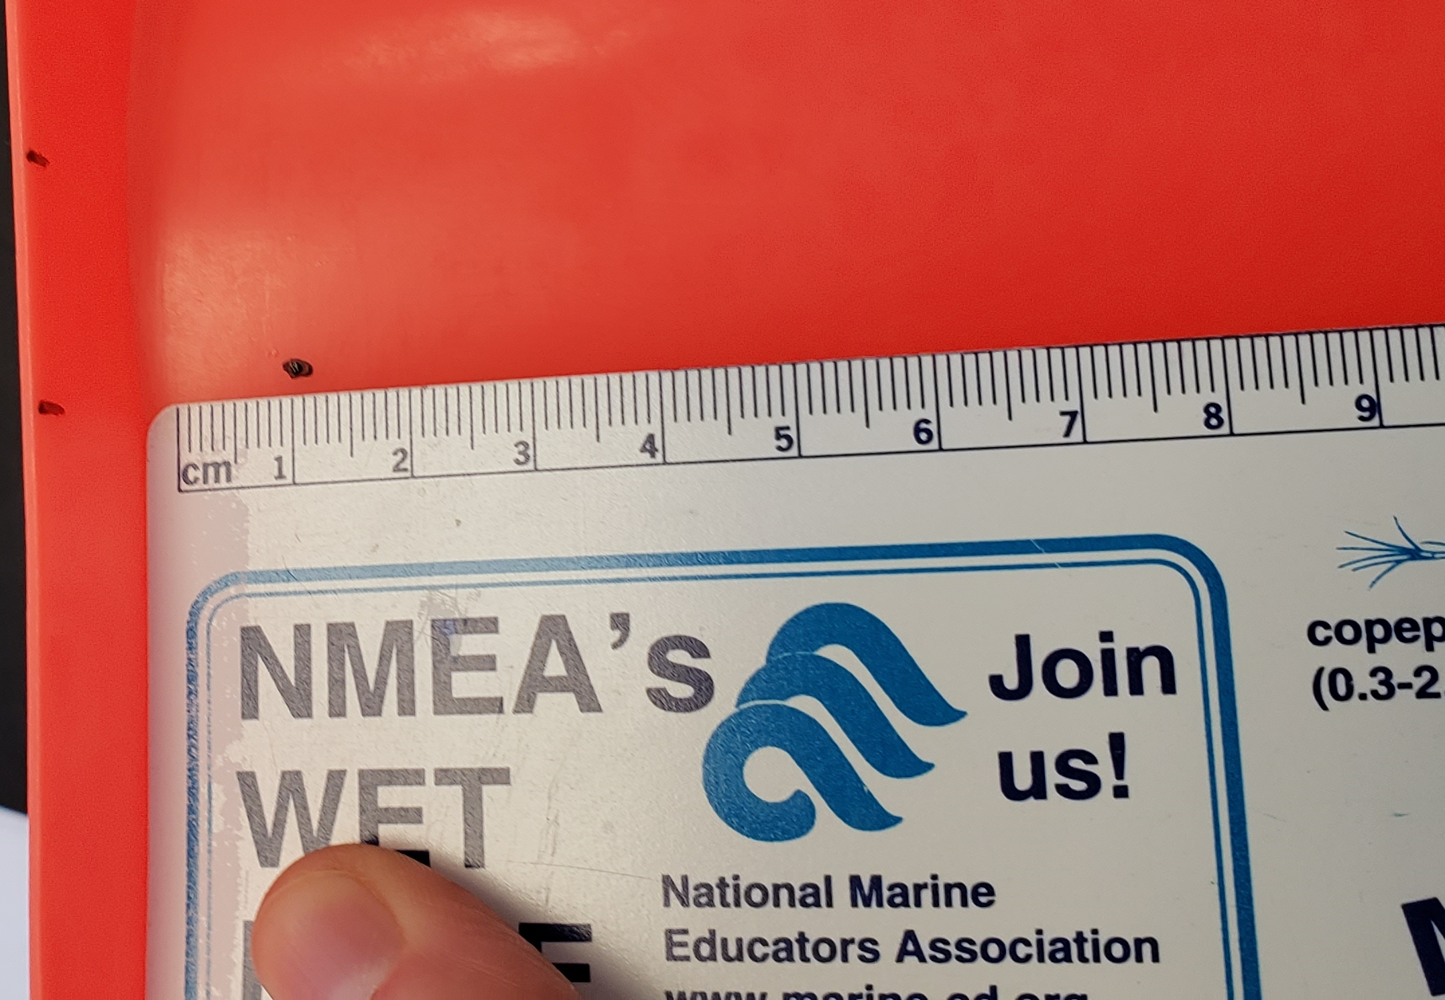
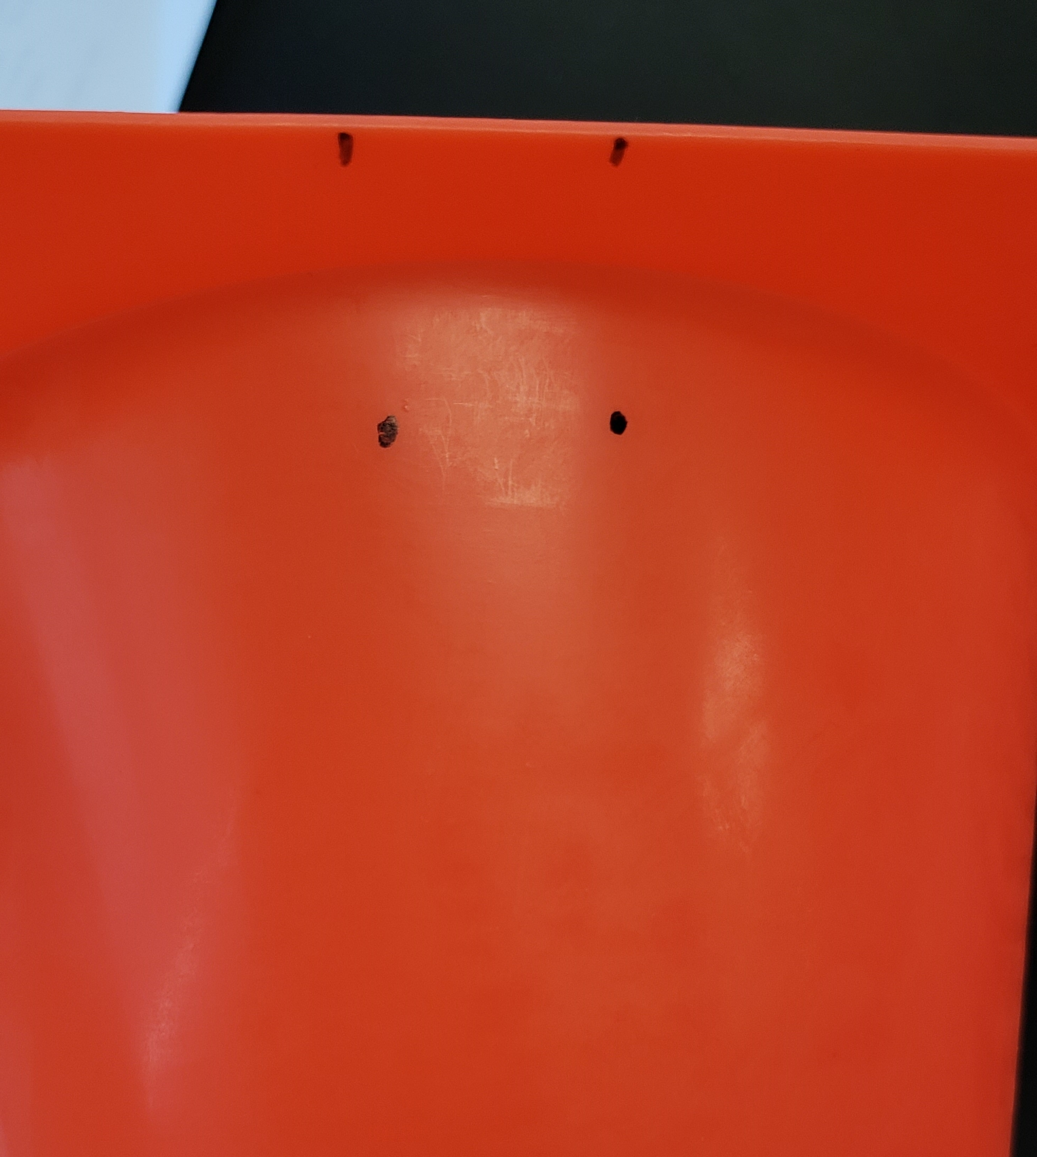
Water Displacement Apparatus
Option 1: Assemble Directions
2. Using a permanent marker and a ruler make two more dots under the the lip of the traffic cone perpendicular with the two original dots **Repeat on opposite side of cone.**
Photos should be a
square like this.
#6091ba
#9fcc3b
#8d64aa
#f8a81b

Slide 4
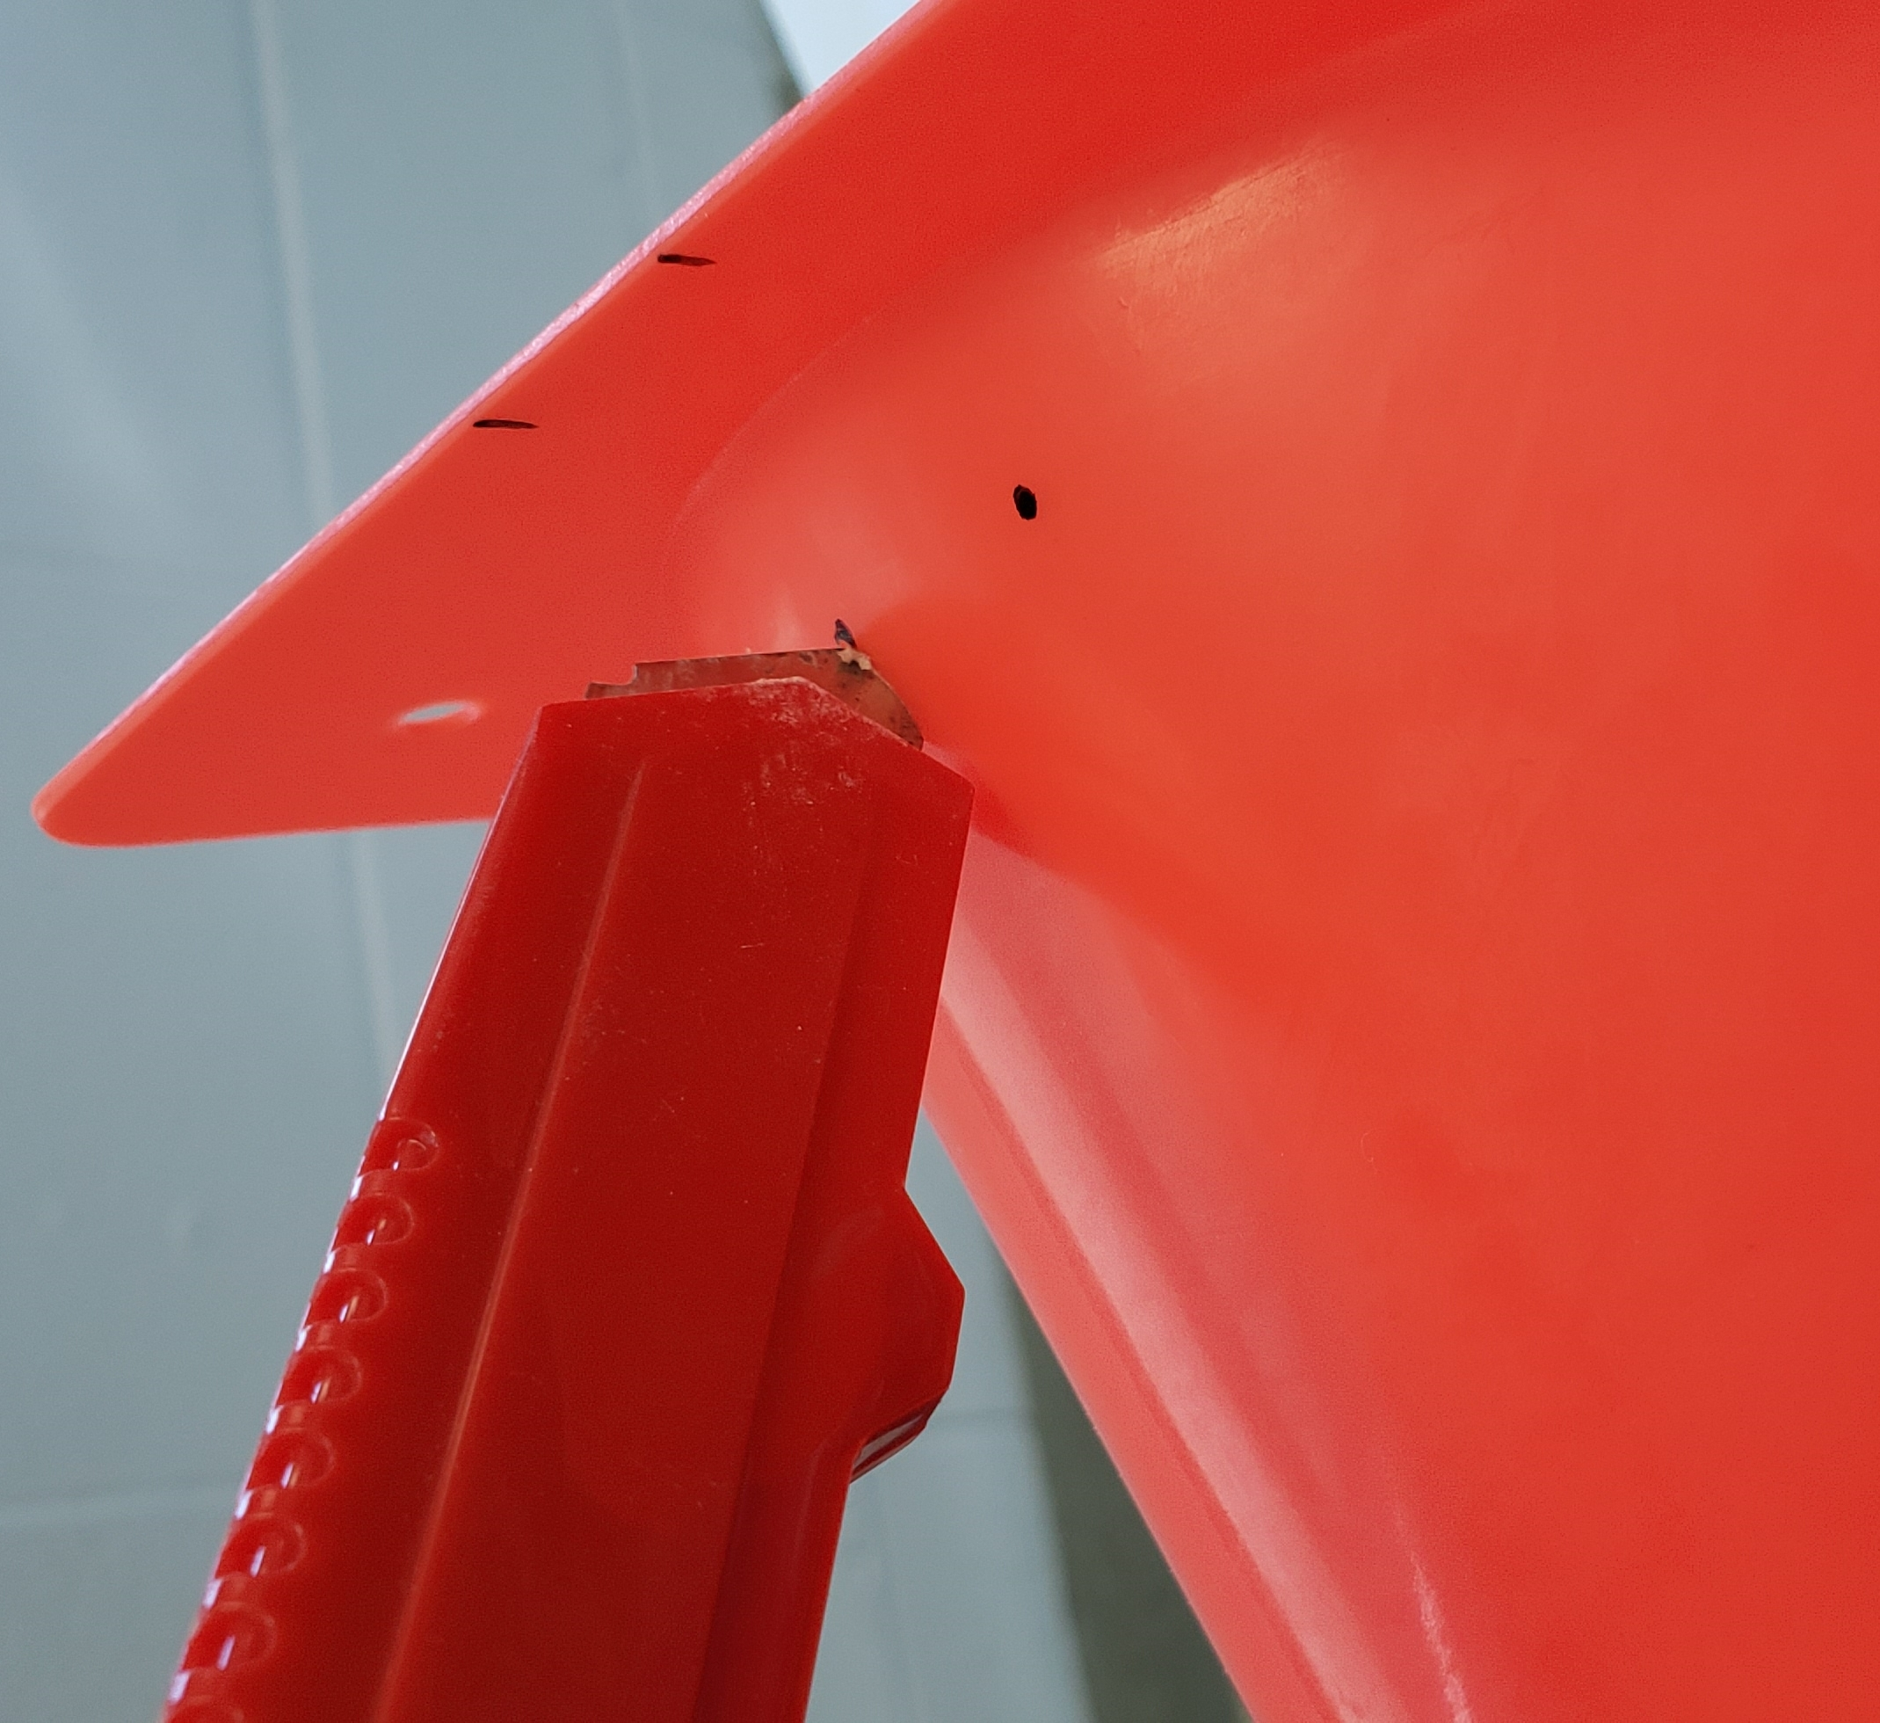
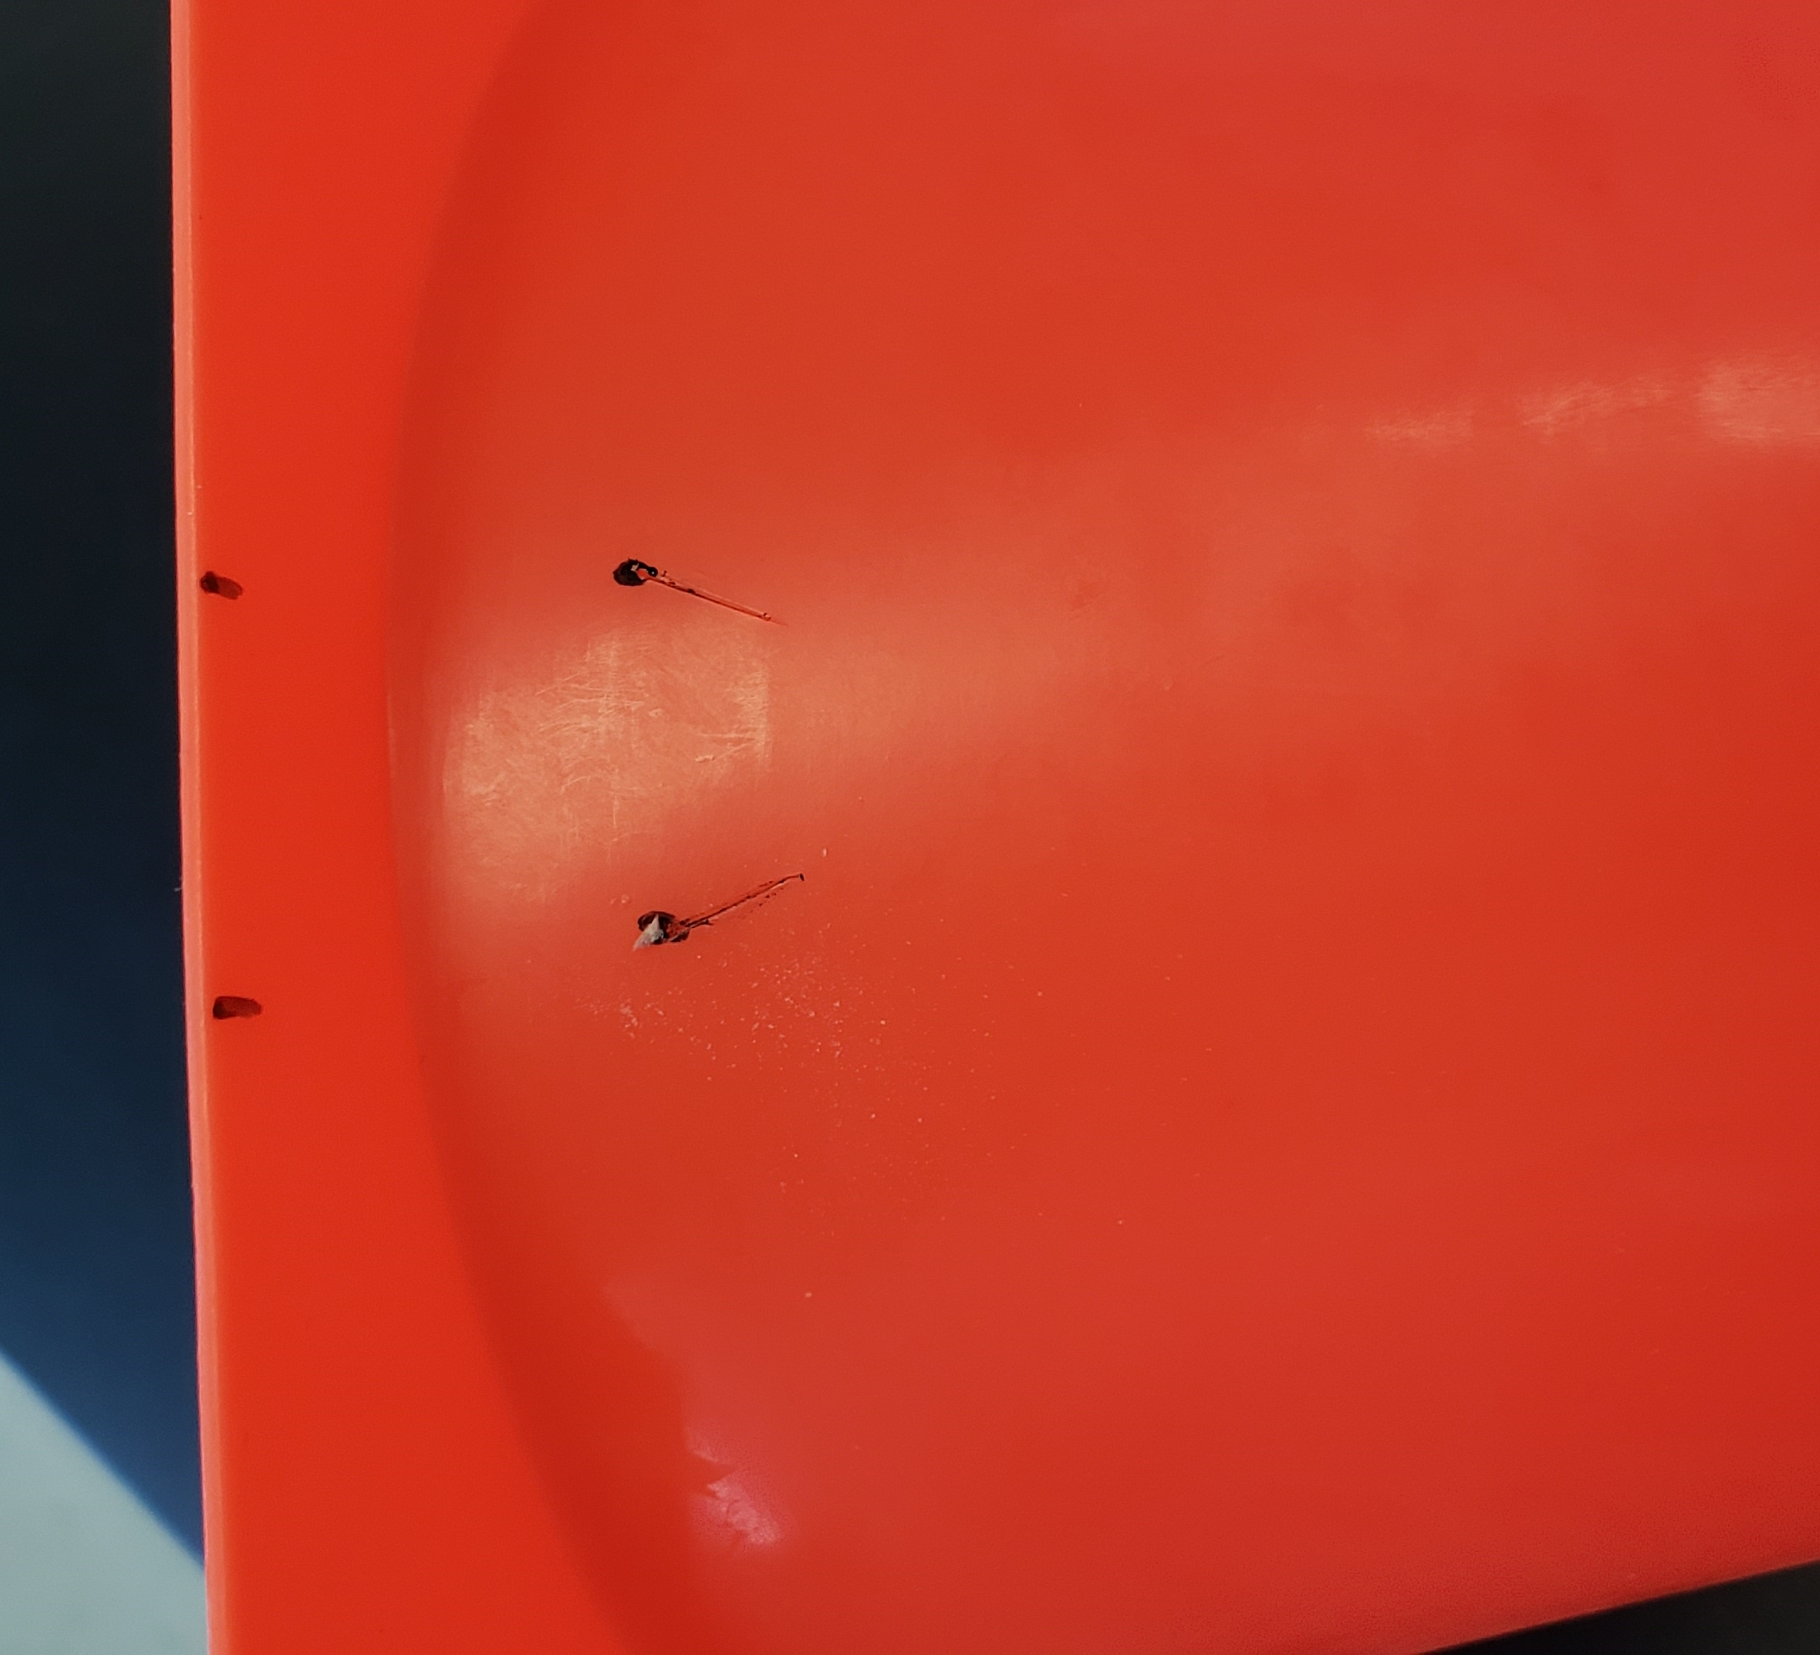
Water Displacement Apparatus
Option 1: Assemble Directions
3. Using the knife make an angled cut an ~0.5 cm in length over each bottom dot. **Repeat on opposite side of cone.**
Photos should be a
square like this.
#6091ba
#9fcc3b
#8d64aa
#f8a81b

Slide 5
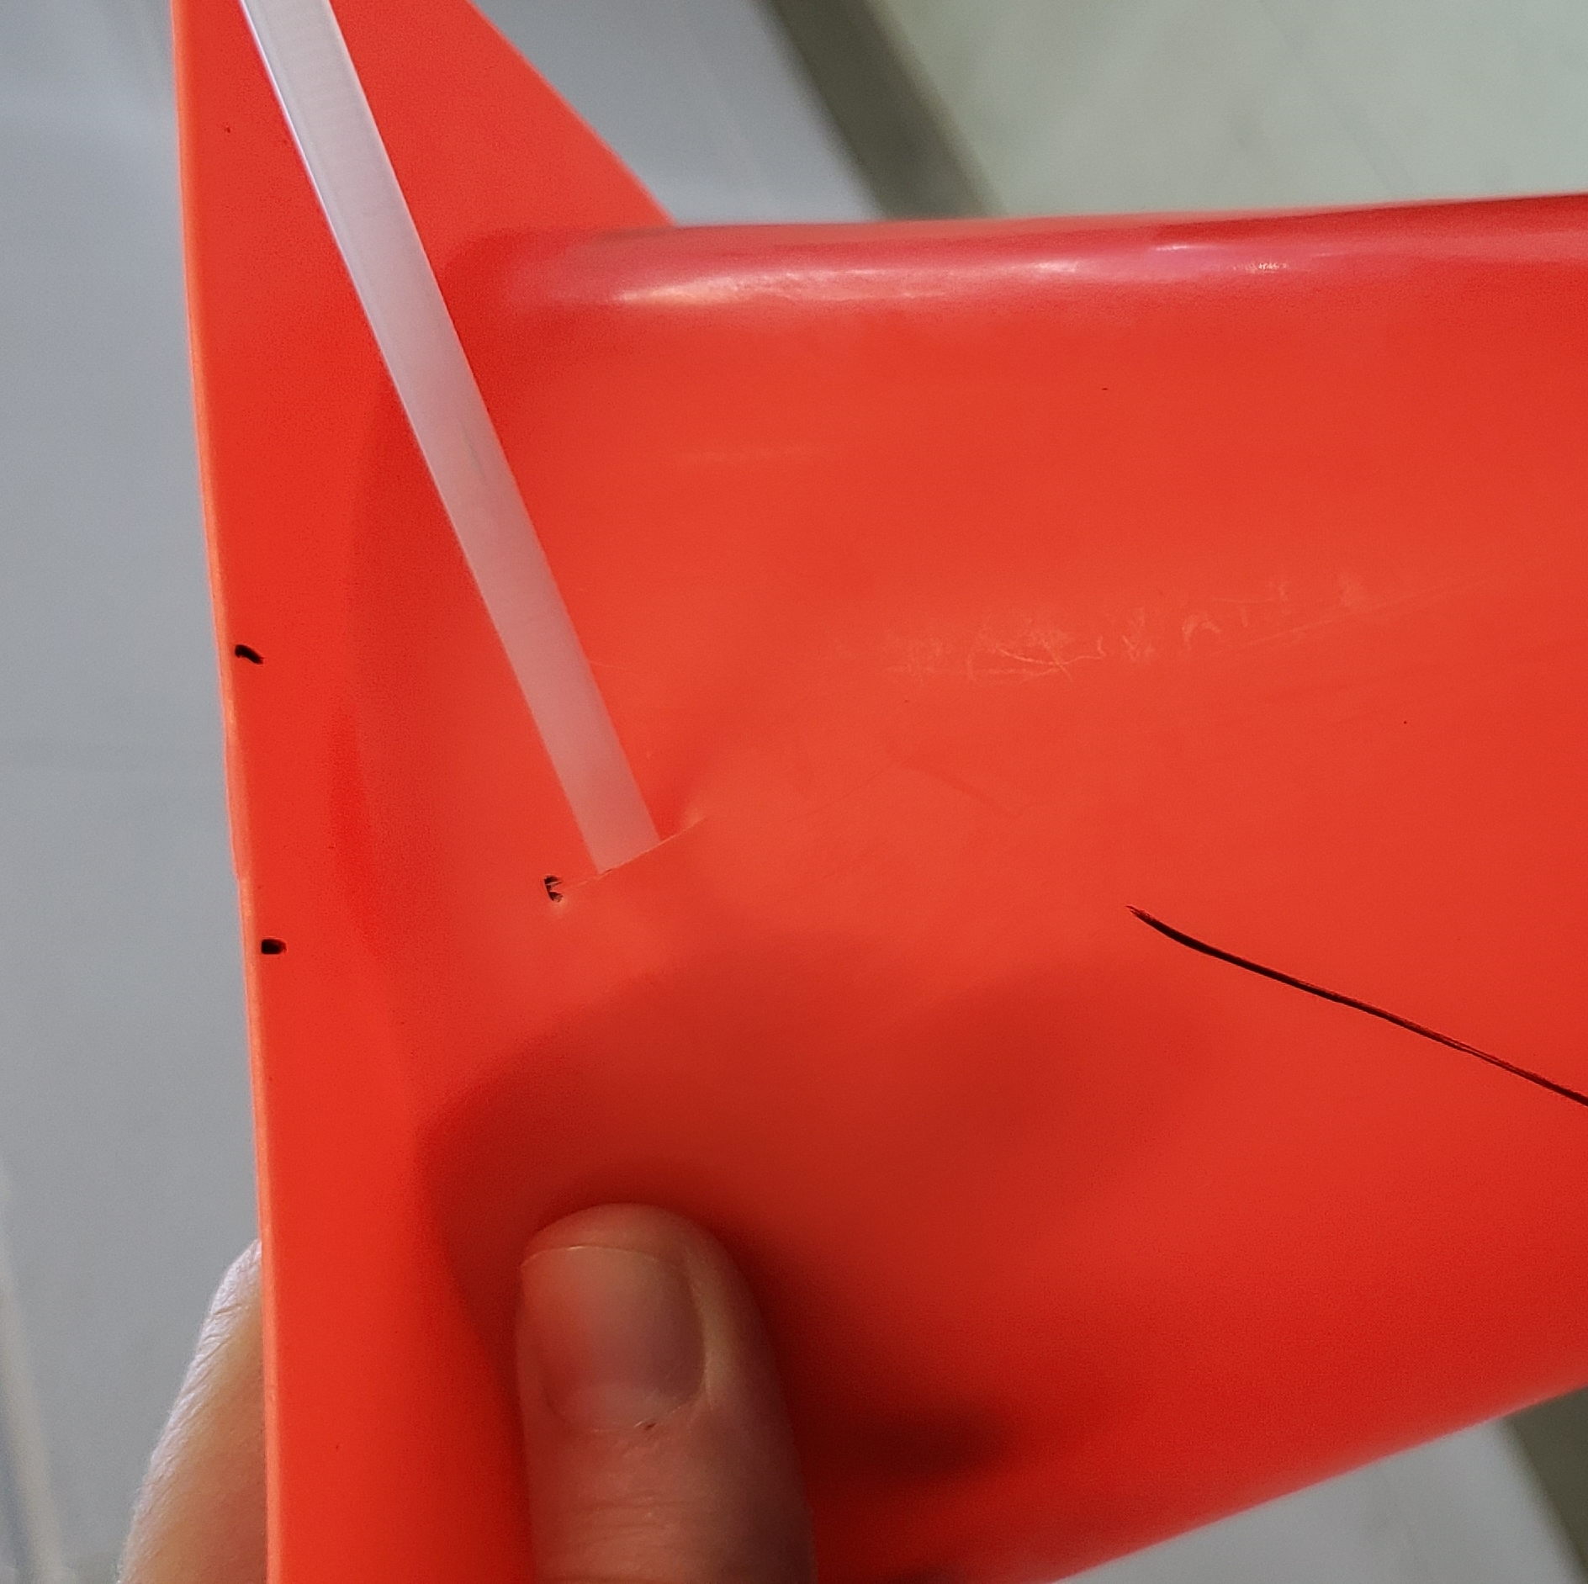
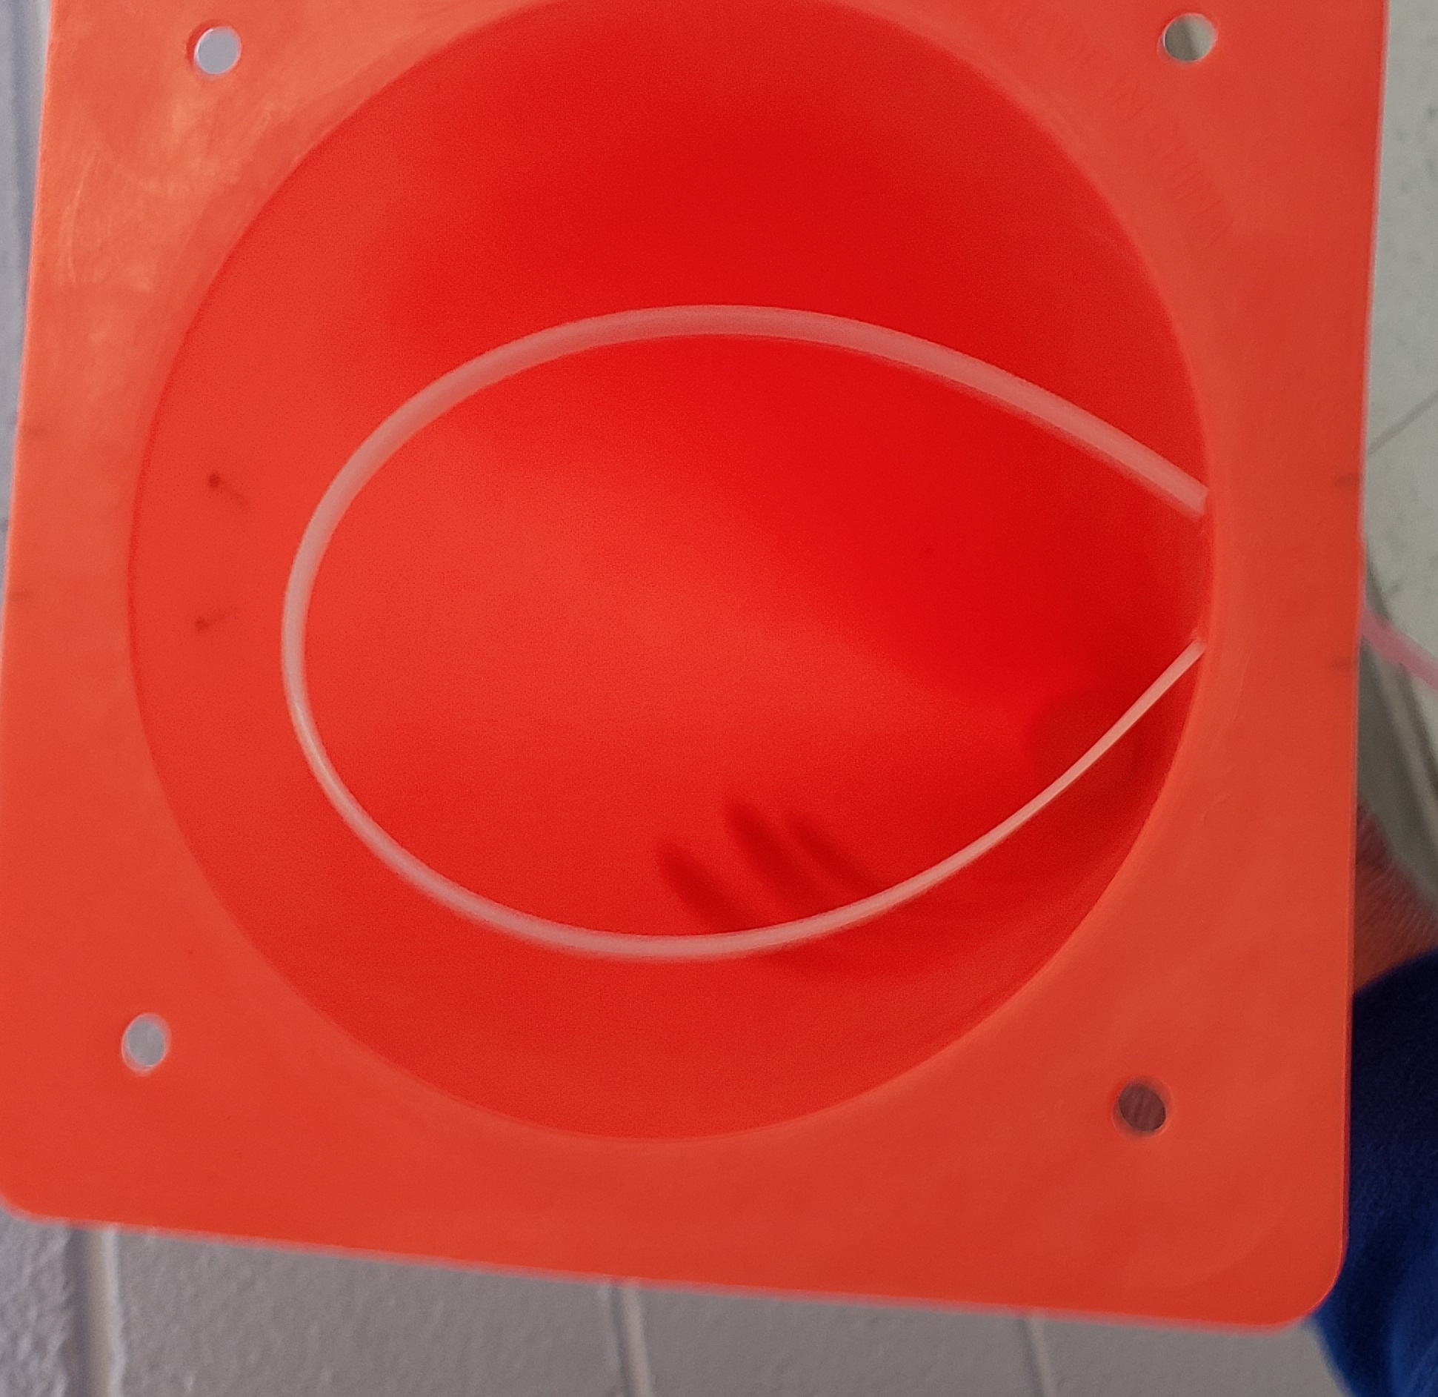
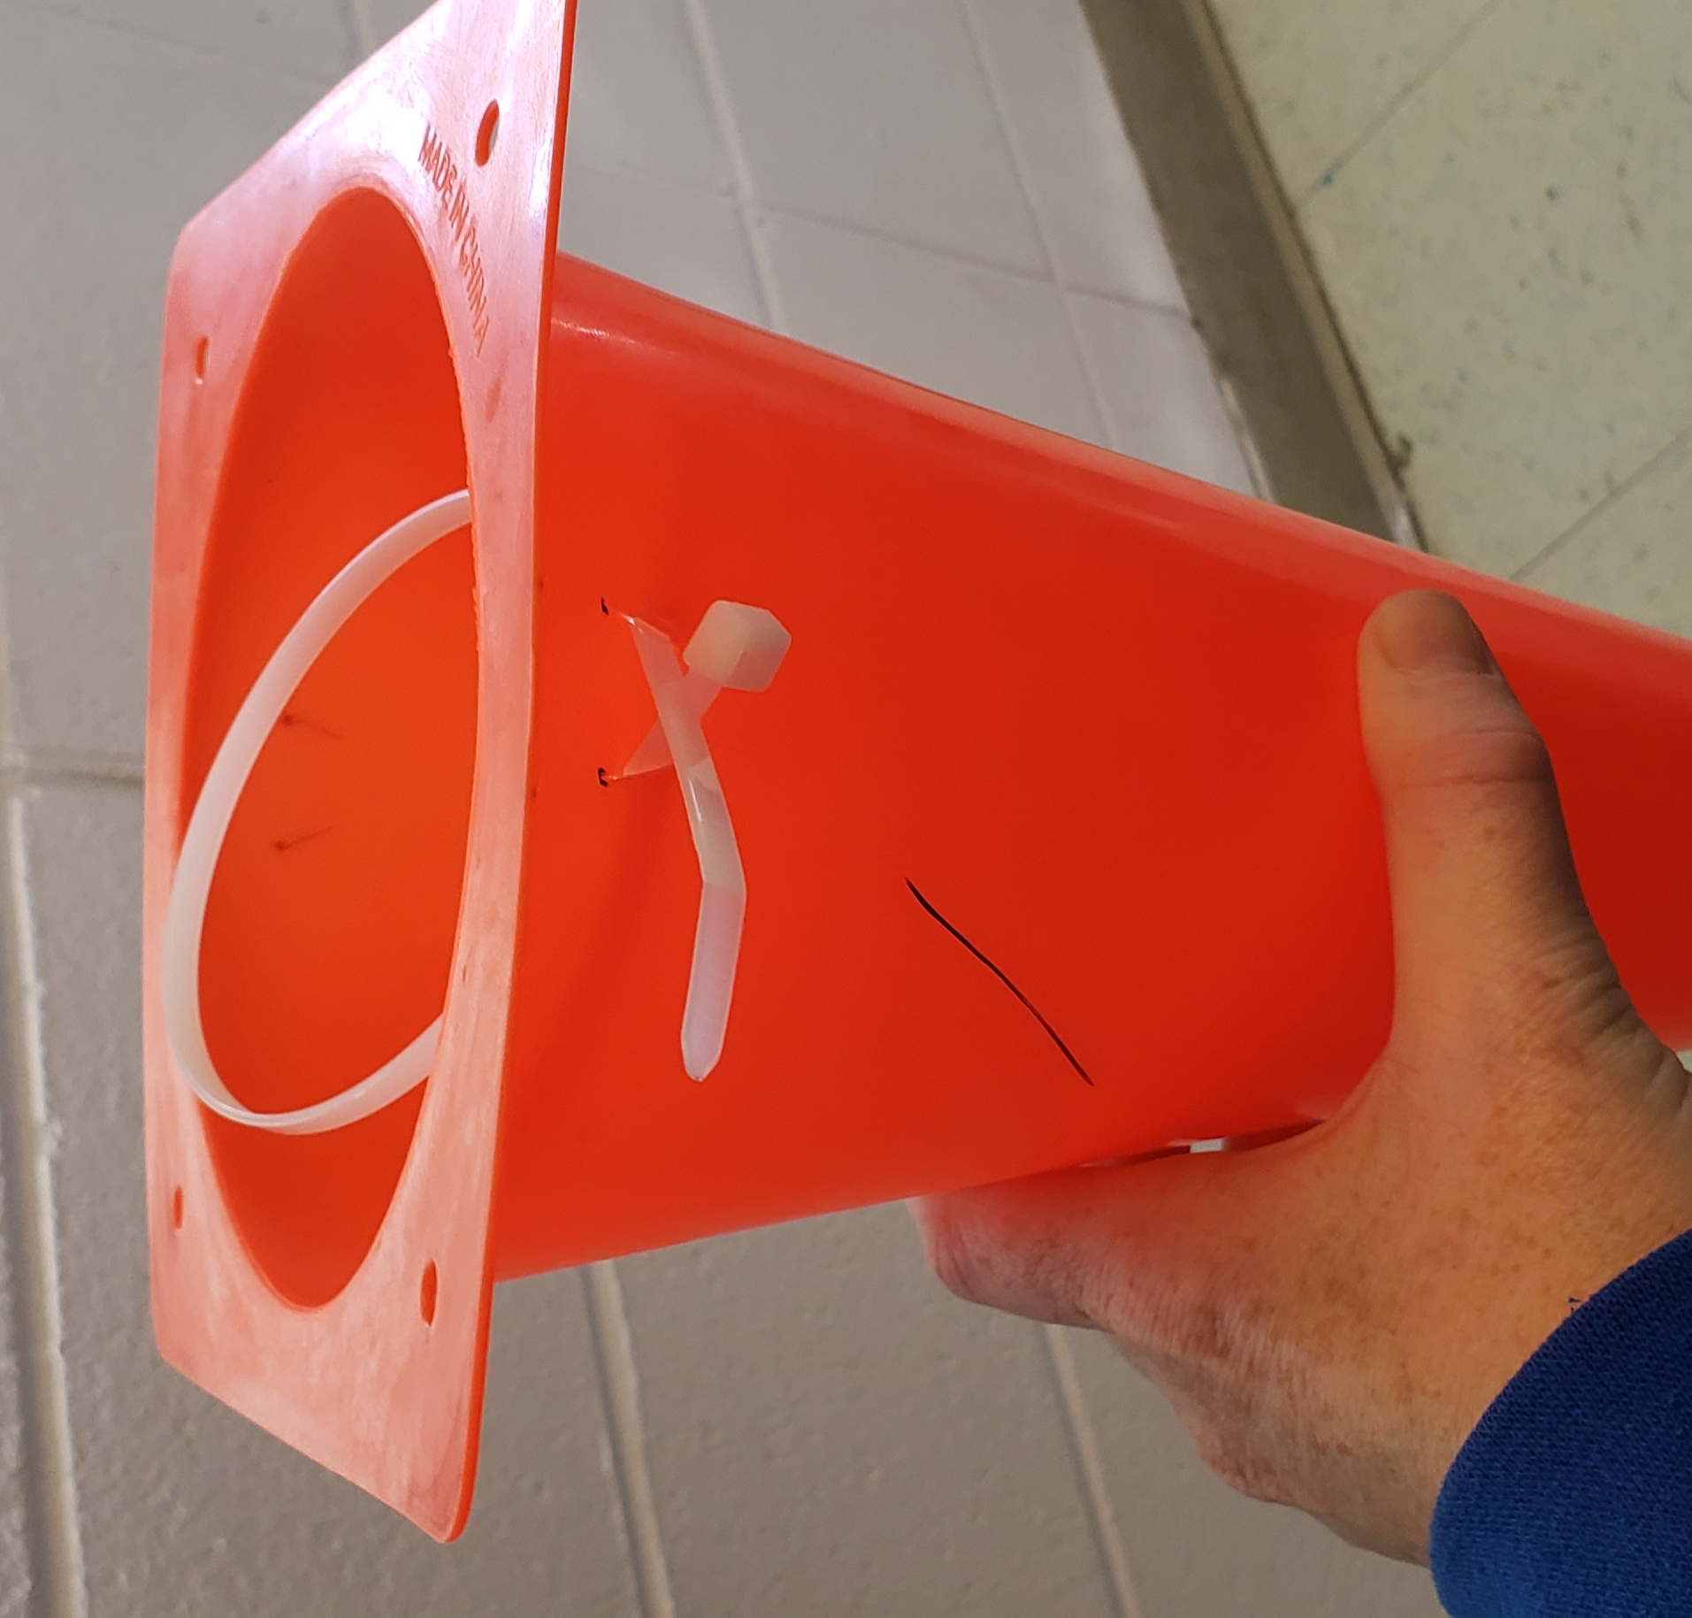
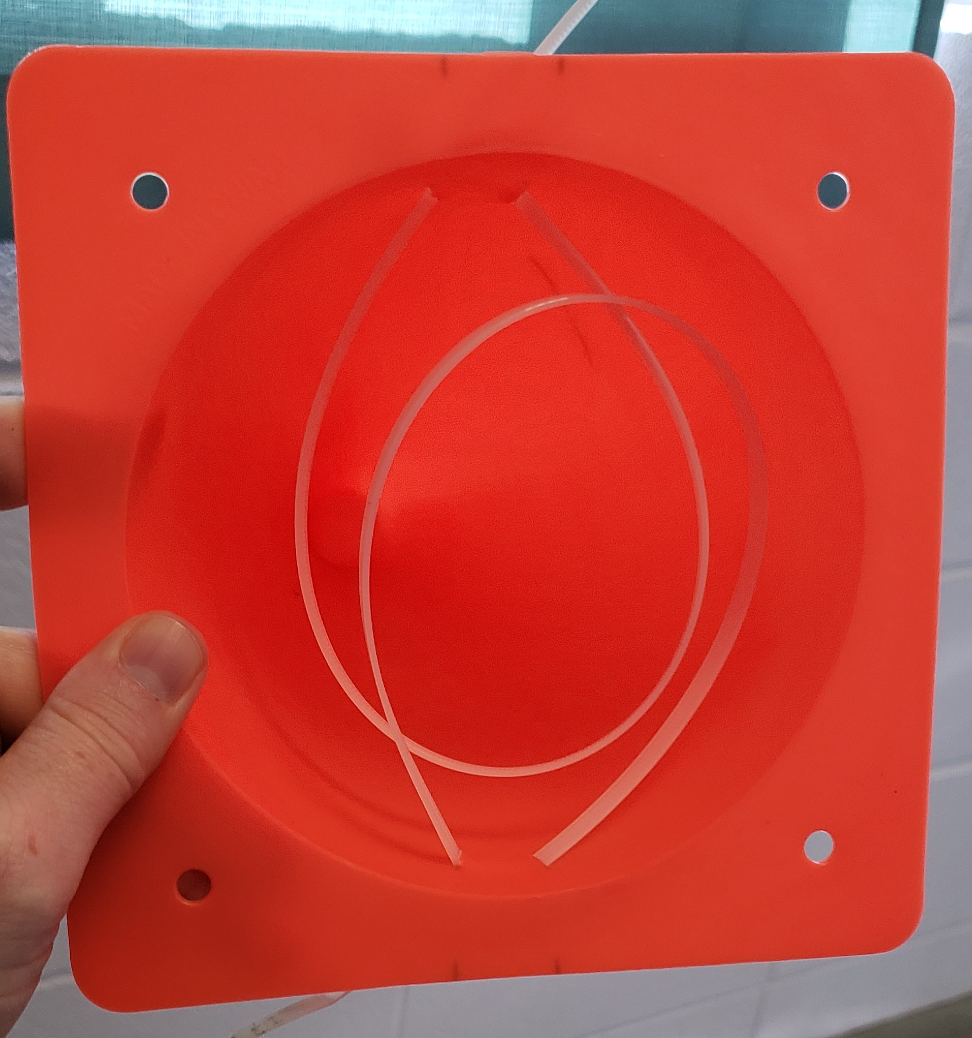
Water Displacement Apparatus
Option 1: Assemble Directions
4. Slide one of the zip ties through one diagonal cut to the back end of the opposite cut on the SAME side. Creating a hoop on the inside of the cone. DO NOT PULL THE zip tie through the securement yet. **Repeat on the opposite side of the cone.**
Photos should be a
square like this.
#8d64aa
#f8a81b

Slide 6
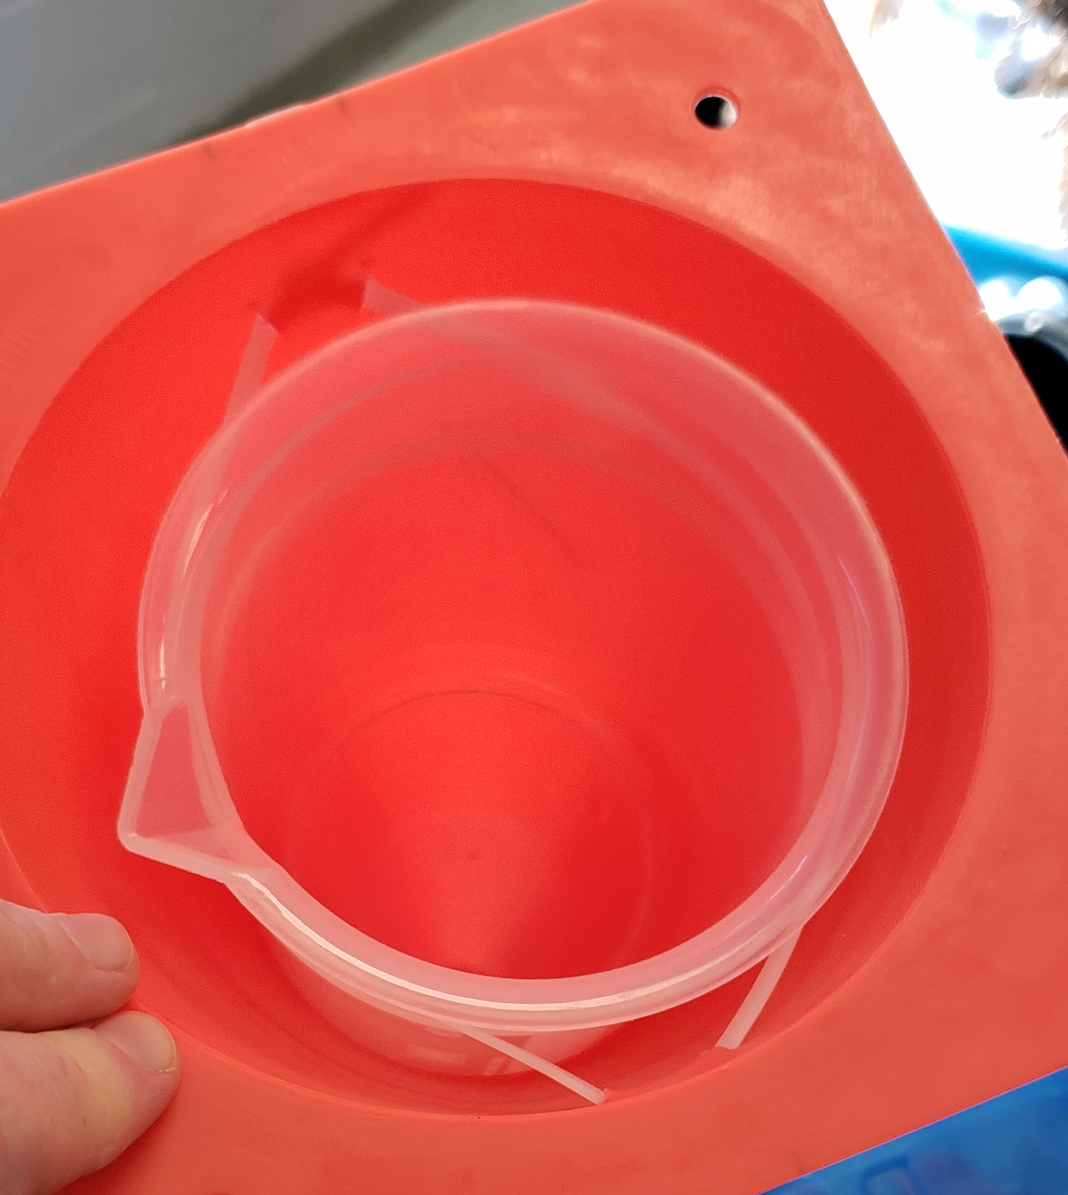
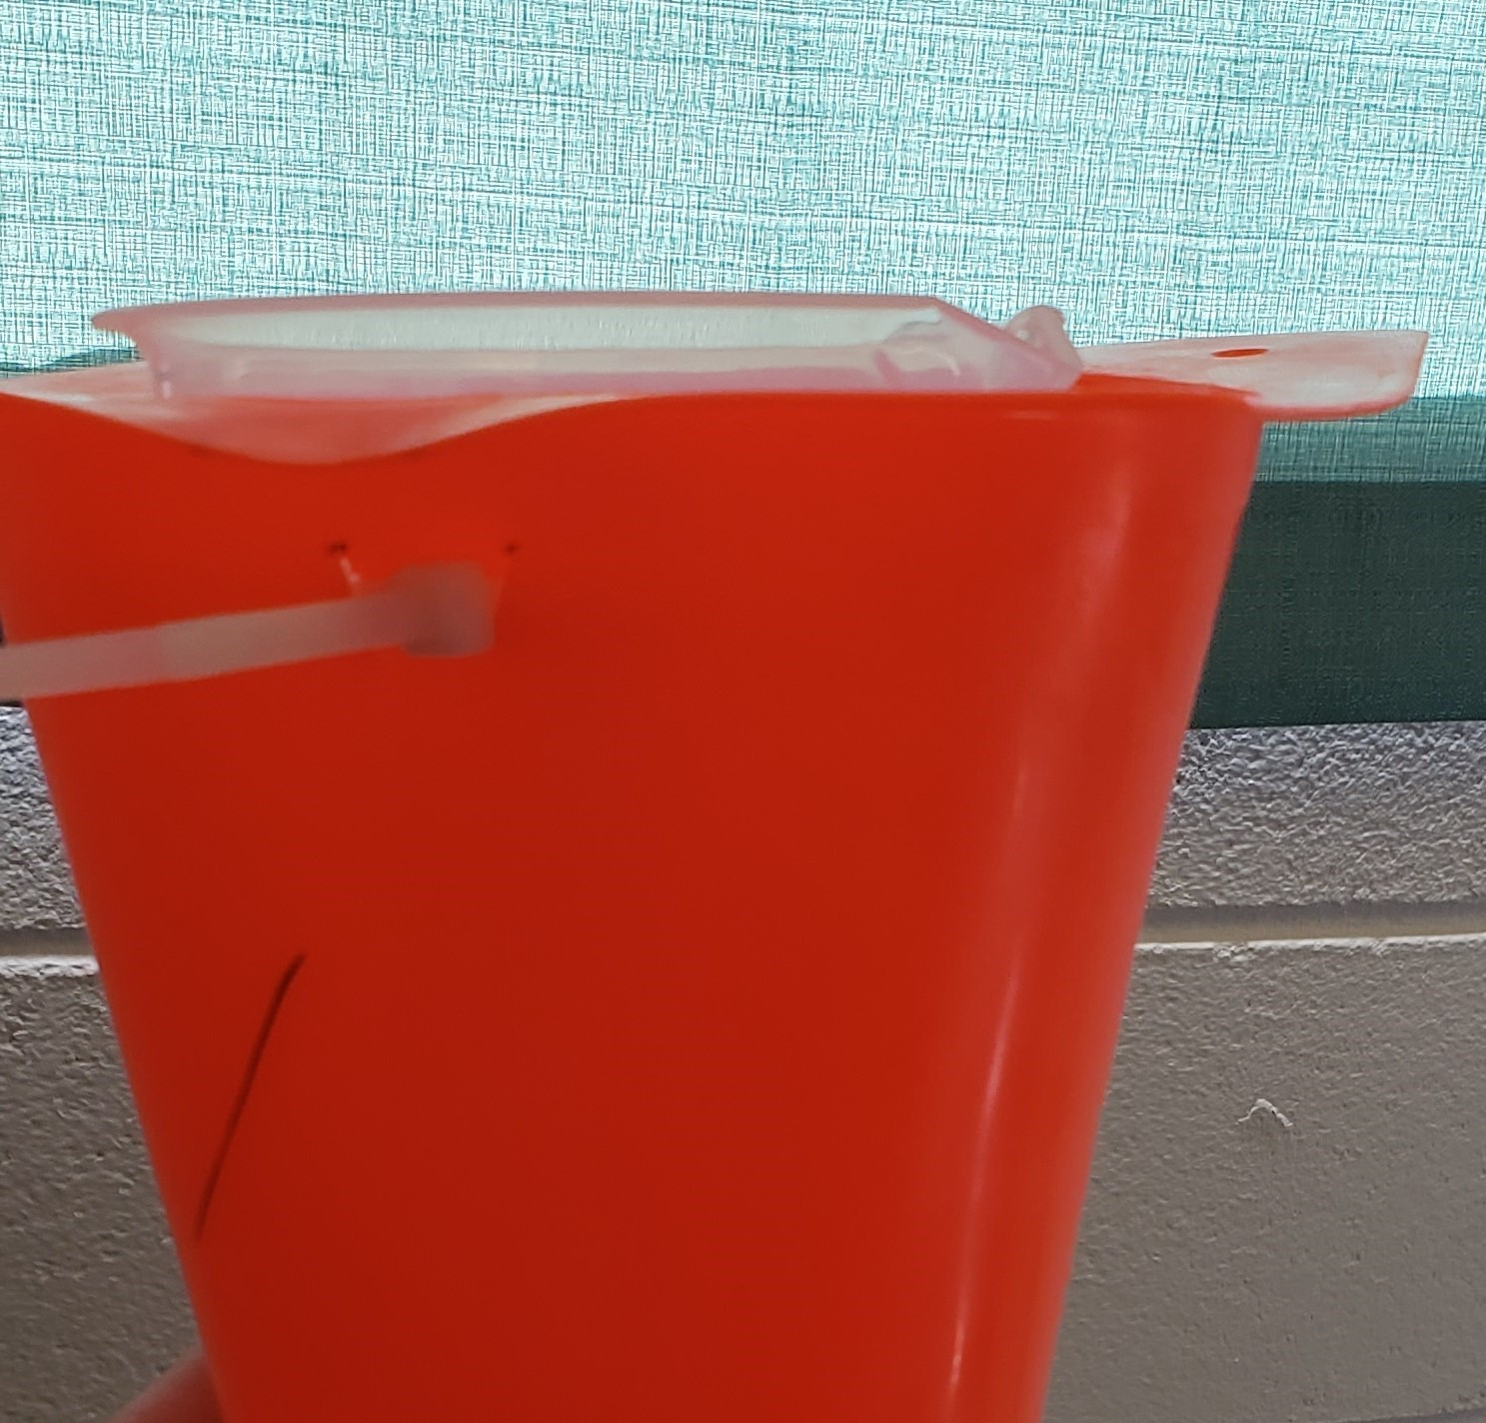
Water Displacement Apparatus
Option 1: Assemble Directions
5. Place the plastic beaker in the hoops in the center of the cone, and pull the zip ties tight on both sides, so the beakeris held in place inside the cone. **It is ok if the beaker can come out of the hoops, you just do not want it to fall through inside the cone.**
Photos should be a
square like this.
#f8a81b

Slide 7
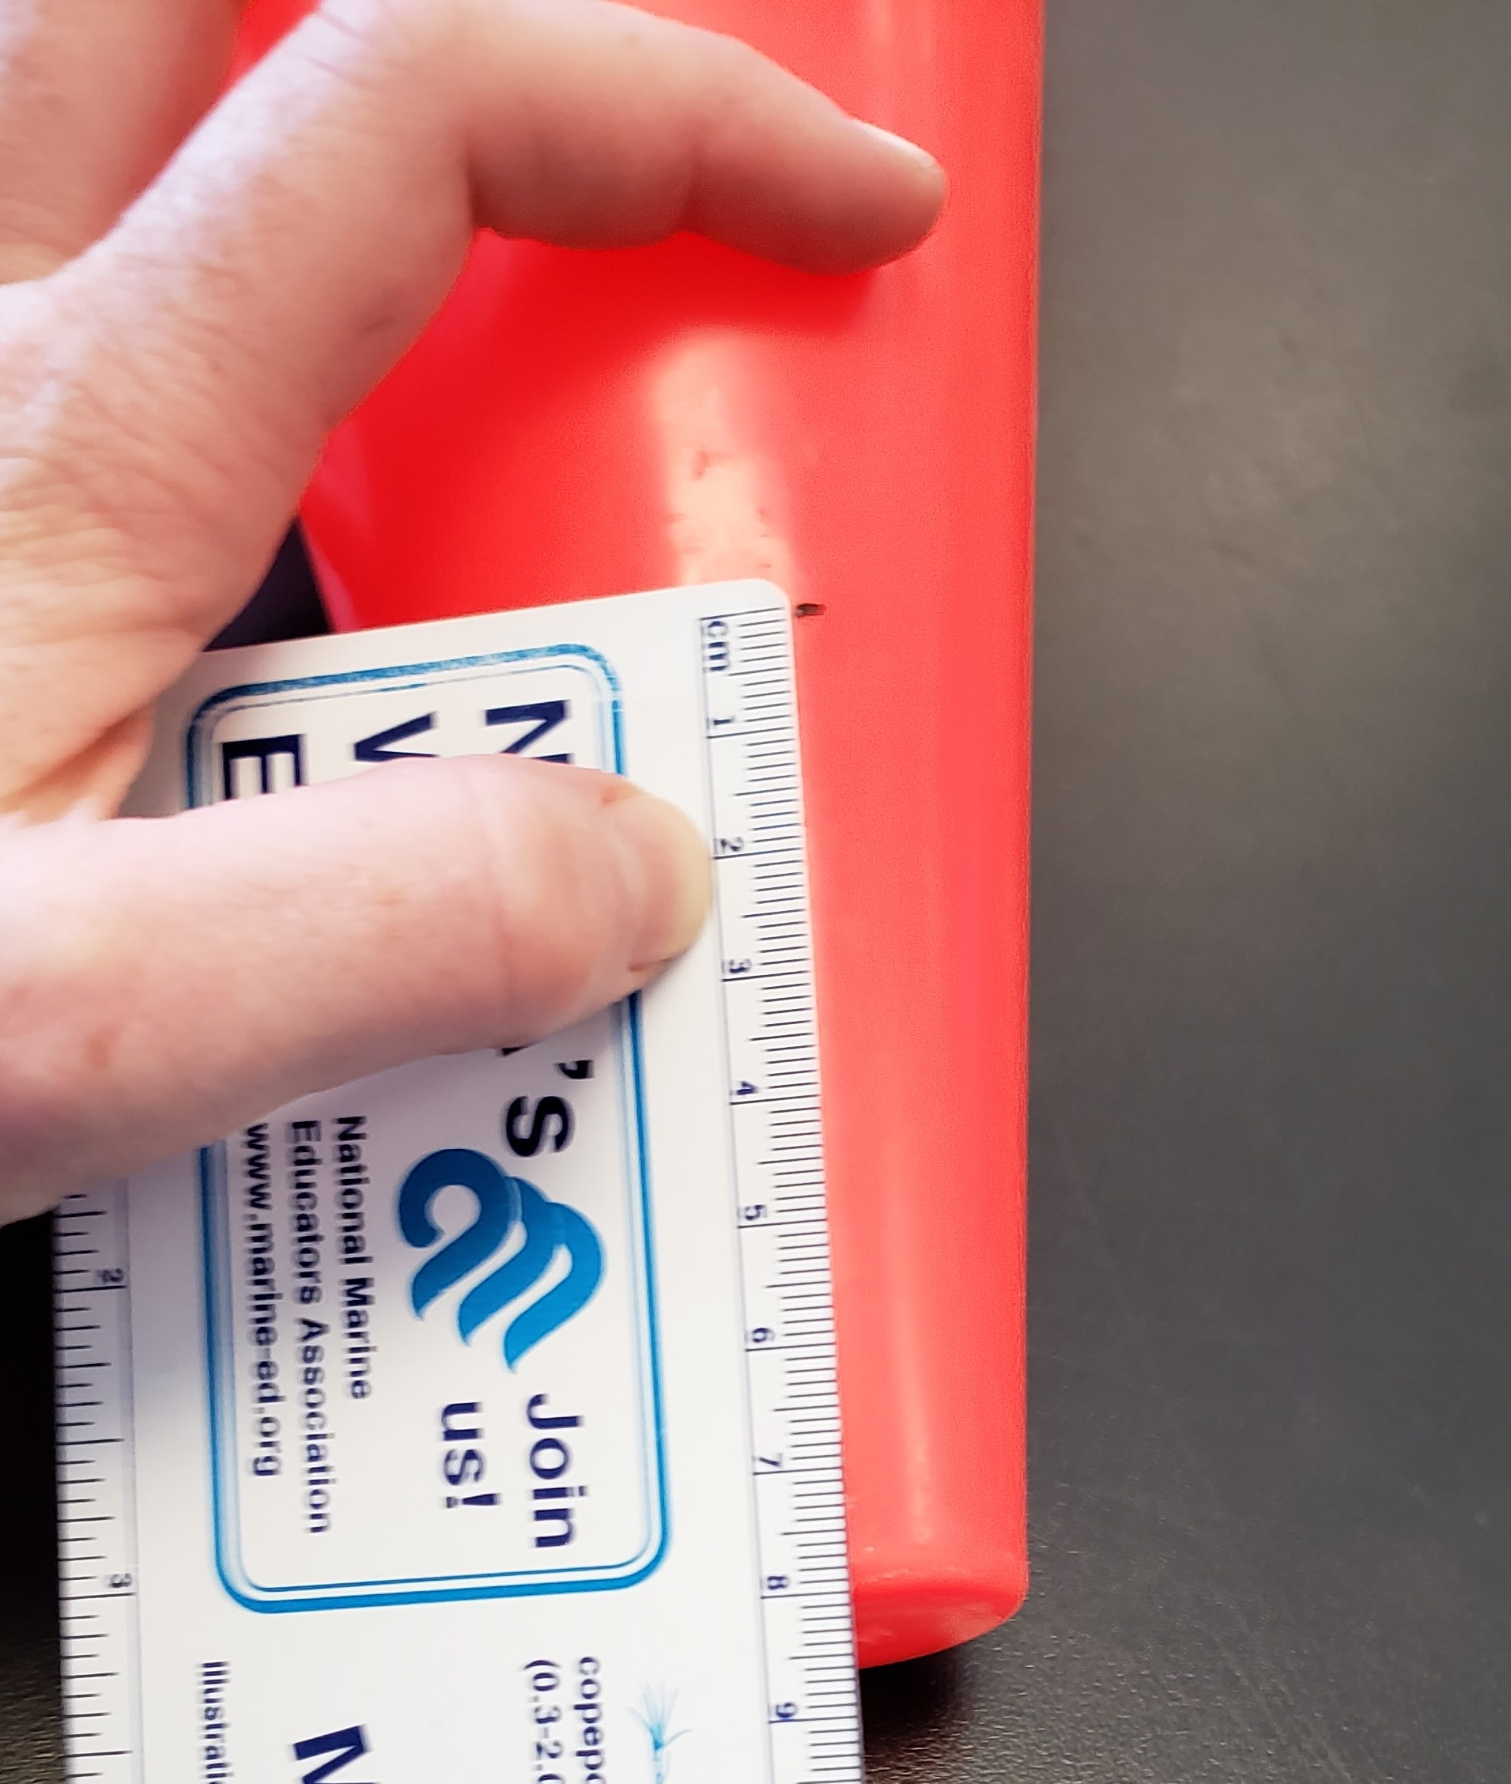
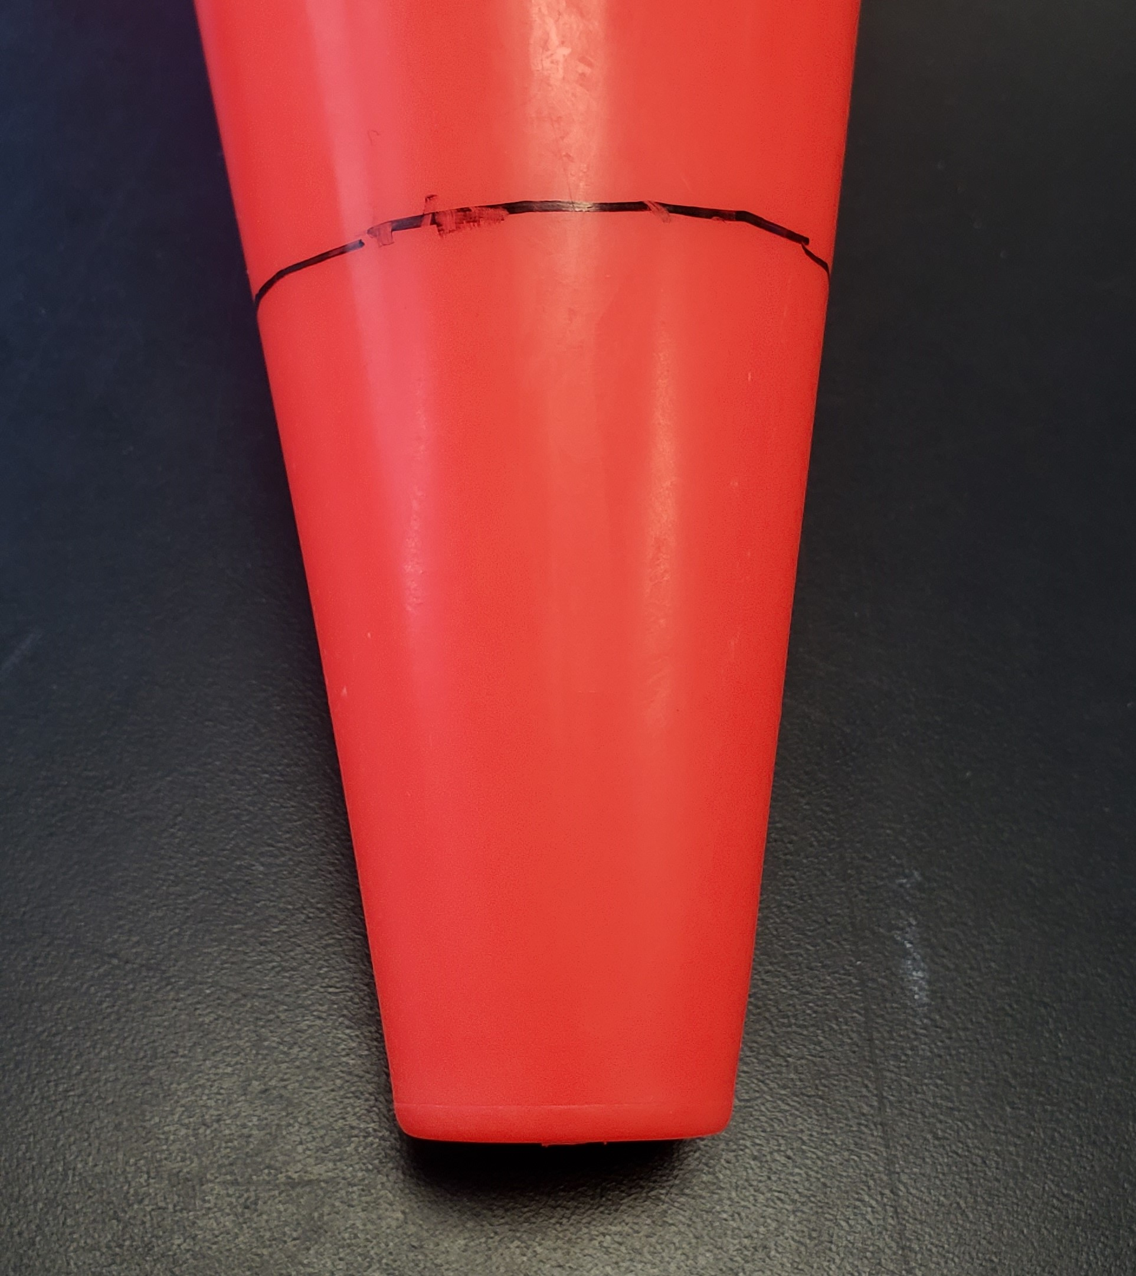
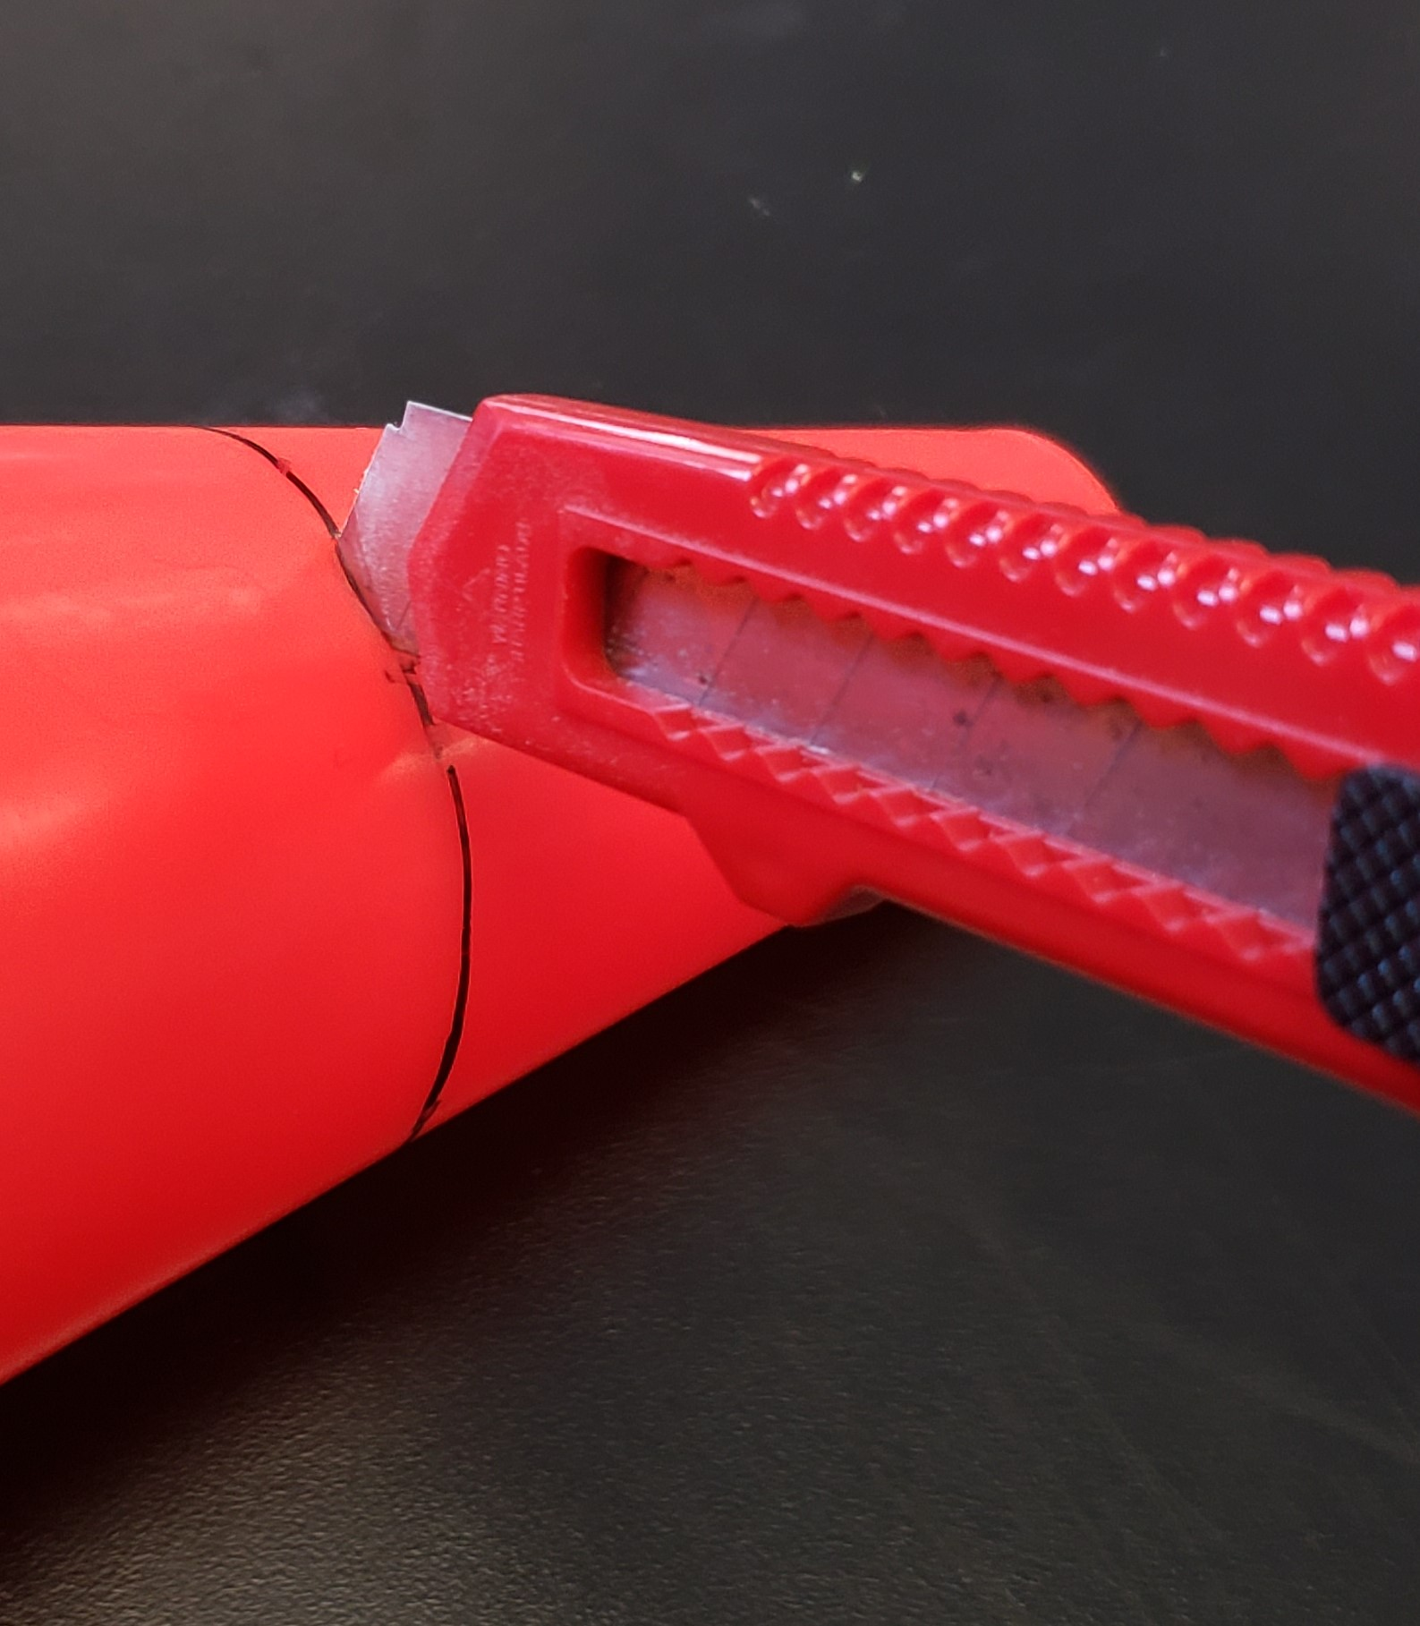
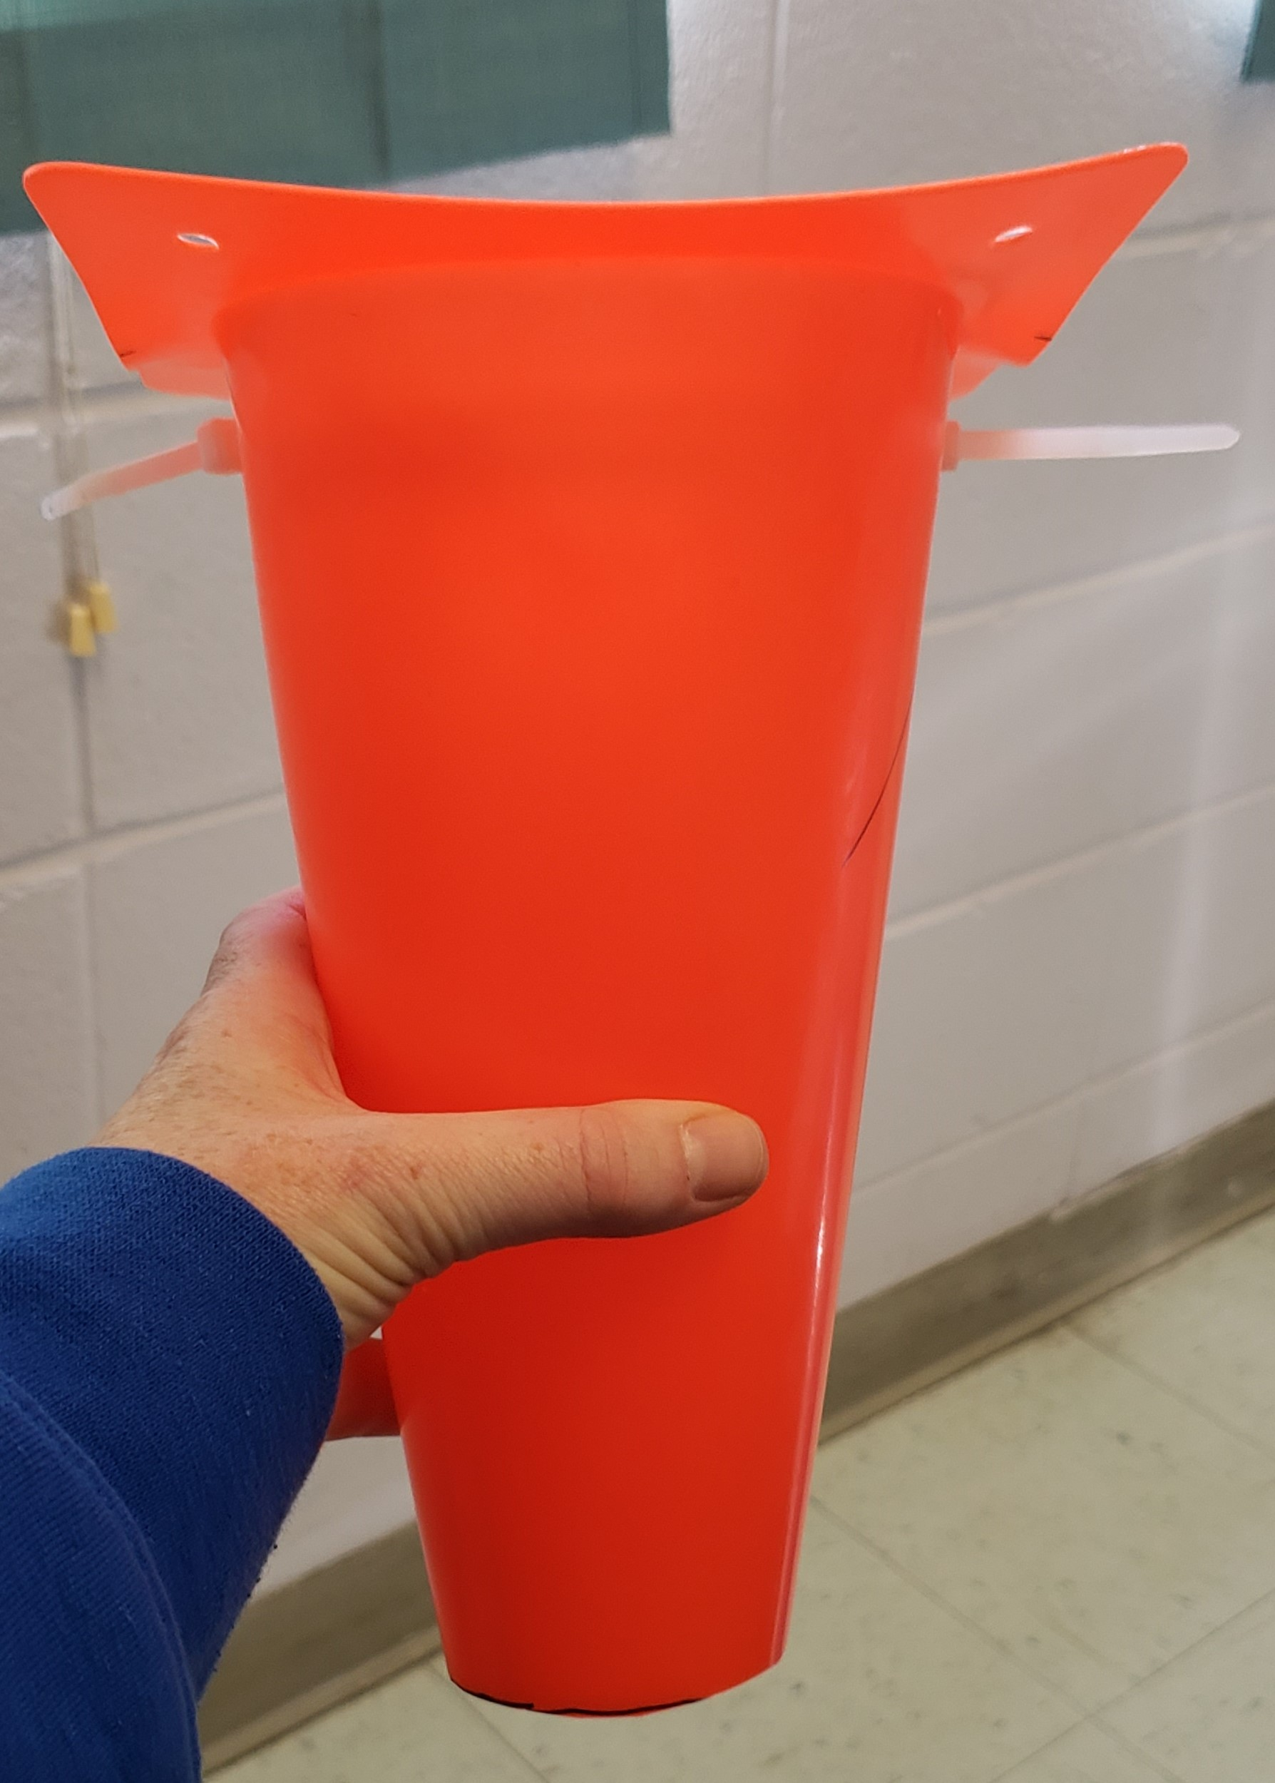
Water Displacement Apparatus
Option 1: Assemble Directions
6. From the tip of the cone mark a dot at 8 cm from the end. Draw a line at this length around the circumference end of the cone. Use the knife to remove the enclosed end of the traffic cone.
#f8a81b

Slide 8
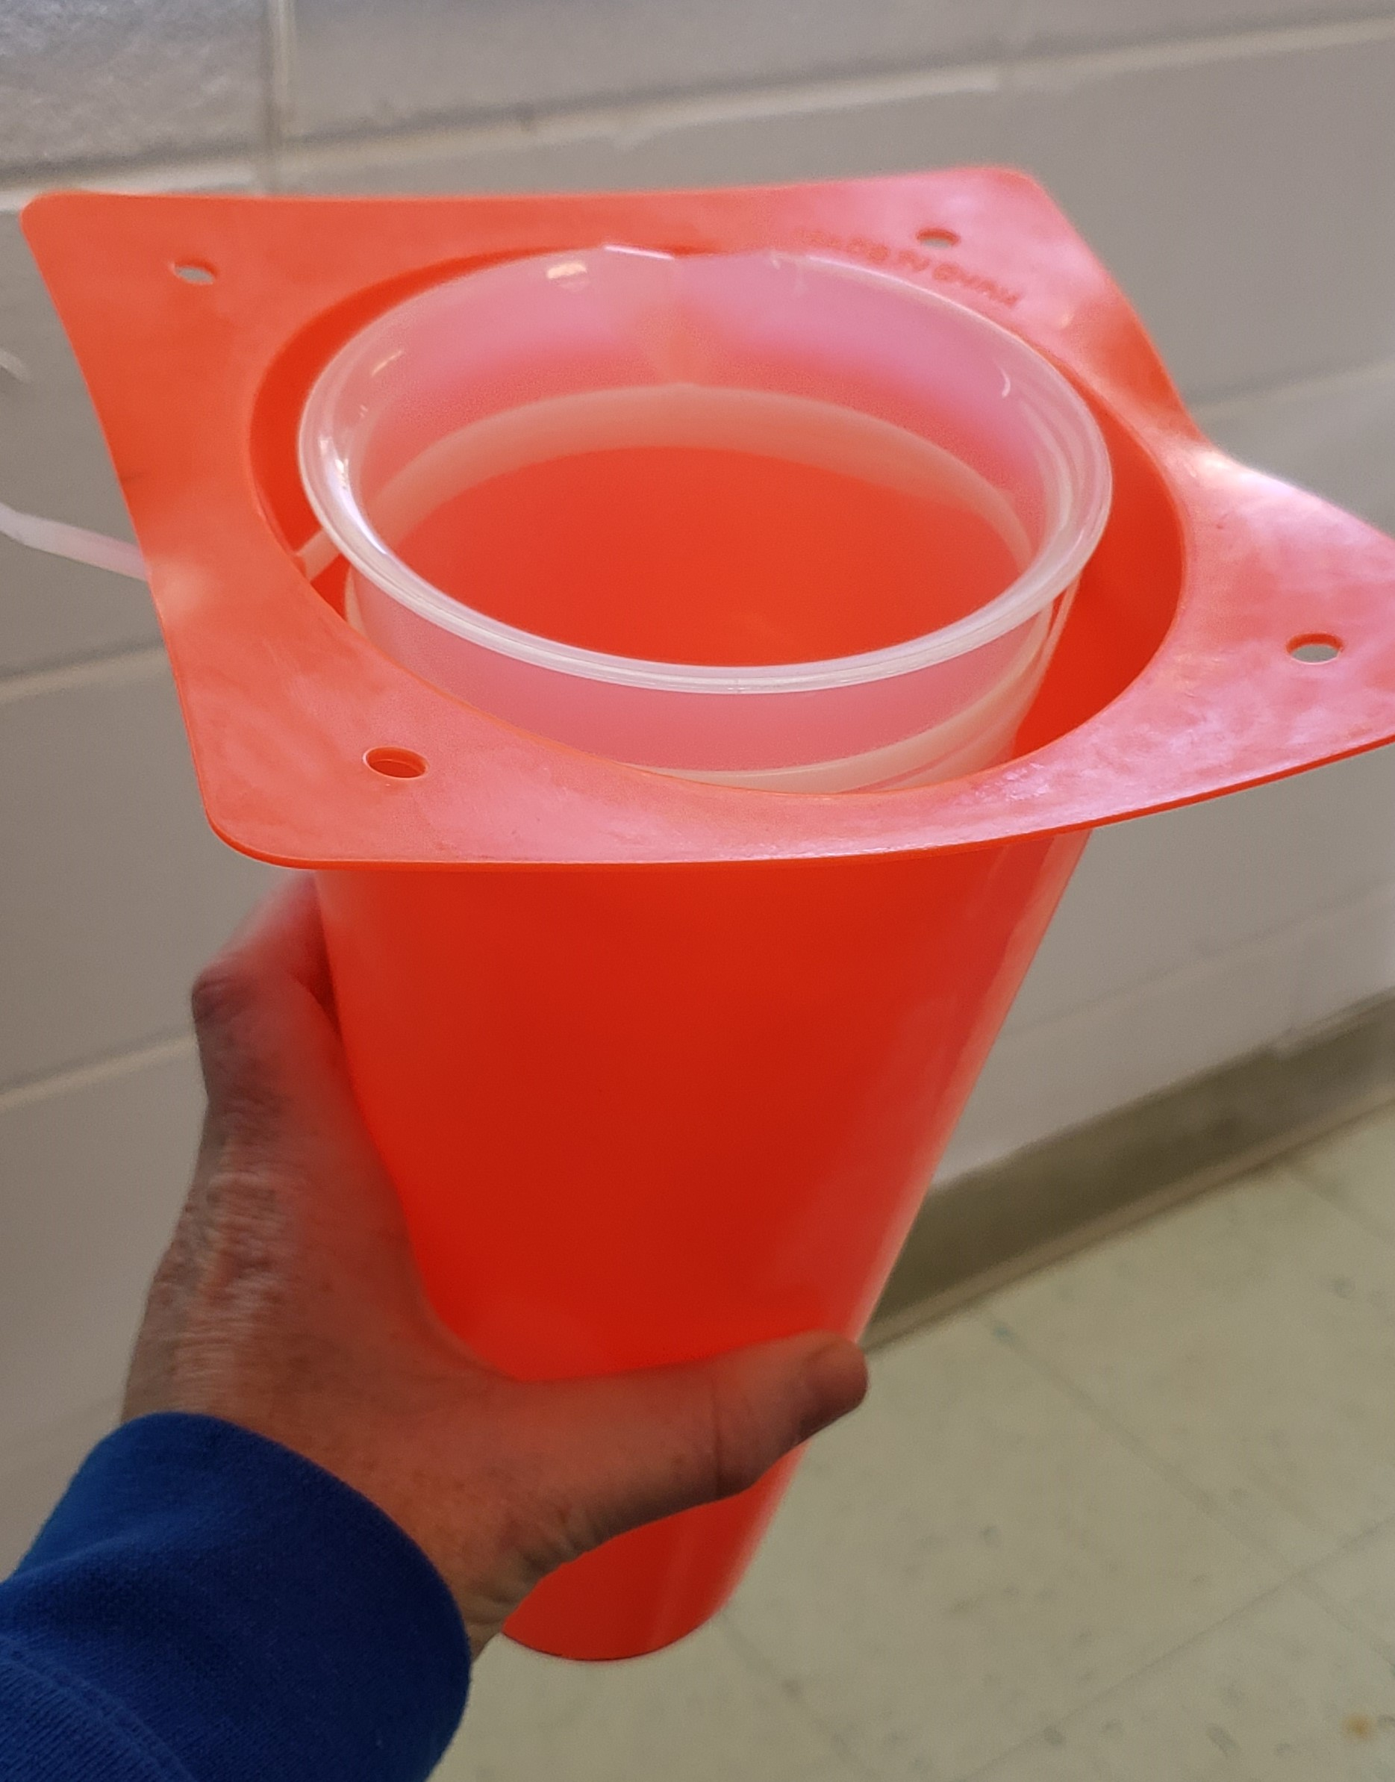
Water Displacement Apparatus
Option 1: Assemble Directions
COMPLETE!
#f8a81b

Slide 9
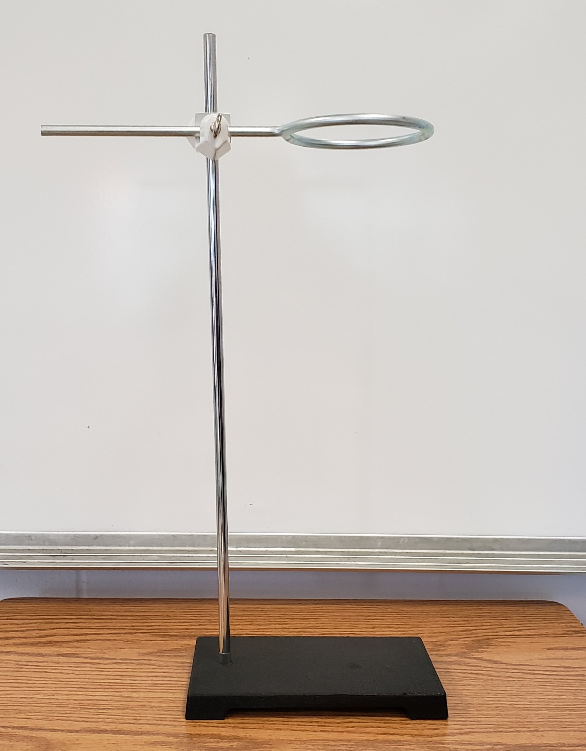
Water Displacement Apparatus
Option 1: Standard Operating Procedure 1. Set up your ring stand with clamp.
#f8a81b

Slide 10
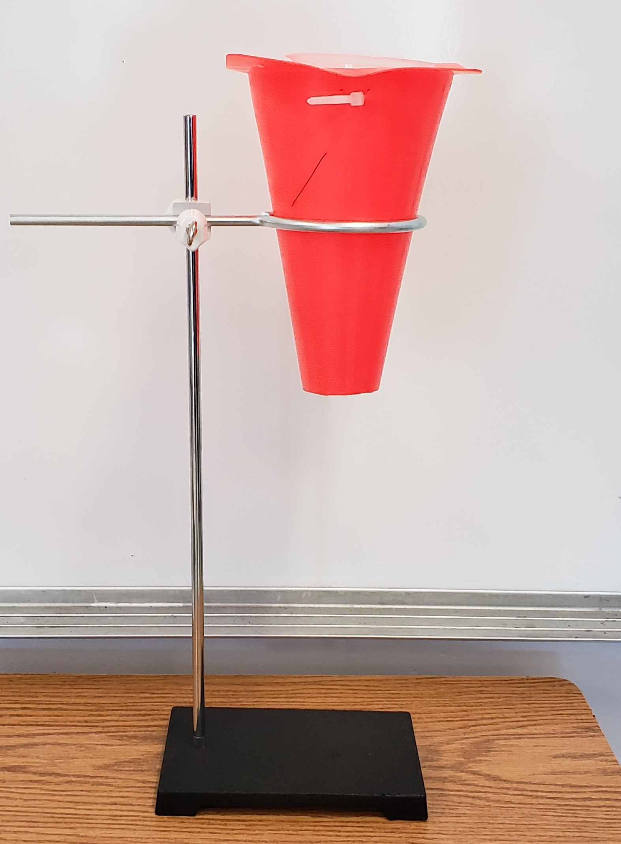
Water Displacement Apparatus
Option 1: Standard Operating Procedure 2. Place the traffic cone/zip tie/beaker set up inside the ring of the clamp.
#f8a81b

Slide 11
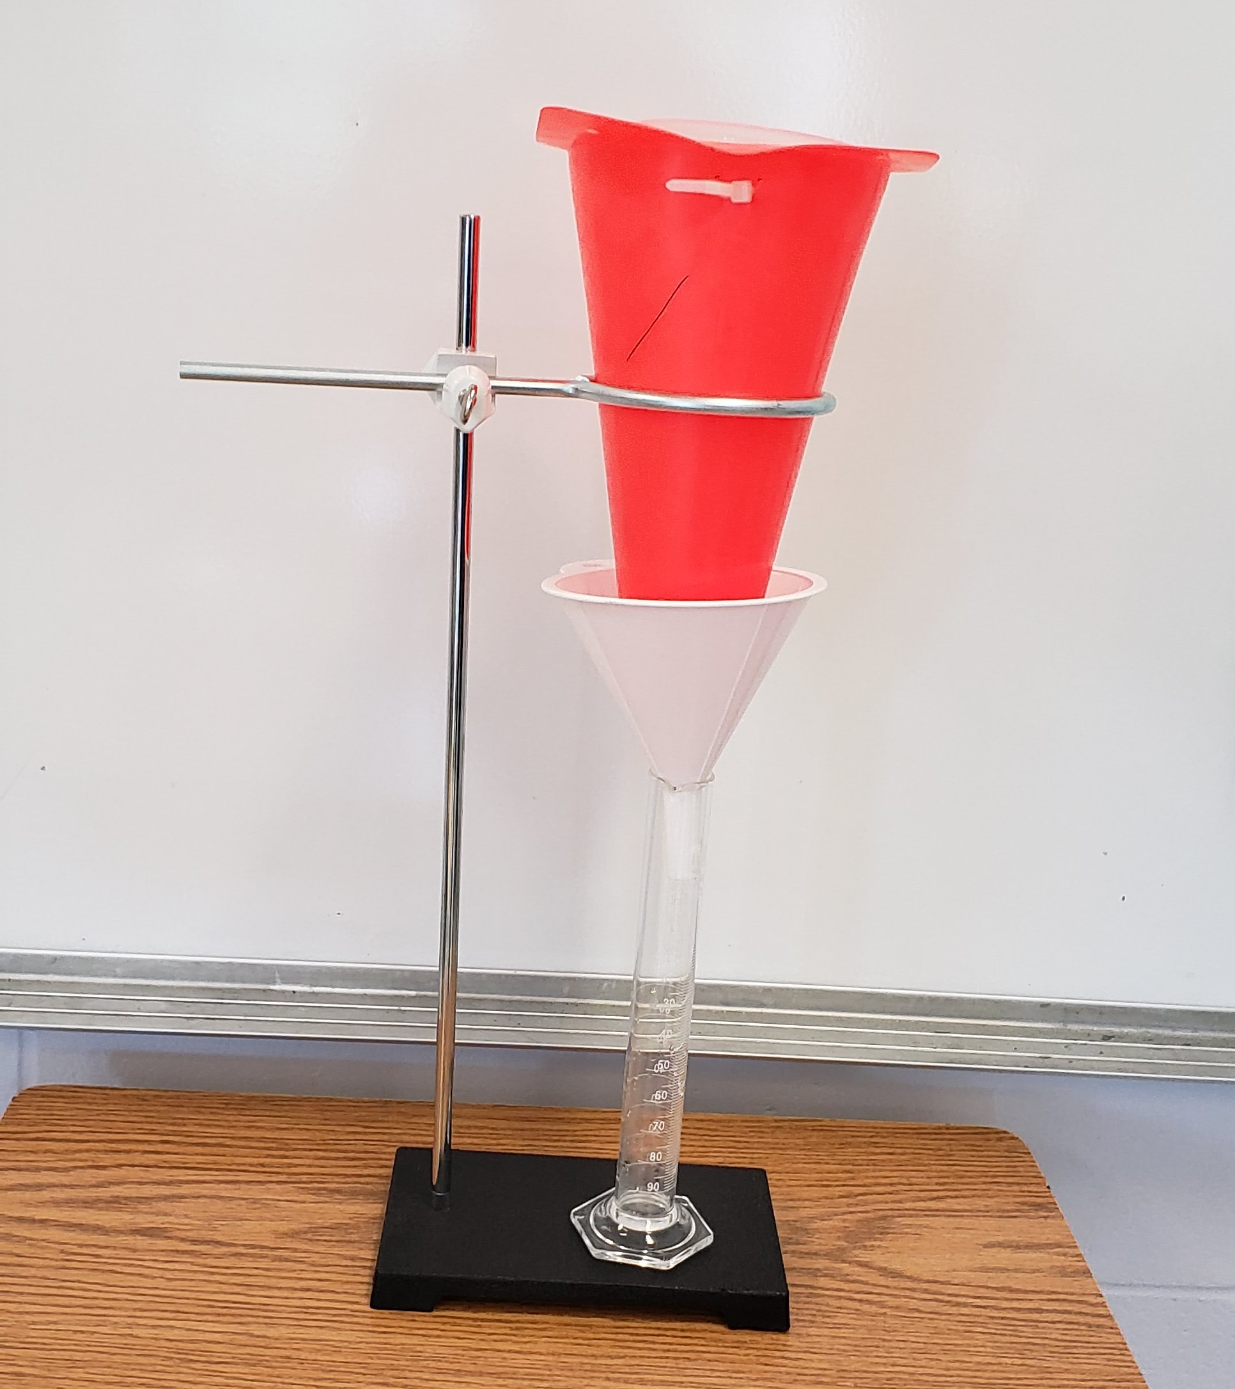
Water Displacement Apparatus
Option 2: Standard Operating Procedure 3. Place a funnel and 100mL graduated cylinder under the traffic cone.
#f8a81b

Slide 12
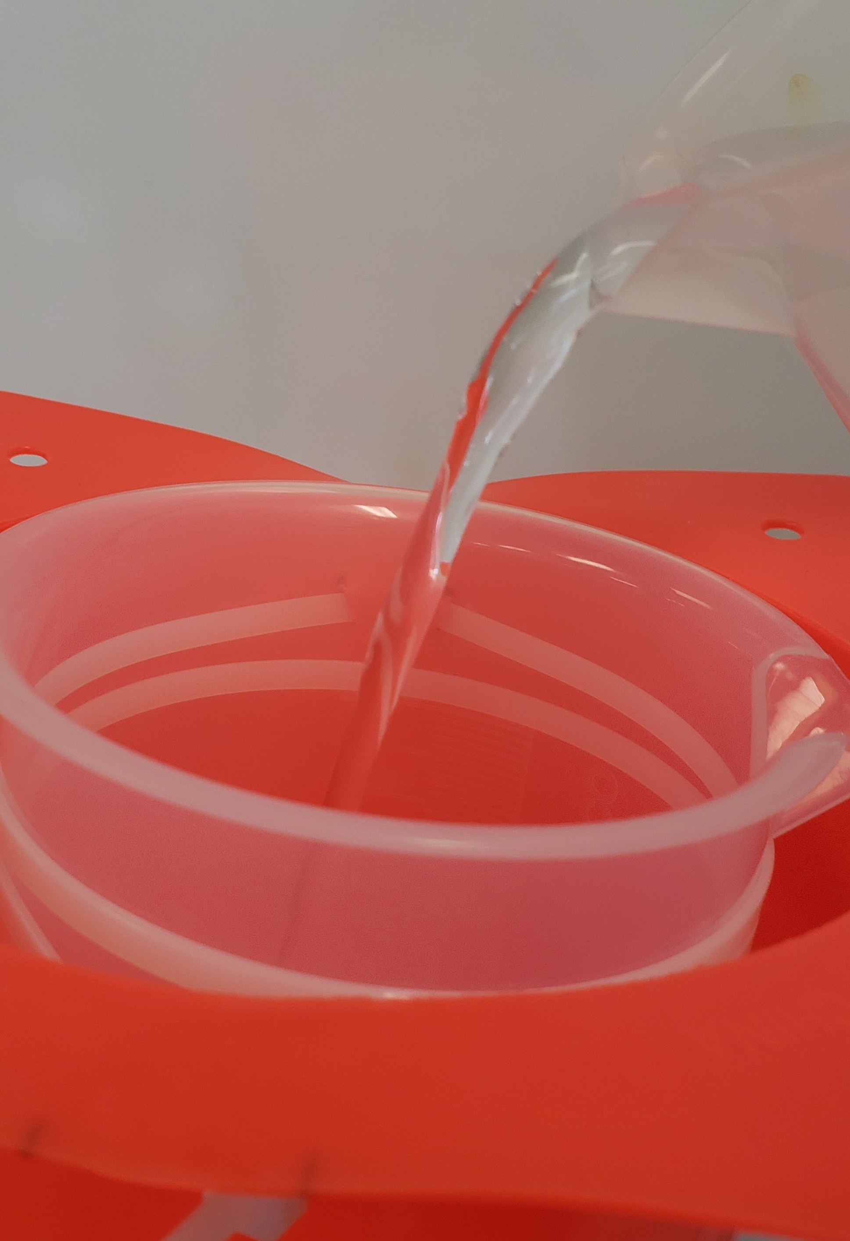
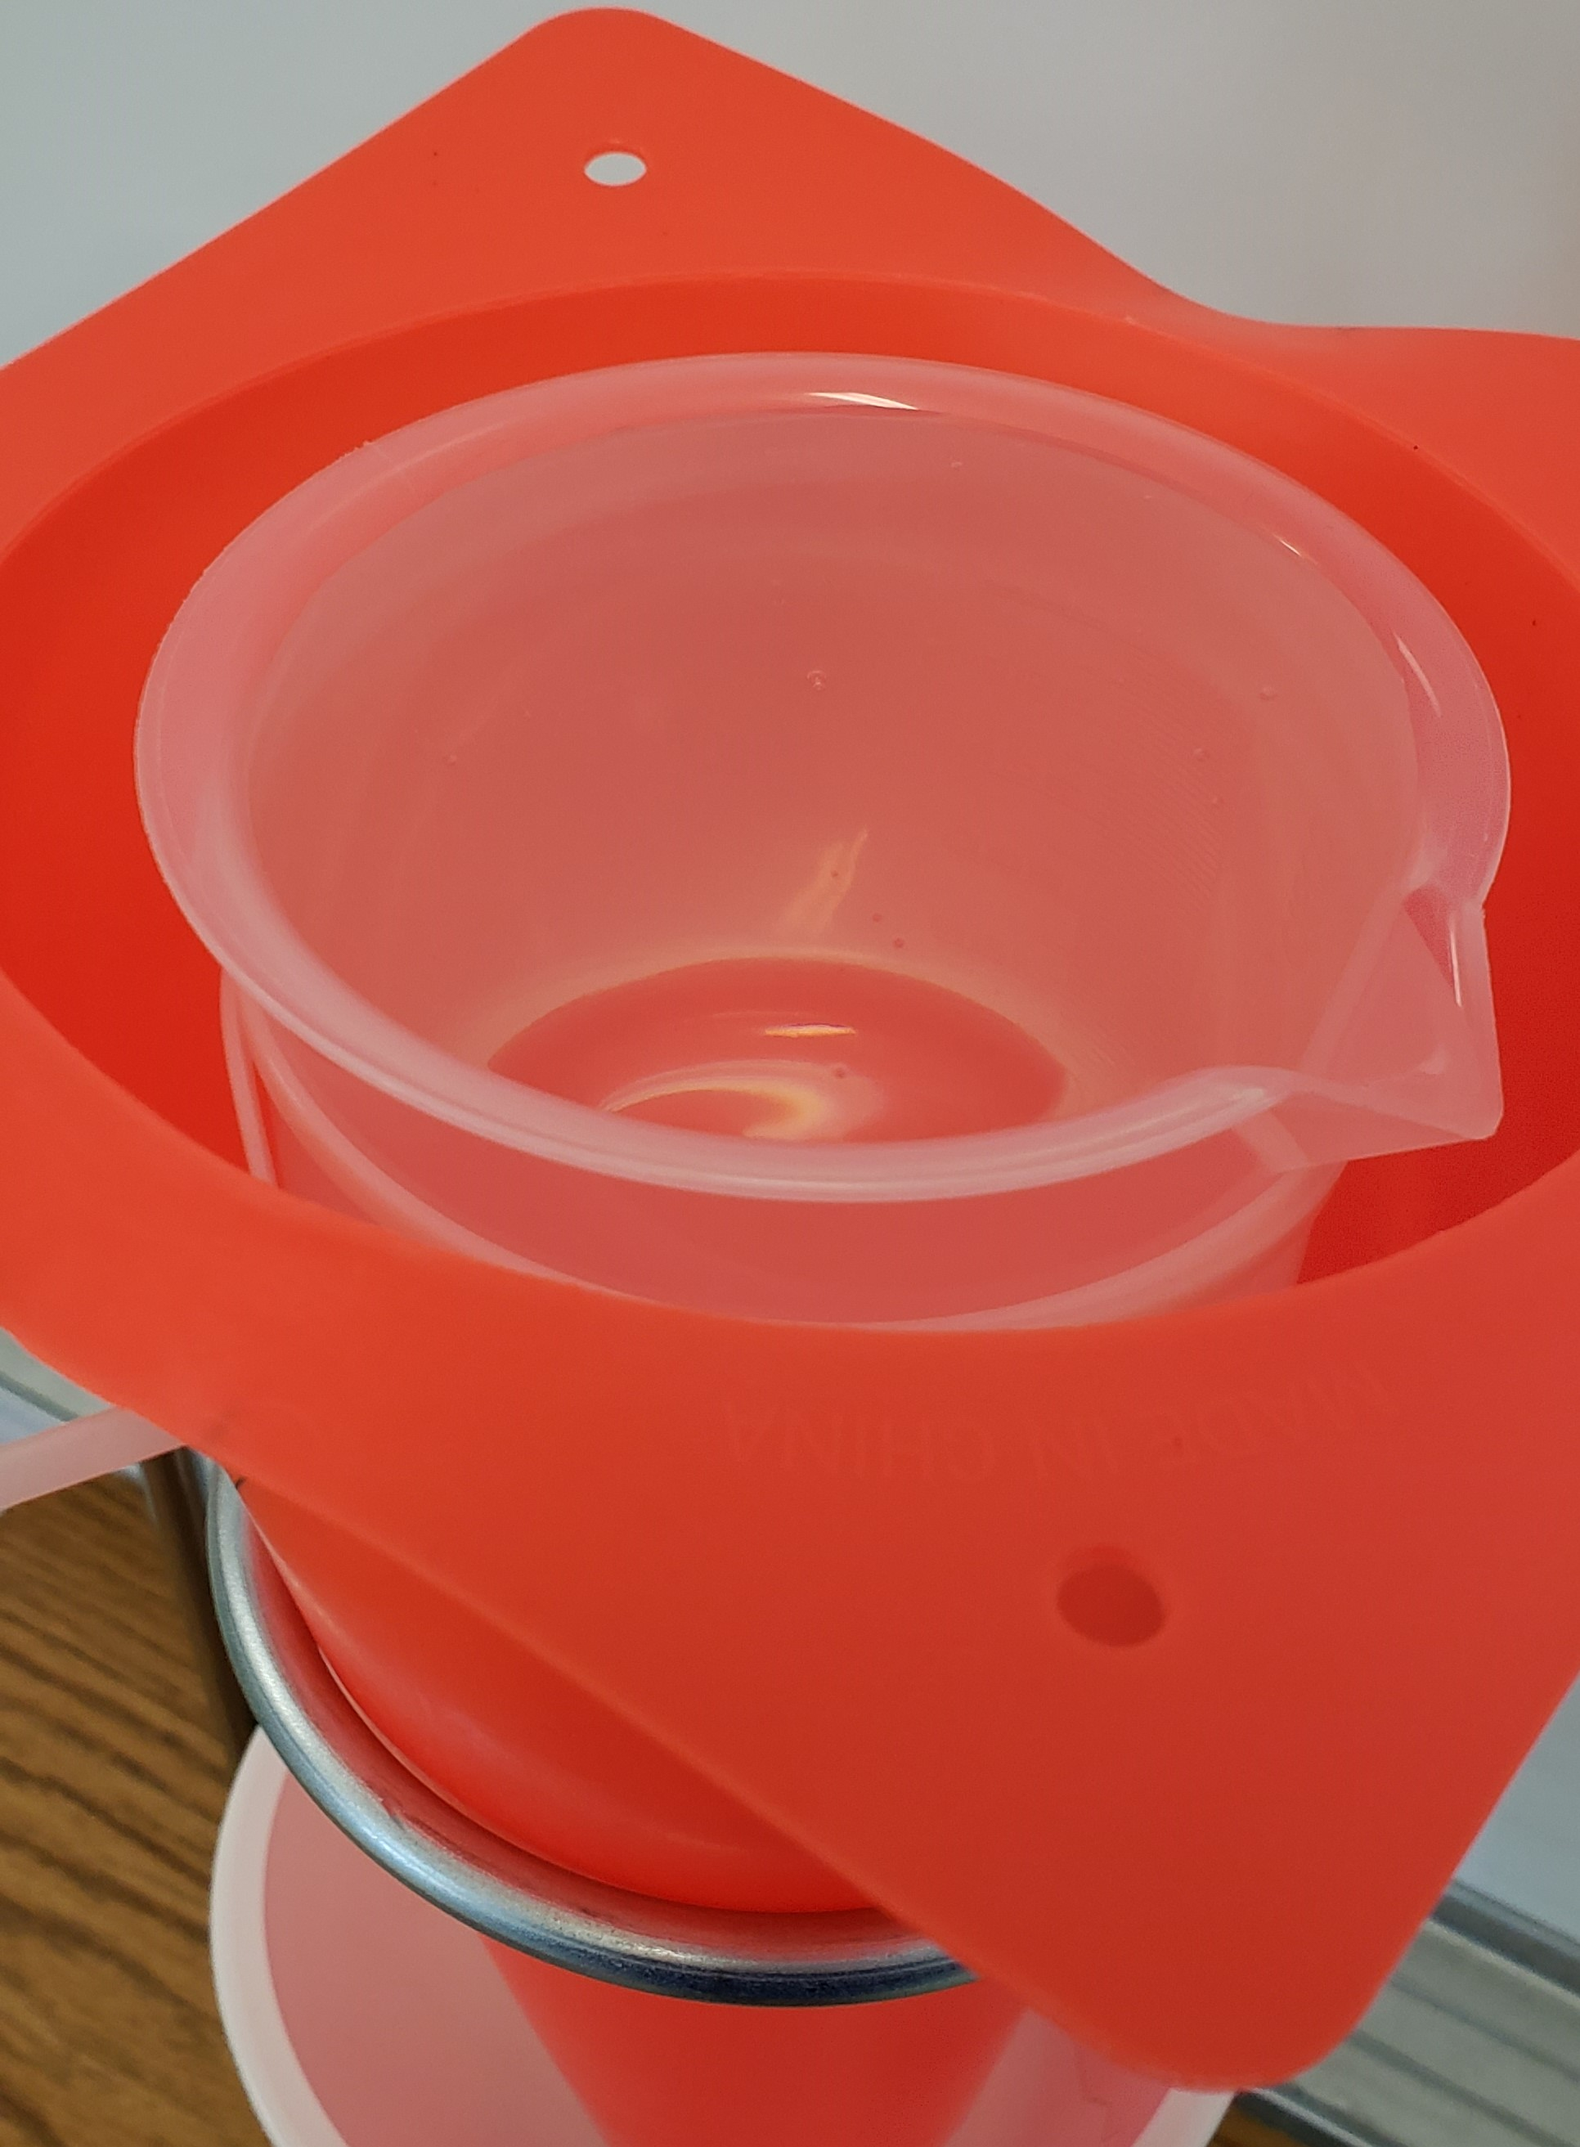
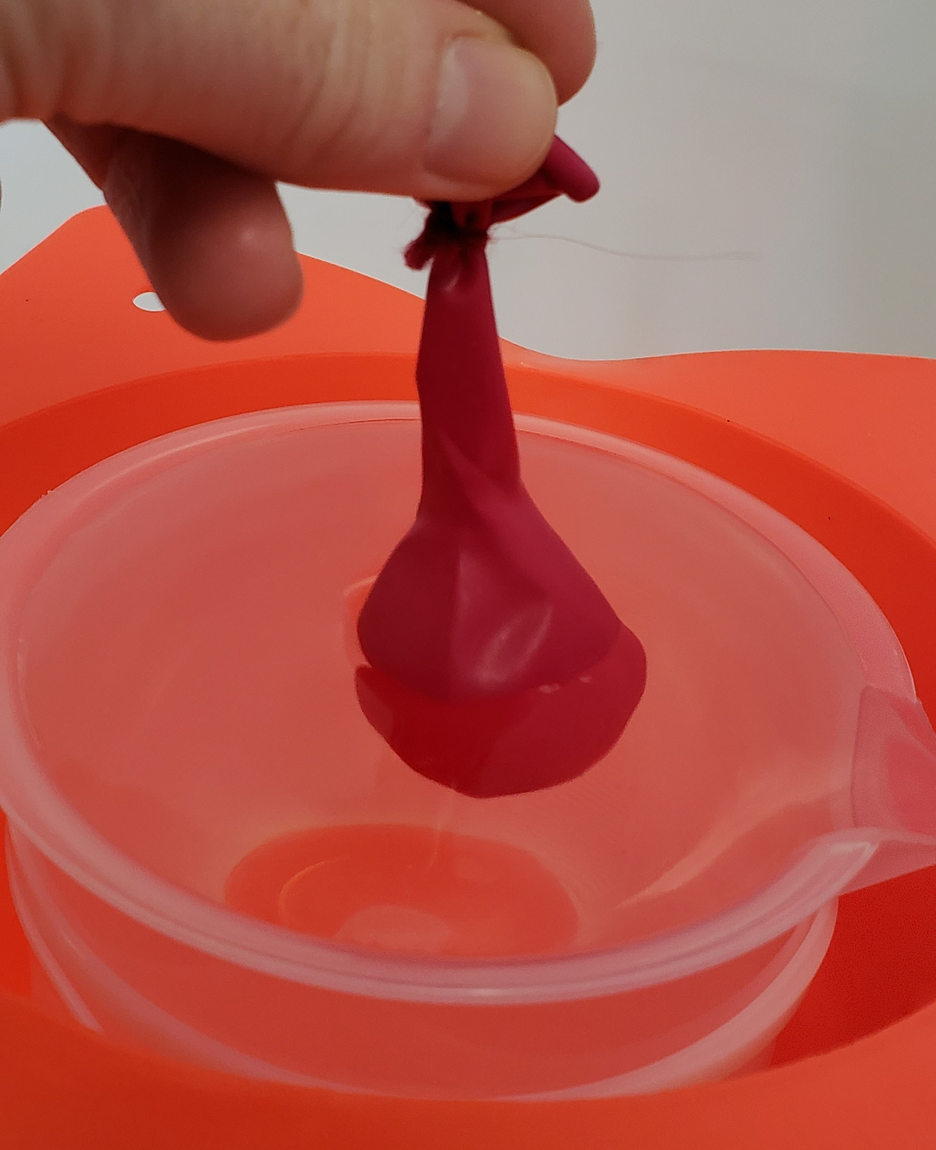
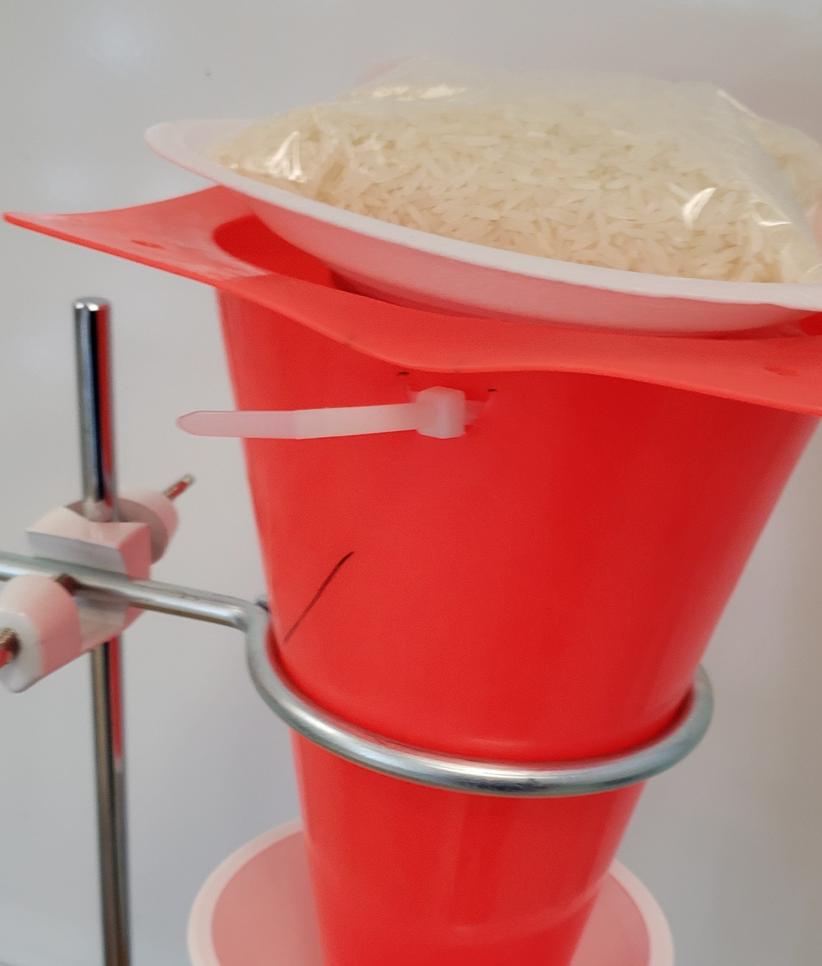
Water Displacement Apparatus
Option 1: Standard Operating Procedure 4. Fill the inside beaker with water until the water is about to spill over the edge. Carefully place the balloon sample in the beaker of water. **It is ok if water spills over your balloon will have a START volume.** Place a foam plate on top of the balloon over the beaker with a bag of rice on top of that. **This will hold the balloon down into the water as it fills with CO2 gas.**
#f8a81b

Slide 13
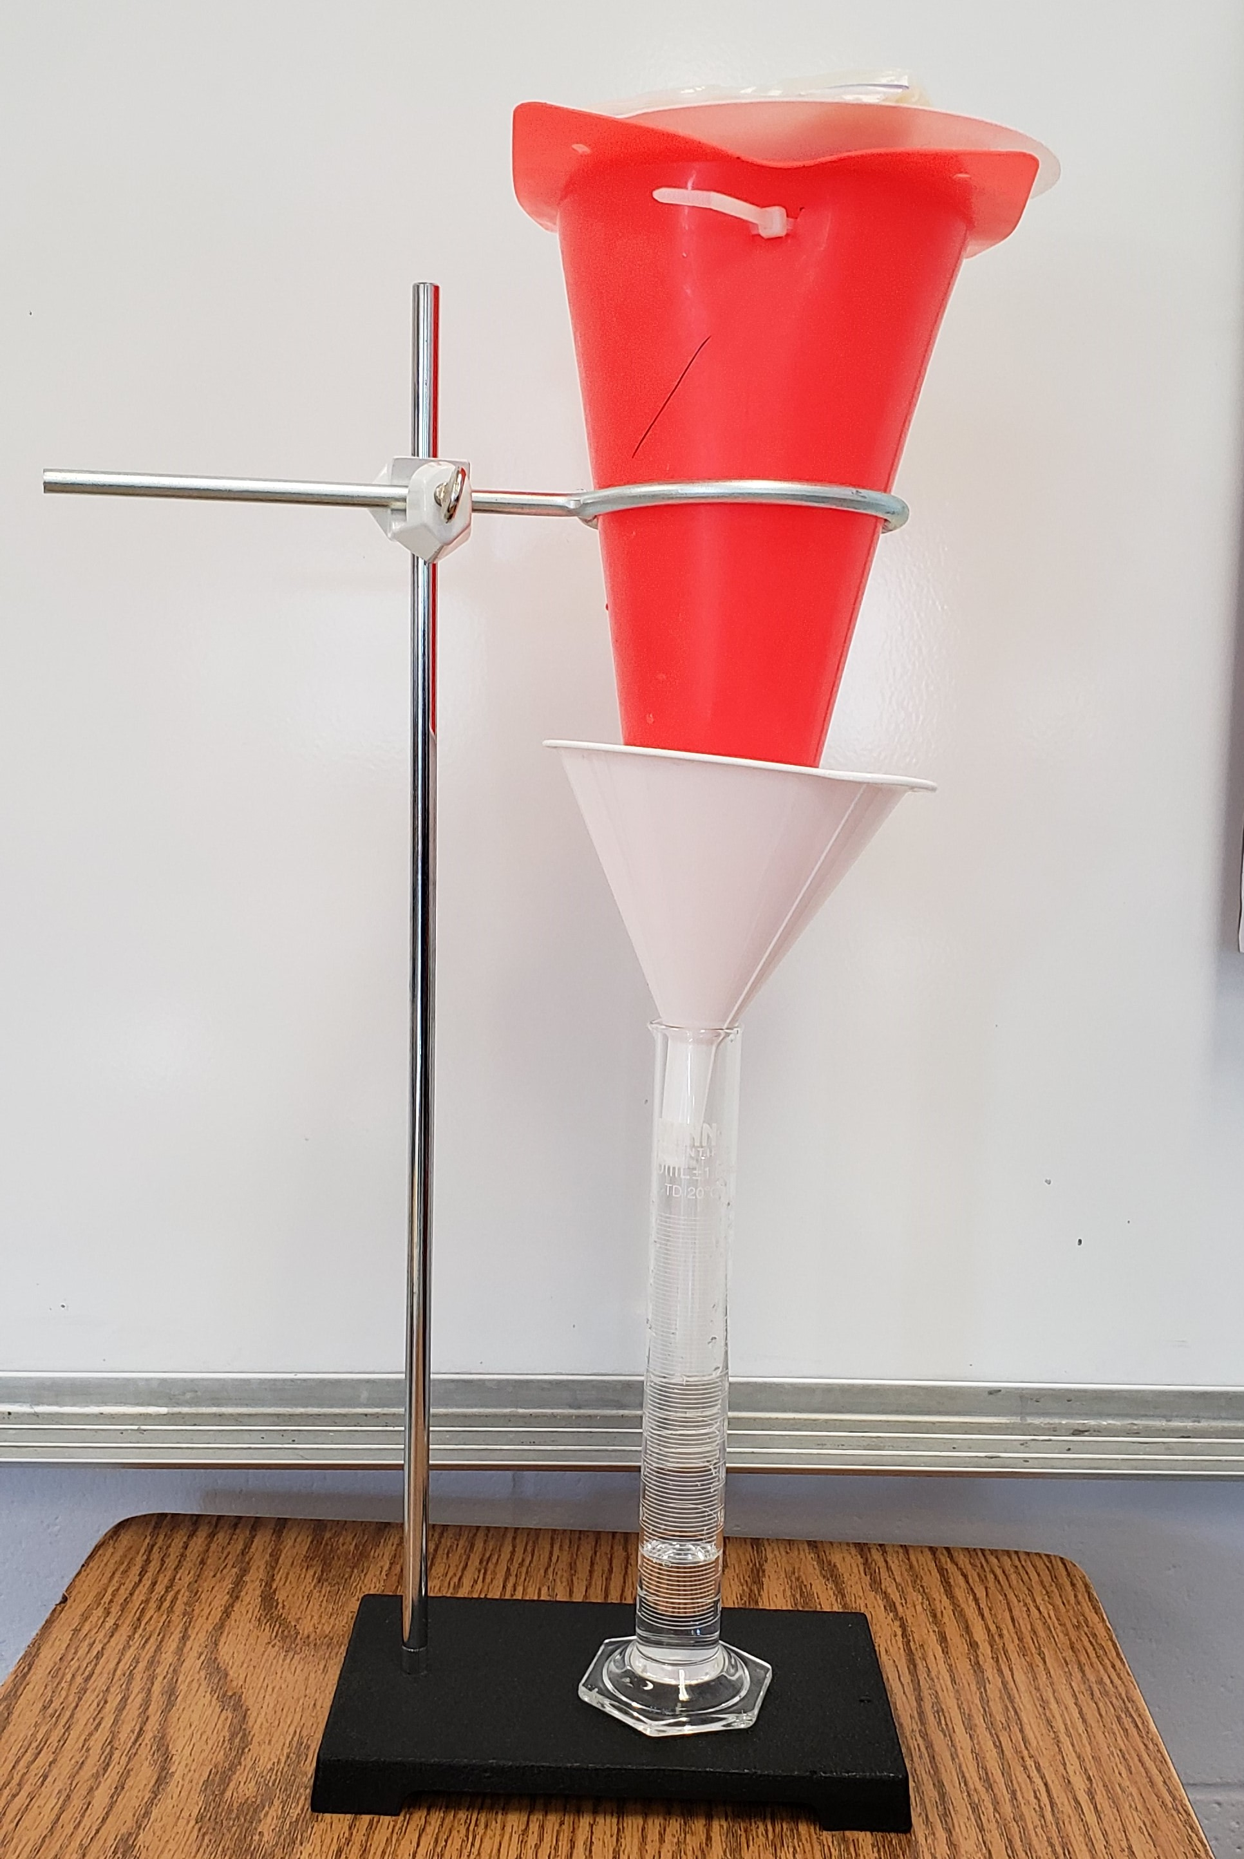
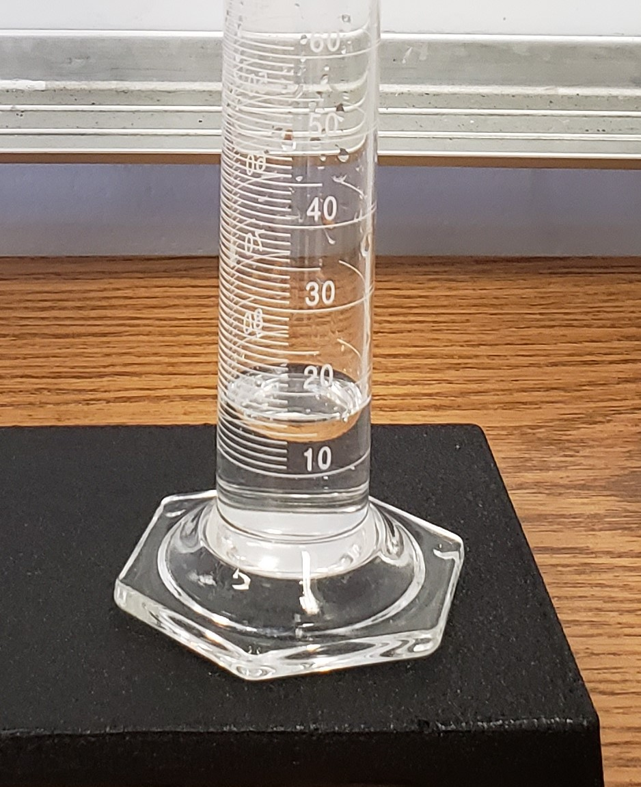
Water Displacement Apparatus
Option 1: Standard Operating Procedure 5. The apparatus is set to measure the water displacement as the balloon’s volume increases overtime. Remember to take your START volume which is the water level in the graduated cylinder and continue to document until time is called.
#f8a81b

Slide 14
Water Displacement Apparatus
Option 2: Standard Operating Procedure 1. Set up your ring stand with clamp.
#f8a81b

Slide 15
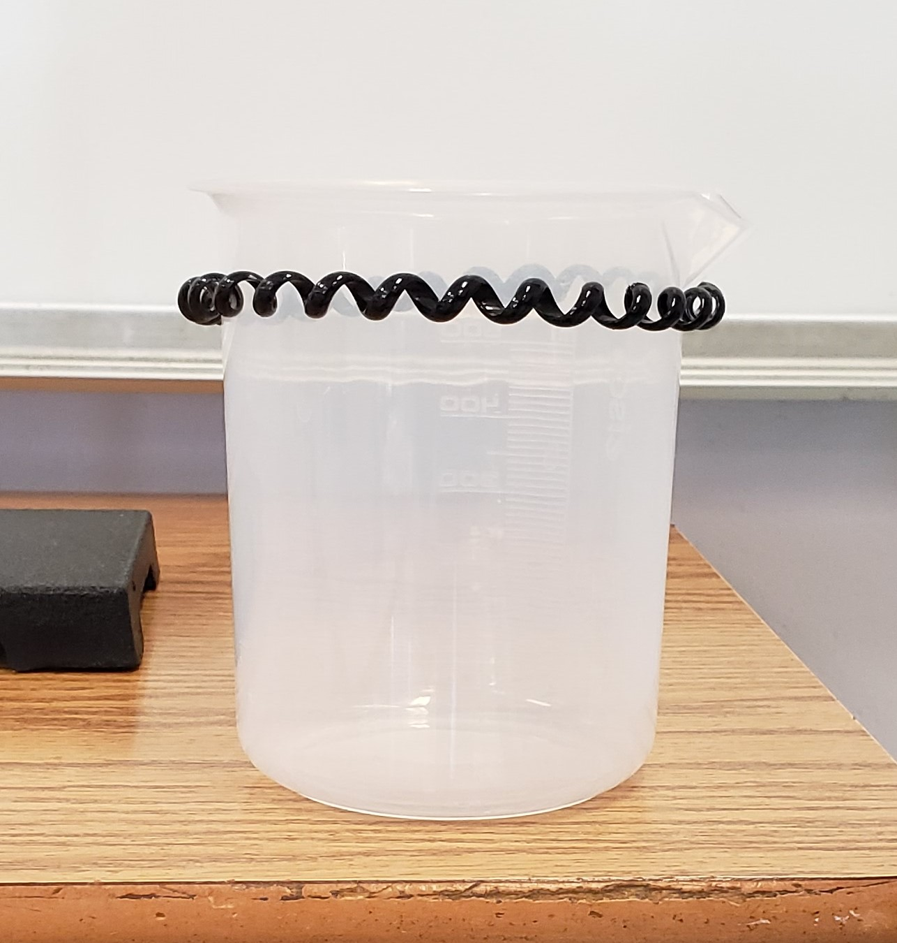
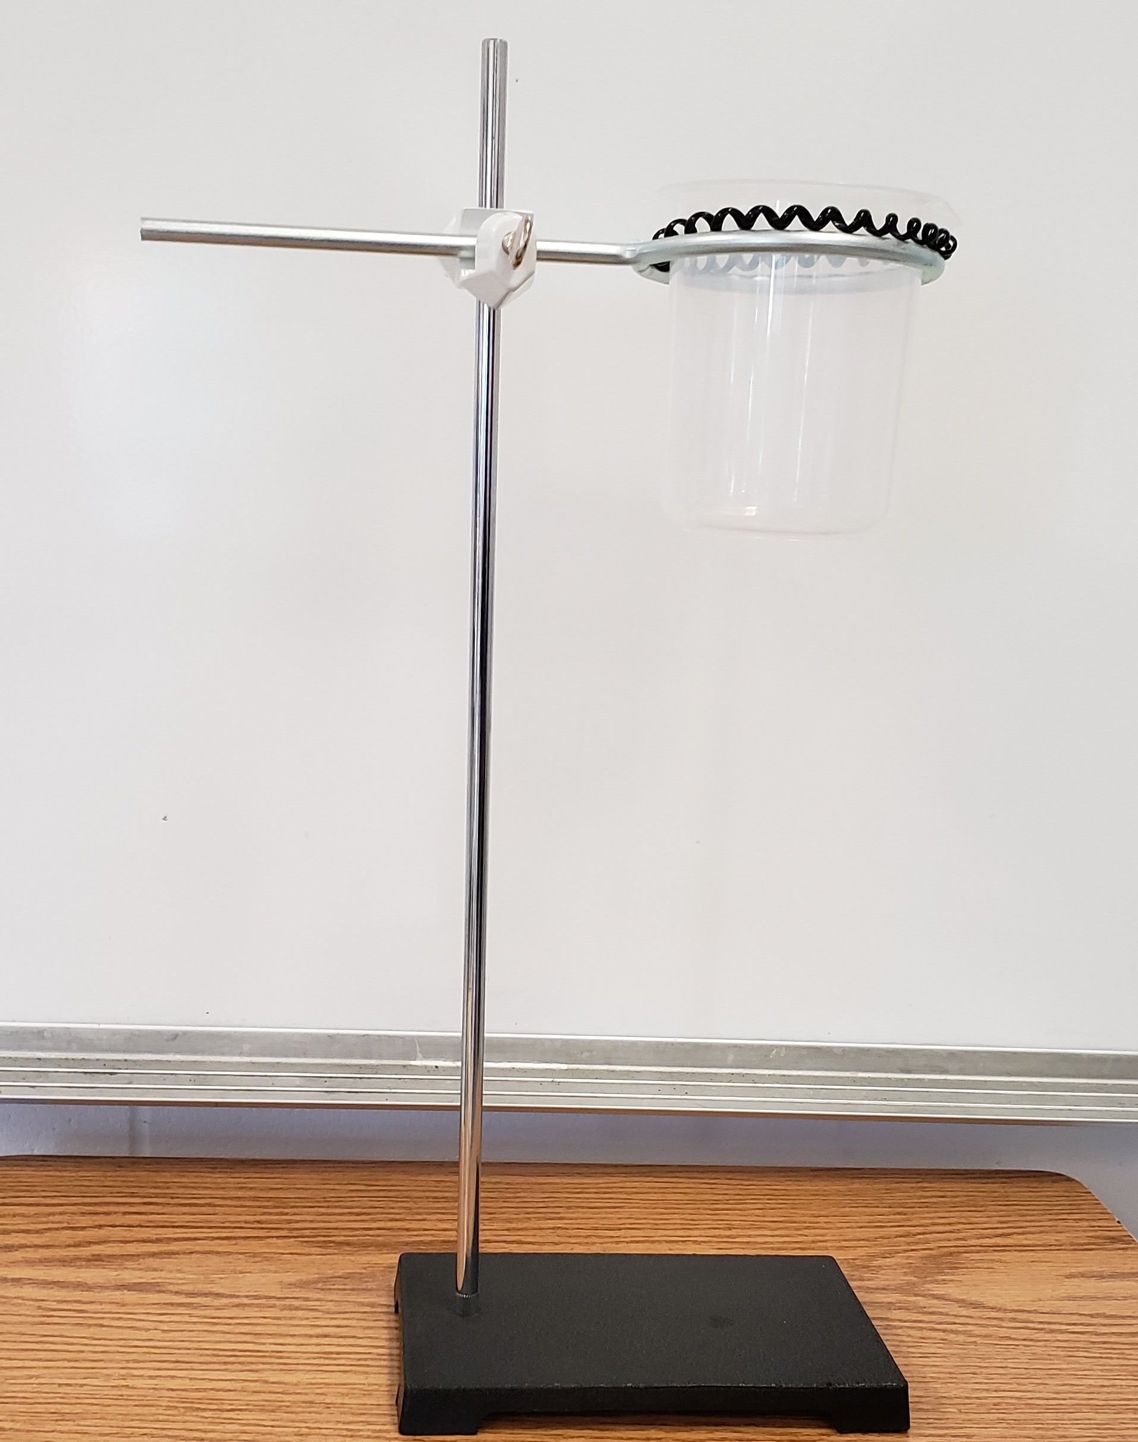
Water Displacement Apparatus
Option 2: Standard Operating Procedure 2. Put plastic cord tie around the neck of the plastic beaker and set the beaker w/ tie inside the ring of the clamp.
#f8a81b

Slide 16
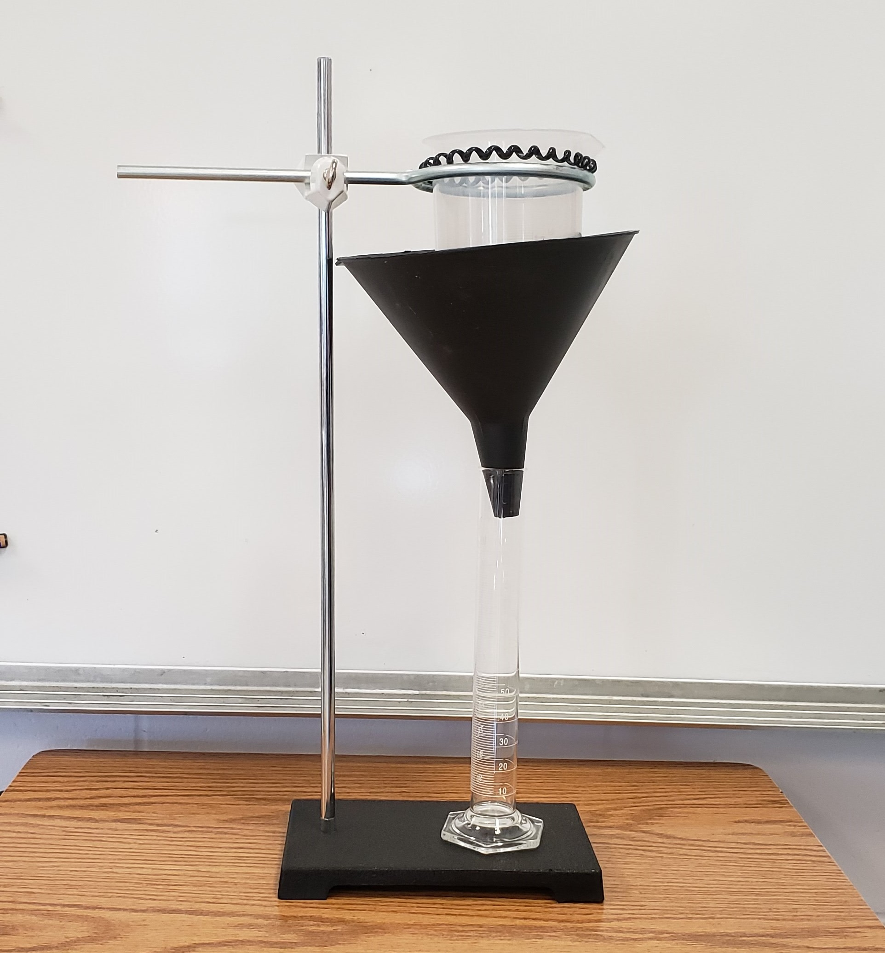
Water Displacement Apparatus
Option 2: Standard Operating Procedure 3. Place a larger funnel and 100mL graduated cylinder under the beaker.
#f8a81b

Slide 17
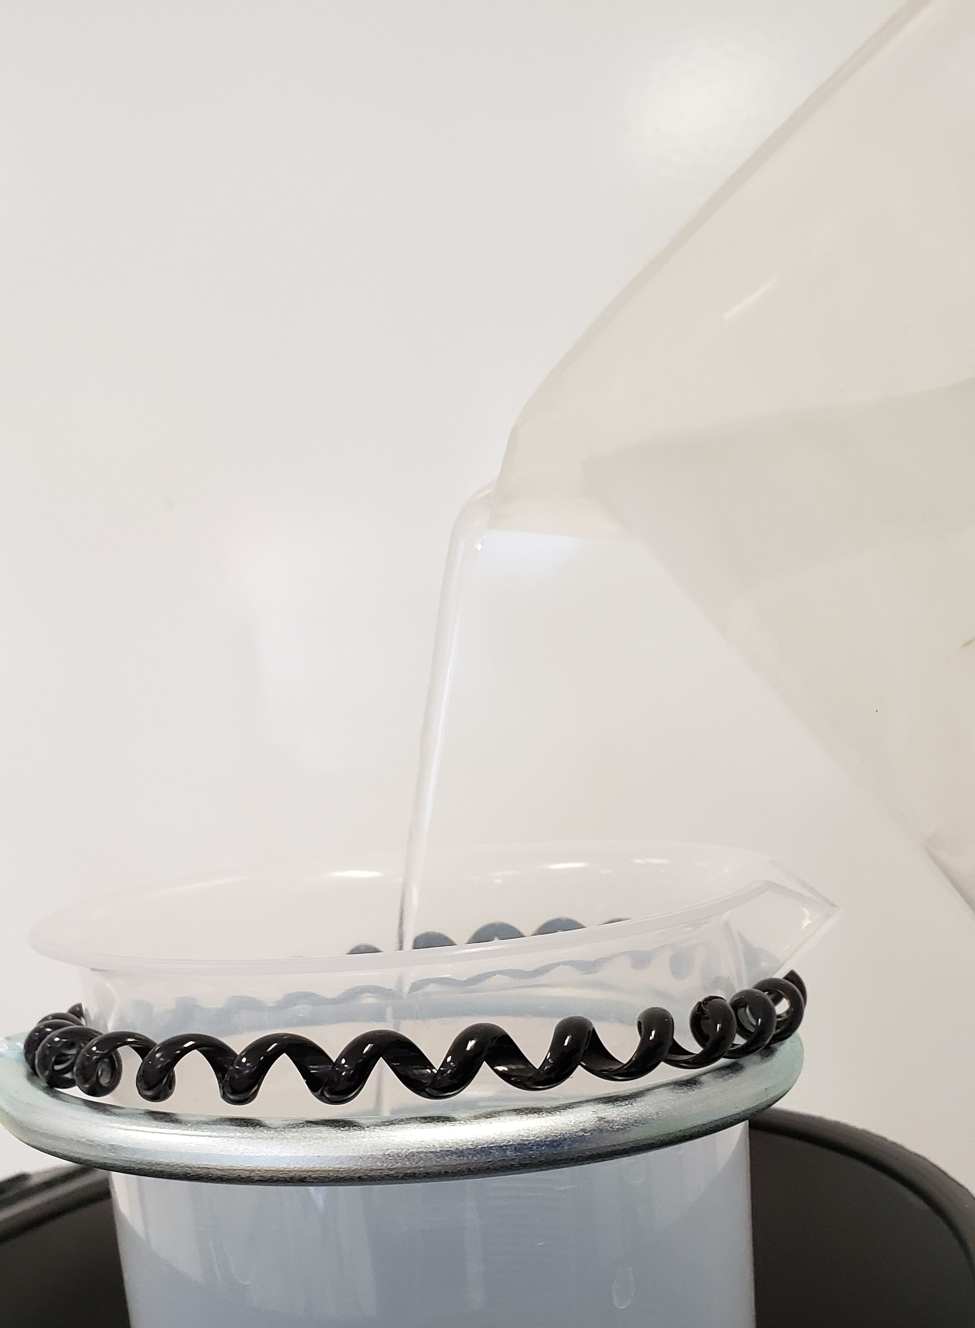
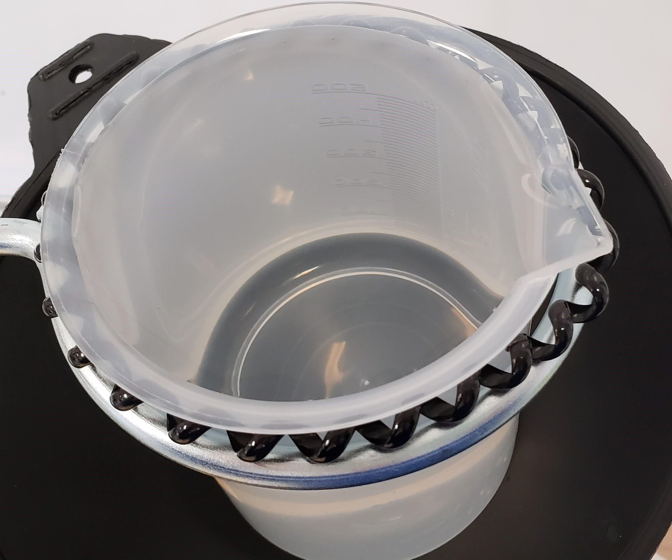
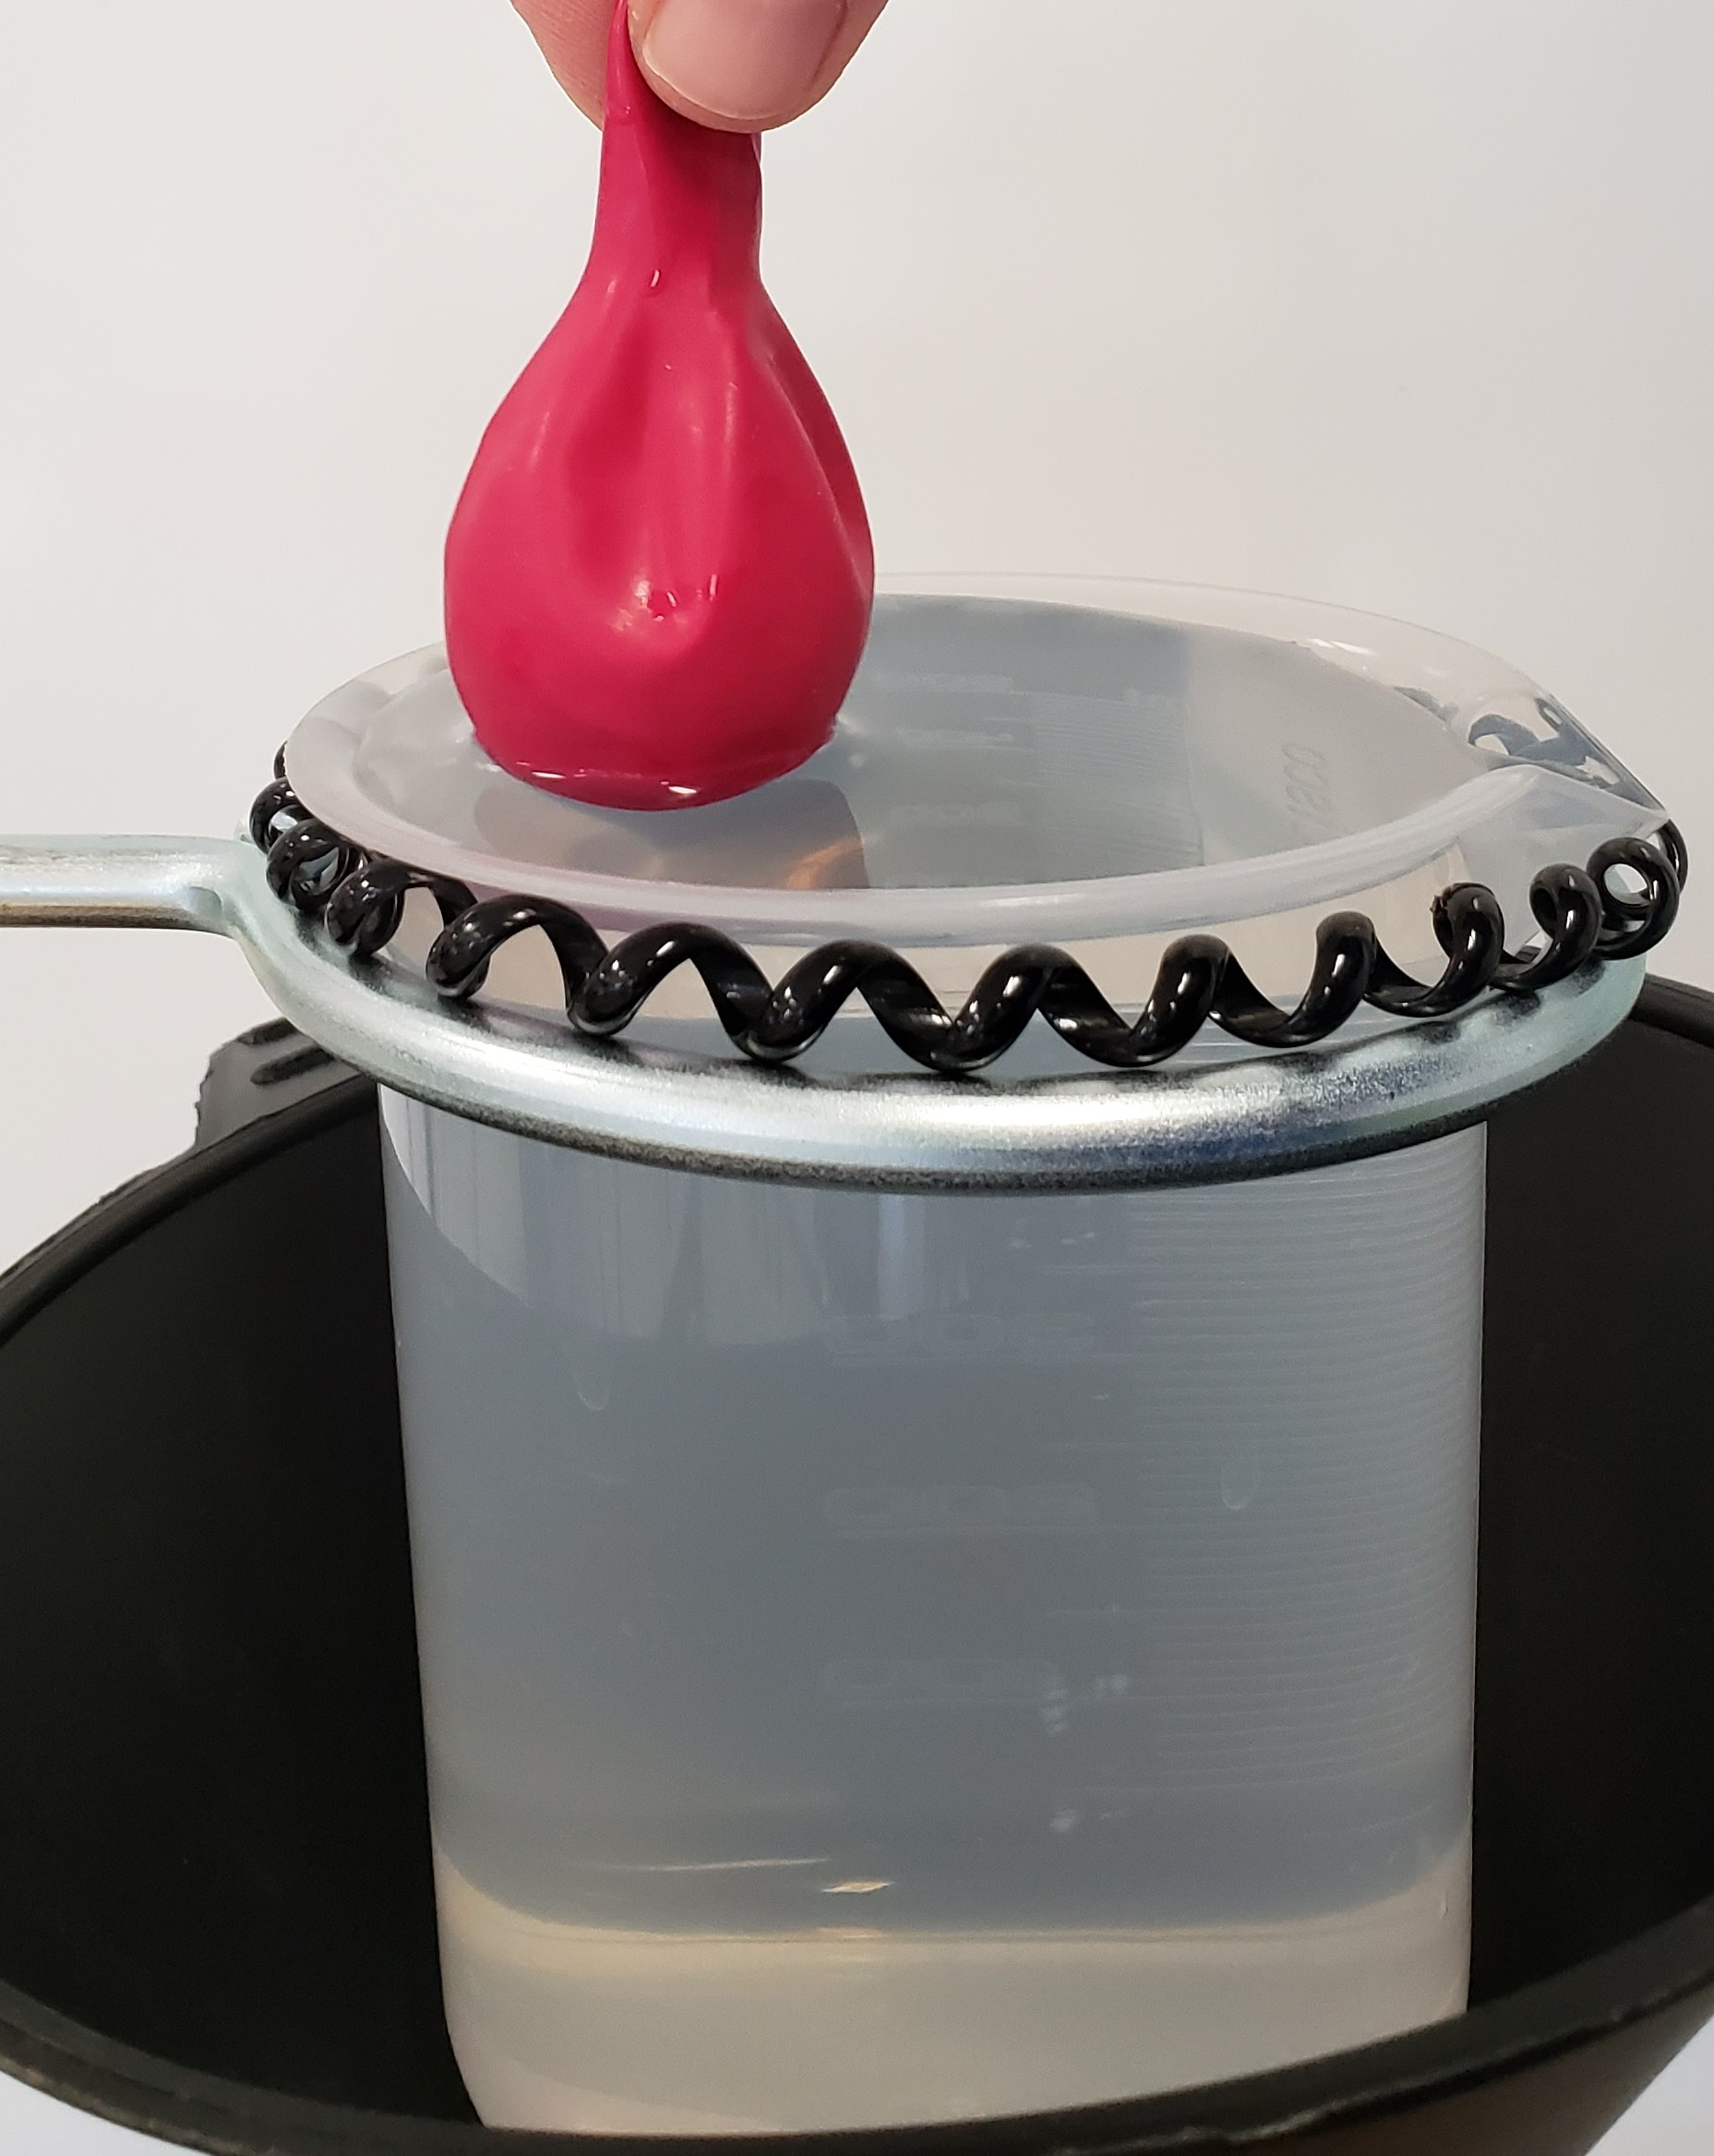
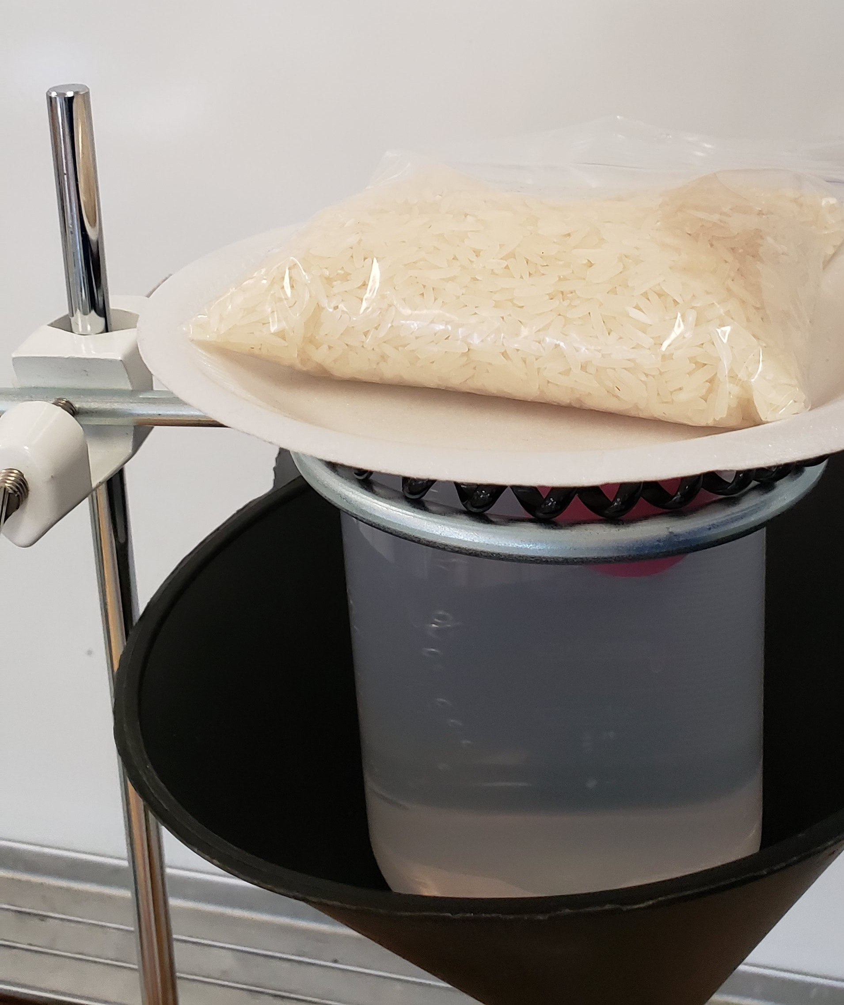
Water Displacement Apparatus
Option 2: Standard Operating Procedure 4. Fill the beaker with water until the water is about to spill over the edge. Carefully place the balloon sample in the beaker of water. **It is ok if water spills over your balloon will have a START volume.** Place a foam plate on top of the balloon over the beaker with a bag of rice on top of that. **This will hold the balloon down into the water as it fills with CO2 gas.**
#f8a81b

Slide 18
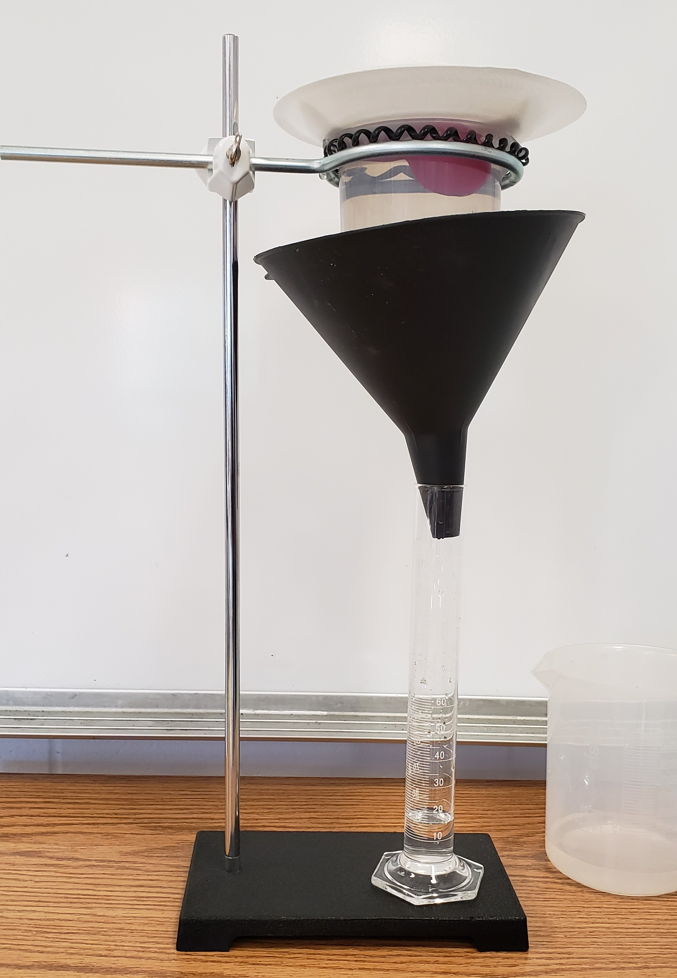
Water Displacement Apparatus
Option 2: Standard Operating Procedure 5. The apparatus is set to measure the water displacement as the balloon’s volume increases overtime. Remember to take your start volume which is the water level in the graduated cylinder and continue to document until time is called.
#f8a81b

