Slide 1
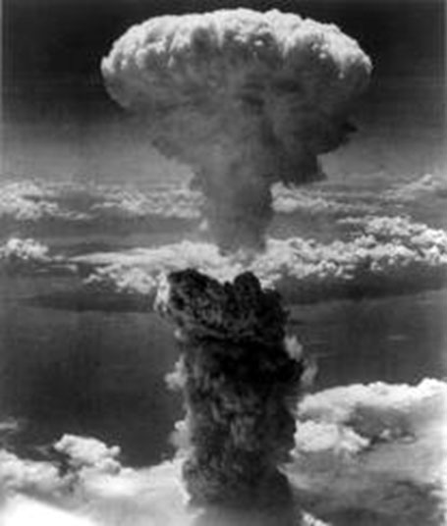
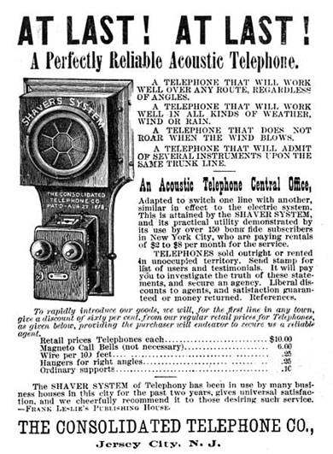
Ethics in Engineering
Notes:
Day 1 Presentation, Ethics in Engineering Activity, TeachEngineering.org
Example engineering inventions: atomic bomb, telephone, iPhone
Image sources:
Left: 1945 Charles Levy, Wikimedia Commons https://commons.wikimedia.org/wiki/File:Nagasakibomb.jpg
Center: 1886 Consolidated Telephone Co., Wikimedia Commons https://en.wikipedia.org/wiki/Telephone#/media/File:Consolidated_Telephone_Co._ad_1886.jpg
Right: 2014 Rayukk, Wikimedia Commons https://commons.wikimedia.org/wiki/File:IPhone6_silver_frontface.png

Slide 2
Day 1 Goals
Exploring new innovations
Evaluating designs
Identifying intended demographics
Defining “ethics”
Considering the impacts of testing

Slide 3
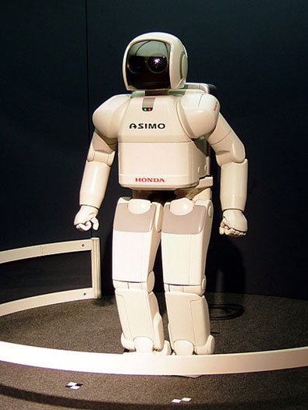
Group and Label Activity
Time magazine publishes a list of the “Best Inventions of the Year”
Printouts of these inventions are on your desks
Working in small teams, sort the inventions into groups. Then label each group with a sticky note.
Possible criteria: location, funding source, creator, purpose, materials, audience or other characteristics of your own choosing
Examples:
digital/non-digital
needs/wants
ASIMO (Advanced Step in Innovative Mobility) is a humanoid robot developed by Honda to work as a a mobile assistant.
Notes:
Time Magazine’s Inventions of 2014: http://time.com/3594971/the-25-best-inventions-of-2014/
Image source (a humanoid robot created by Honda): 2005 Gnsin, Wikimedia Commons https://commons.wikimedia.org/wiki/File:HONDA_ASIMO.jpg

Slide 4
Think/Pair/Share
Imagine you are editors at Time Magazine.
You must identify one invention as the best invention of the year and one as the runner up.
The winning inventions must be from the 16 inventions in your pile.
With your partner, discuss:
Which is the best invention and why?
Which is the runner up and why?
Notes:
(optional) Pull up the following Time Magazine article so students can see the source of the “top inventions” as they read: “The 25 Best Inventions of 2014” at http://time.com/3594971/the-25-best-inventions-of-2014/

Slide 5
And the award goes to….
You have two stickers.
Place them on the 2 inventions that you think are the most deserving of recognition.
Do this activity individually.
Notes:
Graphic source (ribbon): Pixabay, CC0 license, public domain: https://pixabay.com/en/award-ribbon-rosette-blue-161090/

Slide 6
Analysis: About Your Choices…
Which 2 inventions received the most stickers?
If you voted for them, why did you feel they were most deserving?
Does anyone feel a different invention would have been more deserving?
Who will those inventions help?
Who can afford to use them?
Which 2 inventions got the fewest stickers?
Why didn’t more people vote for them?
Notes:
Lead a class discussion on these points.
List students’ decision-making criteria on the classroom board.

Slide 7
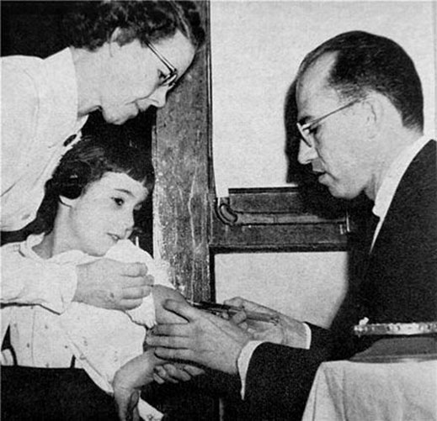
Engineers Make a World of Difference
For whom does engineering make the world a better place?
In what ways does engineering make a difference?
Jonas Salk’s polio vaccine saved hundreds of thousands of people around the world from paralysis.
Notes:
Photo of Jonas Salk with his polio vaccine
Image Source: 1956 Yousuf Karsh, Wikipedia https://en.wikipedia.org/wiki/File:Salk-child-Karsh.jpg

Slide 8
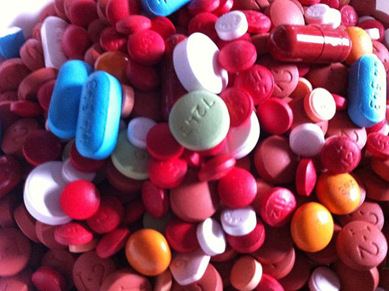
Analyze Two Designs
In your small groups, identify the top 2 designs
Then answer the worksheet questions about those inventions
On the following slides, example answers are provided for analyzing the disposable pill packets →
Notes:
Give students time to write their answers to the questions in the worksheet’s Part 2: Critical Evaluation section.
Image source (pills): 2013 ParentingPatch, Wikimedia Commons https://commons.wikimedia.org/wiki/File:Assorted_Pills_3.JPG

Slide 9
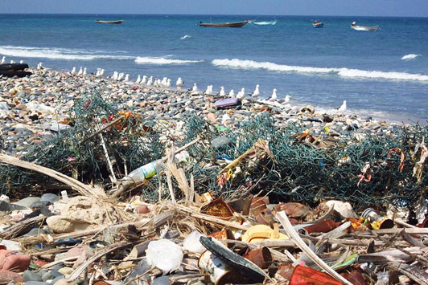
Example Answers for the disposable pill packets
Who does this design benefit? In what ways?
This design benefits people who are chronically ill or their caregivers. It helps them keep track of medications. It is for people who can afford multiple medications and/or who have the insurance coverage for multiple medications.
Who or what might be harmed by this design? In what ways?
The environment might be harmed if the materials are not easily degradable.
A new study estimates that 8 million metric tons of trash—the midpoint of the researchers’ estimate—enters the ocean from land each year. That's equivalent to about 1.5 million cars.
Notes:
Example answers to the worksheet Part 2: Critical Evaluation section. These example answers are in response to the pill packets invention. Use these slides to model the kind of answers you expect from students.
Image source (trash on a beach): 2011 Gerry & Bonni, Wikimedia Commons https://commons.wikimedia.org/wiki/File:Trash_on_beach_(6408224371).jpg

Slide 10
Example Answers (continued) for the disposable pill packets
Who might be discouraged or excluded from using this design?
This design is not for people who cannot read or who are cognitively impaired. It is probably not for people in countries who do not have access to medicines.
Who funded the development of this design, and why do you think they funded it?
A pharmacy funded this design, perhaps so people would order drugs from their pharmacy.
After looking more critically at this design, is there anything else you noticed?
How do people with vision problems read this design?
Notes:
Example answers to the worksheet Part 2: Critical Evaluation section. (continued)

Slide 11
The Engineering Code of Ethics
Review the engineering code of ethics at: http://www.nspe.org/resources/ethics/code-ethics
Create a class definition of “ethics.”
To do this, decide on the five principles you believe are the most important.
Keep these five principles in mind as we progress through the activity.
Notes:
Review the National Society of Professional Engineer’s “Code of Ethics for Engineers” at http://www.nspe.org/resources/ethics/code-ethics
Either review the principles as a class or let students review them individually or in their teams.
After you make a list of 5 principles determined by the class, have students write them on their worksheets and/or post them somewhere in the classroom so they are visible to students during the activity so they can refer to them when they need to define “ethics.”

Slide 12
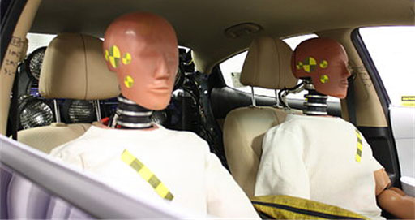
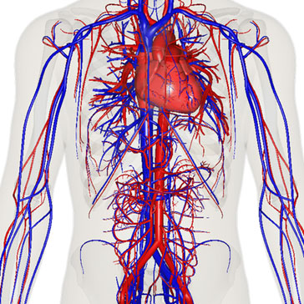
Who is the product tested on?
Historically, women have been under-represented in product and safety testing, which has led to dangerous confusion when it comes to automotive safety and medication dosage.
Notes:
Review with students the implications of this New York Times article at http://www.nytimes.com/2014/05/15/health/nih-tells-researchers-to-end-sex-bias-in-early-studies.html?_r=0
Just discuss the ma in points; no need for students to read the article.
Image sources:
Headline: 2014 Roni Rabin, The New York Times http://www.nytimes.com/2014/05/15/health/nih-tells-researchers-to-end-sex-bias-in-early-studies.html?_r=0
Dummies in crash test: 2013 Calspan Corporation, National Highway Traffic Safety Administration, Wikimedia Commons https://commons.wikimedia.org/wiki/File:V08383P339.jpg
Diagram of human heart, veins and arteries: 2014 BodyParts3D/Anatomography, Wikimedia Commons https://commons.wikimedia.org/wiki/File:Vein_art_near.png

Slide 13
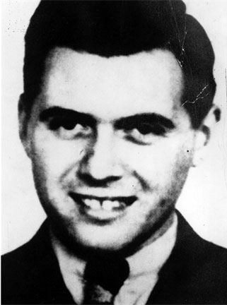
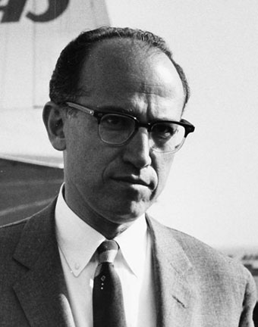
Who is the product tested on?
Do the benefits of the research outweigh the rights of the subjects?
Josef Mengele conducted painful and deadly medical experiments on WW2 concentration camp prisoners.
Jonas Salk deliberately infected mental hospital patients with influenza.
Notes:
Some researchers conduct tests on subjects who are unable to consent. Do the benefits of such research outweigh the rights of the subjects?
Image Sources:
Left (Josef Mengele): c. 1945 unknown SS photographer, Wikipedia https://en.wikipedia.org/wiki/File:Josef_Mengele.jpg
Right (Jonas Salk): 1959 SAS Scandinavian Airlines, Wikimedia Commons https://commons.wikimedia.org/wiki/File:Dr_Jonas_Edward_Salk_(cropped).jpg

Slide 14
Doing good for people
Who benefits from this product and who does not?
How does the product help or hurt people and the environment?
How is this product tested?
How is the product made?
Reflect on how these four considerations add up to “doing good.”
Based on your class definition of ethics, is there anything you would add or change?

Slide 15
Critical and Ethical Thinking in Engineering
Read article about the Odón Device: “Car Mechanic Dreams up a Tool to Ease Births”
As you read the article, fill in the graphic organizer on the worksheet with at least 5 questions about the article.
Question topics: manufacturing, testing, availability, impact, another topic of your choice
Notes:
Have students read this New York Times article: Car Mechanic Dreams up a tool to Ease Births, provided as a handout or shown on the screen from its online source at http://www.nytimes.com/2013/11/14/health/new-tool-to-ease-difficult-births-a-plastic-bag.html?_r=0
Jorge Odón’s device recap: A plastic bag inflated around a baby’s head is used to pull it out of the birth canal.
Give students time to write their answers to the questions in the worksheet’s Part 4: Jorge Odón’s Invention section.

Slide 16
Example Questions
To help you formulate your questions, here are a few example questions about a different device —the Hemopurifier, a blood filter that fights Ebola.
Testing: Why was the Hemopurifier only tested on a person in Germany and not on people in Africa?
Manufacturing: How much does the hemopurifier cost to make. How much is it sold for?
Availability: What kinds of medical facilities are needed for this design to work? How many hospitals around the world have dialysis machines?
Notes:
Example answers to the worksheet Part 4: Jorge Odón’s Invention section. These example answers are in response to the Hemopurifier invention (a blood filter that fights Ebola) invention. Use these example answers to model the kind of answers you expect from students.
http://time.com/3594971/the-25-best-inventions-of-2014/

