Slide 1
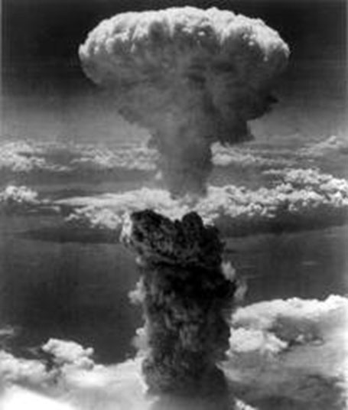
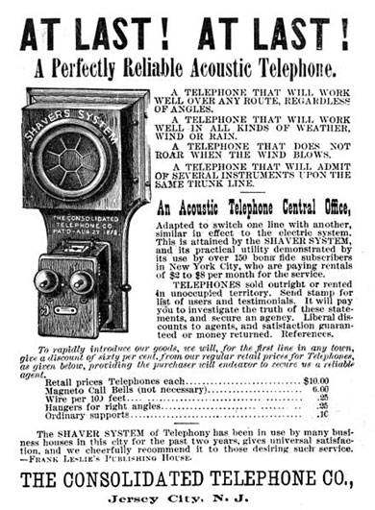
Ethics in Engineering
Notes:
Day 2 Presentation, Ethics in Engineering Activity, TeachEngineering.org
Example well-known engineering inventions: atomic bomb, telephone, iPhone
Image sources:
Left: 1945 Charles Levy, Wikimedia Commons https://commons.wikimedia.org/wiki/File:Nagasakibomb.jpg
Center: 1886 Consolidated Telephone Co., Wikimedia Commons https://en.wikipedia.org/wiki/Telephone#/media/File:Consolidated_Telephone_Co._ad_1886.jpg
Right: 2014 Rayukk, Wikimedia Commons https://commons.wikimedia.org/wiki/File:IPhone6_silver_frontface.png

Slide 2
Day 2 Goals
Review main ethical evaluation ideas:
For whom are the designs intended to benefit?
On whom have the designs been tested?
Develop an alternative design based on one of the inventions we read about
Present your new and improved design to the class

Slide 3
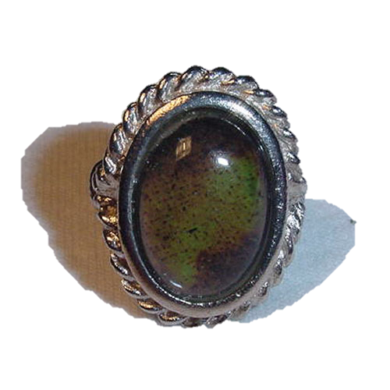
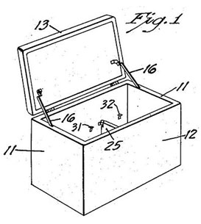
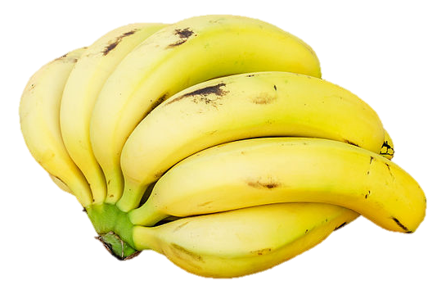
Ethics in Engineering
Who does the product really benefit?
How does it benefit them?
Consider these new innovations…
A ring that alerts its wearer to texts, phone calls, emails and alerts
A cooler that charges cell phones and mixes drinks
Nutritionally supercharged bananas
Notes:
Guide students to ask these questions about some new innovations, such as the following three:
Ringly: A ring that can be synced with an iPhone to subtly glow to inform the wearer to incoming emails, App alerts, text messages, calls and even the arrival of a driver or taxi. The design is intended to benefit style-conscious women who are wealthy enough to own an iPhone and do not want the ringing of a phone to interrupt meetings and work; it provides a fashion-forward way to stay connected. $200
Coolest Cooler: A cooler that also plays music, recharges mobile devices, blends drinks, and has big wheels for easy transport in parking lots and beaches. The cooler is designed to benefit people with the money, time and desire to escalate their tailgating experiences. $400
Super Bananas: Engineered vitamin-A-enriched “superbananas” are designed to help combat the fact that up to half a million children in sub-Saharan Africa go blind each year because of a vitamin A deficiency in their diets. Designed by a university.
Image sources:
Mood ring: 2007 Alkivar, Wikimedia Commons https://commons.wikimedia.org/wiki/File:Moodring1.jpg
Portable ice chest patent drawing: 1953 Richard C. Laramy, Wikimedia Commons https://commons.wikimedia.org/wiki/File:PortableIceChestPatent1955.jpg
Bananas: 2015 Augustus Binu, Wikimedia Commons https://commons.wikimedia.org/wiki/File:Bananas_white_background_DS.jpg

Slide 4
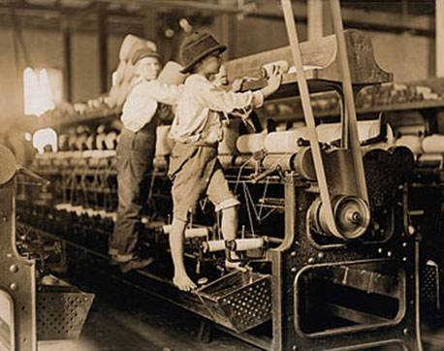
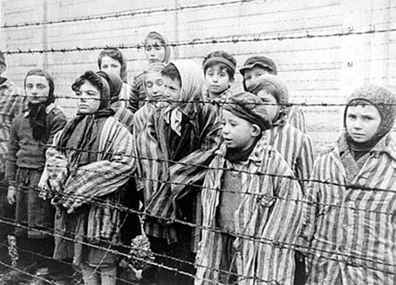
Ethics in Engineering
How are the products developed and tested?
Who makes the products?
Above: Children work in a factory before the passage of child labor laws.
Left: Prisoners in Nazi concentration camps, many of them children, were forced to undergo medical experiments.
Notes:
Remind students of the complicated ethical issues surrounding testing and production of products.
Examples for discussion:
Unethical medical experiments, such as those conducted by Josef Mengele, experimenting and collecting data from those who cannot give consent.
Sweatshops: People working to fabricate products for slave wages.
Remind students to keep these questions in mind during their redesign process.
Image sources:
Children working in a mill in Georgia: 1909 Lewis Hine, Wikimedia Commons https://commons.wikimedia.org/wiki/File:Mill_Children_in_Macon_2.jpg
Children behind a wire fence in Auschwitz: 1945 Alexander Voronzow and others, Wikimedia Commons
https://commons.wikimedia.org/wiki/File:Child_survivors_of_Auschwitz.jpeg

Slide 5
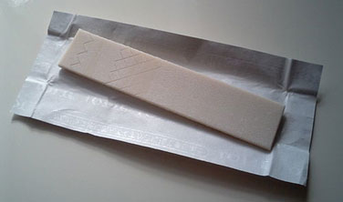
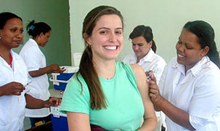
It’s your turn to innovate!
Imagine innovations like these!
You are engineers who will pitch your design to a charitable foundation that is looking for new projects to fund.
Try to imagine affordable ways to repurpose everyday things!
Make your re-imagined product as ethical as possible—meaning it should do the most good for the most people with the least harm to people and the environment
Try to encourage and persuade the foundation to invest in your design.
Chewing gum that kills bacteria is an affordable way to improve dental hygiene.
Vaccines have become more affordable and accessible to people all around the world.
Notes:
Keep this slide up during worktime.
Image sources:
Chewing gum: 2007 Lusheeta, Wikimedia Commons https://commons.wikimedia.org/wiki/File:Chewing_gum_stick.jpg
Woman receiving rubella vaccination: 2008 Sandra Rugio, Wikimedia Commons https://commons.wikimedia.org/wiki/File:VaccineBySandraRugio.jpg

Slide 6
Example: Vista (Redesigned “Blue Room”)
1. What ideas do you have for modifying an existing design to make it more ethical?
I would take the “Blue Room” and modify it so it could be used for people who are confined to a bed and who cannot get up. I would especially want to use it for people who do not have nearby family. The projector would be the same, but hospice workers could upload photographs or compiled images of the confined person’s favorite places. For instance, if the person liked the desert, the projector could show desert images and sounds. These images could be interspersed with images of the person’s family and favorite celebrities or other interests.
2. What problem(s) can your design solve?
People become depressed when they cannot go outside or see people they love. This may help to alleviate people’s depression or sadness by giving them visual reminders of places and people they love.
3. On whom will you test your design? How will you test your design?
I would first use the prototype with people who are not cognitively impaired, but who are physically impaired and confined to their beds in high-traffic hospitals in the U.S., China, India and Africa. I would try the projector with elderly males and females and interview them to find out if they liked the projector and how they would improve it.
Notes:
This slide shows example answers to 3 of the 8 questions students are asked on the worksheet.
For this example, the “Blue Room” invention—a prison room to helps inmates relax—was modified into a product called “Vista” to improve confined hospital and hospice care, especially for elderly and very ill people.
Show students these example answers to model the kinds of answers you expect from them.
Example answers to all worksheet Parts 5 and 6 are provided in the Worksheet Alternative Design Example Answers document.

Slide 7
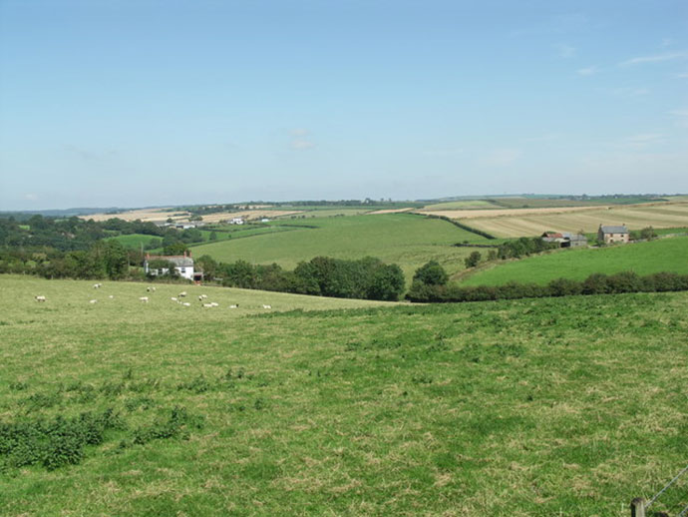
VISTA: The Next Best Thing to the Real Thing TM
Notes:
For this example, the “Blue Room” invention—a prison room to helps inmates relax—was modified into a product called “Vista” to improve confined hospital and hospice care, especially for elderly and very ill people.
Teachers: Replace this alternative design with your own example if you’d like!
Image source (Cornish landscape in the UK): 2007 Richard Williams, Wikimedia Commons https://commons.wikimedia.org/wiki/File:Cornish_Landscape._-_geograph.org.uk_-_533975.jpg

