Slide 1
Engineers create what has never existed!
The Engineering
Design Process
Notes:
Engineering Design Process Presentation
Bones! Bones! Bones! Lesson > TeachEngineering.org

Slide 2
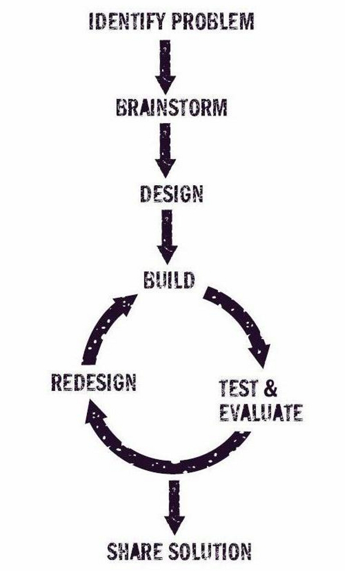
Steps in the Design Process
Define the problem
Come up with design ideas
→ brainstorm!
Select the most promising design
Communicate about and plan to build your design
Create & test your designed product
Review for improvements
Iterate your design (if necessary)
Present the solution
Notes:
Image source: Design Squad-PBS-WGBH engineering design process diagram at http://www.pbslearningmedia.org/resource/adptech12.sci.engin.design.dsposter/the-design-process-poster/

Slide 3

Define the Problem
What is the PROBLEM?
How can it be solved?
What do we need to build or create?
What is our goal?
Write one or two sentences defining
the problem.
Notes:
Image sources:
(screen bean character with question mark by head) Microsoft clipart at http://office.microsoft.com/en-us/worldwide.aspx?CTT=155
(4 stick figures fitting arrow puzzle pieces) Microsoft clipart at http://office.microsoft.com/en-us/images/results.aspx?qu=problem&ex=1#ai:MC900439356|

Slide 4
Brainstorming Guidelines
“Imagination is more important than knowledge.”
— Albert Einstein
No negative comments allowed!!!
Encourage wild ideas.
Record all ideas.
Build on the ideas of others.
Stay focused on the topic.
Allow only one conversation at a time.
Notes:
Image source: (Four people at a table having a brainstorming session) Microsoft clipart at http://office.microsoft.com/en-us/images/results.aspx?qu=brainstorm&ex=1#ai:MC900299691|

Slide 5
Make a Decision
Ideas that don’t get picked
are NOT bad ideas!
Don’t let it be personal
Decide as a team…
  Consider all positives
  and negatives
  Vote as a team
Combine design aspects,
if you want.
Notes:
Image source: (cartoon character making decision) Microsoft clipart at http://office.microsoft.com/en-us/images/results.aspx?qu=decision&ex=1#ai:MC900320122|mt:1|

Slide 6

Plan to Build
Communication is key!
Make a plan:
  Design
  Drawings
  Details
What is the order of
steps to take?
Split up task
Stay focused as a team
Notes:
Image source: (people drawing at a table) Microsoft clipart at http://office.microsoft.com/en-us/images/results.aspx?qu=meeting&ex=1#ai:MC900230989|mt:1|

Slide 7
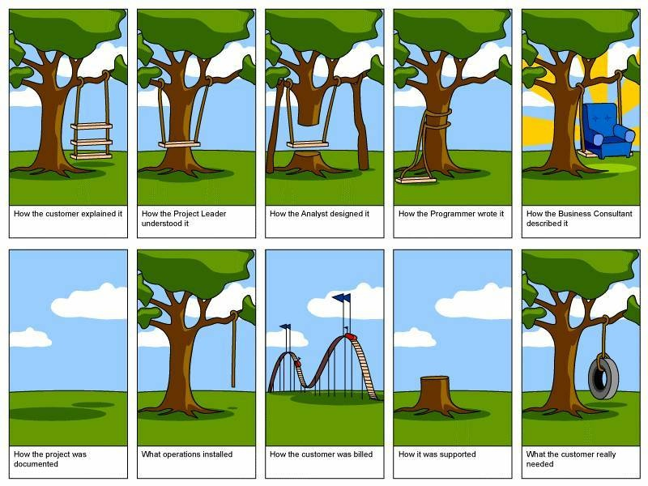
Build… Test… Redesign
Build a prototype
Test it to see how it works
Redesign parts, if necessary, and
Build it again
Iteration – Each design builds on the previous, until the desired accuracy is achieved
Does it work?
What could be improved?
Lets make it better!
Notes:
Image source: (project management tree cartoon) http://www.tamingdata.com/2010/07/08/the-project-management-tree-swing-cartoon-past-and-present/

Slide 8
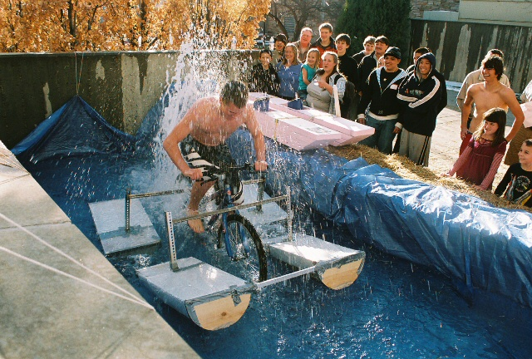
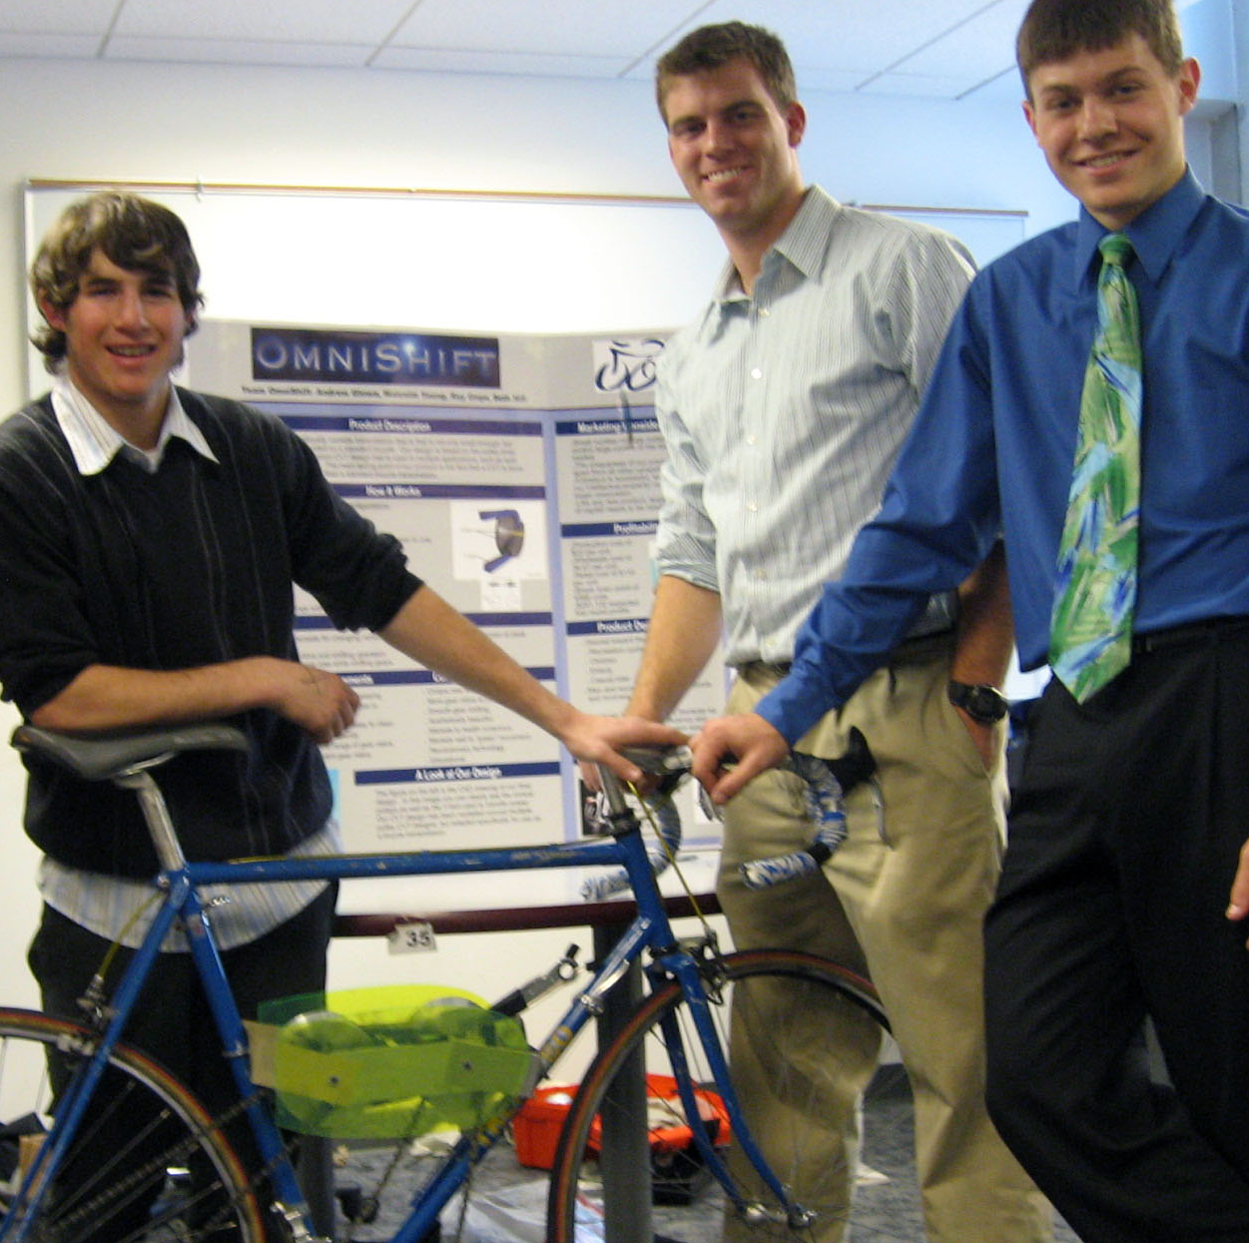
Prototype
“An original, full-scale and usually working model of a new product or new version of an existing product.”
-American Heritage Dictionary
  A functional model
  Does the idea work?
  How can it be improved?
  What aspects should we keep?
Notes:
Source of images: ITL Program, College of Engineering, University of Colorado Boulder; used with permission
http://itll.colorado.edu/design_expo/photo_gallery/de_2007/ and http://itll.colorado.edu/design_expo/photo_gallery/de_2008/

Slide 9
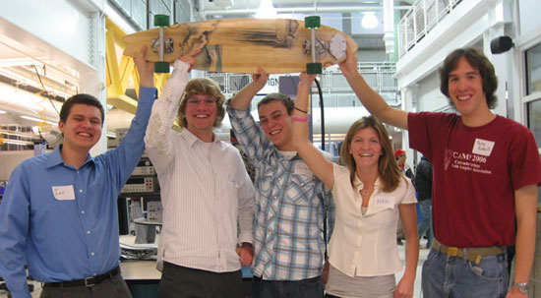
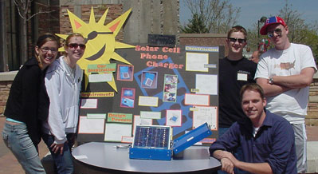
Present the Solution
  Be clear
  Highlight the best features
  How does the design
  solve the problem?
  How could the
  design best be used?
  What improvements could be made in
  future iterations?
Notes:
Source of images: 2007 Denise W. Carlson, ITL Program, College of Engineering, University of Colorado Boulder; used with permission
http://itll.colorado.edu/design_expo/photo_gallery/de_2007/ and http://itll.colorado.edu/design_expo

Slide 10
Engineering Design Process
1. Define the problem
2. Brainstorm
3. Pick a design
4. Plan to build
5. Build…
Test…
Redesign
6. Present the solution
Notes:
Review the steps
Image source: Design Squad-PBS-WGBH engineering design process diagram at http://www.pbslearningmedia.org/resource/adptech12.sci.engin.design.dsposter/the-design-process-poster/

