Slide 1
Net-Zero Energy Classroom!
Lets Design a…

Slide 2
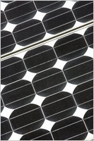
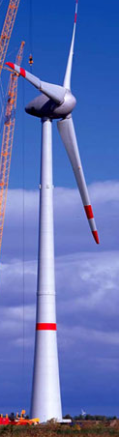
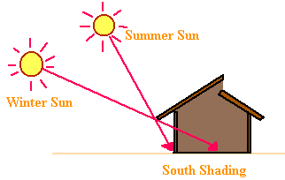
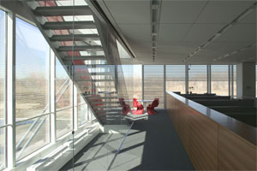
Create Power on Site
Active Solar – PV (Photovoltaic) Panels convert sunlight into electricity.
Wind Power – When the wind blows, the blades spin a turbine which generates electricity.
Passive Solar Heating –Light shines through south facing windows and warms the inside space.
Daylighting – Use outside light instead of turning on lights.

Slide 3
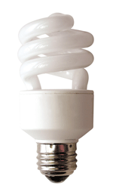
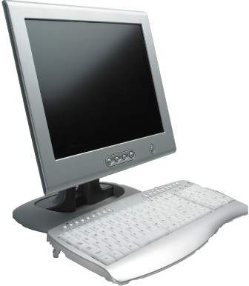
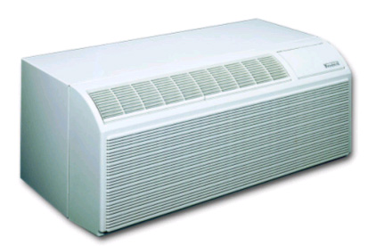
Efficient Use of Power
Lights – CFLs (spiral bulbs) use ¼ the energy of incandescent lights (regular bulbs).
Computers – putting computers, speakers and monitors on a power strip that you can turn off saves energy when you are not using it.
Air Conditioning and Heating – power is needed to run a fan that blows air into the space and to power the heating and cooling device. Very efficient models are available.

Slide 4
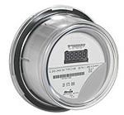
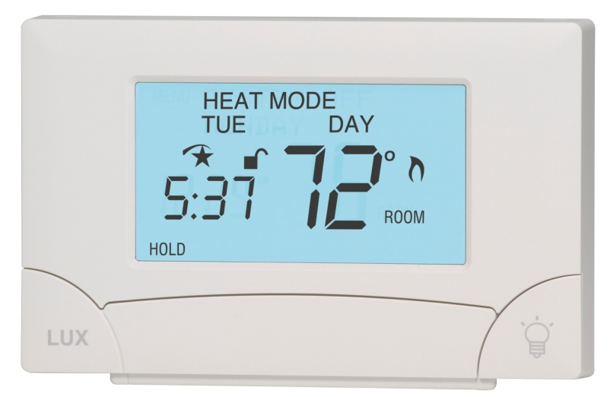
Monitor and Controls
Smart Meter –
  Tracks the total amount of power being used and communicates with the utility.
  Allows extra energy to flow into the grid. The utility will use your extra power and pay you $$$ for it.
Programmable thermostat –
  Allows temperature to adjust when occupants are not in room. Saves heating and cooling energy.

Slide 5
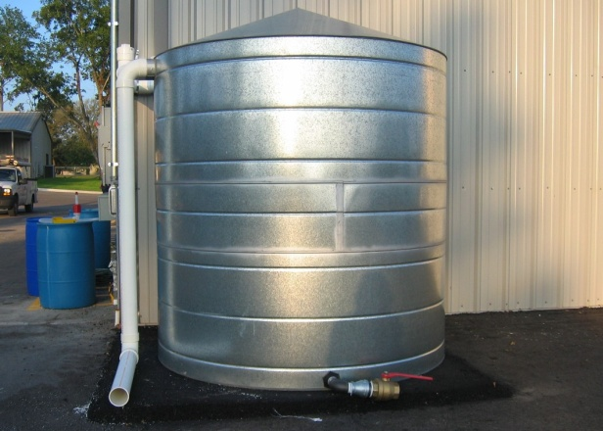
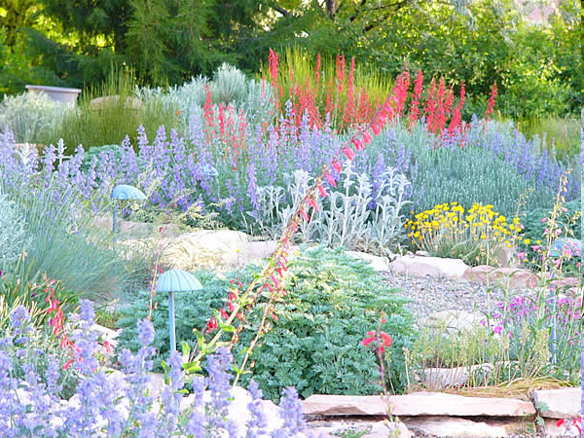
Water Conservation
Water storage tank – rain water that hits the roof is collected and stored to water plants or even to flush toilets
Xeriscape – Using native plants or lawn features that do not require much or any watering.

Slide 6

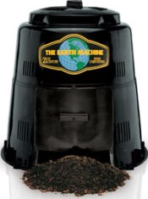
Reducing Waste
Recycle – paper, bottles, cans and other items can be recycled instead of being put in the trash can and ending up buried in the ground.
Compost – Food scraps can be put in a compost pile where they will decompose. Compost makes nutritious soil for plants.

Slide 7
Have fun!

Slide 8


References
http://www.america.gov/st/env-english/2008/February/20080228144750lcnirellep0.1695825.html
https://www.eere-pmc.energy.gov/PMC_News/EERE_Program_News_7-08.aspx
http://dnr.louisiana.gov/sec/execdiv/techasmt/ecep/drafting/c/c.htm
http://windows.lbl.gov/comm_perf/newyorktimes.htm
http://www.deq.mt.gov/Energy/conservation/homes/ExistingHomes/lighting.asp
http://www.roanokecountyva.gov/Departments/Library/ComputerClassSchedule/Default.htm
http://www.cpsc.gov/cpscpub/prerel/prhtml04/04569.html

Slide 9


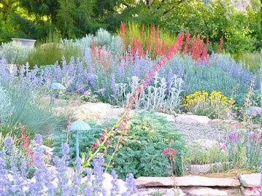
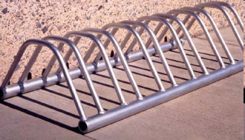
References (cont’d)
http://www.cpuc.ca.gov/cleanenergy/design/2008conferences.html
http://www.energystar.gov/index.cfm?c=cool_change.coolyourworld_product_images
http://www.cstx.gov/home/index.asp?page=1049
http://www.fws.gov/Pollinators/PollinatorPages/PollinatorWeek08.html
http://www.durhamcountync.gov/departments/gnsv/recycle/Recycling_Bin.html
http://www.flagstaff.az.gov/index.asp?NID=963
http://www.aci.az.gov/images/parks_rec/low_bike_rack.jpg

