Slide 1
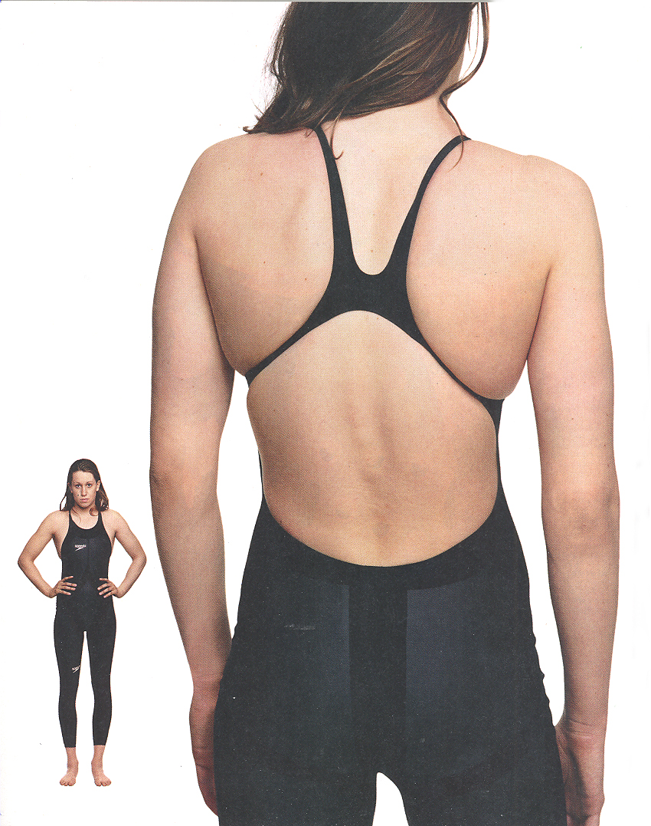
Design within the rules…
Examples of Engineering for the Olympics!
Designed within 2008
Olympic constraints
Compresses body at
key drag points
Makes swimmer
smaller, sleeker, faster
Worn by many gold
medalists
Inventors: Engineers at Speedo

Slide 2
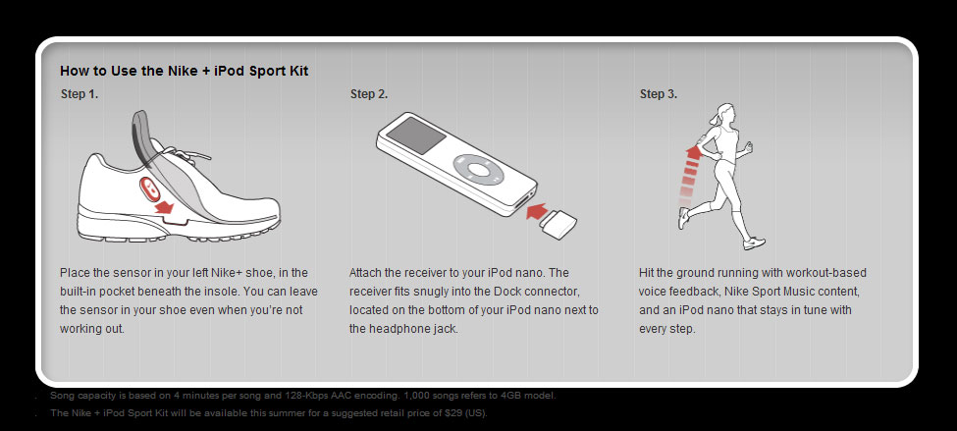
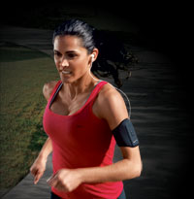
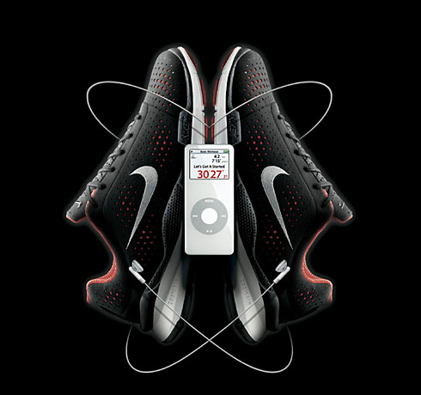
Step lively
Computers in
your shoes?
Ideal for training
Tracks distance,
time and calories
Customize your
musical play lists for workouts
Battery lasts 1000 hours
Inventors: Engineers at iPod/Apple and Nike
Examples of Engineering for the Olympics!

Slide 3
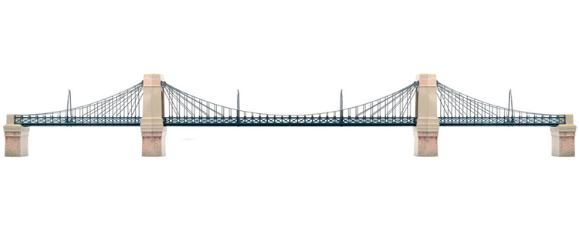
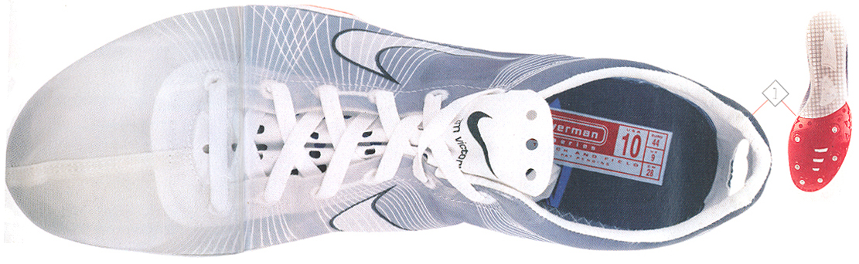
Down to the wire (really!)
Examples of Engineering for the Olympics!
Support threads are like a suspension bridge
Flywire replaces all heavy structure; ~3 oz
Inexpensive — may be manufactured in US
Inventors: Engineers at Nike

Slide 4
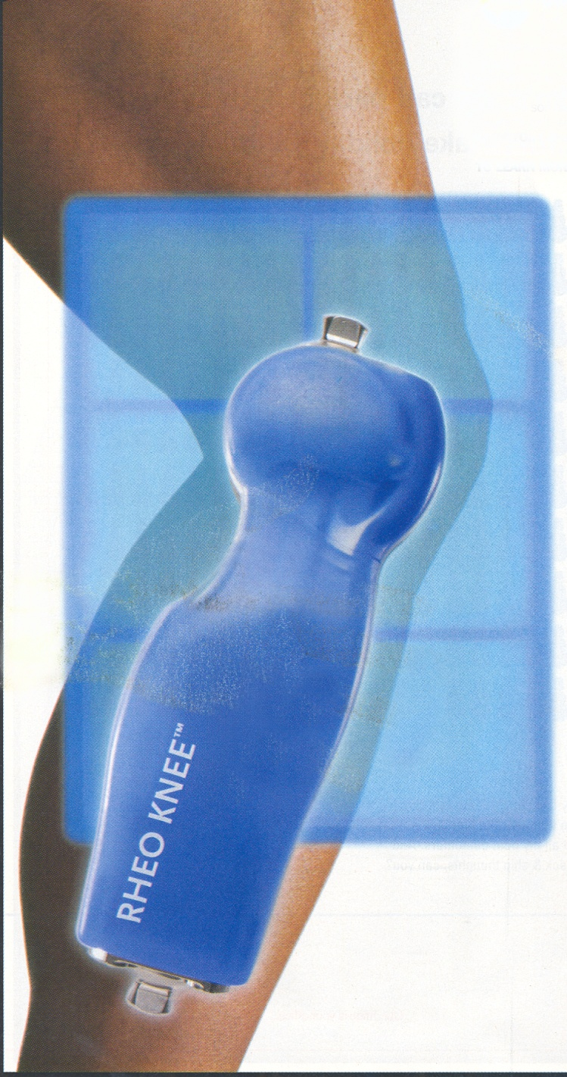
Smooth Operator
Examples of Engineering for the Olympics!
“Smart” prosthetic joint
“Learns” an individual’s movements and self adjusts
Reduces hip and back strain
Control module: made of sensors, a computer chip
and software
Inventors: Engineers at Ossur and MIT

Slide 5
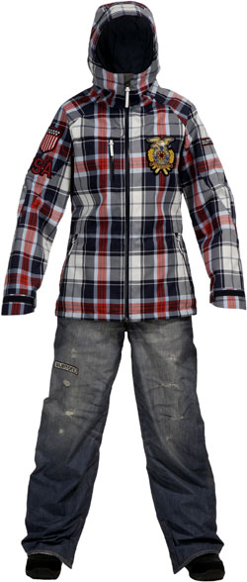
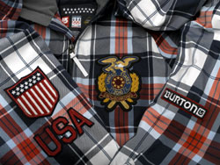
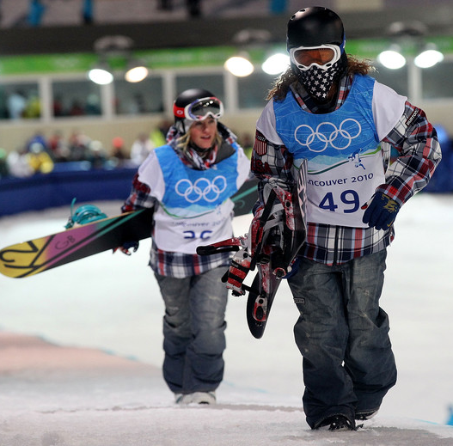
Not your everyday jeans…
Examples of Engineering for the Olympics!
2010 Winter Olympics
snowboarding uniforms
for US, China & Finland
Look like plaid flannel
and worn denim, but are:
…next-generation fabrics
made of waterproof
membranes with breath-
able microporous holes
Inventors: GORE-TEX and Burton Boards
Notes:
While the plaid jacket and denim looking ensemble resembles the clothes you might catch Shaun White in apre-ski putting back a frosty beverage, these duds are actually infused with some of the most modern technology known to snow lovers available. Both the pants and jacket are made of Gore-Tex combining the best breathable and waterproof material for rocking the half pipe.

Slide 6
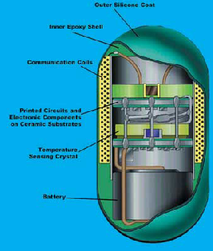
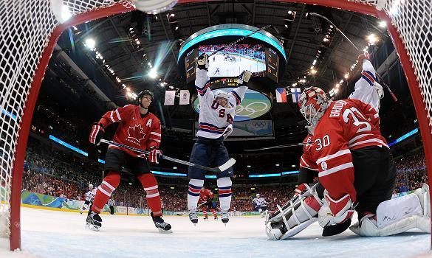
Ingestible computers for athletes (really!)
Examples of Engineering for the Olympics!
“Thermometer Pill” transmits
athletes’ core body temperature
and heart rate data
Alerts to heat
exhaustion
Quartz crystal
sensor & micro-
battery wrapped
in silicon
Inventors: Engineers at NASA and Johns Hopkins University
Notes:
Heat exhaustion is the second-leading cause of death in athletes. Until now, core body temperature has been monitored through observation, but athletes can ignore signs of heat exhaustion and trainers may be too far away to make accurate observations. A "thermometer pill" may save lives.
Initially developed by NASA and Johns Hopkins University to monitor astronauts from space, the pill contains a quartz crystal sensor and micro-battery wrapped in silicon. Once swallowed, a sensor transmits temperature and heart rate data to the trainer as it travels through the gastrointestinal tract. Athletes in field and track, auto racing, football, hockey, cycling and soccer have used a commercial spin-off based on NASA's version.

Slide 7
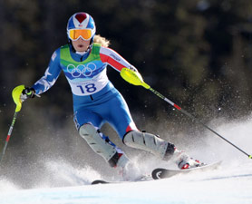
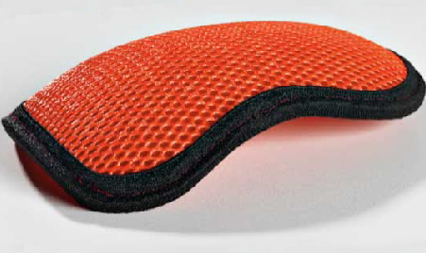
Skiing armor
Examples of Engineering for the Olympics!
Protects from high-
speed wipeouts
and 600mph gates
Soft, thin and flexible material
moves with body, but instantly
hardens upon impact
Spreads shock over surface area
Uses sheer thickening fluid reactive material
Inventors: Engineers at British firm d30 and Spyder
Notes:
Material is neon-orange goo that temporarily hardens with pressure
Non bulky and washable
High-speed sports put athletes at risk. Until recently, protective clothing that could absorb impact was often bulky and restrictive. That's changing with the development of materials such as U.K.-based d30 and Dow Corning's Active Protection System materials. Both are made from materials that flex and move with a body in action but immediately harden upon impact.
High-speed sports put athletes at risk. Until recently, protective clothing that could absorb impact was often bulky and restrictive. That's changing with the development of materials such as UK-based d30 and Dow Corning's Active Protection System materials. Both are made from materials that flex and move with a body in action but immediately harden upon impact.
Researchers at the University of Delaware have embedded materials with nanoparticles that become instantly rigid as soon as a kinetic energy threshold is crossed. That can come in handy for athletes, who could seriously hurt themselves if they fell and for people in the military or in law enforcement, who come into bodily harm unexpectedly on the job. And as a benefit, many of these products are washable. Recent applications include gear for downhill skiers and dirt bike racers, as well as ballet shoes, soccer balls, shorts for equestrians, and protective gear for soldiers and law enforcement agents.

Slide 8
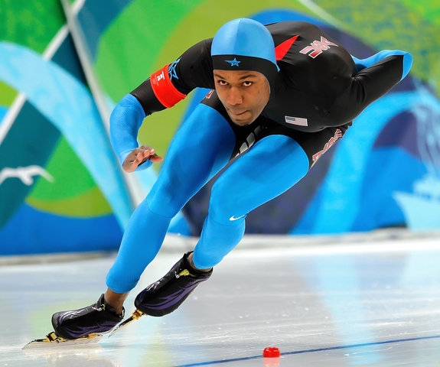
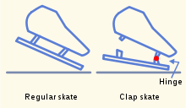
Skater’s edge
Examples of Engineering for the Olympics!
“Clap skates”
Back of blade hinged so stays on ice longer, evens out weight, legs generate more force
Aerodynamic “swift suit” reduces air drag – Nike assures 1% faster times (close races!)
Wind tunnel testing of suits and positions (arms behind backs, drafting, corner tilting)
Inventors: Engineers at Nike (suits) and many others
Notes:
Engineers give speed skaters an edge:
In a sport where just fractions of a second can separate a winner from the also-rans, engineering makes a big difference. Speed skating, for instance, once depended on endurance and brute force. Now, it’s as much a feat of science and technology as strength.
Two major innovations have radically altered the sport.
One is the “slap skate,” which was invented in the Netherlands in the 1890s, but wasn’t widely used until 1996. It features a hinge that allows the sharp skate blade to disconnect from the back of the skater’s boot, distributing the skater’s energy more evenly. Athletes wearing this type of footwear are able to use more of their calves and knees in pushing off the ice. This allows more force to be applied, and for longer, since the blade rarely leaves the ice.
The second is the suit, designed to reduce the skater’s wind resistance, or drag, as much as possible. 25% of the friction a speed skater faces comes from the ice, but 75% is air resistance.
The leading company that makes “swift suits” is Nike, which tested more than 100 types of fabrics and coatings before coming up with a special design that has rough fabric on the arms and legs and a smooth surface on the torso. Swift suits are developed for multiple sports, and they are tailored to fit different events within speed skating, such as Short Track, depending on the distance covered. Nike claims that athletes who wear its swift suits in the Olympic Games are, on average, one percent faster than those who wear other companies’ suits.
The suit is actually more aerodynamic than bare human skin, studies show, because subcutaneous fat, even on the sleekest athlete, wrinkles as the body speeds up and increases air resistance. The aerodynamic material is tested in special wind tunnel labs. Under Olympic rules, no attachments are allowed to the suit other than a hood.
In addition to wearing engineered gear, the athletes often tuck one arm behind their backs to reduce drag. Skaters may “draft” other racers to reduce air drag by using the leading skater’s body as a shield, thus letting the pursuing skater expend less energy. When cornering, they may also tilt close to the ground with one or both hands touching the ice, which allows for faster and more precise pivoting.
The Canadian Olympic Committee hopes to dominate the Vancouver Games, spending up to a quarter of its more than $110 million budget on technological improvements and advanced training. On this year’s list: even faster speed skating suits.
Although the main factors in the outcome of a race are skill and human error, sports engineering leaves less and less to chance. Occasionally, though, an athlete can triumph through sheer luck, and the main factors in the outcome of a race are skill and human error.
In 2002, Australia’s Steven Bradbury won the 1,000 meter Olympic speed skating race. He was in last place the entire time — until one of the lead skaters crashed into the rest of the pack. They all wiped out… except Bradbury, who skated around the mess and took home a gold medal.

Slide 9
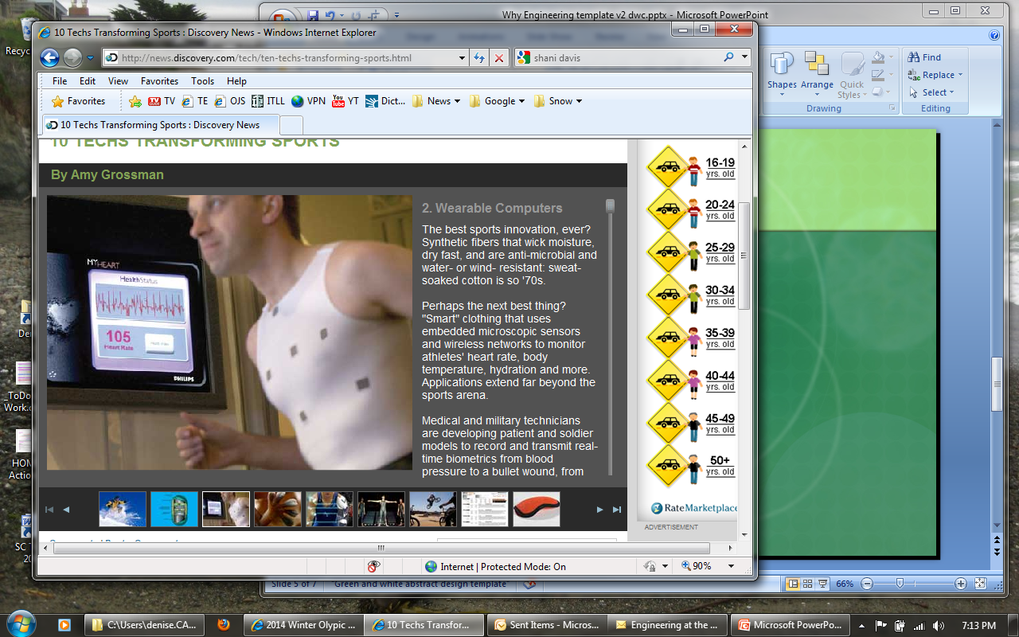
“Smart” clothing
Examples of Engineering for the Olympics!
Fabric with embedded microscopic sensors and wireless networks
Remotely monitors athlete’s heart rate, body temperature, hydration and more
Extends to patient and soldier applications:
Records and transmits real-time biometrics
— from blood pressure to bullet wounds
Notes:
Wearable computers:
The best sports innovation, ever? Synthetic fibers that wick moisture, dry fast, and are anti-microbial and water- or wind- resistant: sweat-soaked cotton is so '70s.
Perhaps the next best thing? "Smart" clothing that uses embedded microscopic sensors and wireless networks to monitor athletes' heart rate, body temperature, hydration and more. Applications extend far beyond the sports arena.
Medical and military technicians are developing patient and soldier models to record and transmit real-time biometrics from blood pressure to a bullet wound, from any location.

Slide 10
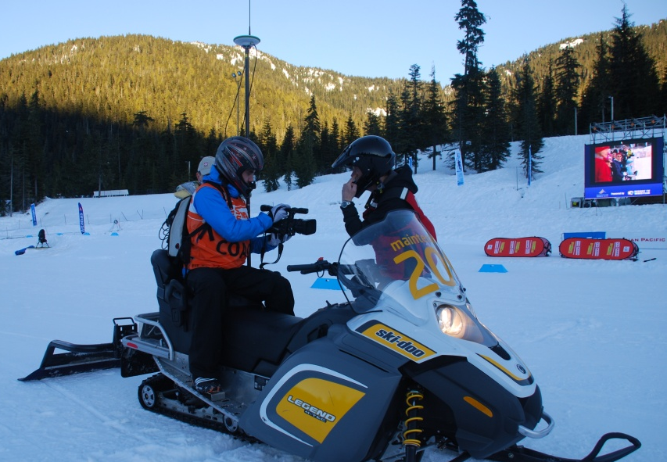
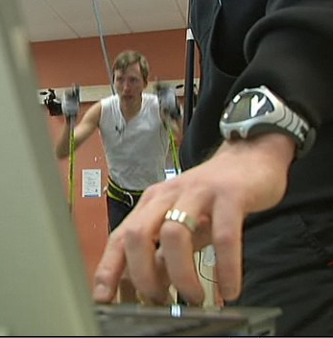
Virtual home field advantage
For 2010 Winter Olympics, mapped cross-country ski courses by designing a real-time kinematics global navigation satellite system
Takes 20 measurements per
second; accurate up to .4 inch
Captured real skier velocities
Programmed treadmill and added film footage for virtual race course roller-ski training
Inventors: Engineers at the Swedish Winter Sport Research Center
Examples of Engineering for the Olympics!
Notes:
Swedish Skiers Seek High-Tech Olympic Advantage
Sweden has an entire research center devoted to winter sports. It's called The Swedish Winter Sport Research Center, and it has a simple goal: harness all manner of biomechanical research and technology to help Swedish athletes excel. The center is prepared to go to some lengths to do it. In fact, they took some expensive, high-tech GPS gear to Whistler last year to help map out the cross-country courses. Normal GPS, accurate to a few feet, just wouldn't do, so they used something called the Real Time Kinematics Global Navigation Satellite System, which uses both stationary reference stations and a rover to get measurements that are accurate to .4 of an inch. The GPS in your car, for comparison, is accurate to a few feet.
Matej Supej helped the Swedish researchers take the measurements. He told me the system is so accurate because it uses both the US and the Russian satellites to take measurements. "We can make 20 measurements a second," Supej said. "We also rigged up skiers with equipment to measure their velocities on different parts of the course.“
One of Supej's helpers was Mikael Swaren, a biomechanics expert at the Center. He explained that the Swedish research team went one step further: "When we took the GPS measurements, we also had videotaped the entire course from a snowmobile."
OK, by now you're asking why. I was too. Well, it turns out that the Swedes were keen to develop a training product that puts your Nordic Track to shame. They wanted to create a treadmill that would allow Swedish cross country skiers to experience, in the most realistic ways possible, the Olympic courses.
Supej and Swaren took the GPS data from Canada back to Sweden, they wrote some sophisticated software, and programmed a large treadmill. The skier dons roller skis, the program starts, and away they go. On a screen in front of the skier, that footage from the course plays on a monitor. It's not virtual reality, but it's about as close to skiing Whistler as you can get and not be there.
"You know where you are, you recognize where you are and you can visualize what it's going to be like during the Olympics," says Swaren.
This is, of course, not like a running treadmill where you use up and down buttons to control the speed. Instead, a laser mounted behind the skier determines where the athlete is on the treadmill, and adjusts the speed accordingly. If the skier moves forward on the treadmill, exerting more energy, the program speeds up. If the skier moves to the back of the treadmill, it slows down. If they stay in the middle, speed is maintained.
As Swaren puts it: "Now now the skiers can come to the research center and they can see the video in front of them on the video screen. And then they can adjust the speed according to how they want. So they can play around and they can go back and ski the same hill a few times over and over again and see what it feels like."
Sprinters, then, can test out different strategies, while long-distance skiers can get a real sense of the pace they'll need to maintain on different parts of the course.
There are limitations. The treadmill can't re-create the snow conditions, for starters. And secondly, says Swaren, "the treadmill can't do turns, just up and down." So, while the skier sees the turns on the video, the treadmill can't actually do the turns. It's always pointing straight ahead.
"So if you see any Swedes skiing straight into the woods, then you know that they've been on the treadmill too much," Swaren jokes.
You can see a video (in Swedish, but you'll get the idea) of the treadmill in action here.

Slide 11
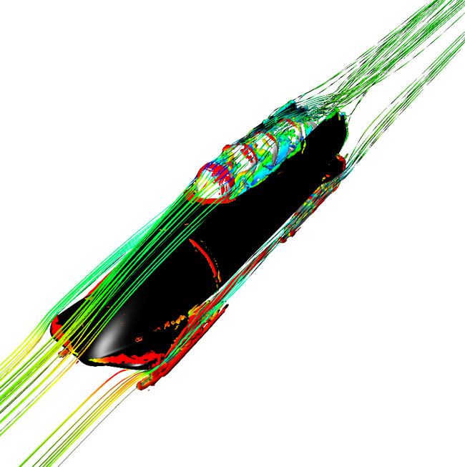
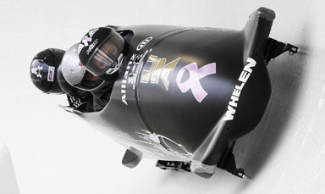
Most aerodynamic sled ever
Examples of Engineering for the Olympics!
Inventors: Race car engineers at Exa Corporation
Digitally modeled the bobsled’s fluid dynamics to minimize drag-inducing air vortexes that form behind riders’ heads
Suspension minimizes energy-draining vibration
Chassis of fiberglass, Kevlar and carbon fiber
Adjusts for weather, track conditions, metal fatigue
2010 Olympics coach: “1/3 of team’s success due to engineering”
Notes:
In 1992, former Daytona 500 champion Geoff Bodine dedicated himself to rebuilding American bobsledding. With the help of car designer Bob Cuneo, he formed the Bo-Dyn Bobsled Project and began building custom sleds to replace the retread imports the U.S. had been using. “Now the Italians are working with Ferrari; the British have McLaren; the Swiss have gone to Audi,” Cuneo says. “But we were the first team to acknowledge the crossover between race cars and bobsleds.” Bo-Dyn engineers have spent nearly two decades improving the suspension, streamlining the sled body and studying metallurgy for the steel runners. The payoff: The U.S. team won its first world championship in 50 years last February. Ultimately, Cuneo estimates that about a third of the team’s success in Vancouver comes down to engineering.
The Whistler Sliding Centre on Blackcomb Mountain (right) is the world’s steepest bobsled track. It drops 500 feet over a distance of 4757 feet, a gradient that generates speeds of up to 95 mph.
The Whistler Sliding Centre on Blackcomb Mountain (right) is the world’s steepest bobsled track. It drops 500 feet over a distance of 4757 feet, a gradient that generates speeds of up to 95 mph.
The Whistler Sliding Centre on Blackcomb Mountain (right) is the world’s steepest bobsled track. It drops 500 ft over a distance of 4757 ft, a gradient that generates speeds of up to 95 mph.
The sled’s 462-lb body is a proprietary blend of fiberglass, Kevlar and carbon fiber. The U.S. team enlisted supercomputing firm Exa to model the sled’s fluid dynamics in order to minimize drag-inducing air vortexes that form behind riders’ heads.
To minimize energy-bleeding vibrations, Cuneo’s team continuously adjusts the steel chassis and torsion-bar suspension for weather, track conditions, metal fatigue and stress from the g-forces.

Slide 12
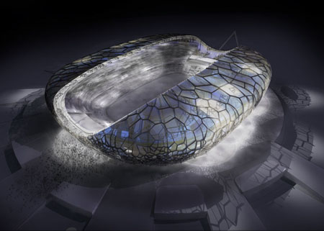
2014 Winter Olympics Stadium
In Sochi, Russia
Stadium for 40,000 in the shape of a pebble
A segmented, semi-transparent skin resembling a dragonfly wing
Inventors: Engineers and architects at Populous
Notes:
State Corporation “Olympstory” has unveiled their innovative design for the 2014 Winter Olympic Stadium with every possible surprising attributes. The main stadium design along with the venue overlay plan delivers a great vision of the upcoming winter Olympics and an everlasting sustainable heritage for Sochi. Its getting advantage from both it’s mountainous backdrop and coastal location, whilst its wonderful crystalline skin engages with the surrounding areas by day, and gives an iconic visor of the spectacular lightings during the night. The stadium has been designed in the shape of a pebble with the capacity of 40,000 seats and boasts clear references with a segmented, semi-transparent skin resembling a dragonfly wing.

Slide 13
Source information Feb 2010 (Winter Olympics)
Not your everyday denim…
http://www.tipsfromthetlist.com/20513.html and http://www.zimbio.com/pictures/S45zd2-s7ns/Snowboard+Day+4/9FUJESPv0iR/Gretchen+Bleiler and http://www.gore-tex.com/remote/Satellite/content/community/press-release/1 and http://insite.artinstitutes.edu/fabric-technology-works-to-enhance-performance-at-winter-olympics-19726.aspx
Skiing armor
http://news.discovery.com/tech/winter-olympics-body-armor.html and http://news.discovery.com/tech/ten-techs-transforming-sports.html
Ingestible computers
http://news.discovery.com/tech/ten-techs-transforming-sports.html
Engineers give speed skaters edge
http://teachers.egfi-k12.org/engineers-give-speed-skaters-an-edge/ and http://www.newsobserver.com/2010/02/17/344883/shani-davis-repeats-as-speedskating.html and http://en.wikipedia.org/wiki/Clap_skate
Smart clothing – wearable computers
http://news.discovery.com/tech/ten-techs-transforming-sports.html
GPS course mapping – virtual home field advantage
http://news.discovery.com/tech/swedish-skiers-seek-high-tech-olympic-advantage.html
Bobsledding
http://www.cbsnews.com/stories/2010/02/22/tech/main6231849.shtml and http://www.popularmechanics.com/outdoors/sports/4345010.html?page=3
Russian 2014 stadium design: http://www.tuvie.com/2014-winter-olypic-stadium-and-paralympic-games-in-sochi-russia/

