Slide 1
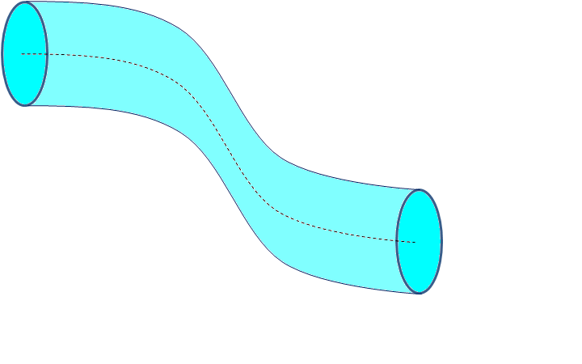
As the water loses elevation from the high end of the pipe to the low end, it gains velocity.
To find the exact value of any parameter,
we apply the Bernoulli equation to two points anywhere along the same streamline.
P₁
v₁
streamline
h₁
P₂
v₂
h₂
Ground (h = 0)
Notes:
Bernoulli’s Principle lesson

Slide 2

h₁ = 250 m
P₁ = atmospheric
The water at the top of the reservoir starts at rest,
so v₁ is zero, and the first term drops out.
Since the final height (h₂) is also zero, this term
drops out, too.
Lastly, P₁ = P₂, which is atmospheric pressure,
so these terms drop out as well.
Plugging in the remaining the known parameters:
ρ_{water} g (250 m) = ½ ρ_{water} v₂²
Now the ρ_{water} terms can be cancelled out.
Using g = 9.8 m/s² and solving for v₂, we have
v₂ = sqrt (2*9.8 m/s² * 250 m)
v₂ = 70 m/s
h₂ = 0 m
P₂ = atmospheric
Notes:
Bernoulli’s Principle lesson

