Slide 1
Blood Clots,
Polymers and Strokes
Notes:
Blood Clots, Polymers and Strokes Presentation, part of the Blood Clots, Polymers and Strokes lesson, TeachEngineering.org

Slide 2
Polymers
Polymers are large molecules made of a repeating series of smaller molecule units.
The small units are called monomers.
Polymerization is the process of linking together monomers to form a larger polymer.
monomer
polymer

Slide 3
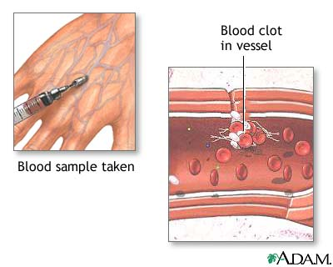
What is a Blood Clot?
When damage occurs to a blood
vessel, the body creates a blood
clot to prevent blood loss. ➔
Damaged vessels release
proteins causing a cascade
leading to coagulation and
the creation of a clot:
  platelets bind to the damaged tissue
  fibrinogen (a protein) is recruited to the site and is converted to fibrin
  fibrin is polymerized and creates a mesh that, when combined with the platelets, creates a blood clot
When the vessel is healed, the body dissolves the clot.
Notes:
Image source: ADAM, Florida Health Finder, http://www.floridahealthfinder.gov/healthencyclopedia/health%20illustrated%20encyclopedia/2/9326.aspx

Slide 4
Vessel Blockage
An embolism is an object (blood clot, plaque) that travels through vessels, gets stuck and blocks blood flow. It can be created from:
  the failure of the body to break-down a clot
  or a clot that breaks off the vessel wall
  excessive plaque build-up in vessel walls
A thrombosis is a blood clot that grows abnormally in a vessel and cuts of blood flow.
Notes:
Embolism = Object (blood clot, plaque) that travels through a vessel and blocks blood flow.
Thrombosis = Abnormal blood clot formation within a vessel.

Slide 5
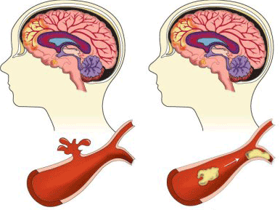
Stroke
A stroke is a loss of brain function due to an interruption of the blood supply to the brain.
⬅ischemic strokes are caused by blood clots that block blood flow to areas
of the brain.
(87% of strokes)
hemorrhagic strokes are caused by a hemorrhages (bleeding) in the brain. ➔
Notes:
A hemorrhagic stroke occurs when a blood vessel bursts within the brain, causing bleeding inside or around brain tissue.
An ischemic stroke occurs when a blood clot blocks the blood flow in an artery of the brain.
Image source: Centers for Disease Control and Prevention, http://www.cdc.gov/stroke/types_of_stroke.htm

Slide 6
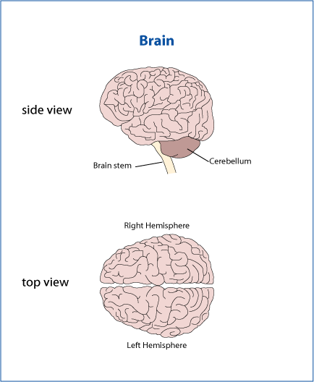
The Brain
Different parts of the brain have different functions.
cerebrum:
controls higher thought, speech, motion and vision
cerebellum:
controls balance and fine motor skills
brain stem:
controls vital life functions
Notes:
Image source: womenshealth.gov, http://womenshealth.gov/publications/our-publications/fact-sheet/stroke.cfm

Slide 7
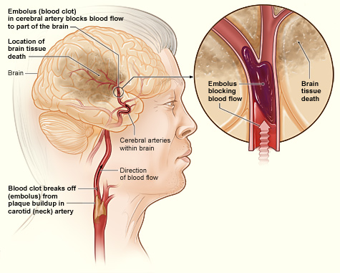

Effects of a Stroke
When a tissue is cut off from its blood supply, it
has no oxygen or nutrients and begins to die.
The effects depend
largely on where in
the brain it occurs,
how large of an area
is affected, and
how long the
tissue is deprived
of blood.
Notes:
Image source (ischemic stroke medical illustration showing location of brain tissue death): National Heart, Lung and Blood Institute, http://www.nhlbi.nih.gov/health/health-topics/topics/stroke/printall-index.html
Image source (act in time): South Dakota Dept. of Health, http://doh.sd.gov/HDS/stroke.aspx

Slide 8
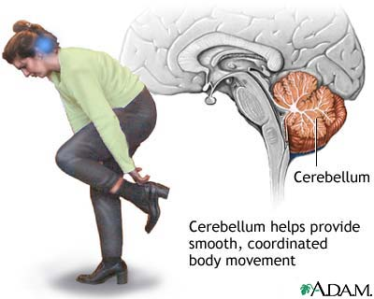
Stroke Locations
cerebrum 
A stroke here causes difficulty thinking and speaking.
brain stem 
A stroke here would likely be lethal.
⬅cerebellum
A stroke here causes dizziness and difficulty controlling fine motor skills.
Notes:
Image source (brain drawing): womenshealth.gov, http://womenshealth.gov/publications/our-publications/fact-sheet/stroke.cfm
Image source (woman/cerebellum drawing): ADAM, MedLine Plus, http://m.medlineplus.gov/ency/imagepages/18008.htm

Slide 9
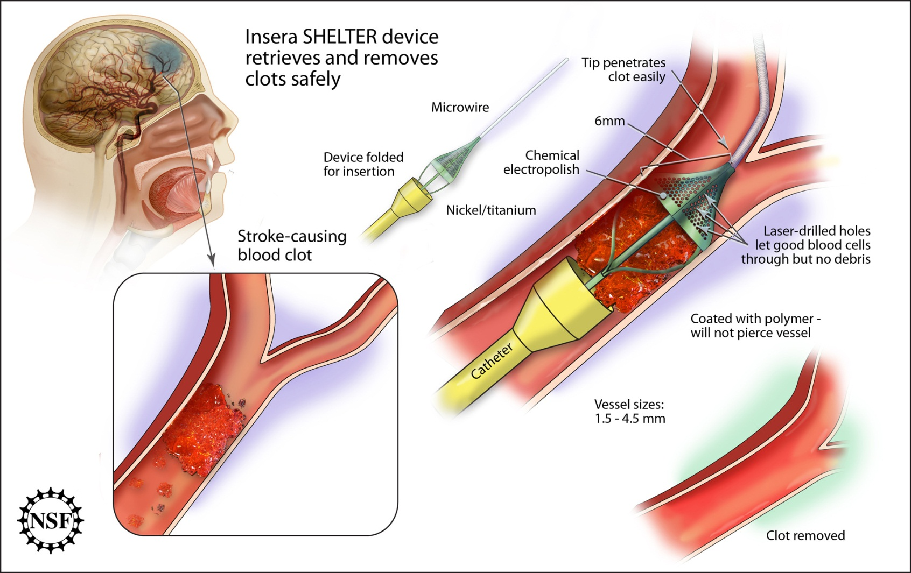
Restoring Blood Flow
Biomedical engineers design tools to remove blood clots.
Notes:
Image source: National Science Foundation http://www.nsf.gov/news/news_images.jsp?cntn_id=117083&org=NSF

Slide 10
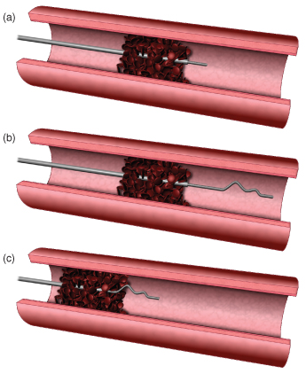
Example Biomedical Device
Merci Retrieval System
  A cork-screw device is inserted
  through the femoral artery in the groin and travels to the site of the blood clot in the brain.
  The tool grabs the clot and pulls it out through the artery.
Notes:
Image source: Lawrence Livermore National Laboratory, https://www.llnl.gov/str/MayJune08/images/ane8.jpg
Show 2:14-minute video clip of Merci Retrieval System at YouTube: http://www.youtube.com/watch?v=99x_APzvD1c
Show students a photo of the Merci and Penumbra devices at: Annals of Internal Medicine, February 15, 2011, Vol. 154, No. 4, https://annals.org/article.aspx?articleid=746808

Slide 11
Example Biomedical Device
Penumbra System
  A thin device is inserted through the femoral artery in the groin area and travels to the site of the clot in the brain.
  The tool sucks up the blood clot to restore blood flow.
Teacher: insert image found at: stroke.ahajournals.org/content/43/1/280/F2.large.jpg
Notes:
Teacher: Insert the device image found at this source: stroke.ahajournals.org/content/43/1/280/F2.large.jpg
Show 1:23-minute video clip of Penumbra System at YouTube: http://www.youtube.com/watch?v=_-irwhRes90

