Slide 1
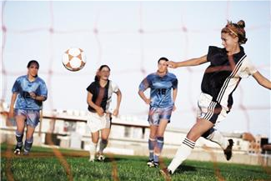
Robot Soccer Challenge
Notes:
Robot Soccer Challenge activity > TeachEngineering.org
Image source: Microsoft clipart at http://office.microsoft.com/en-us/images/results.aspx?qu=soccer&ex=1#ai:MP900422624|

Slide 2
Pre-Activity Quiz
What kind of wireless electrical connection can NXT robots use to communicate with other electrical devices (including other NXTs)?
Can you think of a way to use a Bluetooth connection to enable one NXT robot to remotely control another? Describe it.

Slide 3
Pre-Activity Quiz Answers
What kind of wireless electrical connection can NXT robots use to communicate with other electrical devices (including other NXTs)?
Bluetooth technology is a wireless connection that enables communication between electrical devices.
Can you think of a way to use a Bluetooth connection to enable one NXT robot to remotely control another? Describe it.
Let’s call one NXT the “controller” and the other NXT the “receiver.”
Answer continues on next page ➔

Slide 4
Pre-Activity Quiz Answers (continued)
When each button (orange, left, right) is pressed on the controller NXT, have the controller send a distinct message (“1”, “2”, “3”) via Bluetooth to the receiver.
When no controller button is pressed on the controller NXT, have the controller send another distinct message (“0”) to the receiver.
Program the receiver so that:
when it receives “1” it moves forward
when it receives “2” it moves left
when it receives “3” it moves right
when it receives “0” it does nothing

Slide 5
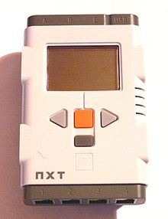
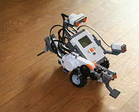
Your Design Challenge
To program two NXTs (a “controller” and a “receiver”) so that one can be used to remotely control the other via a wireless Bluetooth connection so that…
When you press the orange button on the controller NXT, the receiver NXT moves forward.
When you press the left arrow button on the controller NXT, the receiver NXT turns left.
When you press the right arrow button on the controller NXT, the receiver NXT turns right.
Notes:
Images sources: (LEGO NXT intelligent brick) 2008 Hugo12, Wikimedia Commons http://commons.wikimedia.org/wiki/File:Nxt-brique.jpg; (LEGO robot on wooden floor) 2006 Eirik Refsdal, Wikimedia Commons http://commons.wikimedia.org/wiki/File:Lego_Mindstorms_Nxt-FLL.jpg

Slide 6
Design Challenge Objectives (continued)
When we are done, we will be able to control the LEGO MINDSTORMS NXT taskbot (the “receiver”) similarly to how the robot in this video is controlled: http://youtu.be/zohDeKxXUPo?t=1m.
If several groups are able to run their programs at the same time, they can use their NXT taksbots to “play soccer” with a small ball. To do this, each group remotely controls its taskbot, which acts as one of the soccer players.
Notes:
The LEGO NXT battle tank (remote controlled) video is 1:58-minutes long at http://youtu.be/zohDeKxXUPo?t=1m

Slide 7
Part 1: Understanding the Programs
Before you use one NXT to remotely control another, you must understand how the programs for the controller and receiver NXTs work and how they interact with one another.
Notes:
Images sources: (LEGO NXT intelligent brick) 2008 Hugo12, Wikimedia Commons http://commons.wikimedia.org/wiki/File:Nxt-brique.jpg; (LEGO robot on wooden floor) 2006 Eirik Refsdal, Wikimedia Commons http://commons.wikimedia.org/wiki/File:Lego_Mindstorms_Nxt-FLL.jpg

Slide 8
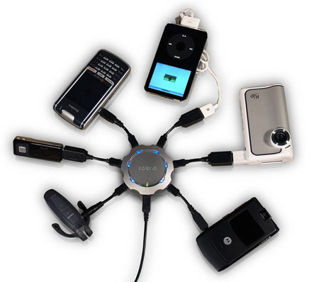
Review: What is an electrical connection?
An electrical connection is the link or bond that passes electricity between two or more things.
Wireless electrical connections allow two devices to be linked remotely without being joined by a wire.
Notes:
Image source: (six devices connected to chargepod multi-device charger hub; source): http://www.techgadgets.in/misc-gadgets/2007/21/callpod-chargepod-a-multi-device-charger-announced/ and CallPod Mobile Necessities http://www.callpod.com/products/chargepod

Slide 9
Review: Bluetooth with the NXT
NXT robots can use a wireless connection called Bluetooth® to communicate.
Like many other devices (such as smartphones), the NXT can send text messages through Bluetooth.
Example: If you were worried about an intruder coming into your room, you could program the NXT to use the ultrasonic sensor to “watch” the door to your bedroom. If the ultrasonic sensor detects the door moving, it could send you a message saying “intruder alert.”

Slide 10
Bluetooth Program Overview
In this activity, we need one NXT to be the remote control device (the “controller”) and the other to be the vehicle that responds to the controller (the “receiver”).
So one NXT, the controller, sends messages via Bluetooth when you press different buttons on the NXT brick.
The other NXT, the receiver, receives those messages via Bluetooth and is programmed to move forward, left, right or backwards when it receives the messages.

Slide 11
Controller Program
Go forward: send 1
Turn Left: send 2
Turn right: send 3
If no buttons pressed: send 0
When any one of the three LEGO brick buttons (see above) is pressed, we want the controller to send a corresponding message (“1”, “2,” or “3”) to the receiver.
When no buttons are pressed, the controller sends the message “0.”
Notes:
Image sources (LEGO NXT intelligent brick) 2008 Hugo12, Wikimedia Commons http://commons.wikimedia.org/wiki/File:Nxt-brique.jpg

Slide 12
Receiver Program
When the receiver NXT receives the “0” message via Bluetooth, it knows that the controller NXT does not have any buttons being pushed and stops moving.
When the receiver receives “1,” it knows that the controller’s orange button is being pushed and the receiver moves forward.
When the receiver receives “2,” it knows that the controller’s left button is being pushed and the receiver turns left.
When the receiver receives “3,” it knows that the controller’s right button is being pushed and the receiver turns right.

Slide 13
Summary: NXT Interactions Using Bluetooth
Controller Program
Receiver Program
controller button pushed ⬇ | Via Bluetooth, the controller sends this message ⬇ | Via Bluetooth, the receiver receives this message ⬇ | receiver action ⬇
no button | “0” | “0” | does not move
orange | “1” | “1” | moves forward
left | “2” | “2” | turns left
right | “3” | “3” | turns right

Slide 14
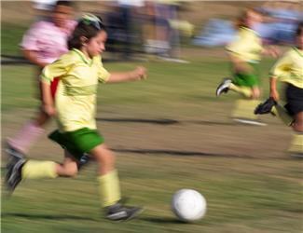
Part 2: Running the Programs!
Now that you understand how the programs work, let’s download them onto the NXTs!
Once groups have the controller/receiver programs working and have some practice with remotely controlling their taskbots, we’ll organize a game of robot soccer!
Notes:
Image source: (girl chases soccer ball): Microsoft clipart: http://office.microsoft.com/en-us/images/results.aspx?qu=soccer&ex=1#ai:MP900422170|

Slide 15
Change the Receiver NXT Name
Since the class will have more than one NXT robot using Bluetooth at the same time, it is best to change the receiving NXTs’ names to something unique so that they are easily recognizable from each other.
To do this, follow the instructions below and on the following slides:
Turn on the receiving NXT and use the USB cord to plug it into the computer.
Launch “LEGO MINSTORMS NXT” software on the computer.
Open a new or existing program.

Slide 16
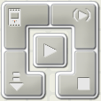
(continued)
Change the Receiver NXT Name
Look for a gray panel of buttons to appear in the bottom right corner of the screen.
Click on the button with a picture of the NXT brick on it.

Slide 17
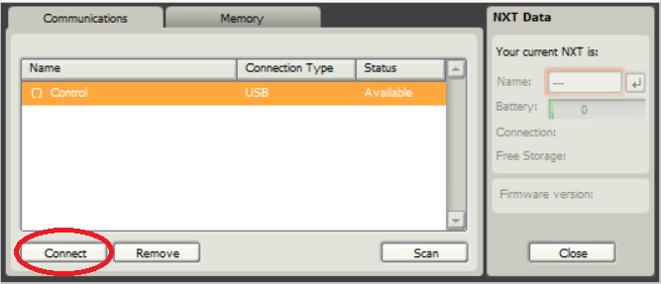
(continued)
Change the Receiver NXT Name
A window appears (see below).
Select the robot name that you want to change (on the screen this is “Control”) > click the “Connect” button.

Slide 18
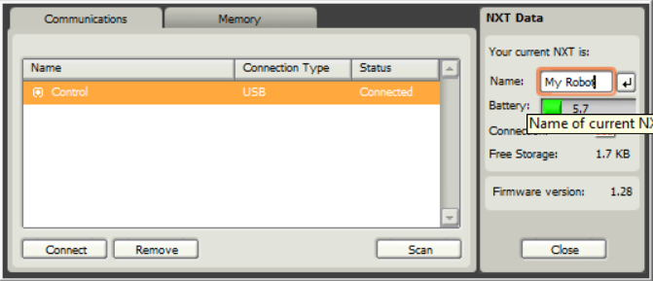
(continued)
Change the Receiver NXT Name
Next, place the cursor inside the orange box and type in the unique name of the robot (in the example, “My Robot”) > then hit the enter button.
Close the window; your NXT has been renamed.

Slide 19
Downloading Instructions
Now you are ready to download the controller and receiver programs onto both NXT bricks.
Note: These two programs are provided so you do not have to create them—no programming is necessary for this challenge.
Download the receiver program, Receiver.rbt, onto the NXT that will be receiving messages, which should be an NXT on a taskbot that can move.

Slide 20
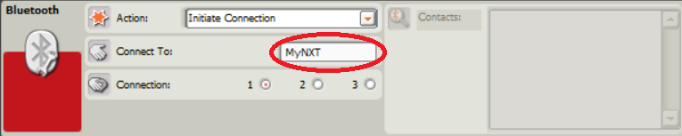
Downloading Instructions
(continued)
Download the controller program by performing these steps:
Open the controller program, Controller.rbt, on the computer and highlight the second block.
In the field next to “Connect To,” type in the unique name you gave your receiver robot.

Slide 21
Downloading Instructions
(continued)
Download the controller program, Controller.rbt, onto the NXT that you want to use as a remote control device.
(This order is important →) Begin running the receiver program on the receiving NXT. Then run the controller program on the NXT that remotely controls it.
Have fun!

Slide 22
Post-Activity Quiz
Explain how we used messages sent over a Bluetooth connection to enable one NXT to be used to remotely control another.
What ideas do you have for how you might change the programming to accomplish different tasks using two NXT bricks?
In your own words, what are the steps of the engineering design process? Which is your favorite step?

Slide 23
Post-Activity Quiz Answer
Explain how we used messages sent over a Bluetooth connection to enable one NXT to be used to remotely control another.
Let’s call one NXT the “controller” and the other NXT the “receiver.”
When each button (orange, left, right) is pressed on the controller, it sends a distinct message (“1”, “2”, “3”) via Bluetooth to the receiver. When no button is pressed on the controller, it sends another distinct message (“0”) to the receiver.
We programmed the receiver NXT so that…
when it receives “1” it moves forward
when it receives “2” it moves left
when it receives “3” it moves right
when it receives “0” it does nothing
What ideas do you have for how you might change the programming to accomplish different tasks using two NXT bricks? Answers will vary.
In your own words, what are the steps of the engineering design process? And which is your favorite step?
The main steps: 1) understand the problem or challenge, 2) brainstorm and research to generate solution ideas and preliminary designs, 3) choose the best solution to pursue as the definitive design, 4) create a prototype, 5) test it and make improvements, 6) present the results and final solution.

Slide 24
Vocabulary
Bluetooth technology: A type of wireless electrical connection used for communication between two devices.
electrical connection: The link or bond that passes electricity between two or more things.
soccer field ➔
Notes:
Image source (soccer field diagram): 2014 Denise W. Carlson, College of Engineering, University of Colorado Boulder. Used with permission.

