Slide 1
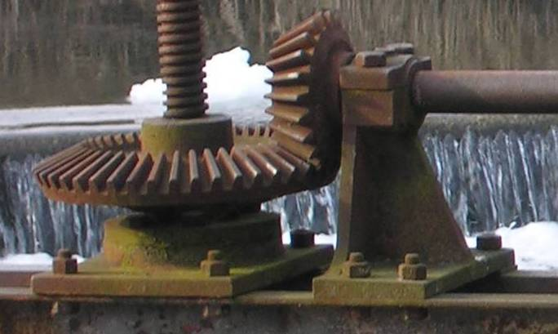

What Are Gears? What Do They Do?
Notes:
What Are Gears? What Do They Do? Lesson > TeachEngineeering.org
Image source (2 gears): 2006 Audrius Meskauskas, Wikimedia Commons: http://en.wikipedia.org/wiki/File:Bevel_gear.jpg
Image source (2 cyclists): Microsoft clipart: http://office.microsoft.com/en-us/images/results.aspx?qu=bicycle&ex=1#ai:MP900407440|mt:2|

Slide 2
Pre-Lesson Quiz
What is a gear?
List as many examples as you can of gears or objects that use gears.

Slide 3
Pre-Lesson Quiz Answers
What is a gear?
A gear is a wheel with teeth that meshes together with other gears and is usually made of metal or plastic.
List as many examples as you can of gears or objects that use gears.
Examples: wind-up toys, non-digital clocks, drills, bicycles, car transmissions, powered wheel chairs, and lifts.

Slide 4
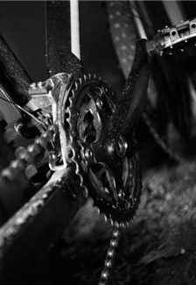
What Are Gears? What Do They Do?
50 minutes
Gears are used all around us and are relevant to understanding of how machines work.
Do you recall seeing gears on your bike? Do you know how the bike gears work to move the bike forward? Today’s lesson will help you understand how gears are used in machines such as clocks, cars and even bulldozers!
We will consider several types of gears.
Then, we will apply ideas about gearing in the next class to two design challenges: 1) Hare Challenge and 2) Snail Challenge
Notes:
50 minutes
Image source: Microsoft clipart at http://office.microsoft.com/en-us/images/results.aspx?qu=bicycle&ex=1#ai:MP900387208|mt:2|

Slide 5
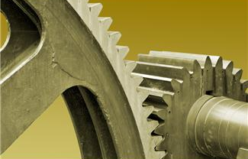
What Is a Gear?
A gear is a wheel with teeth that meshes with another similar gear that is typically larger or smaller.
Gears come in various sizes and types. Depending on the situation, one gear may work better than another.
Gears are used to change the speed, torque and direction of a power source.
What is a gear used for?
Changing speed
Changing direction of motion
Changing torque
Notes:
Image source: Microsoft clipart at http://office.microsoft.com/en-us/images/results.aspx?qu=gear&ex=1#ai:MP900448727|

Slide 6

Introduction to Gears
Watch this excellent 11-minute video: Gear Basics
https://www.youtube.com/watch?v=odpsm3ybPsA
Topics covered:
Spur gears with axles
Using gears to change direction of rotation
Using gears to change rate of rotation
Compare rates of rotation by comparing number of teeth
Compound gears and bevel gears
Mechanical advantage (using gears to change force)
Canal or river locks (using hand-operated wenches)
Bicycles (gears connected by chains = sprockets)
Notes:
The “Gear Basics” video provides a basic introduction to gears, suitable for grades 4 to 9. Gear rotation, gear ratio, rates of rotation, mechanical advantage and examples of use are included.
Image source: Gear Basics video at https://www.youtube.com/watch?v=odpsm3ybPsA

Slide 7
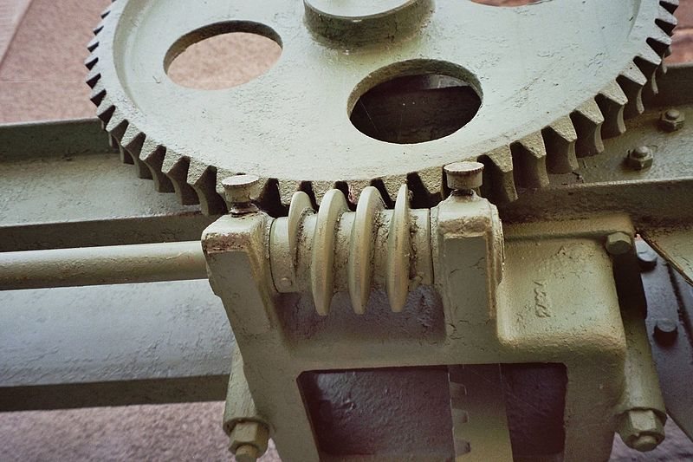
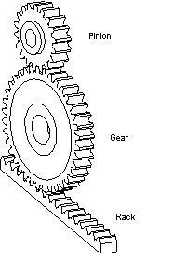
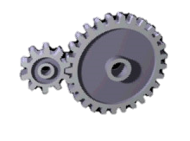
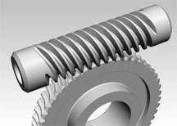
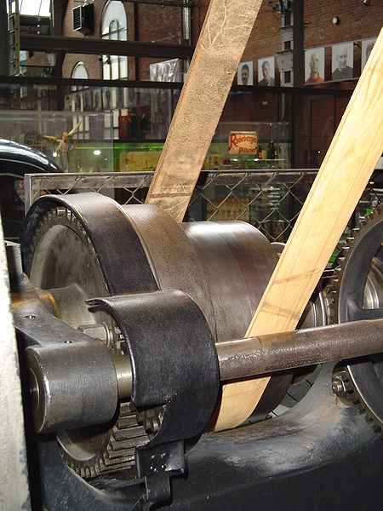
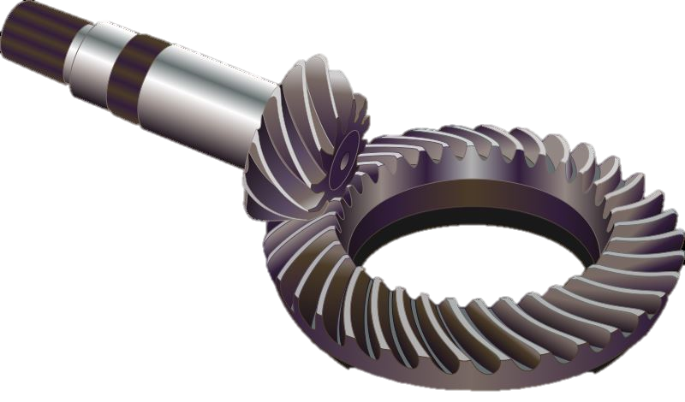
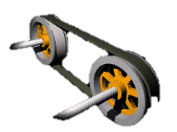
Different Types of Gears
worm gears
spur gears
bevel gears
pulleys
Notes:
Images sources: TOP (left to right):
Spur gears drawing: 2007 GearHeads, English Language Wikipedia, http://commons.wikimedia.org/wiki/File:Spur_gear.JPG
Spur gear: OSHA https://www.osha.gov/SLTC/etools/machineguarding/motions_actions.html
Silver worm gear rendering: 2011 Catsquisher, Wikimedia Commons http://commons.wikimedia.org/wiki/File:Worm_Gear.gif
Worm gear of a weir mechanism: 2005 Markus Schweiss, Wikimedia Commons http://commons.wikimedia.org/wiki/File:Schneckengetriebe02.jpg
Images sources: BOTTOM (left to right):
Rusty bevel gear: 2006 Audriusa, Wikimedia Commons http://commons.wikimedia.org/wiki/File:Bevel_gear.jpg
Silver bevel gear: 2007 Myriam Thyes, Wikimedia Commons http://commons.wikimedia.org/wiki/File:Gear-kegelzahnrad.svg
Pulley-belt around orange and gray wheels: OSHA https://www.osha.gov/SLTC/etools/machineguarding/motions_actions.html
Pulley in transmission: 2005 Kolossos, Wikimedia Commons http://commons.wikimedia.org/wiki/File:Transmisionsantrieb.jpg

Slide 8
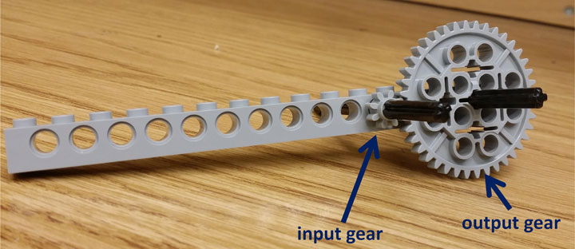
Most Common Gear: Spur Gears
Mini-activity: Assemble the gears as shown below. ⬇ Use the axle to turn the small gear by hand.
Question: If X turns of the small gear causes 1 turn of the large gear, what is X?
In this case, the GEAR RATIO is defined as 1:X (output: input).
Notice that this is the same ratio as the number of teeth, that is, 8:40 or 1:5.
Materials List:
1/16 beam
two #6 axles (put bushing on back side)
8-tooth gear
40-tooth gear
Notes:
Image by authors: Computational Neurobiology Center, College of Engineering, University of Missouri

Slide 9
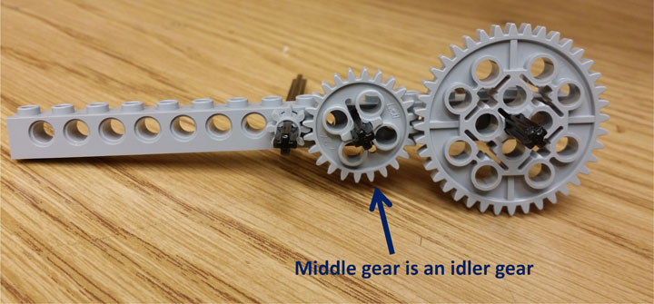
What Are Idler Gears?
Mini-activity continued…
Next, add a third gear in the middle.
To do this, move the small gear left.
Now turn the small 8-tooth gear (at left) and see how the 40-tooth gear (on the right) turns. Does the turn ratio change or stay the same?
No difference! No matter what gear you put in the middle, the gear ratio between the left and right gears does not change! That is why the gear in the middle is called the idler gear; it does not change the gear ratio at all!
The idler makes both the input and output gears rotate in the same direction, and helps add distance between the gears.
Notes:
Image by authors: Computational Neurobiology Center, College of Engineering, University of Missouri

Slide 10
Gear Ratio: Effect on Speed and Torque
Worksheet Questions
Imagine two 40-tooth gear contacting each other. When one 40-tooth gear turns once, how many times will the other 40-tooth gear turn?
Now, imagine replacing one of the 40-tooth gears with an 8-tooth gear, with the 40-tooth gear turning the 8-tooth gear. When the 40-tooth gear turns once, how many times will the 8-tooth gear turn?
Notes:
These are the same questions as on the Get in Gear Worksheet.

Slide 11
Gear Ratio: Effect on Speed and Torque
Worksheet Answers
Imagine two 40-tooth gear contacting each other. When one 40-tooth gear turns once, how many times will the other 40-tooth gear turn? Answer = 1
Now, imagine replacing one of the 40-tooth gears with an 8-tooth gear, with the 40-tooth gear turning the 8-tooth gear. When the 40-tooth gear turns once, how many times will the 8-tooth gear turn? Answer = 5
If the 8-tooth turns the 40-tooth gear (as you will learn later in physics), the 40-tooth gear’s axle will have 5 times the torque (rotational force) than the 8-tooth gear’s axle.
So, although the large gear turns slowly, it can push more!
Notes:
#1 answer: Once, because this is a 1:1 gear ratio.
#2 answer: When the 40-tooth gear turns once, the 8-tooth gear will turn 40/8 = 5 times.
These are the same answers as provided on the Get in Gear Worksheet Answer Key.

Slide 12
What Is Torque? Why Is It Important?
Think of torque as a rotational force, that is, a force that causes rotation and not forward movement.
For the same motor power setting, more torque in a machine (such as a bicycle or car) leads to lower speeds, and less torque leads to higher speeds. This is because power = torque * speed.
When we increase speed from the input to the output gear, we decrease torque by the same amount!
So, in any design you develop, you must decide which is more important: speed or torque, or maybe both... and then select the appropriate gear ratio!

Slide 13
What Are Worm Gears?
Look at this description and animation of a worm gear at http://en.wikipedia.org/wiki/Worm_drive
Watch its application in this 2-minute video, Worm Gear Speed Reducer at http://www.youtube.com/watch?v=S3XAeMCeZr0
Worm gears transmit rotations in perpendicular directions, that is, their axles are perpendicular, like bevel gears.
Worm gears act like gears with one tooth and thus can provide very large gear ratios.
You can transmit rotation one way, from the worm gear to the spur gear, but not the other way. Thus, worm gears can be used as locking mechanisms.
Notes:
Image source: 2011 Catsquisher, Wikimedia Commons http://commons.wikimedia.org/wiki/File:Worm_Gear.gif [animated at this link]

Slide 14
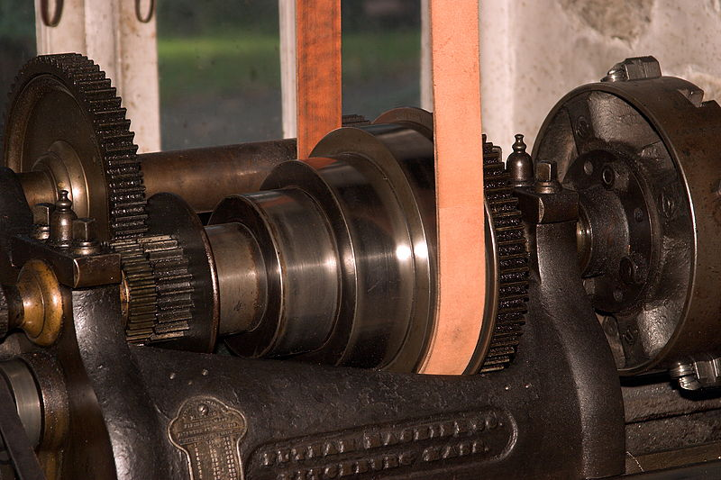
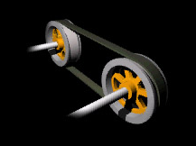
Belts and Pulleys
Belt and pulley combinations look like gears!
They have speed ratios like gears, but they are ratios of diameters.
Belts and pulleys can transmit motion across long distances.
But, both pulleys rotate in the same direction (the opposite of two gears).
Notes:
Left (pulley in transmission): 2005 Kolossos, Wikimedia Commons http://commons.wikimedia.org/wiki/File:Transmisionsantrieb.jpg
Middle (pulley-belt around orange and gray wheels): OSUA https://www.osha.gov/SLTC/etools/machineguarding/motions_actions.html
Right (pulley in machine shop): 2004 Ukexpat, Wikimedia Commons http://commons.wikimedia.org/wiki/File:PutnamLatheHagley01.jpg

Slide 15
Post-Lesson Quiz
What is a gear?
How do we select the gear ratio for a particular application?

Slide 16
Post-Lesson Quiz Answers
What is a gear?
A gear is a wheel with teeth that meshes together with other gears. It is usually made of metal or plastic.
How do we select the gear ratio for a particular application?
Some applications (machines) may need to be fast, while other machines may need to be strong. When designing gears for a machine, it is important to know whether speed or torque (strength) is more important. Remember that power = torque x speed, so, if the NXT motor power setting is kept fixed, then increasing the torque decreases speed, and vice versa. In general, if you need to have more torque, select a larger gear ratio. If you need to move fast, then use a smaller gear ratio.

Slide 17
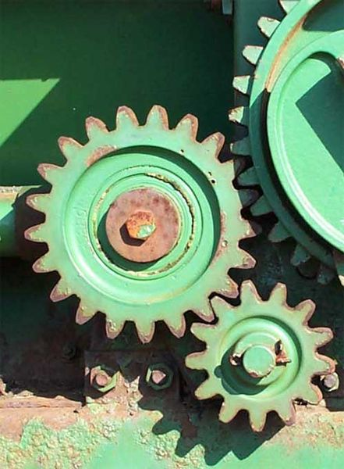
Vocabulary
design: Loosely stated, the art of creating something that does not exist.
gear: A rotating machine part with cut teeth that mesh with another toothed part in order to transmit torque; usually, the teeth on both gears are identical in shape.
pulley: A wheel on an axle that is designed to support movement and change in direction via a cable/belt/chain along its circumference.
torque: The tendency of a force to rotate an object about its axis or pivot.
Notes:
Image source (spur gears on farm equipment): 2002 Jared C. Benedict, Wikimedia Commons: http://commons.wikimedia.org/wiki/File:Gears_large.jpg

