Slide 1
Tinkercad Circuits & EV Motor Workshop
Part 1: Intro to Circuits
& Circuits Simulator

Slide 2
What You’ll Need!
Computer, Mouse & Internet Connection
Microsoft Windows 10, Apple OSX10.10, or Chrome OS on Chromebooks
TinkerCAD Account
Go to https://www.tinkercad.com
+
Browsers that work best with Tinkercad:
- Google Chrome version 50 (or newer), Safari 10 or newer, Microsoft Edge (Chromium)
Notes:
Direct students to Tinkercad.com>Tinker (top menu bar)>Circuits>login or join classroom and enter code generated by the teacher>start “tinkering”>Designs>Circuits>Create

Slide 3
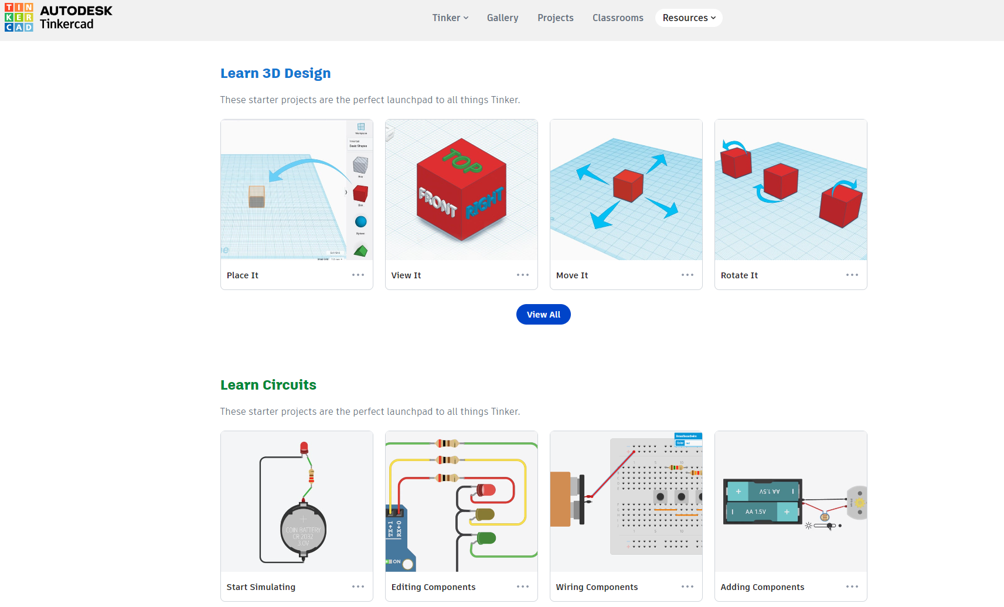
Tinkercad Tutorials
Notes:
Follow the slide instructions. Enable students to peer support each other, and do regular check ins with the class.

Slide 4
Session 1: Circuits Basics
Notes:
Let’s dive into the basics of circuits!

Slide 5
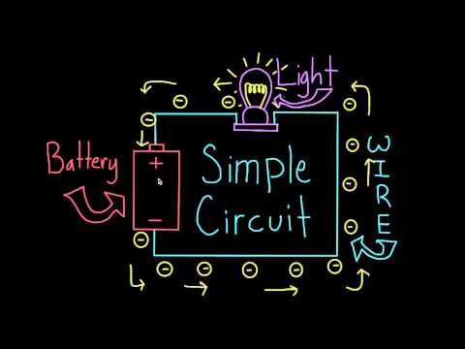
Notes:
Play the video for the class.

Slide 6
Electronics Principles
Going microscopic
THE ELECTRON
Part of the ATOM
Acts like WATER
moving electrons are CURRENT
POTENTIAL motivates CURRENT
RESISTANCE restricts current
“voltage”
Notes:
Have you heard of an electron before? It’s the “negative charge carrier” of the atom; one of the fundamental building blocks of everything around us.
In this section, we will draw a comparison between how electrons move and behaviour of water molecules, since the behaviour of water is far more relatable.
Let’s start by defining a few key things:
1: Moving electrons flow in a “current”, much like water droplets create a current as they flow together down a river.
2: Something called potential energy is what motivates current to flow. This electrical potential is more commonly called “voltage”
3: Certain circuit elements exhibit a trait called resistance, which inhibits the free flow of current (much as boulders and dams restrict the flow of a river)

Slide 7
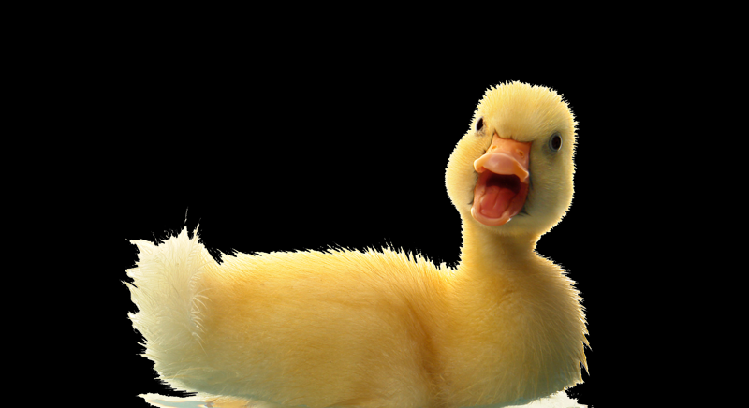
Electronics Principles
Electricity is like flowing water
And how did the water get up there?
What motivates the water to flow?
GRAVITATION
AL
POTENTIAL
ENERGY
+ WORK DONE BY PUMP
We call the water flow “Current”
CURRENT
(FLOW RATE)
Water Pump
The taller the hill, the greater the potential
Notes:
We will use some water analogies in this presentation to make electricity and circuits easier to understand.
Electric current is flow of electricity and voltage is pressure of electricity. The volt measures the amount of pressure or push in an electric circuit. The push is the force that moves electricity, so we sometimes refer to a voltage as an electromotive force, abbreviated EMF. Another name we often use for voltage is electrical potential.
This example can help you better understand electrical pressure because it is similar to water pressure. The amount of electromotive force (EMF), or voltage, indicates how much electricity the voltage source can move in a circuit. An EMF of 100 volts is much stronger than one of 10 volts. A higher voltage can move more electricity than a lower one.

Slide 8
Electronics Principles
Water flow is like current
So, the analogy is:
But now, gravity’s not the driving force...
ELECTRICAL
+
GRAVITATIONAL
POTENTIAL
ENERGY
a.k.a...
Voltage is the Electro-Motive Force...
“VOLTAGE”
(Magnified)
Copper Wire
And we still call it Current!
...the voltage from a Battery motivates electrical current
CURRENT
Electrons
(FLOW RATE)
...we just use a different symbol, “I”
(it’s French! Andre Ampere)
Notes:
Let's explore this water analogy a little bit further.
Here we have a diagram of a magnified copper wire with some electrons floating around in it. The fact that the electrons are simply freely floating around inside of this wire Is a characteristic of conductors. Conductors allow For the free flow of electrons.
How does it map back to electronics?
We said electrons are like water, so we replace our stream with something. Let's use a copper wire. It's made of atoms, so it has plenty of electrons, and metals (particularly copper) have this cool property where their atoms are willing to trade some of their electrons back and forth with each other. So you can kinda think of a copper wire as a tube full of electrons we can push back and forth.
Not on a hill though! Gravity isn’t pulling electrons down the wire, we need a new type of potential: electrical potential. We usually call this voltage, and it works just like height did on our hill
Before, the water was lifted high up by the pump, but we don’t get voltage by lifting the electrons up in the air. We usually get it from a battery, which creates a high potential, high voltage area at its positive terminal and a low potential, low voltage area by its negative terminal.
So now, electrons want to fall from the high potential, high voltage area at the top to the low potential, low voltage area at the bottom. Then, the battery picks them back up again, just like the pump. And just like the pump, that uses energy, that’s why your batteries die eventually.
As we said before this motivation of current provided by the battery is called voltage or electrical potential. When the electrons flow, this is called current, much in the same way that water flowing downhill is called current. Where voltage is intuitively labeled with the letter “V”. Current is often denoted with the less intuitive letter “I”.

Slide 9
Electronics Principles
Pipe size is like resistance
resistor
It’s like constricting a hose; current flow is restricted
Resistance changes electrical energy into heat or work
(it reduces voltage)
RESISTANCE
Notes:
We had also mentioned something to do with the restriction of current, Similar to how a boulder will Inhibit the flow of water through a stream. An electrical component specifically designed to restrict the flow of electrical current Is called a resistor. Resistors convert the flow of electrical energy into heat, And in turn, they reduce voltage. You may think of this like water flowing through a hose. If we constrict the hose, It reduces the water pressure and slows the flow of water through the hose.
You can also think of the free electrons flowing in a copper wire like water flowing through pipe. A large amount of moving electrons represents an electric current. It is easier to imagine water flowing through a pipe as a current than it is to think of electrons flowing through a wire because and electron is too small to be seen, but they can be measured with a multimeter. So you can also think of a wire as a pipe for electrical current.
When dealing with resistors, you may notice that the small components sport a colorful headband. Typically these colored bands appear in sets of three or four. The colors designate how much the resistor will...well….resist! The unit that we use to describe how strongly a resistor will resist is called an OHM, Represented by the capital Greek letter Omega.

Slide 10
Electronics Principles
The resistance waterfall
Resistors restrict Current...
With nothing to resist the flow, you get a waterfall, with nearly infinite current!
(the shortest path down)
...let’s imagine the case of NO resistance...
Notes:
Resistance limits or controls the amount of current flowing through a circuit. Resistors are perhaps the most common component in electronic circuits. Resistors can be either fixed or variable in value.
A fixed resistor has a resistance value that does not change, while a variable resistor has a resistance that can be varied over a range of values. This allows us to change or adjust how a circuit functions.
If you have ever used an electric stove to heat water or installed an incandescent light bulb to light a room, you have used a device with a fixed resistance. These devices convert the energy from the current flowing through them to heat and light. If you have every turned the volume knob on a radio or used a light dimmer you have changed the flow of current to a circuit using a variable resistance.

Slide 11
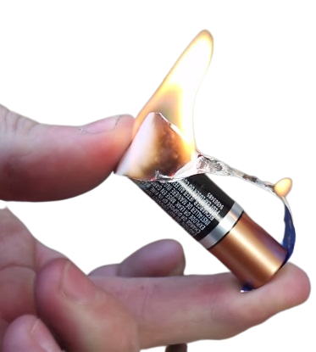
Electronics Principles
Short circuits
In the context of electronics,
it’s not so pretty...
Without resistance, we have a SHORTcut from + to - on the battery...
This “Short Circuit” allows UNLIMITED CURRENT to flow, which can damage electronics
Notes:
- Bad thing in electronics! Call it a short circuit (shortest circuit? Connect positive to negative, done)
- Electrons want to fall from high potential to low potential, so they do, but with nothing slowing them down, they go fast
- current isn’t tidy! They crash into each other, produce a lot of heat
- This can damage electrons! Start fires!

Slide 12
Electronics Principles
When we DO introduce resistance, think of it as a water wheel!
Resistance is measured in Ohms ( Ω)
A smaller (faster) wheel,
passes more water...
The size of a resistor is designated by its bands
Flow converted and discarded as heat (work)
Less Resistance = More Flow
1
0
x10³
0
1
2
3
4
5
6
7
8
9
10k Ohms ( Ω)
Notice...
Voltage (hill height) isn’t necessarily affected...
Notes:
Let's explore this water analogy a little bit further.
- so we need a resistor. On our hill, resistor is like a water wheel. If we drop a heavy wheel into the path of our stream it slows things down. Some energy that was making flow faster goes into turning the wheel.
- If we replaced our heavy wheel with a smaller, lighter wheel, we get faster flow, easier to spin so less energy goes into spinning the wheel.
- good relationship to keep in mind! Less resistance, more current. Put another way, slow things down less, they go faster.
- also, notice voltage wasn’t affected here. Didn’t change the height of the pump! Still applying the same voltage.
- Another note on resistance. We measure it in ohms (abbreviated with an omega). Resistors are labelled with a system of colored bands that tells you how big they are
(This section is kind of optional. It’s sort of useful but usually you can just type the bands into a converter online or measure with a multimeter. But if you want to go over the colored band system, this is what I do)
- have them get read out the colored bands from their resistors (should be brown-black-orange-gold and orange-orange-brown-gold)
- the gold band is weird and different, its for precision, tells you how accurately they made the resistor, so we don’t care that much about it right now.
- start at the other end and read towards gold. For three bands, the first two are digits and the last is a multiplier.
- Read the digits straight off the chart, so for brown-black-orange, digits are 10.
- Then, get the multiplier. Orange goes to 3, but we don’t multiply by 3, we multiply by 10^3, or 1000. Always 10 to whatever power the color is (that isn’t just because our digits are 10, which confuses people sometimes)
- 10 times 1000 is 10,000, so it is a 10,000 ohm resistor, or 10 kOhm.
- have them try to decode orange-orange-brown (they should get 330, orange-orange for digits is 33, then brown is 1, so 33 * 10^1 = 330)
- this system is kind of a mess! Colors can be hard to read, especially once they fade, and it’s a hassle. Don’t try to memorize this chart. Just google it or use a multimeter. But its useful to have seen it once so you know how its supposed to work.

Slide 13
Electronics Principles
Let’s summarize…
(so far)
Ohm’s Law
is a math-based relationship that describes how a circuit will behave
+
PUMP
What if:
BATTERY
VOLTAGE
+
HILL HEIGHT
Volts
(V)
Current
Amps (A)
Resistance
Ohms (Ω)
CURRENT
FLOW RATE
ELECTRONS
RESISTANCE
WATER WHEEL
RESISTOR
Notes:
- we can do more with our hill than you might expect. First, to summarize:
- Voltage is like height on the hill. Get it from a pump on the hill, battery in our circuit.
- Current is the flow. Electrons through a wire, water through a stream
- Resistance is whatever is slowing things down. Water wheel on our hill, resistor in our circuit.
- We are going to change one and see how the others react. Give a thumbs up if you think something will increase, down for decrease, sideways for staying the same.
- First, lets increase voltage. Taller pump, bigger battery. More potential.
- ask to show hands what happens to resistance? – nothing. Same size resistor! Didn’t change how big the water wheel is.
- ask to how hands what about current? – increases! Added energy, has to go somewhere. We get faster flow.
- so that seems like a relationship! Increasing V increases I
- next, resistance. Heavier water wheel, bigger resistor.
- ask for hands first, what happens to voltage? – nothing, still different components. Did not change the height of the pump. Different component in our circuit, still applying the same voltage.
- ask for hands what about current? – decrease! We are slowing things down more, so they have to go slower. Easy.
- this is another relationship, R goes up, I goes down.
- to me, this all feels kinda math-y. Like we could maybe represent these relationships as an equation. That would be useful! We could do math on these abstract concepts about our hill.
- turns out we can, its called Ohm’s law, and it’s a pretty clean little equation! V=IR.
- If that seems like it came out of nowhere, think of it like mathematical machinery that guarantees the intuitive facts about our hill are true in the math (like, increasing R makes the right side bigger, and we said we couldn’t change V because they’re different components. But its an equation, we have to balance the two sides, so the only way to make them the same size again is to decrease I, exactly like we said should happen on the hill)
- Units! Volts, Amps, Ohms. You will see them written as milliamps or kilo-ohms, just convert to base unit before you use this equation.

Slide 14
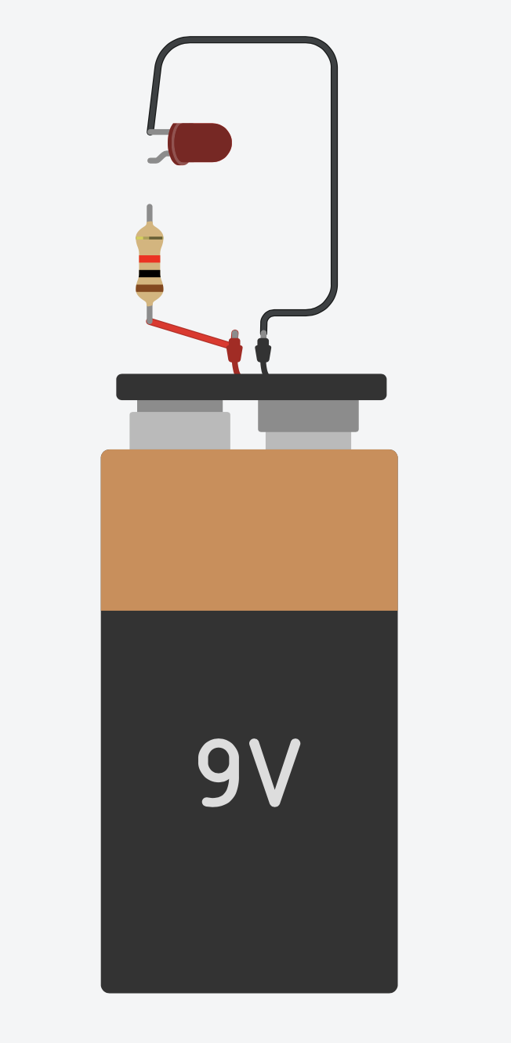
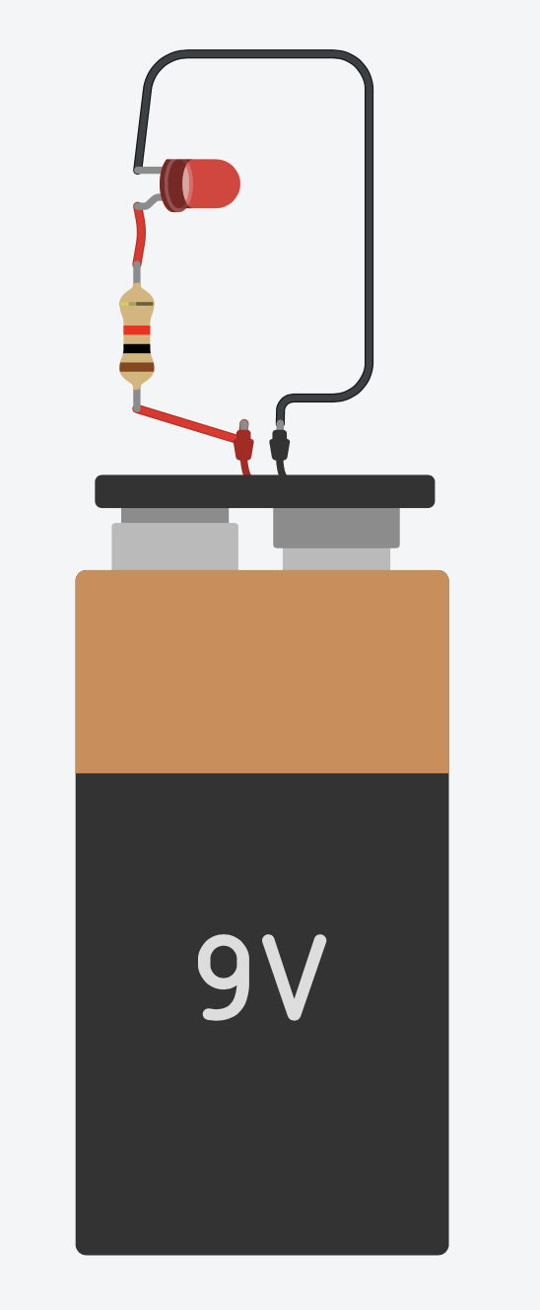
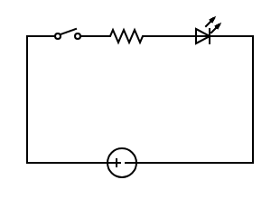
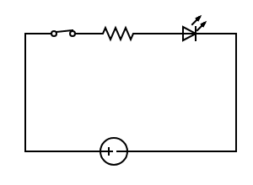
Electrical Circuits Explained
Electrical circuits contain conductive paths for current (or electrons) to flow:
Open loop = current can’t flow
Closed loop = current can flow
Circuits enable us to turn lights on/off, computers to work, and more!
Open Circuit
Closed Circuit
Notes:
An electrical circuit contains conductive paths for current to flow. A closed loop means current can flow while an open loop means a current can’t flow. In this example, the circuit on the left is open and the circuit on the right is closed. The L.E.D on the left is off while the LED on the right is on.”

Slide 15
Series & Parallel Circuits
What is series?
Let’s see an example:
“Series” means components are hooked up one after another.
Current is what makes a light bulb glow!
More current = More light
What is parallel?
“Parallel means components are hooked up side by side.
A series circuit decreases the current.
A parallel circuit increases the current.
Notes:
There are two different types of circuits: series and parallel. In a series circuit, all components are connected to each other and voltage runs along one path.
In a parallel circuit, voltage can travel different paths, and components in different paths are not connected. For example, if you removed one of the bulbs in the series circuit, the circuit would be open and the remaining bulb would be off.
However, if you removed one of the bulbs in the parallel circuit the remaining bulb would still be on because it is not connected to the other bulb; therefore, the circuit would be closed. The example in the images shown here represent how series and parallel circuits differ for circuits with two light bulbs. In a series circuit, voltage is shared between the two light bulbs so the two light bulbs are relatively dim.
On the other hand, the two light bulbs in the parallel circuit are both relatively bright since voltage travels through two different paths. Because the bulbs in the parallel circuit do not share voltage, they are relatively bright.
EP have series & parallel project pre-made and demo it
Students then build own circuit.
Image: https://www.dreamstime.com/stock-illustration-series-parallel-circuits-connected-along-single-path-same-current-flows-all-components-image67662763#res26615551

Slide 16
Session 2: Circuits Simulator
Notes:
Let’s explore how circuits work with a circuit simulator.

Slide 17
Tinkercad Circuit Simulator
Instructions:
Login toTinkercad.com>
Designs>Circuits>Create
Follow along to learn to use the Tinkercad Circuit Simulator interface
Notes:
Direct students to Tinkercad.com>Tinker (top menu bar)>Circuits>login or join classroom and enter code generated by the teacher>start “tinkering”>Designs>Circuits>Create

Slide 18
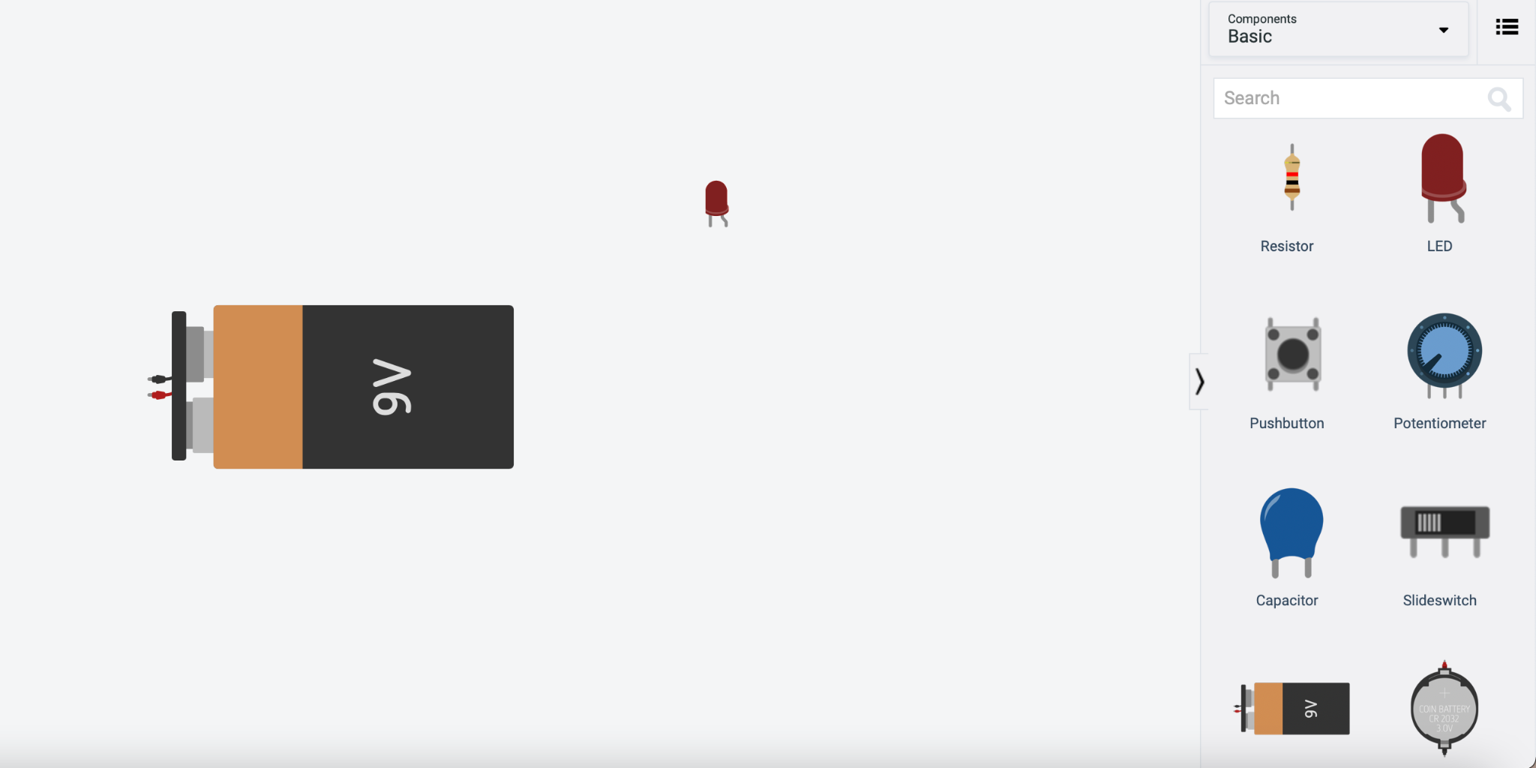
Getting the Gear
1. Search for 9V battery
2. Click and drag into workspace
3. Find LED and repeat!
We’re going to use the battery to power the LED in our circuit.
Notes:
Follow the slide instructions. Enable students to peer support each other, and do regular check ins with the class.

Slide 19
Using the Tools
We can use the toolbar at the top left for:
Copying & Pasting
Deleting
Undo/Redo
Changing wire colors
Rotating
Flipping
Notes:
Follow the slide instructions. Enable students to peer support each other, and do regular check ins with the class.

Slide 20
Wiring LEDs
LEDs have two sides, and it matters which is which.
The anode is the longer, bent terminal
The anode connects to positive (+) power
The cathode is the shorter, straight terminal
If you forget which is which, you can hover over the ends to see anode/cathode!
The cathode connects to negative (-) power
Notes:
Follow the slide instructions. Enable students to peer support each other, and do regular check ins with the class.

Slide 21
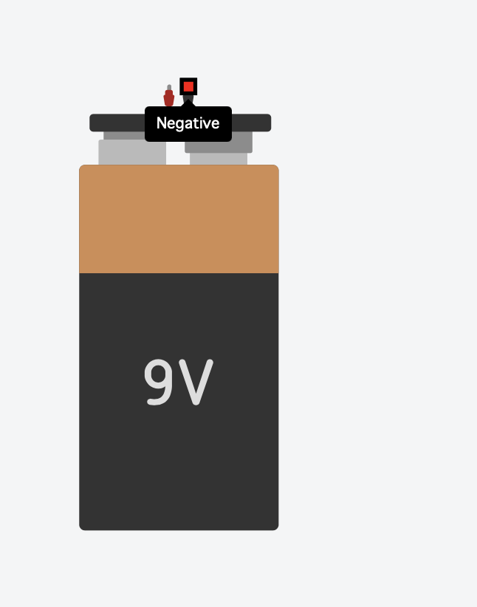
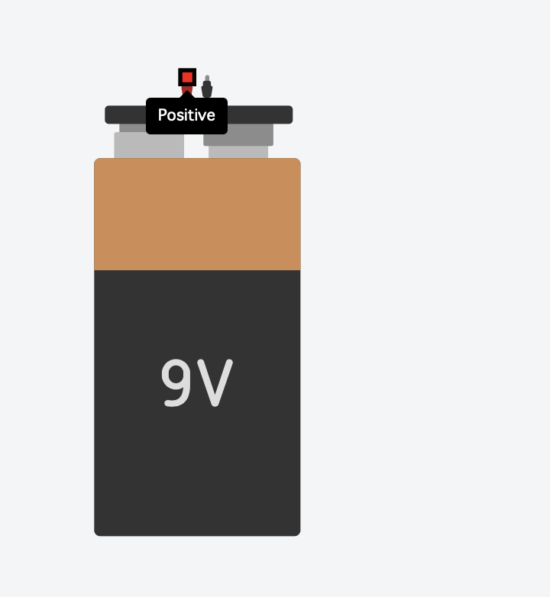
Wiring the Battery
The battery has positive and negative terminals just like the LEDs.
Traditionally, RED is positive and BLACK is negative
If you forget, you can hover over the terminals to see which is which!
Notes:
Follow the slide instructions. Enable students to peer support each other, and do regular check ins with the class.

Slide 22
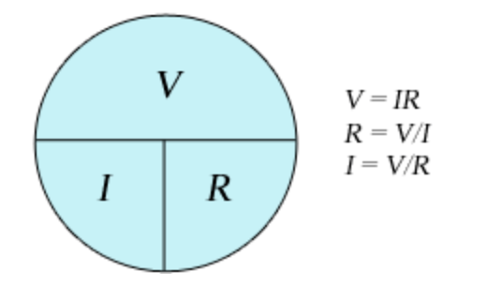
Circuits Vocab
V = the voltage in an electric circuit is a measure of the amount of electrical potential energy per charge between two points in the circuit.
I = (Current in Ampere) the flow of electrons in an electric circuit.
R = Resistance is the opposition to current flow. the greater the electrical resistance for a given voltage, the less electric current will exist.
Ohm’s Law: Ohm's Law relates the quantities of voltage, electric current, and resistance in one easy-to-use equation
Notes:
Follow the slide instructions. Enable students to peer support each other, and do regular check ins with the class.

Slide 23
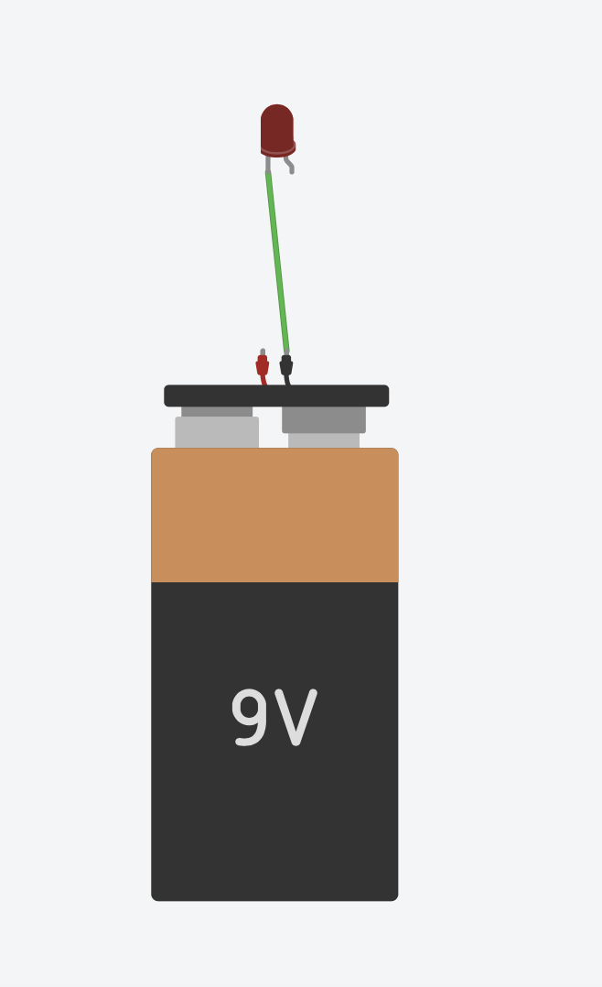
Building the Circuit
STEP 1:
Click on the negative terminal of the battery.
Drag the mouse over to the cathode of the LED and click.
Bonus:
Color the wire BLACK so you remember that its negative!
Notes:
Follow the slide instructions. Enable students to peer support each other, and do regular check ins with the class.

Slide 24
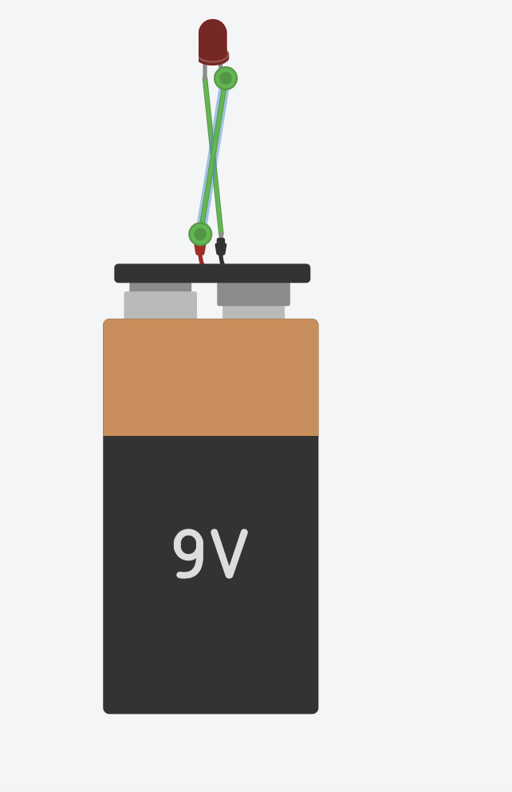
Building the Circuit
STEP 2:
Click on the positive terminal of the battery.
Drag the mouse over to the anode of the LED
Bonus:
Color the wire RED so you remember that its positive!
Notes:
Follow the slide instructions. Enable students to peer support each other, and do regular check ins with the class.

Slide 25
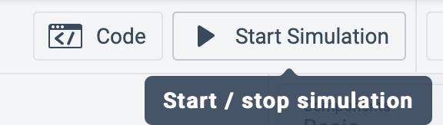
Running the Simulation
Find Start Simulation in the top right.
Click it to see our circuit in action!
Notes:
Follow the slide instructions. Enable students to peer support each other, and do regular check ins with the class.

Slide 26
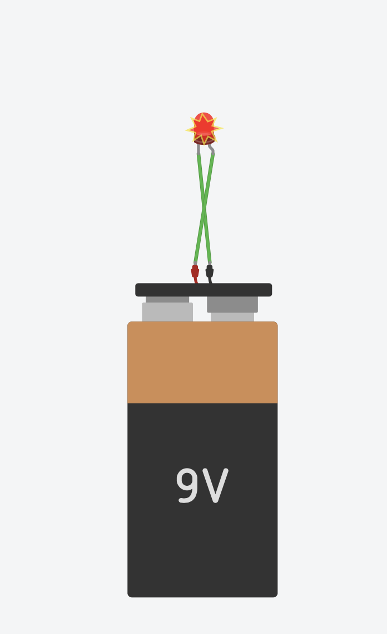
Uh Oh! Troubleshooting
We broke our LED! Remember before how current meant more light? Well more current can also mean too much heat.
We supplied our LED with too much current, and it got too hot and exploded!
Remember ohm’s law? We can limit this current with resistance.
Ohm’s Law Table
Notes:
Follow the slide instructions. Enable students to peer support each other, and do regular check ins with the class.

Slide 27
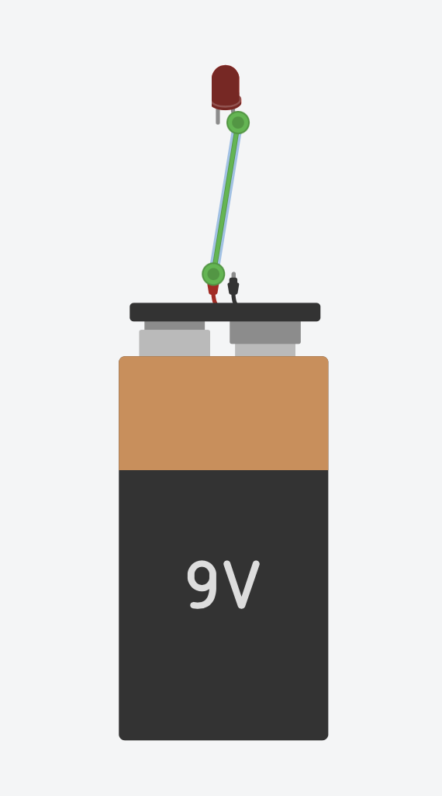
Problem Solving
Let’s fix our circuit!
Just like before, click on the terminal of the battery, then click on the terminal of the LED to make a connection
Bonus:
Who can name which LED terminal we hooked up?
Notes:
Follow the slide instructions. Enable students to peer support each other, and do regular check ins with the class.

Slide 28
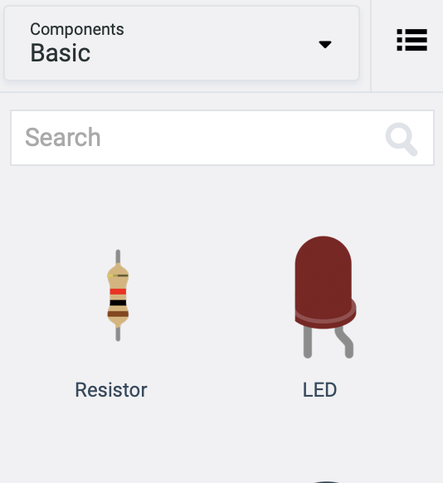
Getting More Gear
Search for a resistor in the search menu.
Click, drag, and click to drop the resistor into our workspace.
Notes:
Follow the slide instructions. Enable students to peer support each other, and do regular check ins with the class.

Slide 29
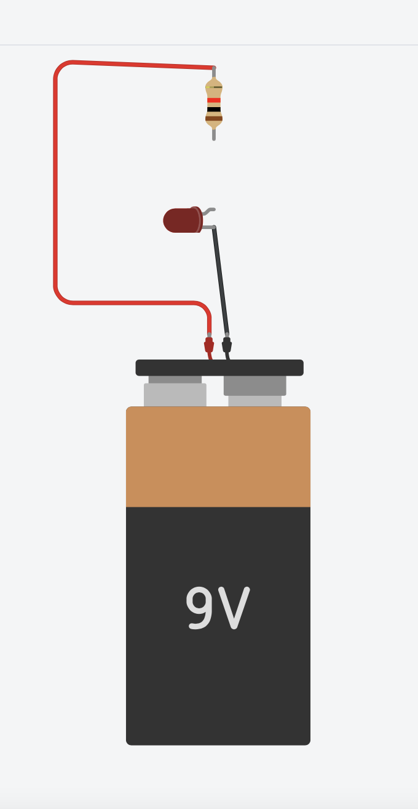
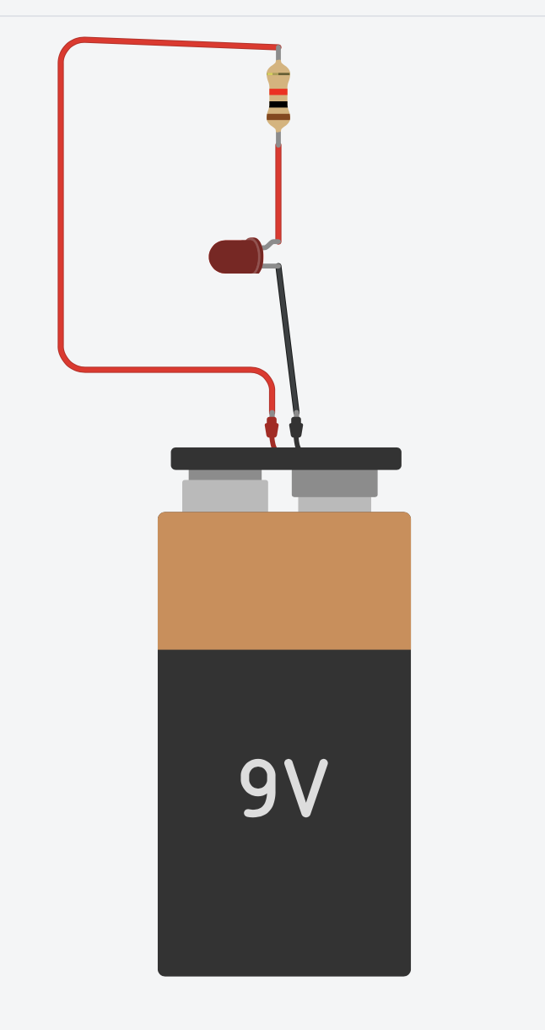
Building the Circuit Part II
Now we want to put the resistor in series with the LED.
To do so, we need a complete loop that travels from the positive battery end, to the resistor, out of the resistor to the anode of the LED, and finally back to the negative end of the battery.
Notes:
Follow the slide instructions. Enable students to peer support each other, and do regular check ins with the class.

Slide 30
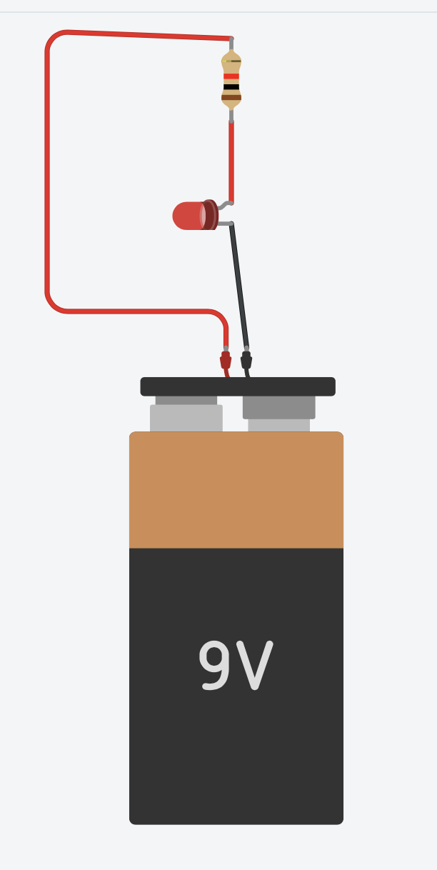
Test it Out!
Find Start Simulation in the top right.
Click it to see our circuit in action!
Viola! We have successfully created an LED circuit!
Notes:
Follow the slide instructions. Enable students to peer support each other, and do regular check ins with the class.

Slide 31
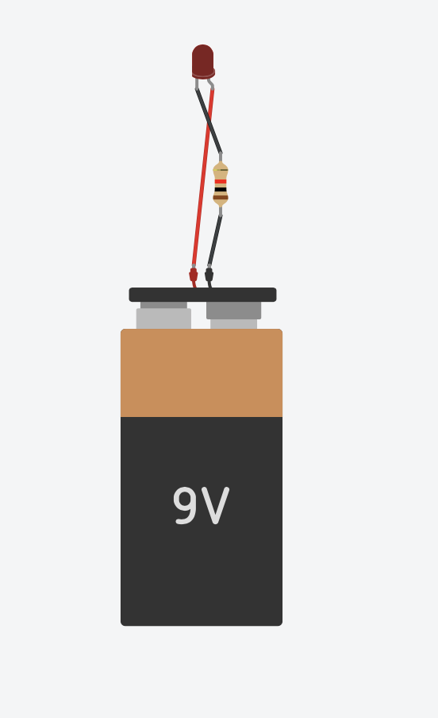
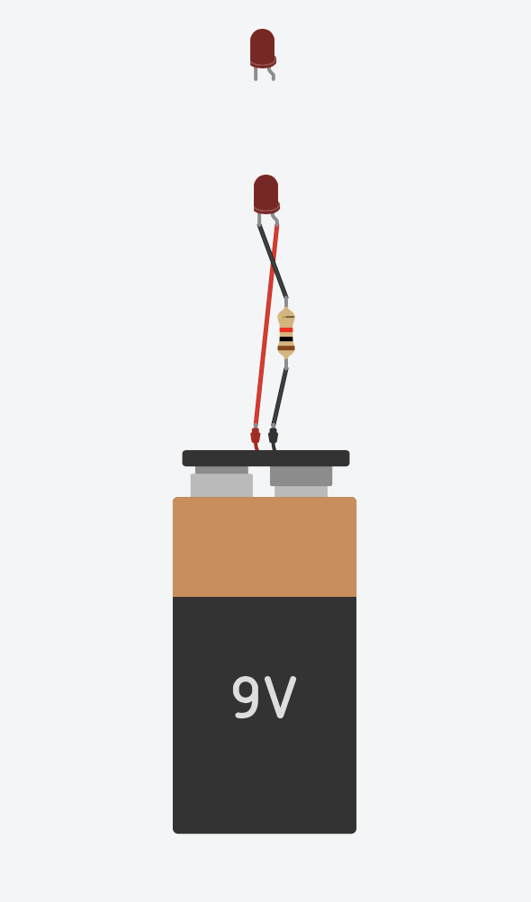
Parallel Circuit
We’re going to make another circuit, this time with LEDs in parallel.
To start, let’s recreate our simple series circuit.
On top of this, let’s grab another LED
Notes:
Follow the slide instructions. Enable students to peer support each other, and do regular check ins with the class.

Slide 32
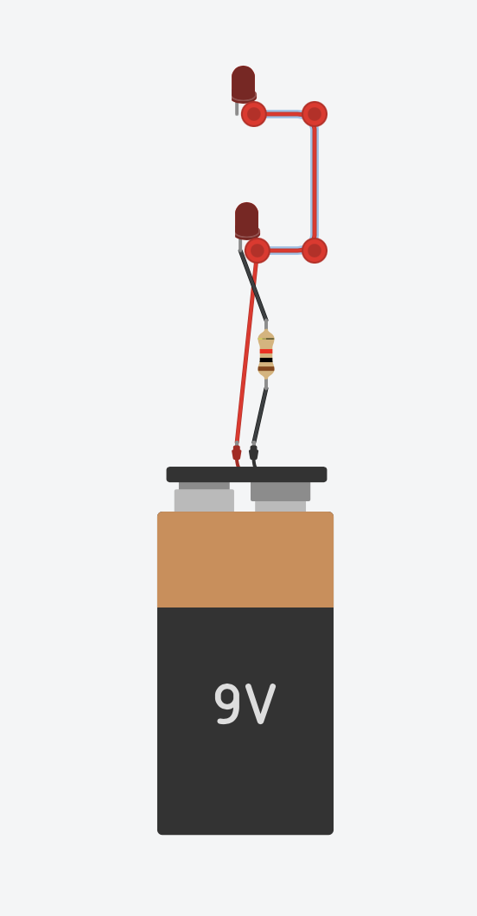
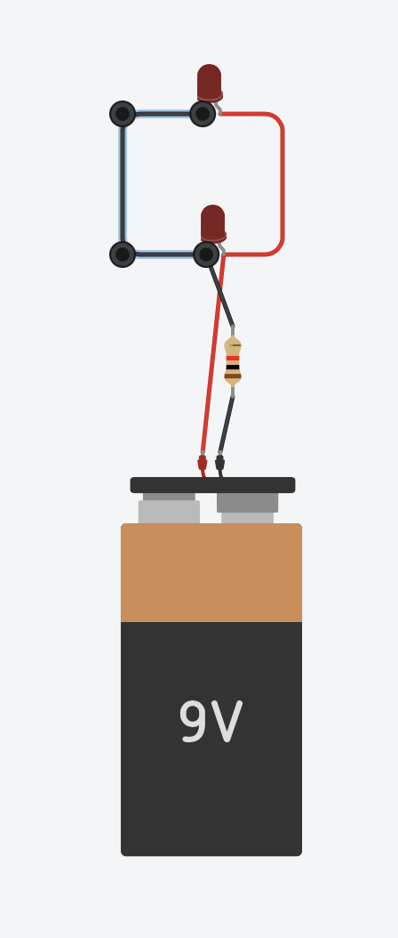
Parallel Circuit
Now we’ll see why coloring our wires was important.
To make a correct parallel circuit, we need our anodes of our LEDs to be connected, and the cathodes to be connected.
Exercise:
Trace your finger from negative to positive of the battery, you should be able to find two paths
Notes:
Follow the slide instructions. Enable students to peer support each other, and do regular check ins with the class.

Slide 33
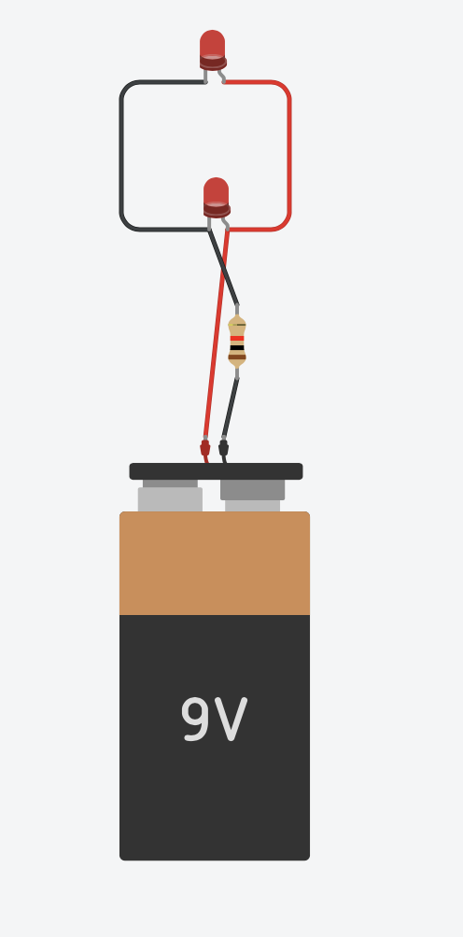
Parallel Circuit
Notice that the two LEDs are both as bright as the single series LED was.
Recall that more current is more brightness, and with unchanging resistance more current means more voltage. (Ohm’s law! V = IR)
Now, the LEDs have to be the same brightness because the voltage across them is the same! The voltage from the battery has to be 9V, and each LED connects the two terminals of the battery together.
If the negative end of the battery is 0V, and the positive terminal is 9V, then the voltage across both LEDs is 9V!
Notes:
Follow the slide instructions. Enable students to peer support each other, and do regular check ins with the class.

Slide 34
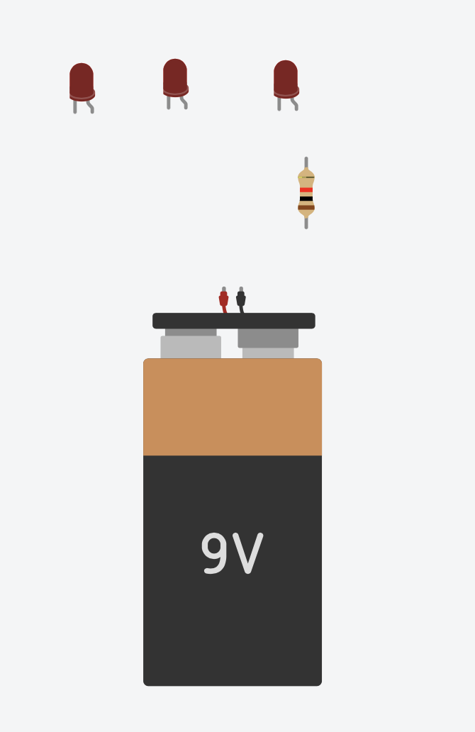
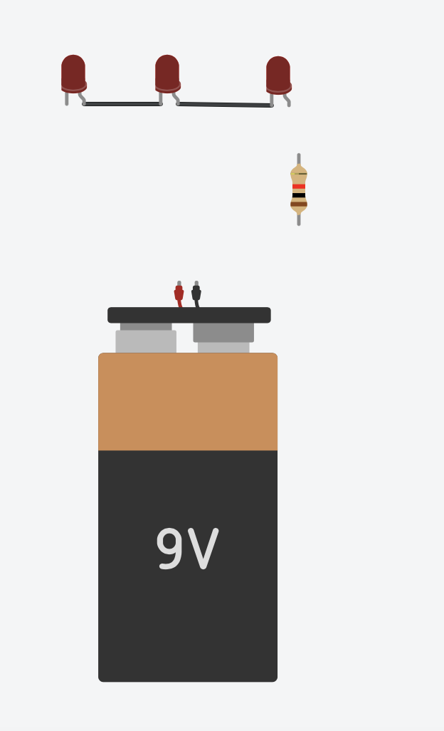
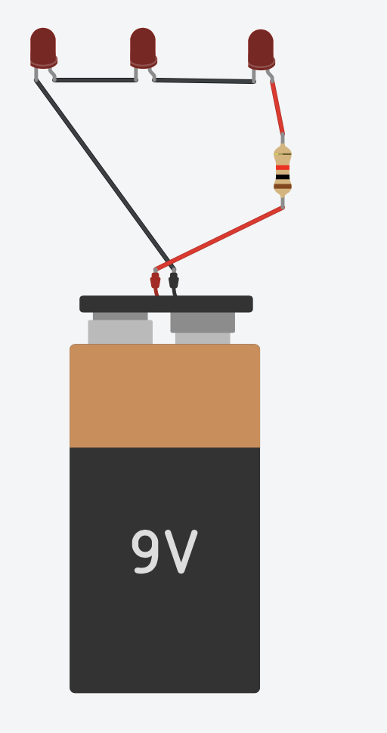
Series Circuit
Grab three LEDs, a resistor, and a battery.
Then connect all three LEDs (anode to cathode).
Now connect the LED string to the “ground” (negative battery terminal) and the resistor to the positive terminal.
Exercise:
Trace your finger from negative to positive of the battery, you should only be able to find one unbroken path
Notes:
Follow the slide instructions. Enable students to peer support each other, and do regular check ins with the class.

Slide 35
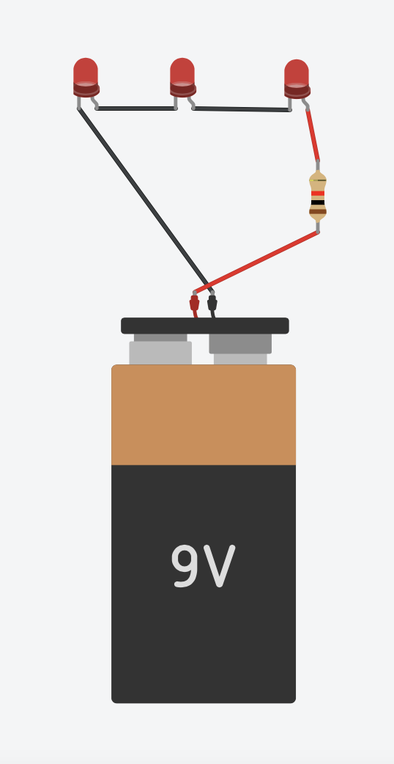
Series Circuit
We’ve completed our series circuit. Notice how all the components form one unbroken loop.
With our parallel circuit, each loop was given 9V across it. This is still true, however now that voltage is shared between 3 LEDs instead of 1.
This makes the LEDs dimmer than those of the parallel circuit.
Notes:
Follow the slide instructions. Enable students to peer support each other, and do regular check ins with the class.

Slide 36
Create Your Own Tinkercad Circuit
Notes:
Let’s explore Ohm’s Law using the circuit simulator

Slide 37
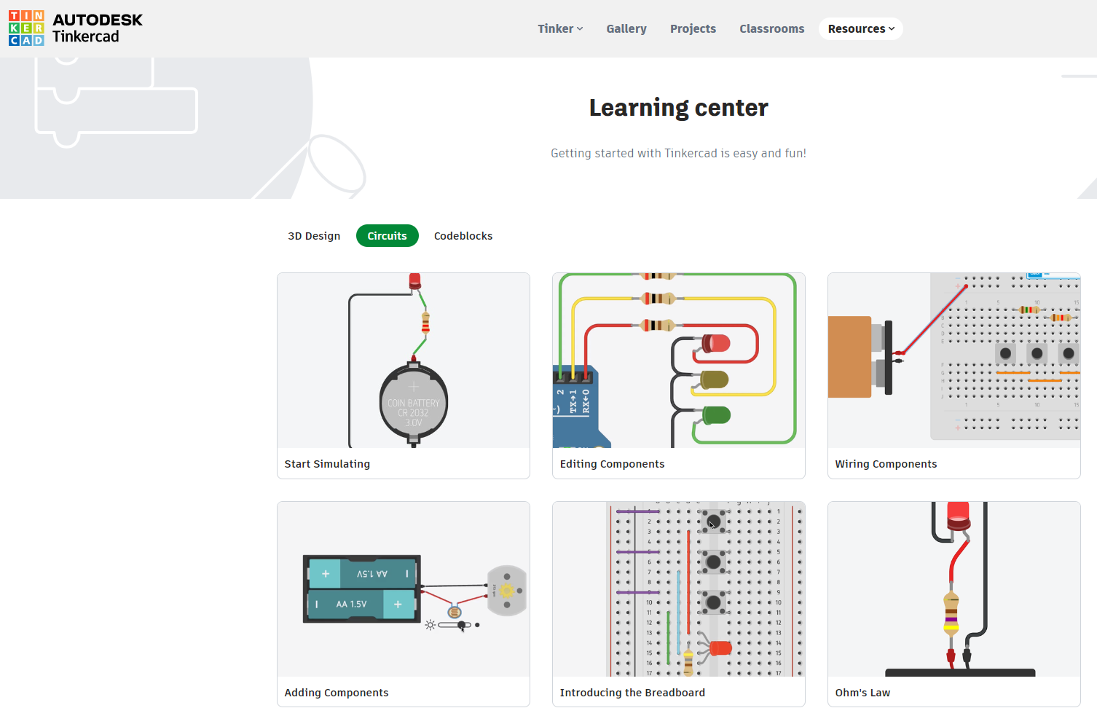
Choose a Tinkercad Circuits Tutorial
Notes:
Direct students to Tinkercad.com>Resources (top menu bar)>Learning Center>View All under Learn Circuits

Slide 38
It’s YOUR turn to get creative with circuits!
Instructions:
Choose a Learning Center “Circuits” project
Get tinkering! Use “Basic Components”
Batteries
LEDs
Resistors
and more
Share your creation!
Reminders:
Wire the components in a closed loop
LEDs need current-limiting resistors
Anode to positive (red)
Cathode to negative (black)
Click on “Start Simulation” to test your circuit
Back arrow or “Control Z” to undo
Click on the Tinkercad “waffle box” icon to get back to the homepage
Ask for help if you get stuck!
Notes:
Follow these instructions to begin creating you Tinkercad circuit.

Slide 39
Circuits Review
Take a screenshot of your circuit design.
How does your circuit work?
What components did you use?
What is your power source (type and number of batteries)?
How many LEDs did you use? If more than one LED, are they connected in series, parallel, or both?
What ideas do you have to change up your circuit?
Notes:
Have students do a think-pair-share and wrap-up with a class reflection.

Slide 40
Tinkercad Circuits & EV Motor Workshop
Part 2: Motor Circuit Simulator
& Build an Electric Motor Circuit

Slide 41
What You’ll Need!
Computer, Mouse & Internet Connection
Microsoft Windows 10, Apple OSX10.10, or Chrome OS on Chromebooks
TinkerCAD Account
Go to https://www.tinkercad.com
+
Browsers that work best with Tinkercad:
- Google Chrome version 50 (or newer), Safari 10 or newer, Microsoft Edge (Chromium)
Notes:
Direct students to Tinkercad.com>Tinker (top menu bar)>Circuits>login or join classroom and enter code generated by the teacher>start “tinkering”>Designs>Circuits>Create

Slide 42
Review Electronics Principles
Let’s summarize…
(so far)
Ohm’s Law
is a math-based relationship that describes how a circuit will behave
+
PUMP
What if:
BATTERY
VOLTAGE
+
HILL HEIGHT
Volts
(V)
Current
Amps (A)
Resistance
Ohms (Ω)
CURRENT
FLOW RATE
ELECTRONS
RESISTANCE
WATER WHEEL
RESISTOR
Notes:
Review Ohm’s Law.

Slide 43
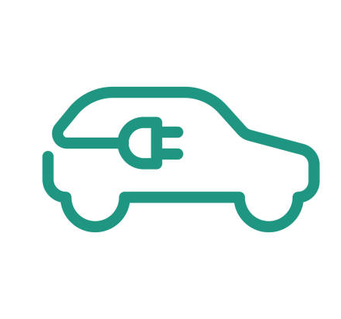
Session 3: Electric Motor Circuit Simulator
Notes:
Let’s make simulate a motor circuit.

Slide 44
The goal today is to understand:
What makes an electric car go?
How can we model that?
Notes:
Have a quick discussion to share student thoughts on how EVs are powered and how an EV can be modeled.

Slide 45
Basic Electric Motor Circuit
0 rpm (revolutions per minute)
Switch open (incomplete circuit)
Notes:
An electrical circuit contains conductive paths for current to flow. Current cannot flow in an open loop because the circuit is incomplete. In this example, the circuit switch is open (off) so the circuit is incomplete, and the motor spindle is not spinning.

Slide 46
Basic Electric Motor Circuit
2,974 rpm (revolutions per minute)
Switch closed (circuit complete)
Notes:
An electrical circuit contains conductive paths for current to flow. Current can flow in a closed loop because the circuit is complete. In this example, the circuit switch is closed (on) so the circuit is complete, and the motor spindle is spinning.

Slide 47
First, let’s build a simulation of an electric motor
Login to your Tinkercad account
Follow along to build an electric motor circuit simulation!
Notes:
Follow these instructions to begin creating you Tinkercad circuit.

Slide 48
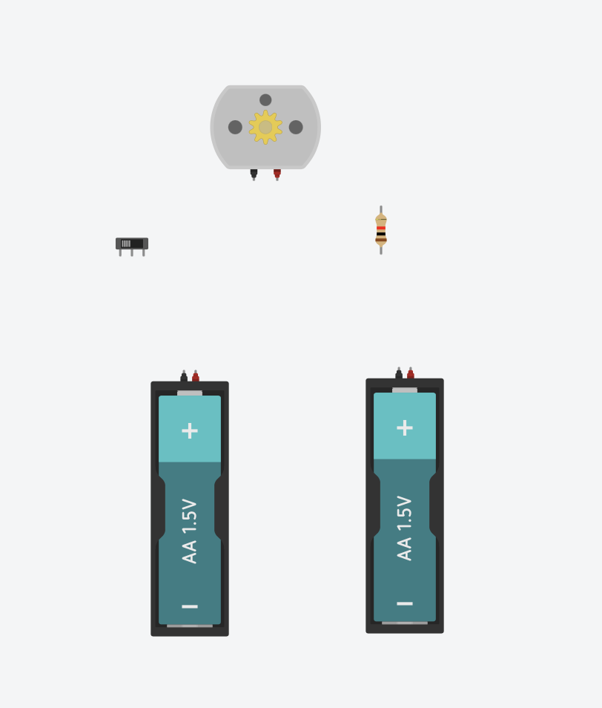
Simple DC Motor
Tinkercad Circuit Simulator Supplies:
Slide switch
Resistor
DC Motor
2 AA Batteries
Wires
Vocab:
DC: Direct current – steady current, not switching back and forth
RPM: (Revolution per minute) – how many times the motor spins in one minute
Notes:
Direct students to Tinkercad.com>Tinker (top menu bar)>Circuits>login or join classroom and enter code generated by the teacher>start “tinkering”>Designs>Create>Circuit

Slide 49
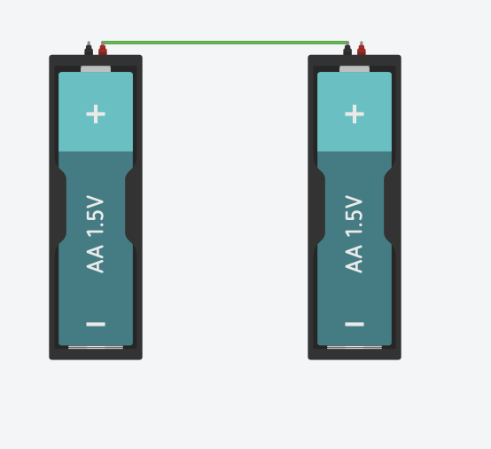
Step 1:
Connect the POSITIVE of one battery to the NEGATIVE of the next.
Like before, it’s a good idea to color this negative wire black.
Notes:
Follow the slide instructions. Enable students to peer support each other, and do regular check ins with the class.

Slide 50
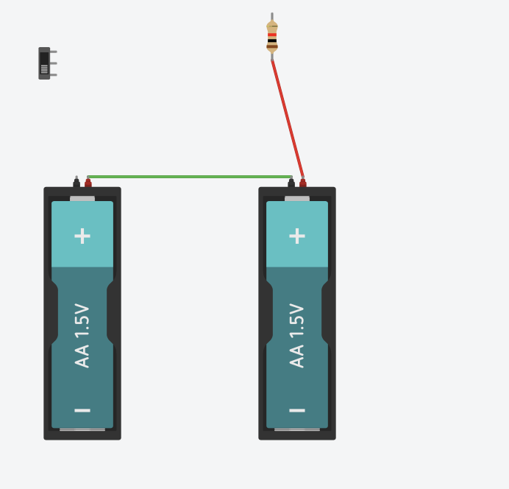
Step 2:
Connect the positive terminal of one of the AA batteries to the resistor.
Notes:
Follow the slide instructions. Enable students to peer support each other, and do regular check ins with the class.

Slide 51
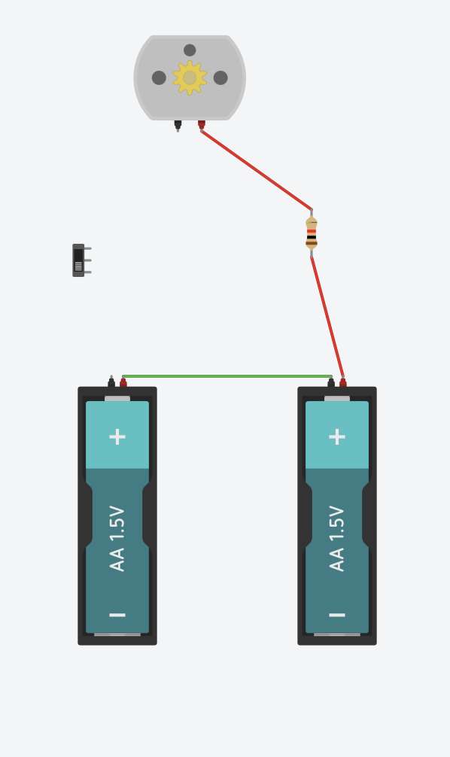
Step 3:
Connect the resistor to the positive terminal of the motor (indicated by the red connection point).
Notes:
Follow the slide instructions. Enable students to peer support each other, and do regular check ins with the class.

Slide 52
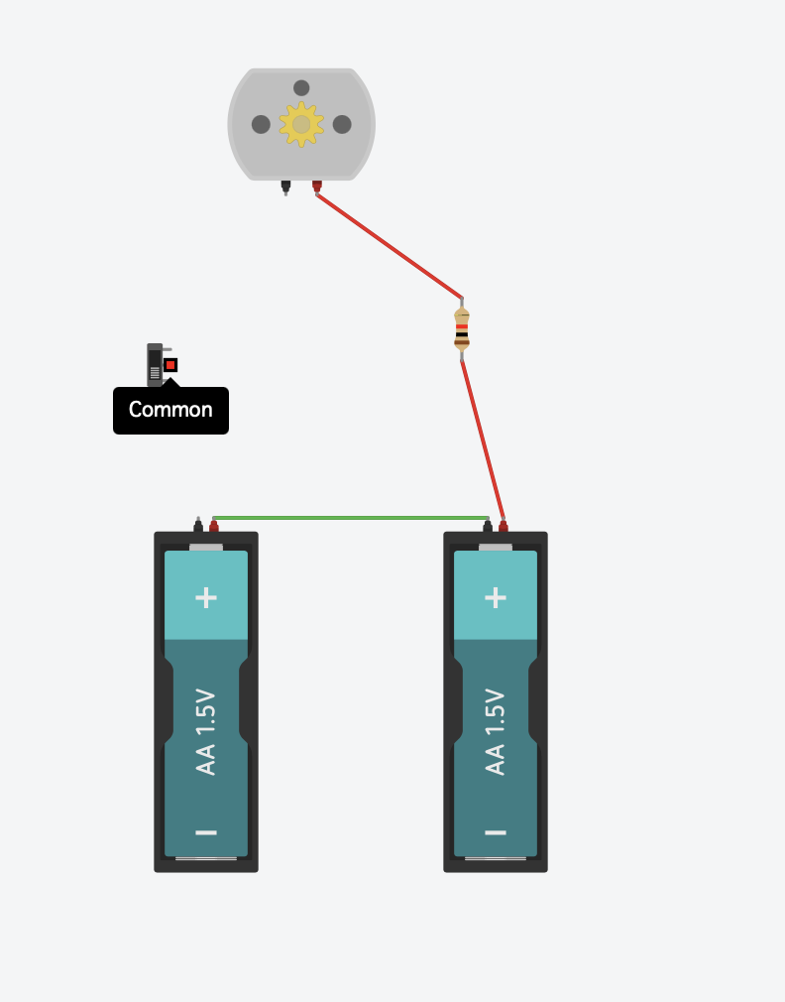
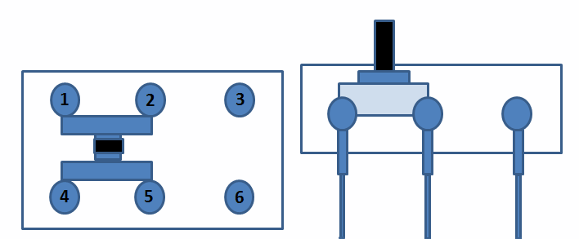
Step 4:
Slide switches have 3 terminals. The common, terminal 1, and terminal 2.
The switch will connect the common to the terminal on the side of the switch.
Push to the right, and the common connects to the rightmost pin.
Push left, and common connects to the leftmost pin.
common
Notes:
Follow the slide instructions. Enable students to peer support each other, and do regular check ins with the class.

Slide 53
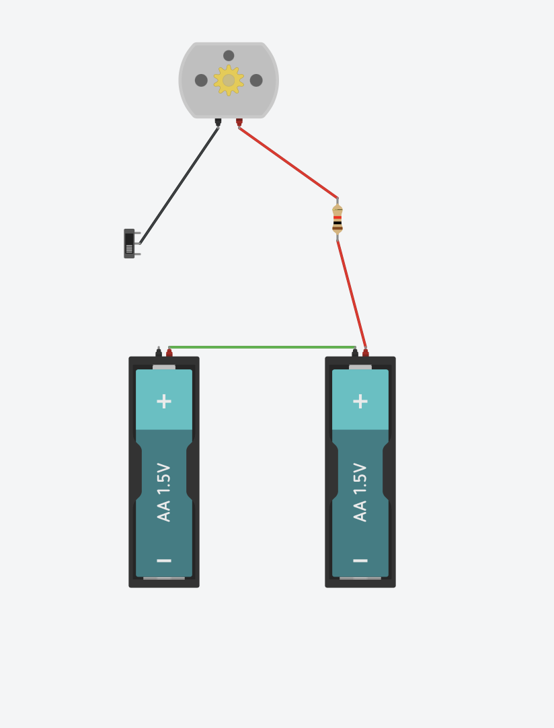
Step 5:
Connect the common to the negative (black terminal) of the DC motor
Notes:
Follow the slide instructions. Enable students to peer support each other, and do regular check ins with the class.

Slide 54
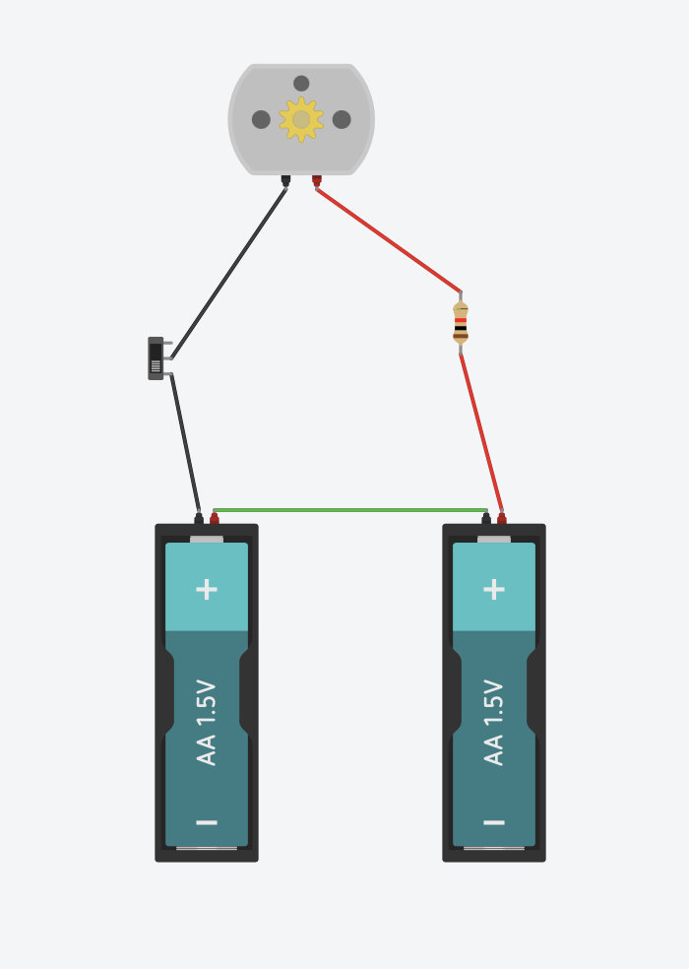
Step 6:
Finish the circuit by connecting terminal 1 to the negative wire of the battery.
What do you think will happen when we run the simulation? How about if we flip the switch?
Notes:
Follow the slide instructions. Enable students to peer support each other, and do regular check ins with the class.

Slide 55
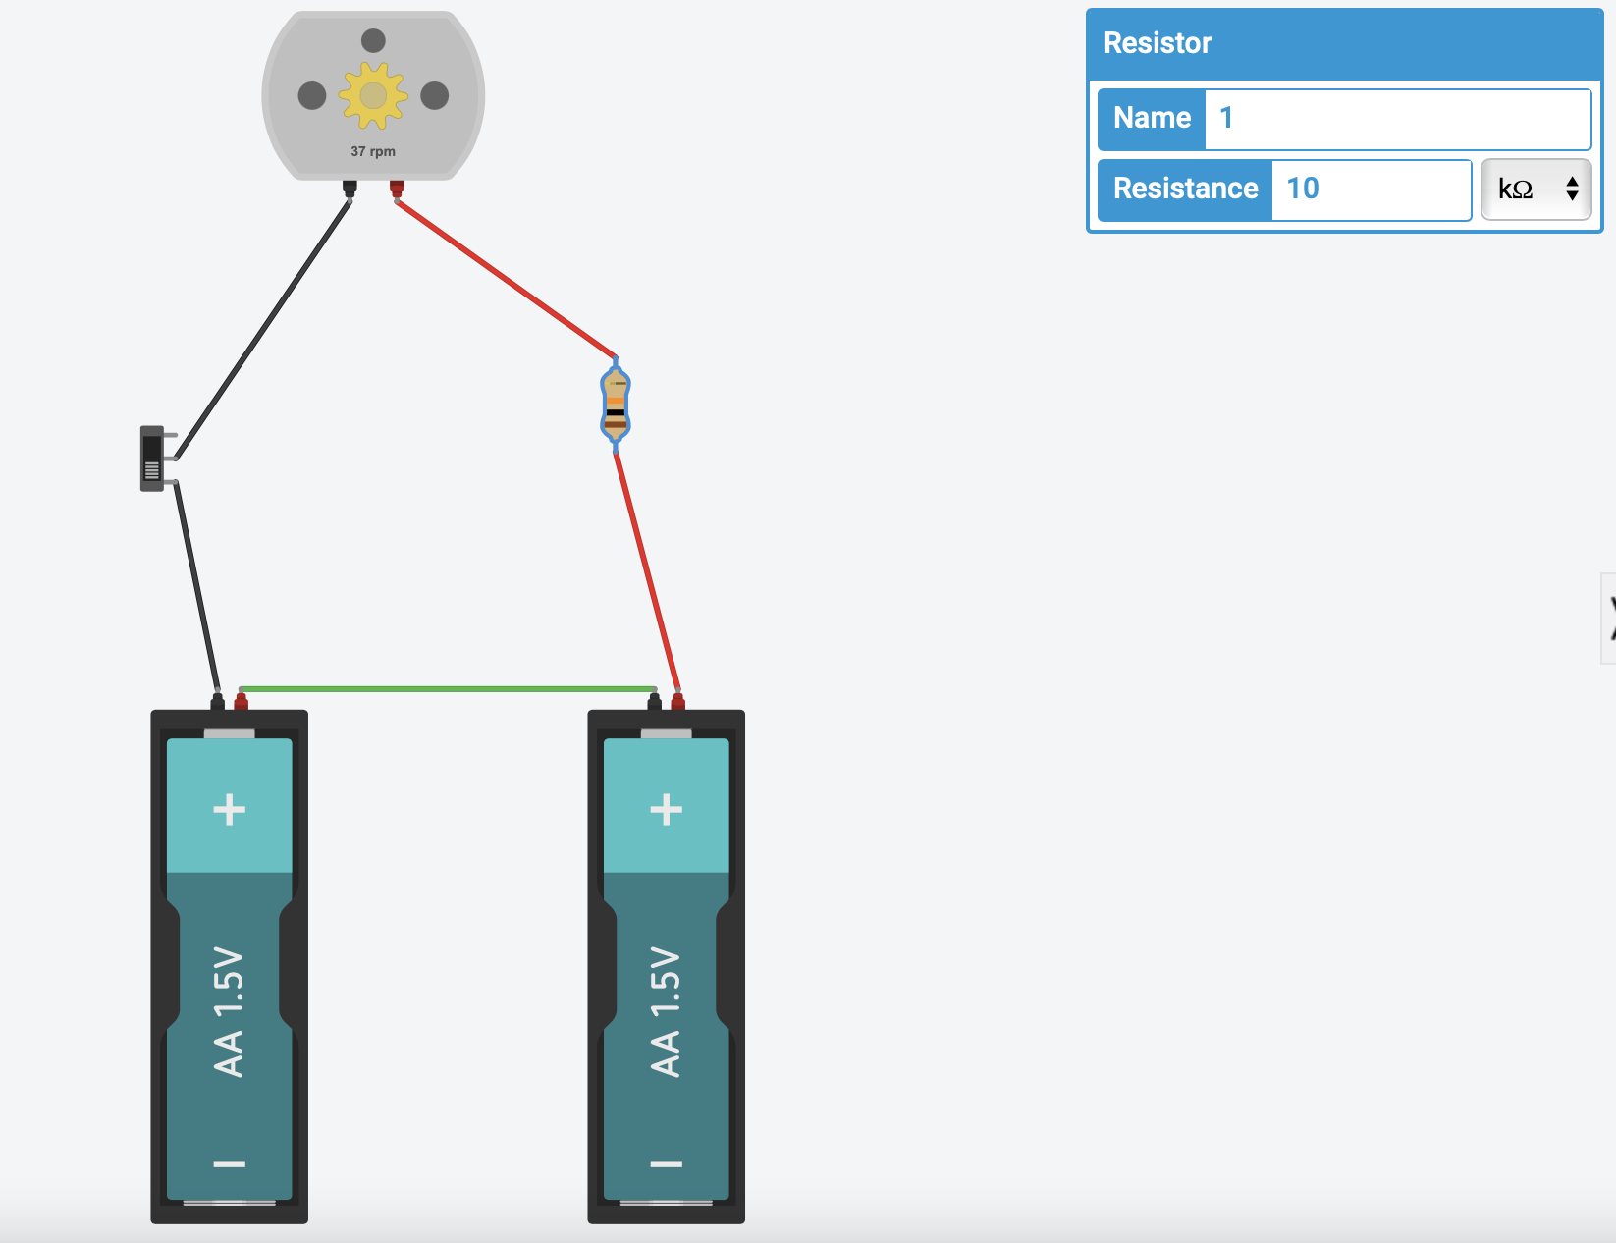
Step 7:
In order to change the speed of the motor (RPM) play around with different values in the resistor.
Try to predict what different values will do to the RPM and think about why that might be the case.
Tips:
Higher resistances = slower speeds (smaller RPMs)
Lower resistances = higher speeds (higher RPMs)
Notes:
Follow the slide instructions. Enable students to peer support each other, and do regular check ins with the class.

Slide 56
Circuits Review
Take a screenshot of your motor circuit design.
What components did you use?
How does your motor circuit work?
What is motor power source (type and number of batteries)?
Advanced Questions:
What would happen if you:
connected the positive battery terminal to the negative motor terminal?
connected the negative battery terminal to the positive motor terminal?
Notes:
Advanced questions 1 & 2 – 1. Higher RPM – 2. Negative RPM (reverse direction of spin)

Slide 57
Session 4: Build an Electric Motor Circuit
Notes:
Let’s build an actual EV motor circuit.

Slide 58
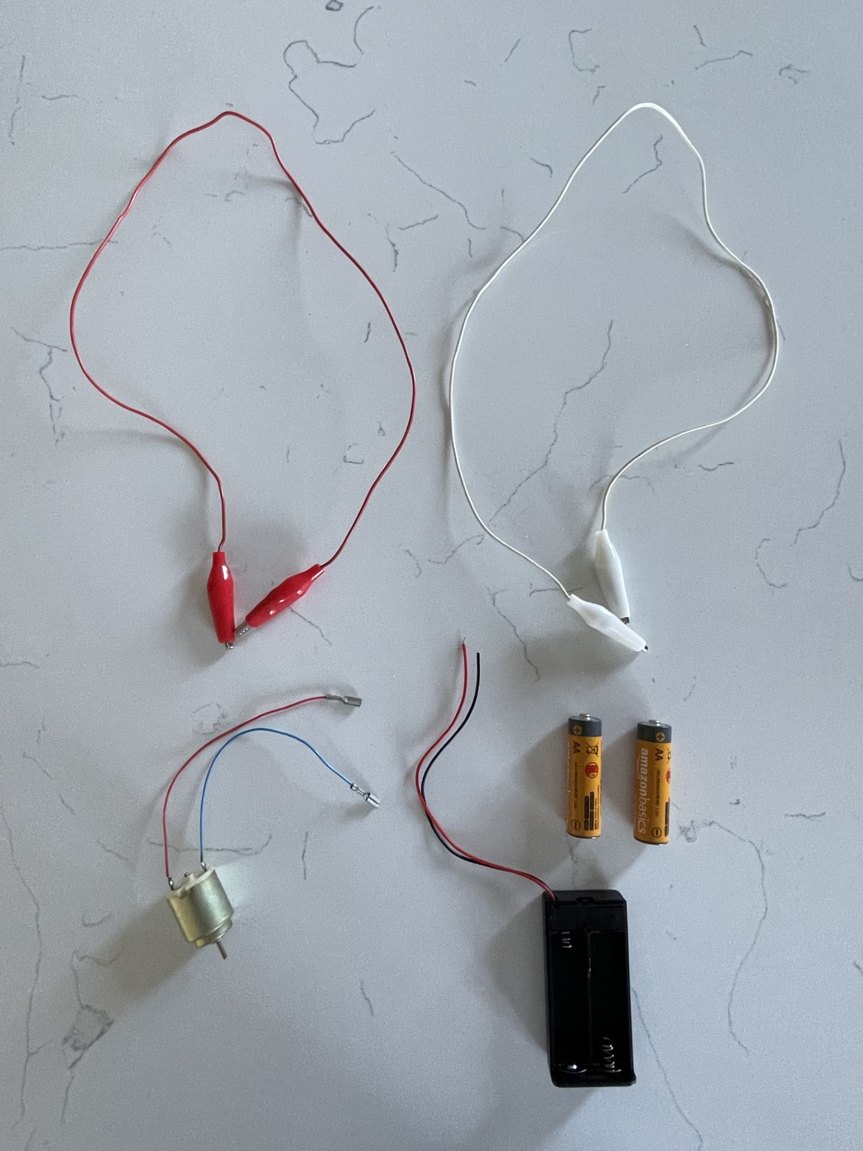
Now, let’s build an electric motor circuit!
Motor Components:
2 AA Batteries
1 AA Battery Pack with switch
2 Alligator Clips
1 DC Motor
Notes:
Follow the slide instructions. Enable students to peer support each other, and do regular check ins with the class.

Slide 59
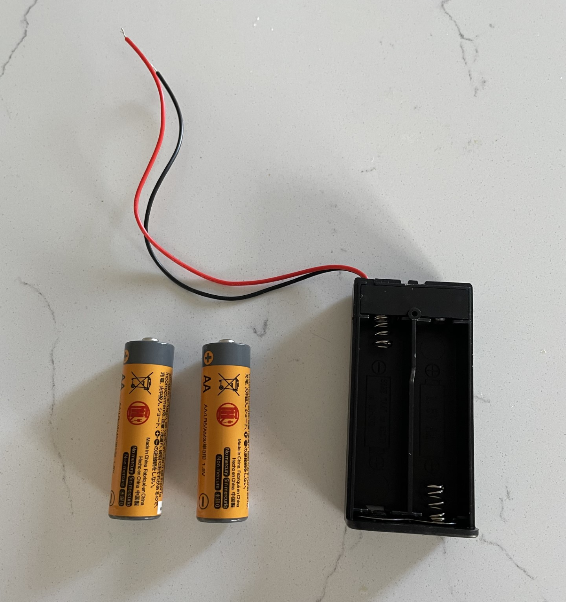
Positive Terminal
Negative Terminal
Step 1
Batteries:
The batteries will provide power to the electric motor.
AA batteries have a negative end (the flat side), and a positive end (the side with the bump).
Put two AA batteries in the battery pack.
Positive Terminal
Negative Terminal
Notes:
Follow the slide instructions. Enable students to peer support each other, and do regular check ins with the class.

Slide 60
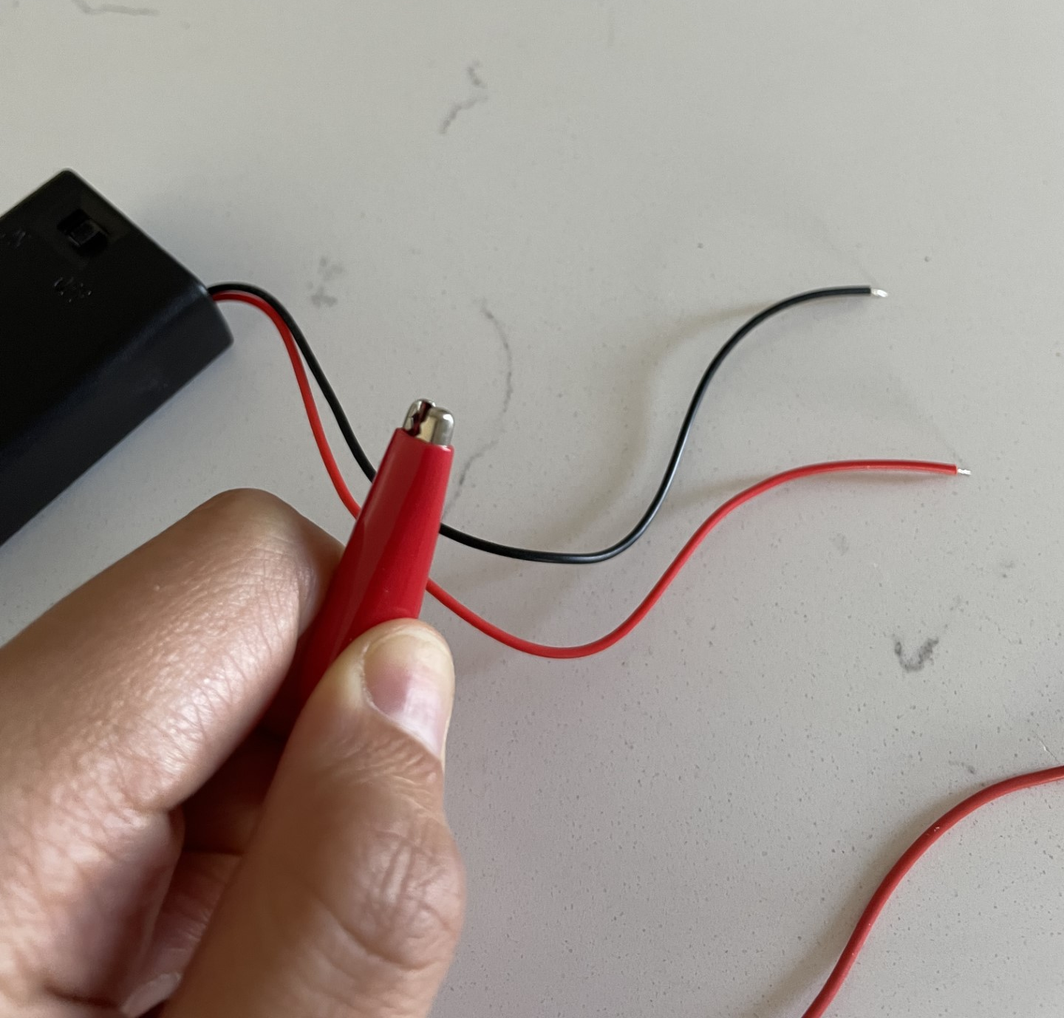
Step 2
Connectors:
For this circuit, we’ll be using alligator clips. These allow us to connect terminals by clamping them together.
To open, squeeze the back end and let go to chomp!
A more permanent option is to solder the wires in the circuit.
v
SQUEEZE
v
SQUEEZE
Notes:
Follow the slide instructions. Enable students to peer support each other, and do regular check ins with the class.

Slide 61
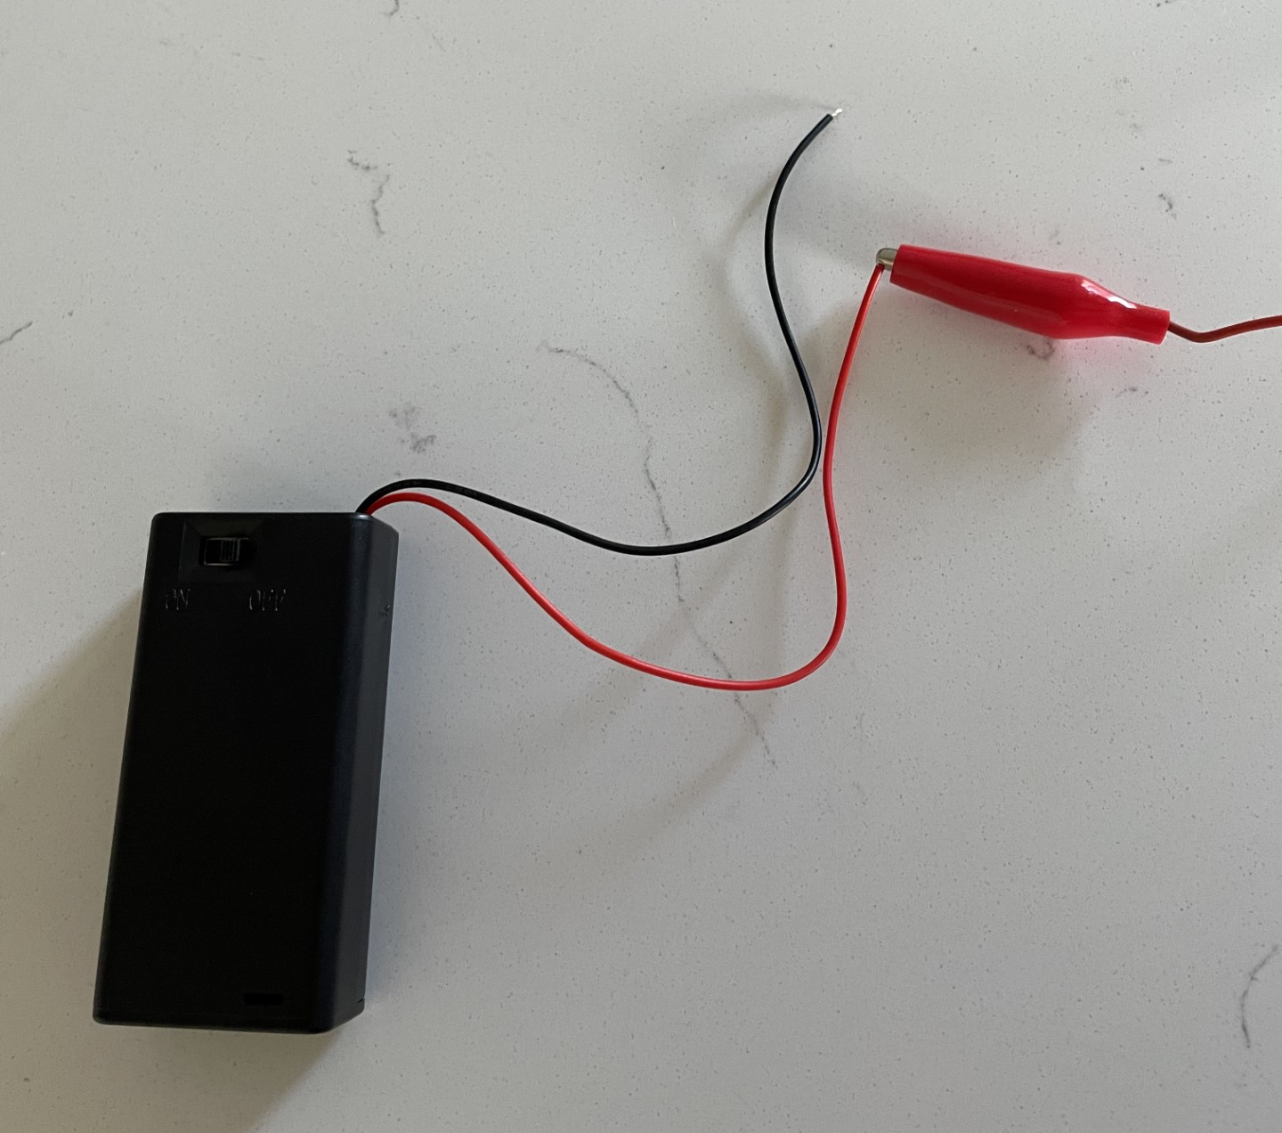
Step 3
Connections:
An electric current is the flow of charge (electrons) through a conductor, such as metal wires.
When you connect alligator clips to create a circuit, make sure the metal clip bites down on the metal leads.
If you connect to the rubber, there won’t be any current!
Notes:
Follow the slide instructions. Enable students to peer support each other, and do regular check ins with the class.

Slide 62
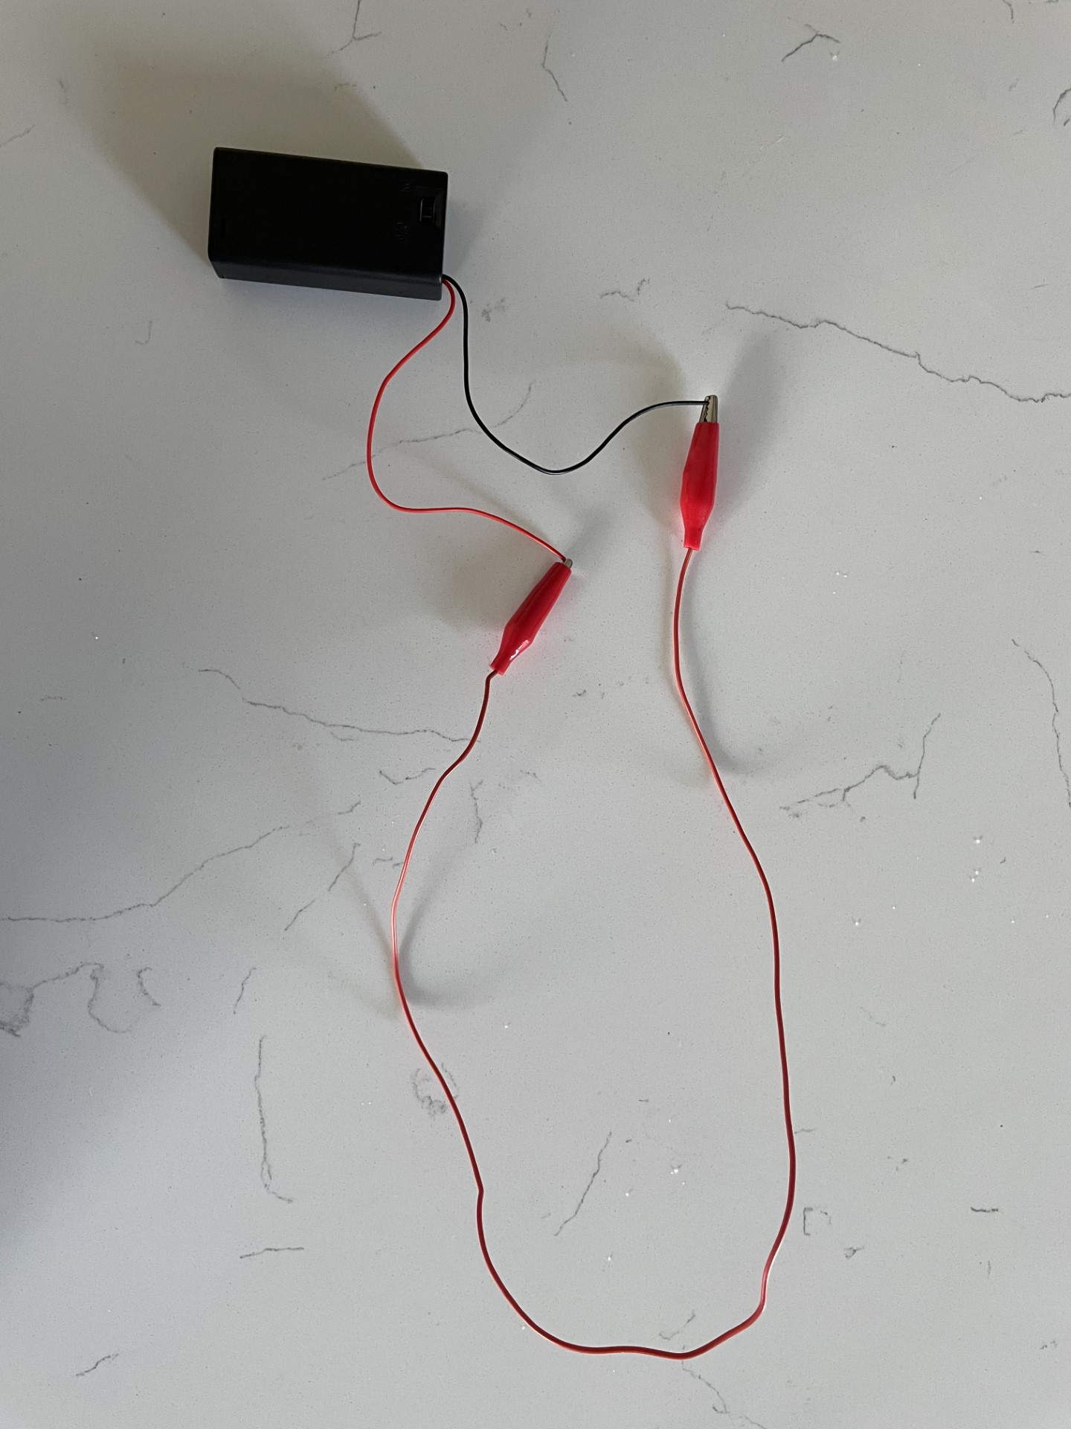
Step 4
Series Batteries:
We want to connect our batteries in series, meaning the POSITIVE end of the battery connects to the NEGATIVE end of the battery.
Series battery connections essentially creates one BIG battery.
Instead of 1.5 Volts (that’s the voltage of one AA battery), we will have:
1.5V + 1.5V = 3V total in our circuit!
Notes:
Follow the slide instructions. Enable students to peer support each other, and do regular check ins with the class.

Slide 63
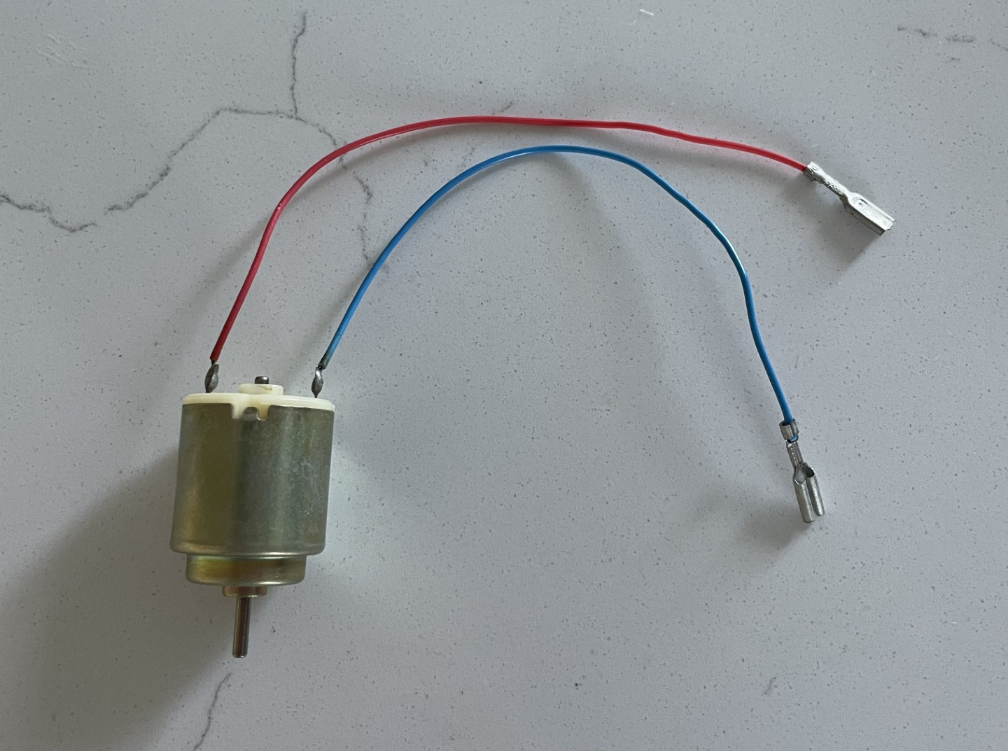
Positive Terminal
Step 5
Electric Motor:
Next we’ll add the motor to the circuit.
Like the battery pack, the POSITIVE end of the motor is the red wire and the NEGATIVE end of the motor is the blue wire.
Negative Terminal
Notes:
Follow the slide instructions. Enable students to peer support each other, and do regular check ins with the class.

Slide 64
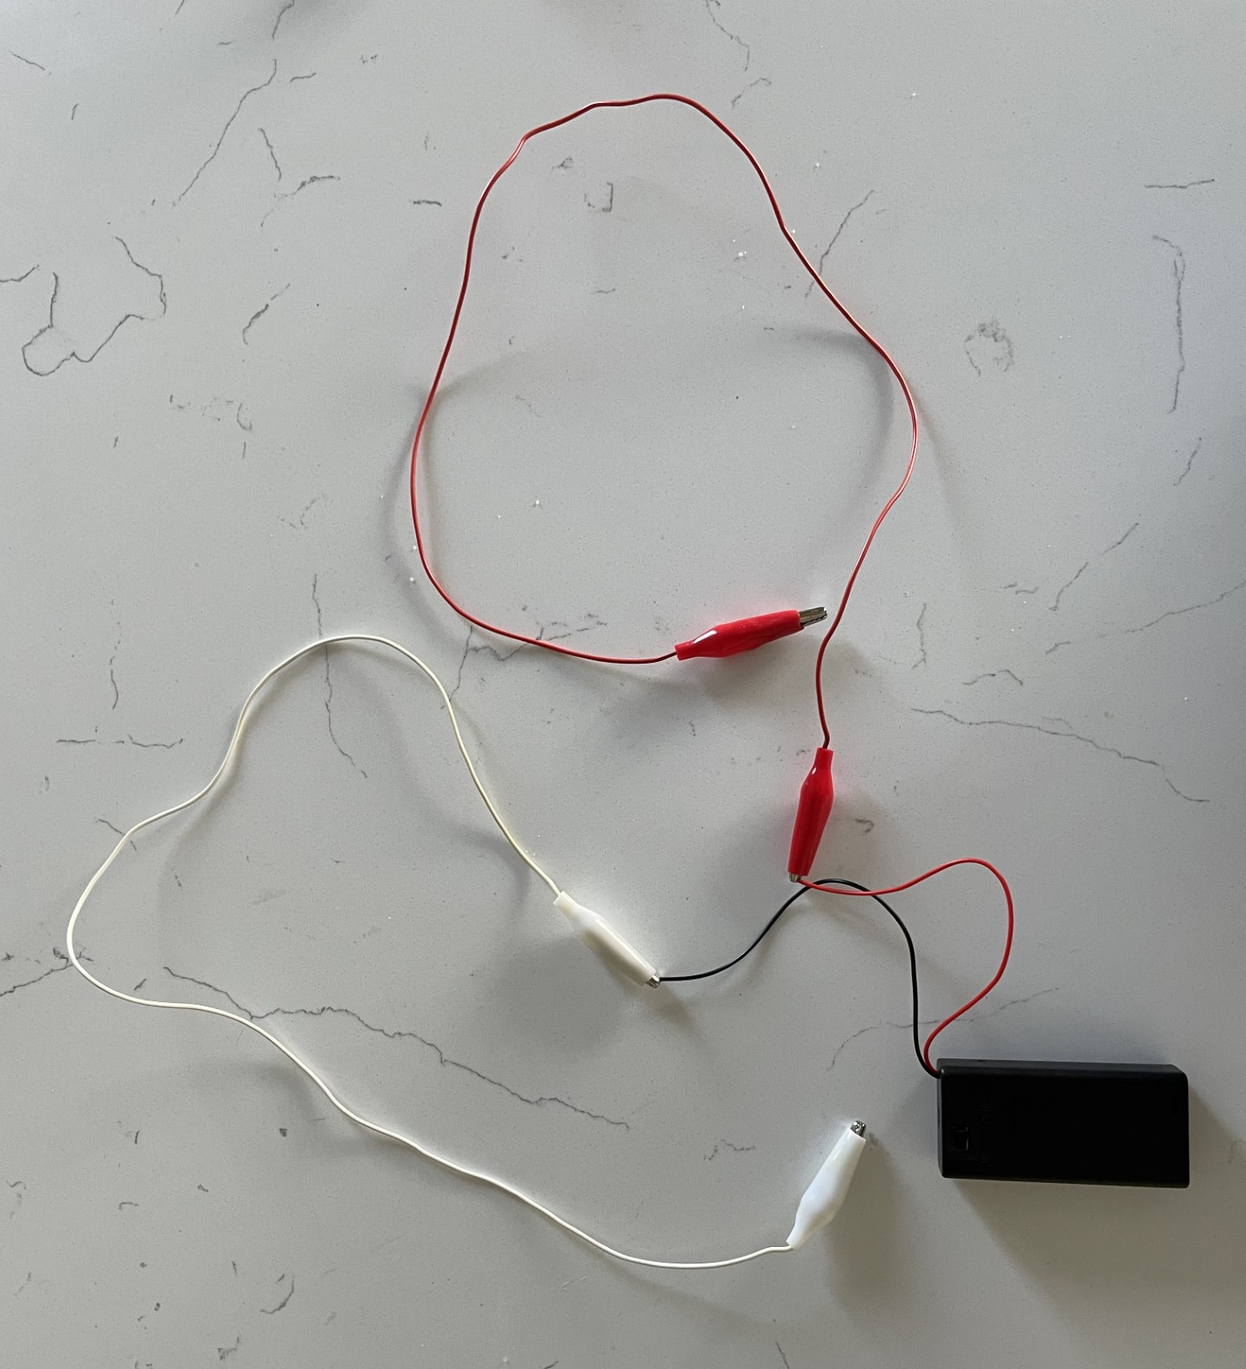
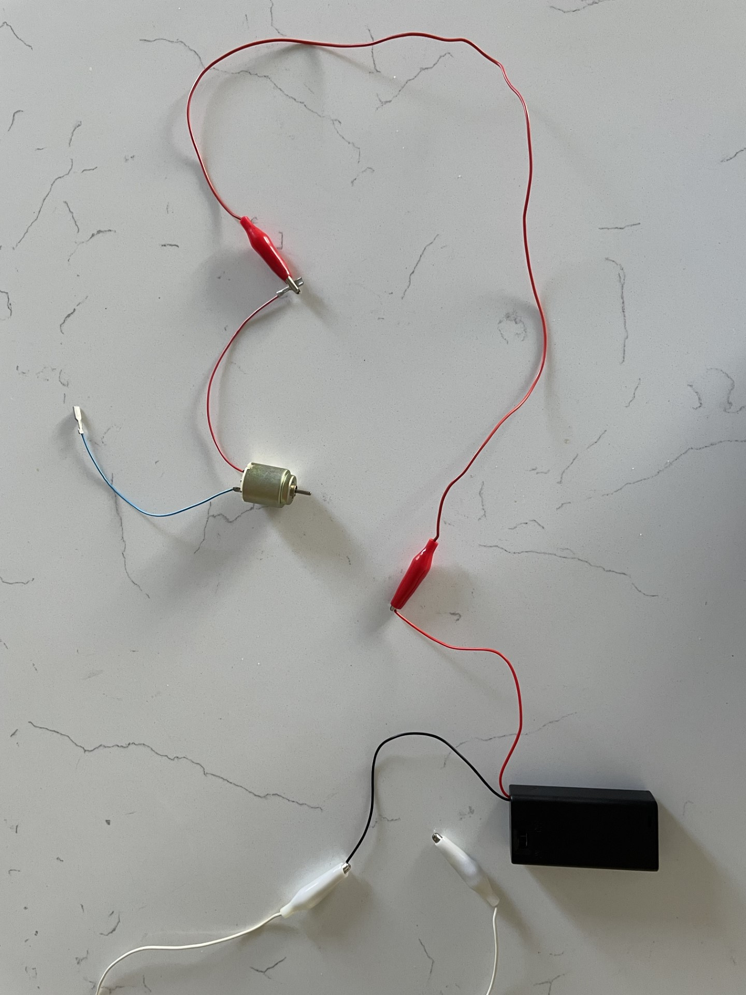
Step 6
Connect Motor:
Just like the batteries, we want the motor in series.
Use a set of alligator clips that connects to each end of the battery pack.
Then we’ll connect the POSITIVE of the battery pack to the POSITIVE of the motor and the NEGATIVE of the battery pack to the NEGATIVE of the motor.
CONNECT
Notes:
Follow the slide instructions. Enable students to peer support each other, and do regular check ins with the class.

Slide 65
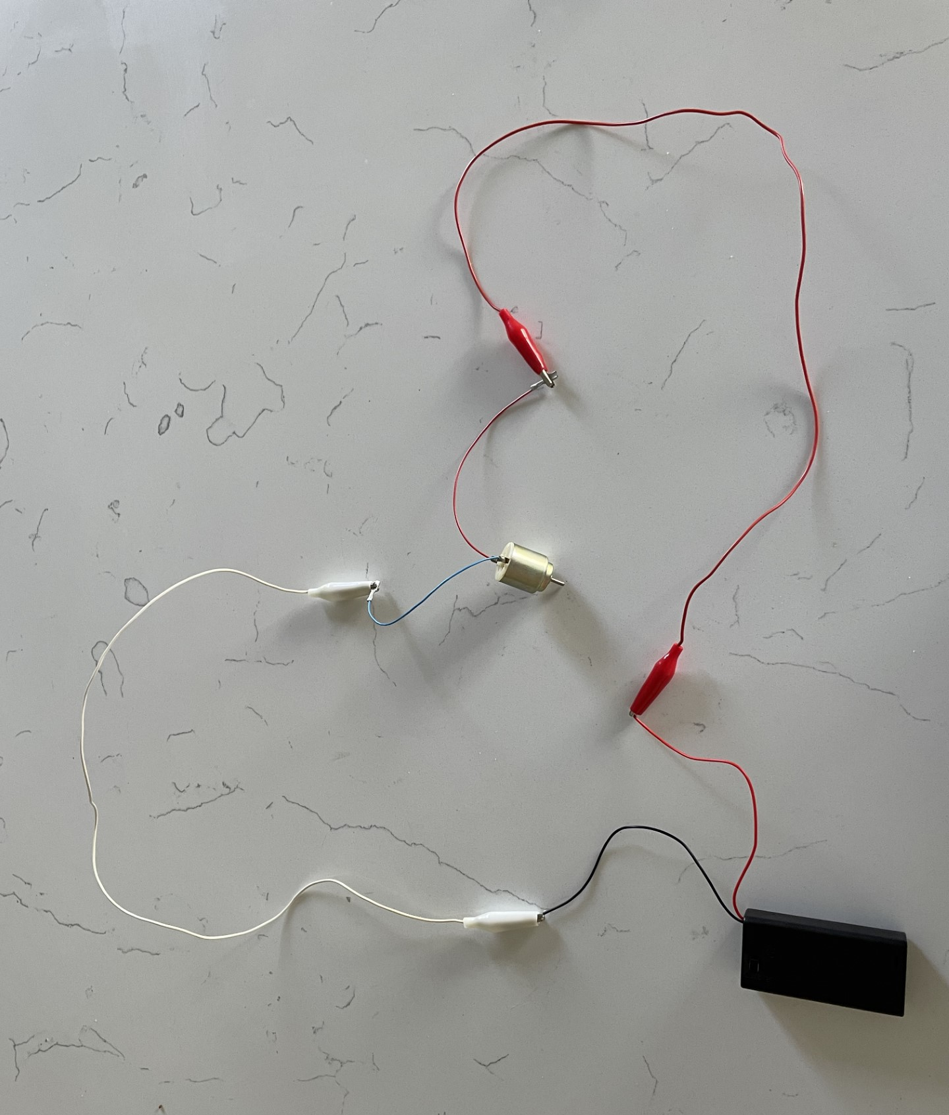
Step 7
Test the Circuit:
The circuit loop is complete. Turn the battery pack switch on and the electric motor should run!
Troubleshoot if the motor does NOT run:
Trace the wires through the circuit, it should make one unbroken loop.
Give the motor spindle a gentle twist with the circuit on.
Notes:
You can put a piece of tape on the axle of the motor as a flag to show the direction of spin. As an exercise you can flip the negative and positive connections of the motor to show it spin the other direction.

Slide 66
Circuits Review
Take a photo or short video of your completed electric motor circuit.
What components did you use?
How does your motor circuit work?
What is motor power source (type and number of batteries)?
Notes:
Have students share out about successes and challenges with building the model EV motor circuit.

Slide 67
End of Workshop
Way to charge it!
Notes:
Your team now has the basis of your model EV project
Image credit: https://images.app.goo.gl/P5Vk1kYRoaShX1Kr7

