Slide 1
SALTWATER CIRCUIT

Slide 2
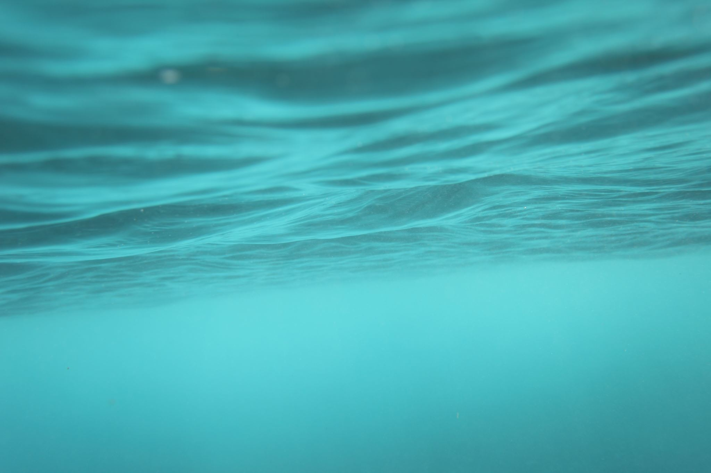
Saltwater Circuit

Slide 3
What is a saltwater circuit?
It’s an electric circuit that uses saltwater as one of its circuit elements.
When you mix water and salt, the salt dissolves. Salt turns into sodium ions and chloride ions.
When you apply a electric voltage, the circuit conducts electricity if enough sodium ions and chlorine ions are present in the water.

Slide 4
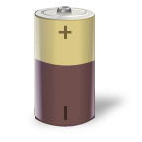
Basic Circuit
Electric circuit: A chain of connected circuit elements
Circuit
Element
Circuit
Element
Circuit
Element
Circuit
Element
Closed circuit: All circuit elements are connected and electric current flows through the circuit.
Open circuit: At least one break in the circuit. Not all elements are connected. Electric current does not flow in the circuit.

Slide 5
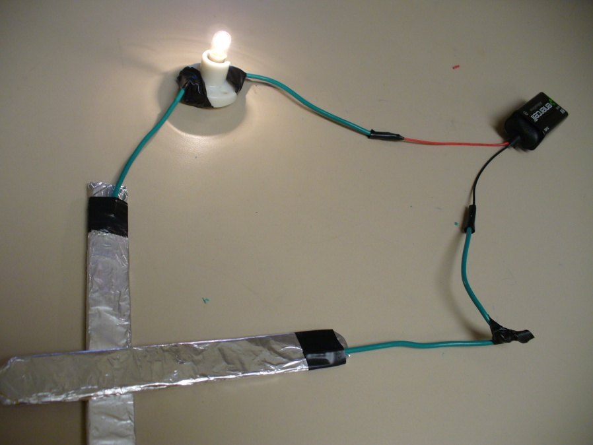
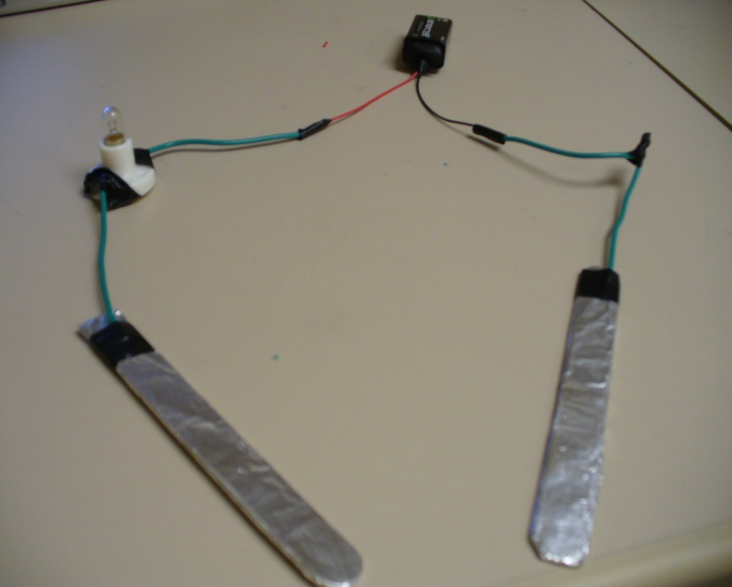
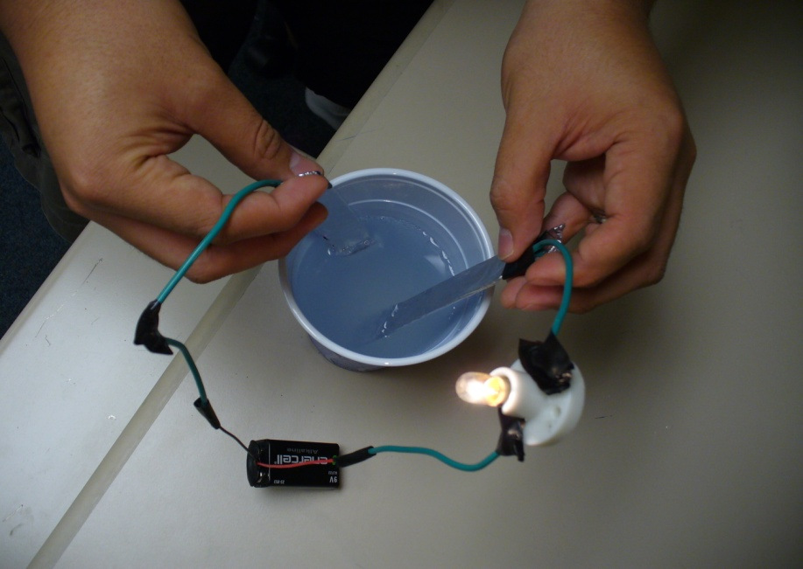
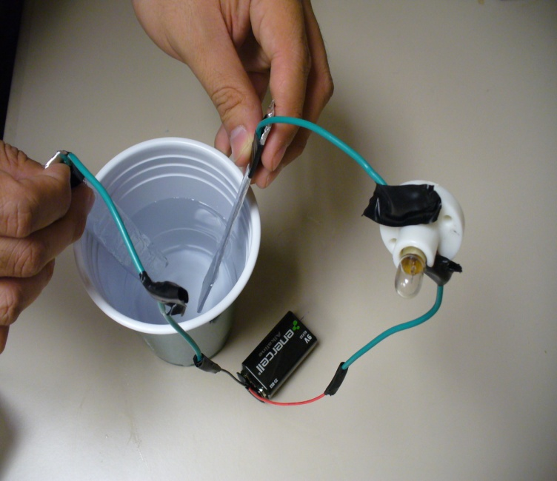
Saltwater Circuit
Electrodes touching:
The circuit is closed.
Electrodes not touching:
The circuit is open.
Electrodes in saltwater:
The circuit is closed.
Electrodes in water:
The circuit is open.

Slide 6
Your Objective:
Answer the following question:
How does the quantity of salt in a saltwater circuit effect the current flowing through the saltwater circuit?

Slide 7
The end

Slide 8
References
PBS Kids Go. Zoom-Saltwater Rocks. WGBH Educational Foundation. Accessed May 1, 2010. http://pbskids.org/zoom/activities/sci/saltwatertester.html
Wikipedia.org, Wikipedia Foundation Inc., Accessed May 1, 2010. (Source of vocabulary definitions with some adaptation.) http://wikipedia.org

Slide 9
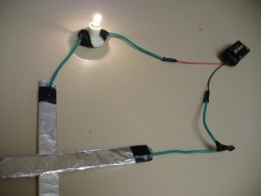
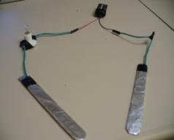
Image sources
Circuit
Element
Circuit
Element
Circuit
Element
Diagrams by Juan Ramirez Jr., ITL Program, College of Engineering, University of Colorado at Boulder, 2009
Circuit
Element
Battery image from Microsoft clipart
Light bulb image from Microsoft clipart
Wave image from Microsoft clipart
Photos by Juan Ramirez Jr., ITL Program, College of Engineering, University of Colorado at Boulder, 2009

