Slide 1
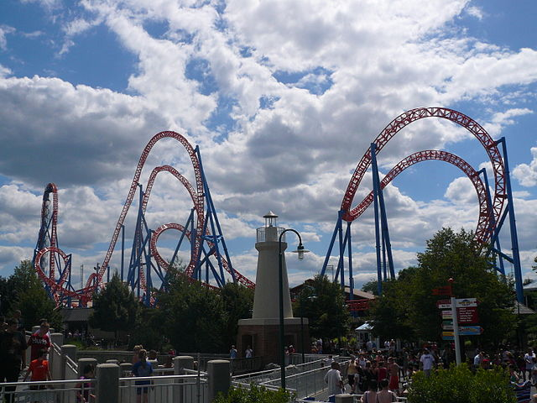
A Tale of Friction
Basic Rollercoaster Physics
Fahrenheit Rollercoaster, Hershey, PA | max height = 121 ft | max speed = 58 mph
Notes:
A Tale of Friction Presentation, A Tale of Friction lesson, TeachEngineering.org
image source: (Fahrenheit Rollercoaster) 2010 Michael Gray, Wikimedia Commons CC BY-SA 2.0 https://commons.wikimedia.org/wiki/File:Fahrenheit_Roller_Coaster.jpg
All diagrams by author Miguel R. Ramirez, high school math teacher, Texas, USA

Slide 2
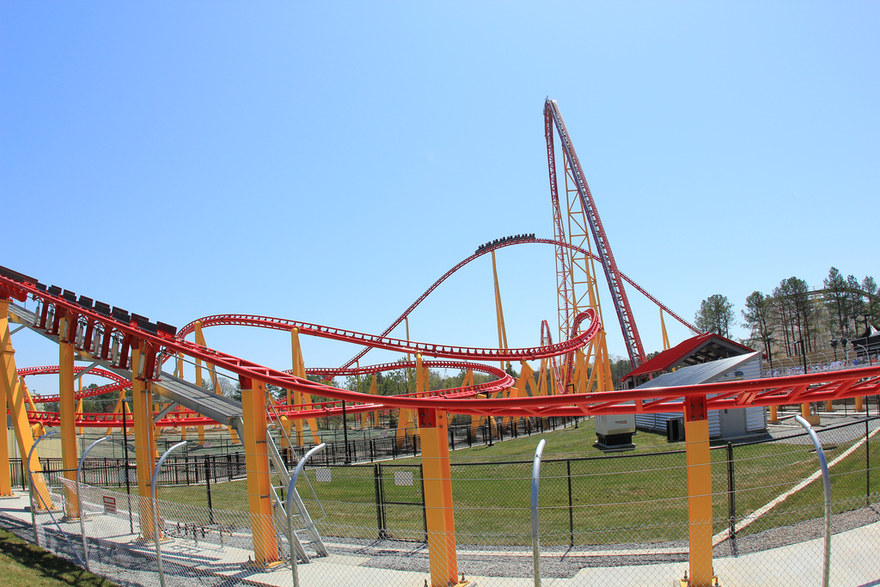
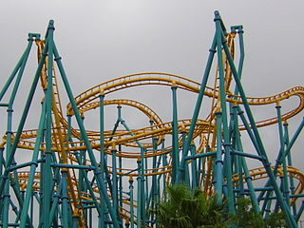
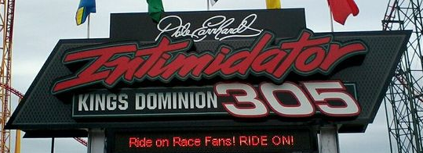
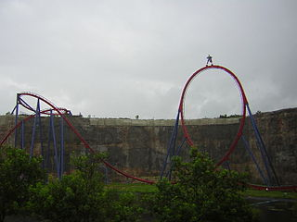
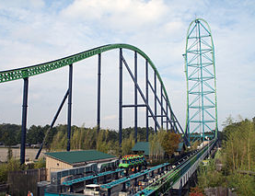
PLAY
PLAY
PLAY
PLAY
Notes:
Video clips:
(top left: Intimidator; 3:31 min) https://www.youtube.com/watch?v=oW1ejbSPxoE
(top right: Poltergeist; 2:19 min) https://www.youtube.com/watch?v=6AWjhWCmF60
(bottom left: Superman Krypton, TX; 3:47 min) https://www.youtube.com/watch?v=Eq3C90Pdeqg
(bottom right: Kingda Ka, NJ; 1:46 min) https://www.youtube.com/watch?v=AfBBq04ZScE
///
Image sources:
(top left: Intimidator 305 side track layout) 2010 Davynin Flickr CC BY 2.0
https://www.flickr.com/photos/daveynin/4488756076
(top right: Poltergeist) 2004 Christ Hagerman Wikimedia Commons CC BY 2.0
https://commons.wikimedia.org/wiki/File:Poltergeist.jpg
(bottom left: Superman) 2004 Christ Hagerman Wikimedia Commons CC BY 2.0
https://commons.wikimedia.org/wiki/File:Superman_Krypton_Coaster_vertical_loop.jpg
(bottom right: Kingda Ka) 2006 Dusso Janladde, Wikimedia Commons CC BY 2.0
https://commons.wikimedia.org/wiki/File:Kingda_Ka.jpg

Slide 3
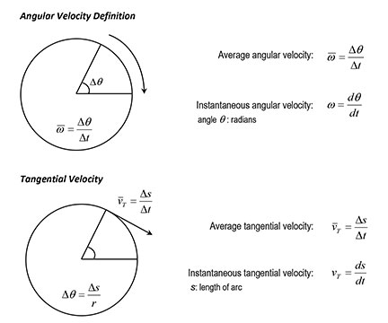
Rotational Movement Kinematics
Similar to how linear velocity is defined, angular velocity is the angle swept by unit of time. Tangential velocity is the equivalent of linear velocity for a particle moving on a circumference.
or

Slide 4
Rotational Kinetic Energy and Momentum of Inertia of a Rigid Body
For a single particle:
Tangential kinetic energy:
Rotational kinetic energy:
Momentum of inertia:
For a system of particles:
Momentum of inertia:
For a rigid body:
Momentum of inertia:

Slide 5
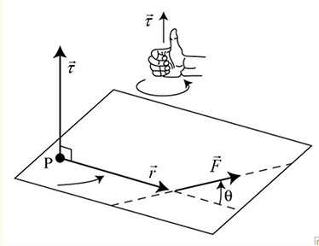
Angular Momentum and Torque of a Rigid Body
Law of lever:
Torque:
Magnitude:
Newton’s second law:
Torque is a measure of how much a force acting on an object causes that object to rotate. It is formally defined as a vector coming from the special product of the position vector of the point of application of the force, and the force vector. Its magnitude depends on the angle between position and force vectors. If these vectors are parallel, the torque is zero.

Slide 6
Angular Momentum and Torque of a Rigid Body
Linear momentum:
Force definition:
For m = constant:
Angular momentum:
Defining torque (force producing rotation) in a circular movement (r constant) as the change in time of the angular moment:

Slide 7
Angular Momentum and Torque of a Rigid Body
Linear momentum:
Force definition:
For m = constant:
Angular momentum:
Taking a_{T}= α⋅r, and making I = m⋅r²:
or

Slide 8
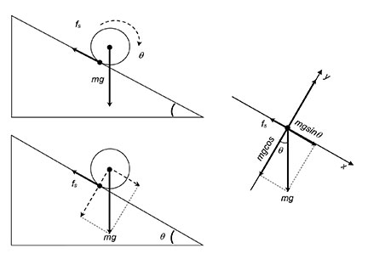
Friction Force for a Rigid Sphere Rolling on an Incline
The sphere rolls because of the torque produced by the friction force f_{s} and the weight’s component parallel to the incline:
and
If the sphere’s momentum of inertia is I = 2/5⋅m⋅r² and α = a/r:
or
With this value:
Solving for a in the above equation, the acceleration of the sphere rolling on the incline is:

Slide 9
Friction Force for a Rigid Sphere Rolling on an Incline
Combining:
and
the static friction force is now:
But by definition, the static friction force is proportional to the normal force the body exerts on the surface :
Taking F_{n} from the free-body diagram:

Slide 10
Friction Force for a Rigid Sphere Rolling on an Incline
Combining the two expressions for f_{s}:
the coefficient of static friction can be expressed as:
This expression states that the coefficient of static friction is a function of the incline’s angle only, specifically, a function of the slope of this surface.

Slide 11
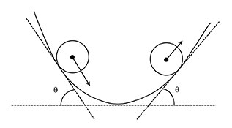
Friction Force for a Rigid Sphere Rolling on a Variable Slope Path
Let f (x) a differentiable function. If:
then: tan θ = f ’(x)
The coefficient of static friction μ_{s} can be expressed as:
At any point of a curved path f (x), a tangent line can be visualized as a portion of an incline.
The slope m of this incline is the tangent of the angle between this line and the horizontal, tan θ.
In calculus, this slope is given by the value of f’(x), the derivative of the function f (x) at that point.
The static friction force f_{s} is now:

Slide 12
Friction Force for a Rigid Sphere Rolling on a Variable Slope Path
Because tan θ = f ’(x), it is possible to define a right triangle with sides in terms of f ’(x):
If:
, then:
Using basic trigonometry:
The static friction force is now:

Slide 13
Friction Force for a Rigid Sphere Rolling on a Variable Slope Path
But, something needs to be fixed in this procedure. By definition, the static friction coefficient μ_{s} must always be positive, while the slope of a path may be positive or negative.
So the required corrections must be:
Where:
denotes the absolute value of the function f ’(x)

Slide 14
Work-Energy for a Sphere Rolling on a Variable Slope Path with Friction
The work-energy theorem states that the mechanical energy (kinetic energy + potential energy) of an isolated system under only conservative forces remains constant:
In a system under non-conservative forces, like friction, the work-energy theorem states that work done by these forces is equivalent to the change in the mechanical energy:
Additionally, the work done by non-conservative forces depends on the path or trajectory of the system, or in the time these forces affect the system.

Slide 15
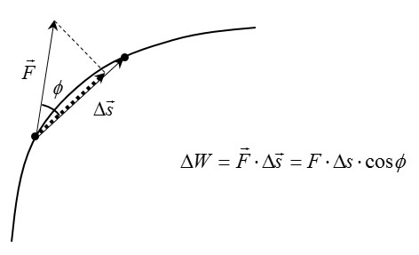
Friction Force for a Rigid Sphere Rolling on a Variable Slope Path
By definition, mechanical work is the product of the displacement and the force component along the displacement:
For a variable slope path y = f (x), the work done by the friction f_{s} over a portion Δs of the path is:
For a differential portion of the path:

Slide 16
Friction Force for a Rigid Sphere Rolling on a Variable Slope Path
Expressing ds in terms of the differentials dx and dy, the differential arc can be expressed in terms of the f ’(x):
The work along the differential portion of the path can be expressed as:

Slide 17
Friction Force for a Rigid Sphere Rolling on a Variable Slope Path
Because dx > 0, using properties of the absolute value and the definition of differential of a function:
Friction forces always acts against the movement, so the work done by them must always be negative:

Slide 18
Friction Force for a Rigid Sphere Rolling on a Variable Slope Path
Taking small displacements instead differentials:
Using this expression in the work-energy theorem:
This expression relates the work done by friction with the mechanical energy of a sphere rolling on a little portion of a curved path.
Visualize this portion as a little incline.
Height h is given by the function f (x).

Slide 19
Friction Force for a Rigid Sphere Rolling on a Variable Slope Path
Then, dividing by m:
From this expression, we can determine final velocity at the end of the incline:

Slide 20
Friction Force for a Rigid Sphere Rolling on a Variable Slope Path
We can approximate the friction of a spherical body on a curved path as the rolling of this body on a sequence of inclines.
The final velocity at the end of one incline is the initial velocity at the beginning of the next incline.

Slide 21
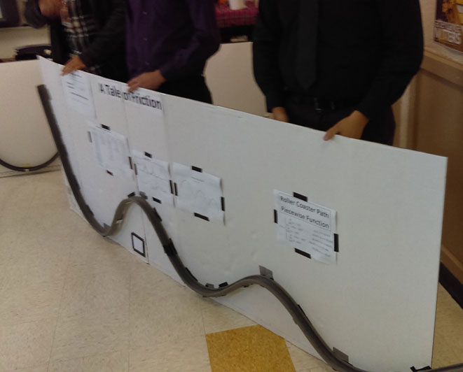
Are you ready to apply what you have learned?

