Slide 1
Introduction to Evolutionary Computation
Notes:
Presentation for the Introduction to Evolutionary Computation lesson, TeachEngineering.org

Slide 2
Questions to consider during this lesson:
- How is digital evolution similar to biological evolution? How is it different?
- How can the principles of natural selection be applied to solve engineering design problems?

Slide 3
Evolution
Evolution is a process that results in heritable changes in the traits of a population of organisms over multiple generations
Evolution occurs whenever and wherever three conditions are met:
- replication (reproduction)
- variation (differences among individuals)
- competition (different reproduction rates)
This process is called natural selection. There are other mechanisms that contribute to the process of evolution, but natural selection is the main force that leads to adaptive traits

Slide 4
Introduction to Digital Evolution
Avida software was created to study the process of evolution (“a” = artificial “vida” = life)
Digital organisms are small, self-replicating computer programs
Digital organisms live and reproduce in a virtual environment determined by the user
Random replication errors cause mutations to occur in the programs as they reproduce, which leads to variation within a population

Slide 5
http://avida.devosoft.org/about/
Instance of evolution in a model environment
Digital organisms and the environment in Avida differ from the biological world, but the mechanisms that cause evolution are the same
The application enables researchers to address questions about evolution that are difficult or impossible to answer using biological organisms
Faster replication
Larger population sizes
Complete control over environment
Observe and record events without interfering
Notes:
Image source: http://avida.devosoft.org/about/

Slide 6
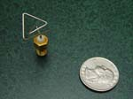
Evolutionary Computation & Engineering
The principles of natural selection can be applied to engineering problems
A random set of potential solutions to a problem are competed in a modeled environment
The best solutions outcompete less efficient solutions
Evolutionary computation has been applied to solve many engineering problems, such as:
robotic controllers and morphology
self-managing computer systems
a NASA satellite antenna ➔
http://www.nasa.gov/centers/ames/news/releases/2004/04_55AR.html
Notes:
NASA engineers use evolutionary computation to design very small satellite antennas. Through a “survival of the fittest” approach, the software examines millions of potential antenna designs before settling on one. Evolutionary computation applies the principles of evolution by natural selection to identify the best potential solutions and often suggest possible solutions that engineers never considered.
Learn more about the NASA antenna at http://www.nasa.gov/centers/ames/news/releases/2004/04_55AR.html
Image source: http://www.nasa.gov/centers/ames/news/releases/2004/04_55AR.html

Slide 7
Avida-ED is an educational version of Avida that was developed to teach evolution and the nature of scientific inquiry
user-friendly interface
you can ask your own questions and collect data to answer them
outcomes are not preprogrammed – every run is unique
you can observe mutations, replication and the effects of evolution on a population
Notes:
Image source: http://avida.devosoft.org/about/

Slide 8
Digital Organism Replicating in Avida-ED
Notice that some commands are circled in green – these are the mutations at which random replication errors occurred

Slide 9
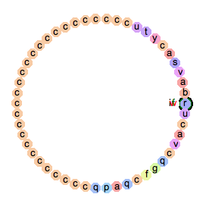
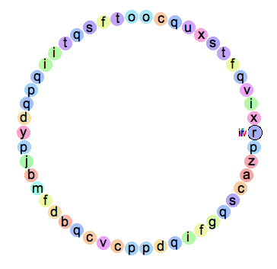
Digital Organisms in Avida-ED
Over many generations,
mutations accumulate
ancestor
descendant
A series of computer commands represented by letters (A-Z)
Genetic information of the organism (similar to DNA)

Slide 10
Digital Organisms in Avida-ED process numbers from their environments
Original ancestor:
Capable of replication only
Half of its code is (c), which is a no-operation command
Descendant:
Differs from ancestor due to random replication errors
May have a series of commands that code for a specific function (for example, adding two numbers together)

Slide 11
The ancestor organism reproduces in the virtual petri dish and results in a population of unique individuals
Click here to change the environmental variables

Slide 12
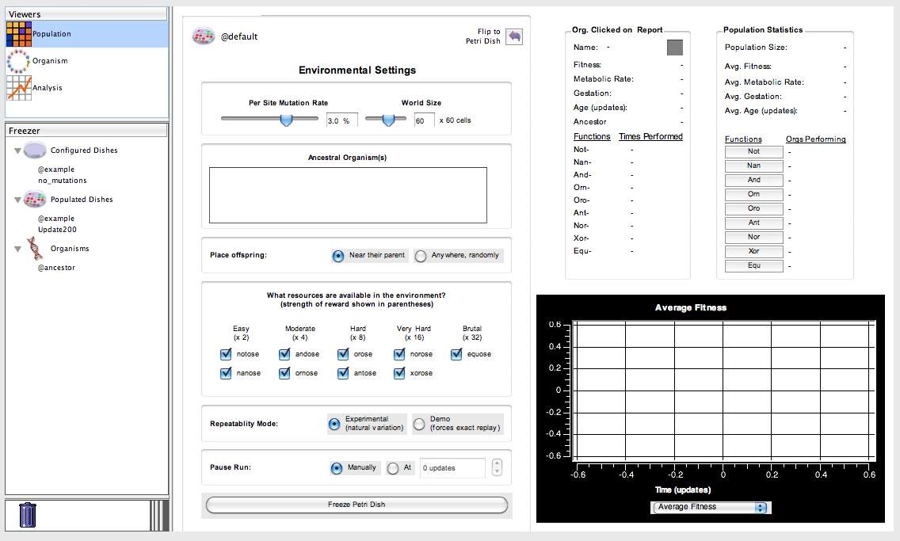
The user controls which logic functions are rewarded, as well as the mutation rate and world size
Click here to return to the virtual petri dish

Slide 13
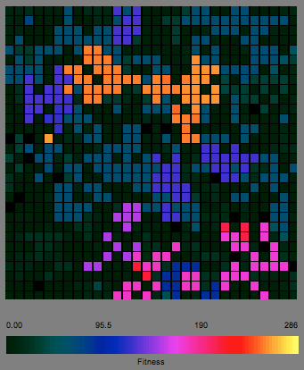
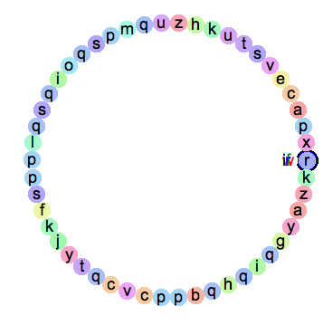
The sequence of commands differs among individuals. Certain logic functions are rewarded with increased “energy” (computing power), which allows the organism to execute its commands (and reproduce) faster
Individuals compete for space on the grid. Offspring are placed into a random adjacent box on the grid and may overwrite existing organisms.
Individuals in a population can be viewed and saved in Avida-ED.

Slide 14
Summary
Avida-ED provides an instance of evolution because digital organisms:
- replicate
- differ from each other due to random replication errors
- compete for space on the virtual petri dish
Although the digital organisms are not identical to any biological organism, the processes that act on them and lead to evolution are the same
Software such as Avida can be used to solve engineering problems.
Each digital organism represents a possible solution and the digital environment is a model of the real-world conditions that the design would be subjected to.

Slide 15
Discuss your answers to the following questions:
How is digital evolution similar to biological evolution? How is it different?
How can the principles of natural selection be applied to solve engineering design problems?

