Slide 1
BIODEGRADABLE HUSK-BAG DESIGN CHALLENGE

Slide 2
Standards:
State STEM Standards The student examines the relationship of biotechnology to the development of commercial products. The student is expected to design an environmentally friendly, biodegradable potato chip bag.
ITEEA Standards Provide a common set of developmentally appropriate expectations in the study of technology, including the engineering design process.
NGSS Standards Design a solution to a complex real-world problem, based on scientific knowledge, student-generated sources of evidence, prioritized criteria, and tradeoff considerations.

Slide 3
Learning Objectives:
We will analyze a real-world environmental issue by calculating the volume of plastic pollutants from a single product.
We will engineer a prototype to resolve the issues of the use of toxic plastic.
We will learn, laugh and leap with academic growth!

Slide 4
What is your favorite bag of chips?
How many bags of chips did you eat this week? Month? Year?
Let’s add up how many bags of potato chips were eaten in this room?
How many bags do you think are produced to meet the demands of customers?
What do you notice about the design of these bags of potato chips?

Slide 5
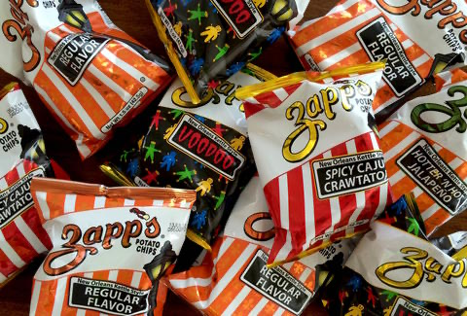
Why are we talking about bags of chips?
Why are we talking about bags of potato chips?
Nano-academy
Teachengineering.com

Slide 6
Why do we need to stop plastic pollution?
https://youtu.be/Yomf5pBN8dY

Slide 7
Plastic Pollution
What are the uses of plastic?
How much plastic do you see in this room?
Can we live without plastic?
Can we at least reduce our usage?

Slide 8
Background – Single-use Plastics
Are you ready for a break up? (video)

Slide 9
What can we do to use less plastic?
Have a purposeful discussion with your group to answer this question.
Be prepared to share out.

Slide 10
You do the math:
Graph the data table in your Worksheet
Find the equation of the line
How many bags were sold in the last six years?
Imagine how many bags of potato chips will be sold in the next six years.

Slide 12
What can we do to use less plastic?

Slide 13
Let’s start with a potato chip bag.
Write ideas on how we can design a new potato chip bag that is biodegradable.
Words to know | Definition
pollutant | Contaminant introduced to the natural environment.
degradation | The reduction of a chemical.
biodegradable | Capable of being decomposed by bacteria.
Plastic Pollution | Accumulation of plastic in the environment.

Slide 14
Your job is to engineer a bio-degradable potato chip bag – plastic free!

Slide 15
Engineer a new bag.
Start, Now (20 minutes)

Slide 16
Quality control test
TEST | Run 1 | Run 2 | Run 3 | % Score | Passed (100%) | Failed (<100)
Shake
Toss
Drop
Tensile Strength
Moisture Content
Temperature
Aesthetics/label

Slide 17
Reflection time!

Slide 18
Answer these questions (Team share out)
What worked?
What didn’t work?
How can this be applied to the real world?
Which biodegradable bag would you buy?
Which group engineered the best quality bag?

