Slide 1
Periodic Table Intro: Parts of a Whole

Slide 2
Warm-Up
List as many items that contain the name of an element.
For example: unleaded gasoline lithium-ion battery
As a class, we will take turns listing items to create one large class list.

Slide 3
What did you all come up with?
unleaded gasoline
lithium-ion battery

Slide 4
Agenda/Learning Objectives
How do you sort data?
Can you show information based on how data is organized?
How is the Periodic Table sorted?

Slide 5
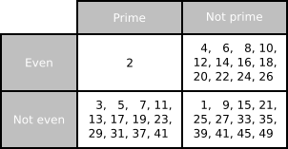
Let’s Talk Grids:
This is a Carroll diagram.
“A Carroll diagram is a way to sort data, such as a group of objects, shapes or numbers, based on given properties or traits in a yes/no fashion”
(Thanks Google!)
Does it make sense why the 2 in this table is all by itself?
A Carroll Diagram of numbers. “Carroll” as in the author of Alice in Wonderland.

Slide 6
Let’s Practice Grids:
Each person needs a worksheet.
Each group needs a large whiteboard and marker.
A Carroll Diagram of numbers. “Carroll” as in the author of Alice in Wonderland.

Slide 7
Let’s Practice Grids:
Large whiteboards at the ready!
For this practice round…
Copy down the categories
Fill in each section with items that could go into each section

Slide 8
Let’s Practice Grids:
Large whiteboards at the ready!
For this practice round…
Copy down the categories
Fill in each section with items that could go into each section
 | Numbered Playing Card | Face Card
Red Suit
Black Suit

Slide 9
Your Turn!
Large whiteboards at the ready!
You are now going to receive a set of images. DO NOT LOSE THE PAPER CLIP.
Create your own Carroll Diagram to sort ALL images. A “misc./other” category is not allowed.
As you work through the images, complete the front of the worksheet.

Slide 10
What did you all come up with?

Slide 11
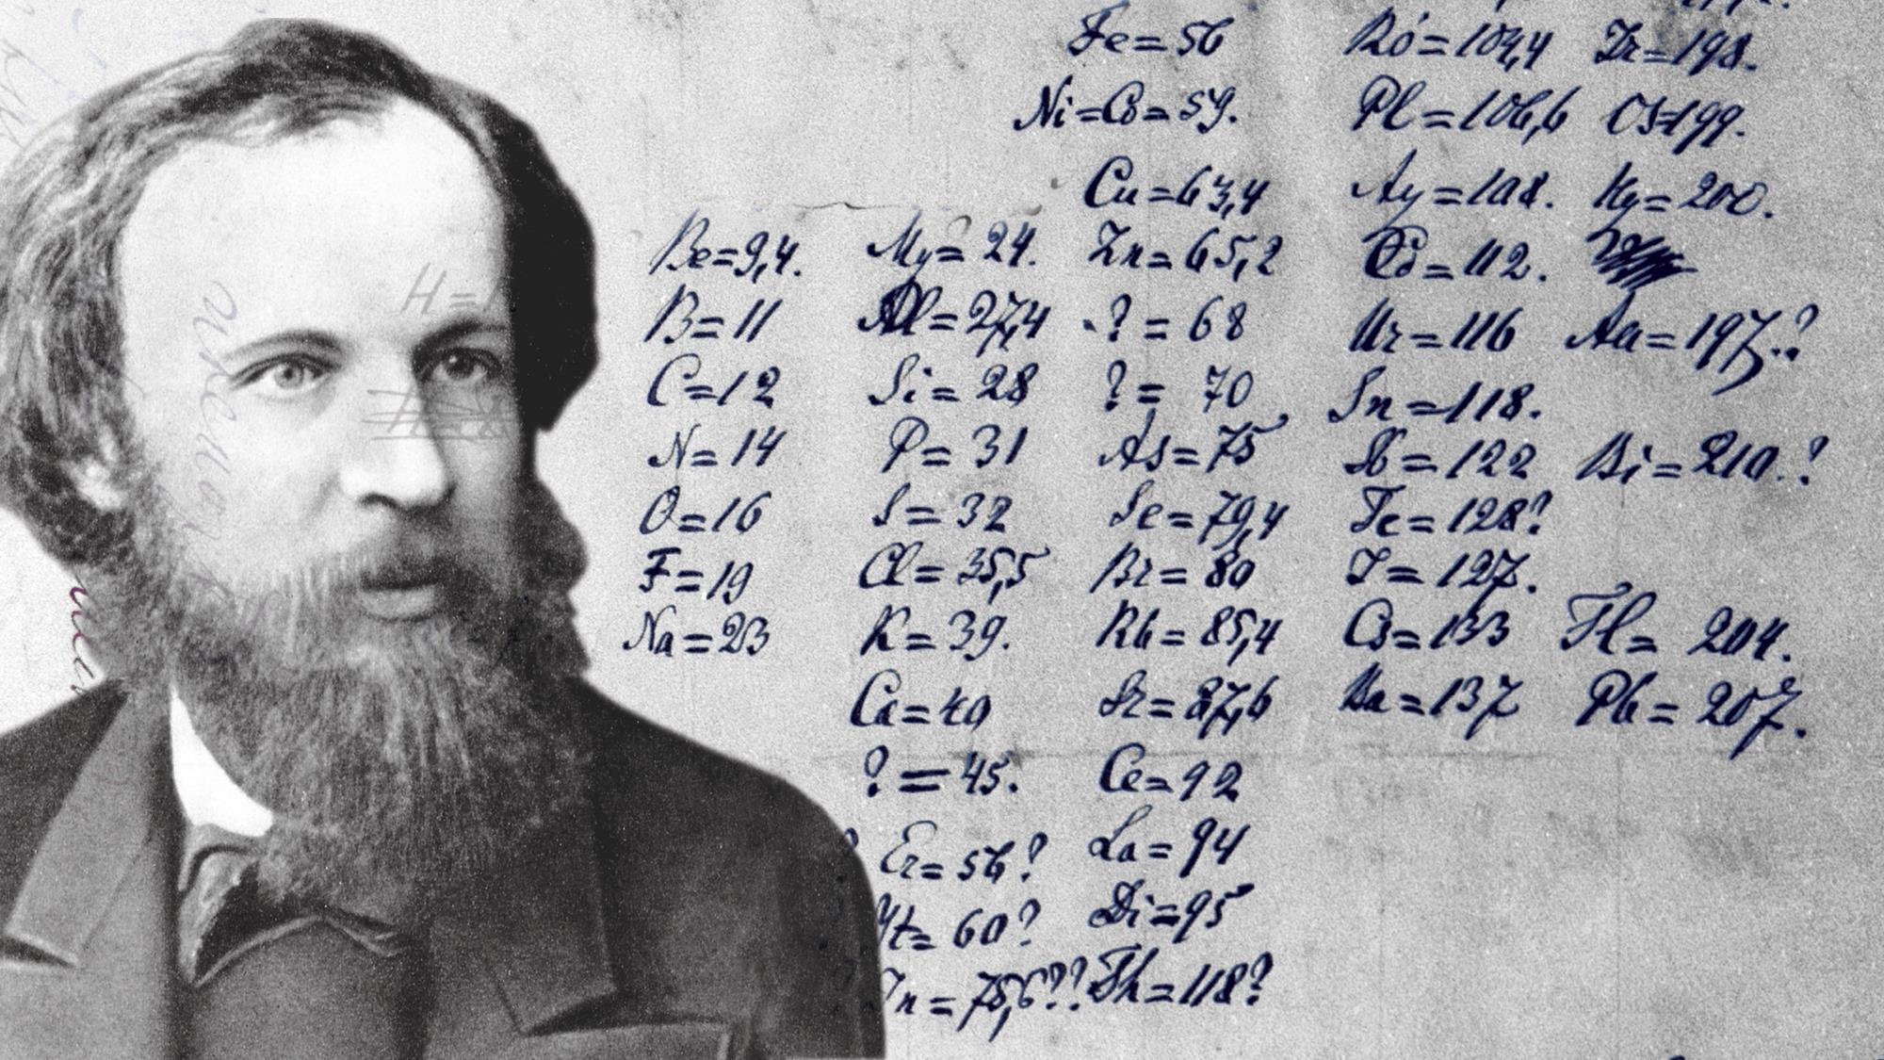
The main man responsible for today:
All he had to work off of was:
Names of Elements
Atomic Masses
Observed properties/reactions
Dmitri Mendeleev, the “Father of the Periodic Table” circa 1869

Slide 12
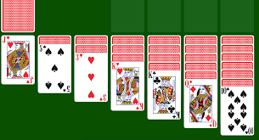
His Inspiration:

Slide 13
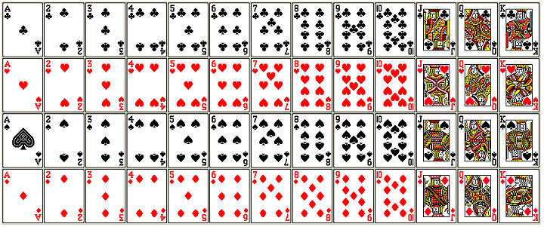
Let’s see how this works:
What two ways are these cards sorted on screen?

Slide 14
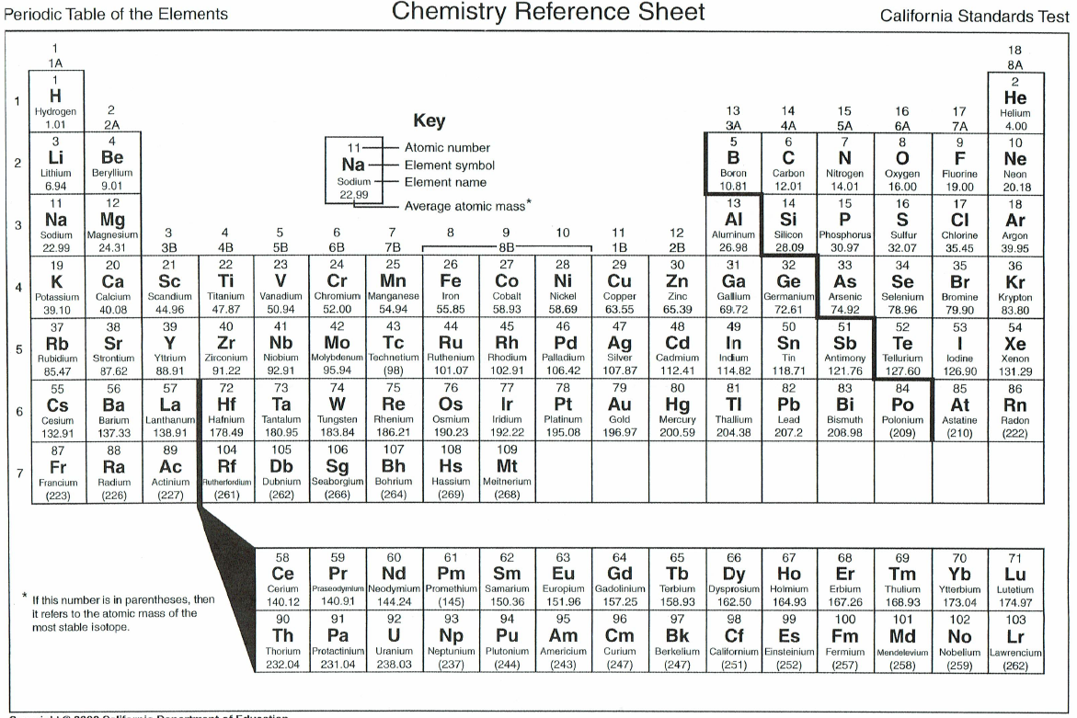
Periodic Table Basics:
See that bolded staircase? That’s what separates metals from nonmetals:
Left of the staircase = metal*
Right of the staircase = nonmetal
“On” the staircase = metalloid
*1 exception

Slide 15
Reading a Single Square:
Pick any element:
?
?
?
?
?
?
?
?

Slide 16
A bit more vocab:
Note how Li, Na, and K all explode in water (Cs and Fr too, by the way)
The “period” comes from the fact that characteristics tend to repeat across rows.
So on the Periodic Table, rows are called periods.
Columns are called groups, as that is the “group” of elements that behave similarly.

Slide 17
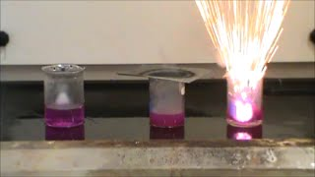
For Example:

