Slide 1
Let’s Get Cracking! Stress/Strain Instruction (Teacher Resource)

Slide 2
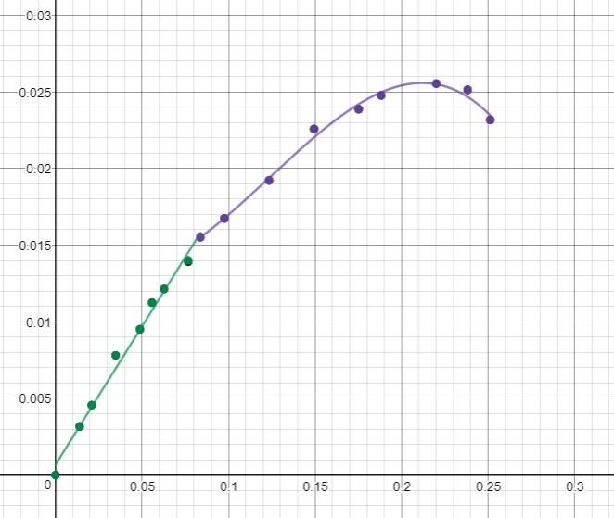
Introduction to Stress and Strain (Lesson)
Mechanical Engineers characterize materials using forces, stress, and strain. They analyze the behavior of materials in order to define safety constraints. In simple terms, they need to determine how much stress can be applied before the material breaks or becomes permanently deformed. Biomedical engineers test materials to strengthen or replace tissues or broken bones.
Stress versus Strain Graph
Stress (N/m²)
Point of Fracture
Elastic Region (linear)
Yield Stress
Deformation (or ductile) Region
Strain

Slide 3
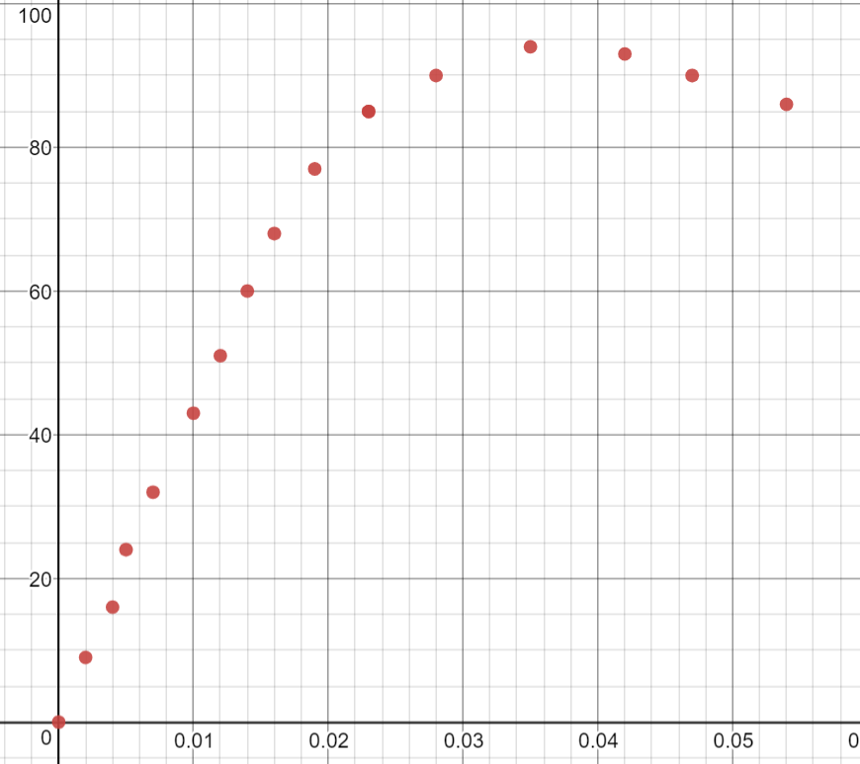
Modeling with Piecewise Functions
Step 1: Create a table in Desmos and adjust the window to show all the data points in a Scatterplot.
Strain (mm/mm) | Stress (N/mm²)
0 | 0
.002 | 9
.004 | 16
.005 | 24
.007 | 32
.101 | 43
.012 | 51
.014 | 60
.016 | 68
.019 | 77
.023 | 85
.028 | 90
.035 | 94
.042 | 93
.047 | 90
.054 | 86
.060 | 80
. . .

Slide 4
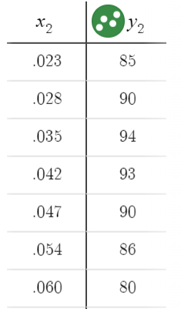
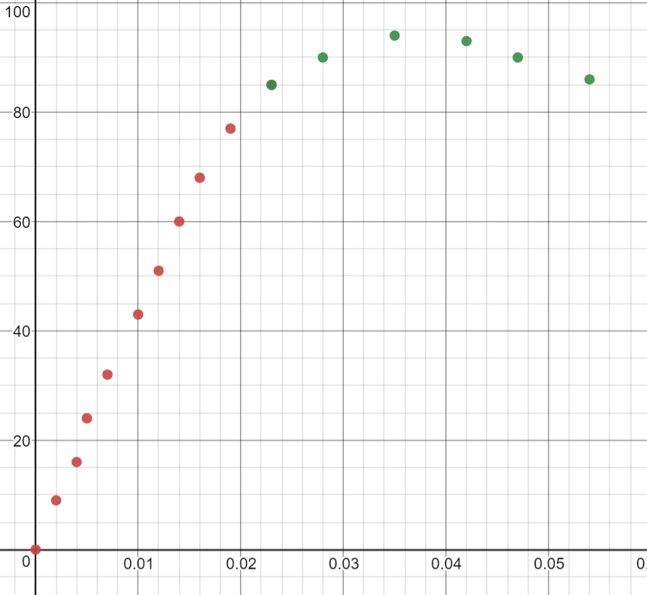
Step 2: Determine the point where the linear and ductile regions meet.
Step 3: Create a second table in Desmos and retype the points representing the ductile region. If there is a point beyond the obvious fraction point, do not include it in either set. The last point in the linear region should be the first point in the ductile region. Set them to a different color than the points in the first table.
Step 4: Delete the ductile region points from the first table.
Strain (mm/mm) | Stress (N/mm²)
0 | 0
.002 | 9
.004 | 16
.005 | 24
.070 | 32
.101 | 43
.012 | 51
.014 | 60
.016 | 68
.019 | 77
.023 | 85
.028 | 90
.035 | 94
.042 | 93
.047 | 90
.054 | 86
.060 | 80
. . .

Slide 5
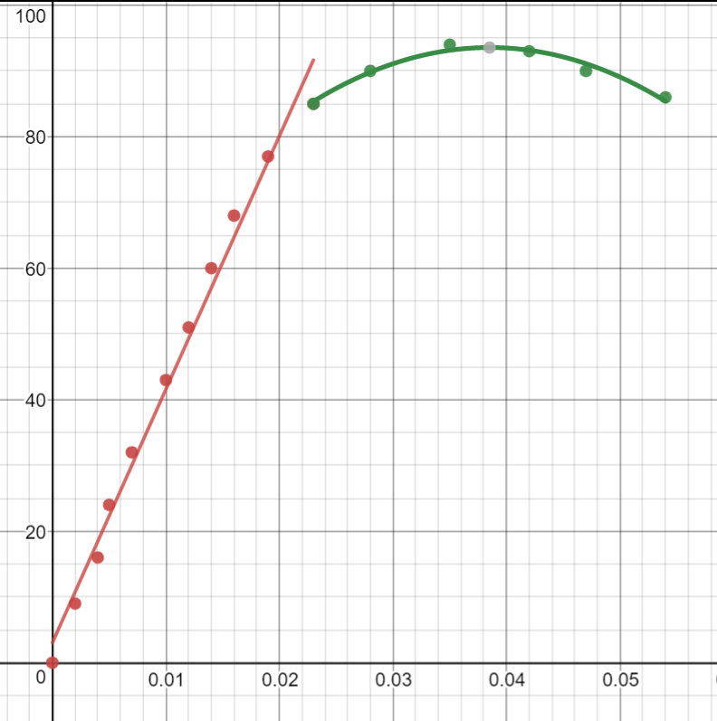
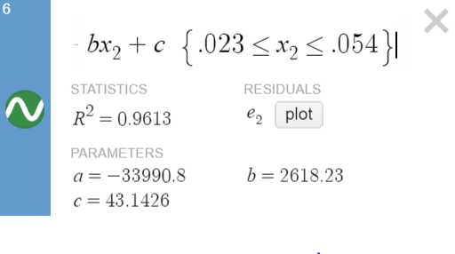
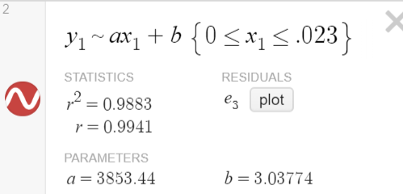
Step 5: Run a linear regression on the first data set. Add a new entry below the table and type $y_{1}\sim ax_{1}+b$. Notice the tilde in lieu of an equal sign. Set the color to match the data points. Restrict the domain appropriately.
Step 6: Run a higher ordered polynomial regression on the second data set. You may have to test quadratic, cubic, or quartic to determine the best fit. If the r value does not change much with each higher order, there is no need to add complexity. To run a quadratic regression you would type $y_{2}\sim ax_{2}^{2}+bx_{2}+c$. Restrict the domain appropriately.
When writing the piecewise function, you would write the second function beginning with an open interval but sometimes Desmos only works with a <= sign on a restricted domain.

Slide 6
Step 7: Write the complete piecewise function.
$$f\left(x\right)= \left\{\begin{aligned}3853x+3 , 0≤x≤.023 \\ −33991x^{2}+2618x+43, .023<x≤.060\end{aligned}\right.$$
When writing the piecewise function, you would write the second function beginning with an open interval but sometimes Desmos only works with a <= sign on a restricted domain.

Slide 7
Newton’s Second Law
The equation for Newton’s second law is: $F=ma$
In engineering, weight is considered a force and is measured in Newtons. The units for mass are kg. Gravity is used for acceleration as 9.8 m/s². One Newton is equal to 1 kilogram meter per second squared. If you have forgotten this from Science class, in simplest terms, when you are given a mass in kg, simply multiply it by 9.8 m/s² to find the force in Newtons.
Example: Callie the 30 kg Catahoula Leopard Dog is standing on top of a force scale. What is the reading on the scale in N?
$$F=30 kg ∙9.8 \frac{m}{s^{2}}=294 \frac{kg∙m}{s^{2}}=294 N$$

Slide 8
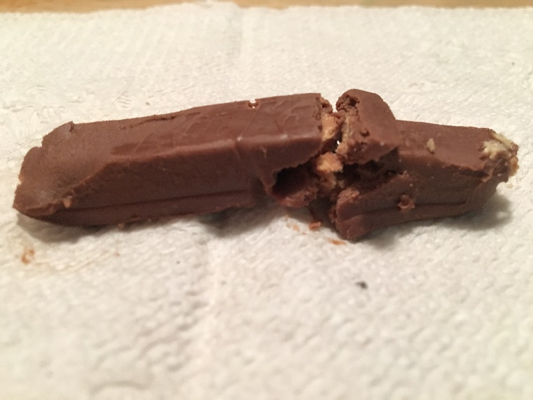
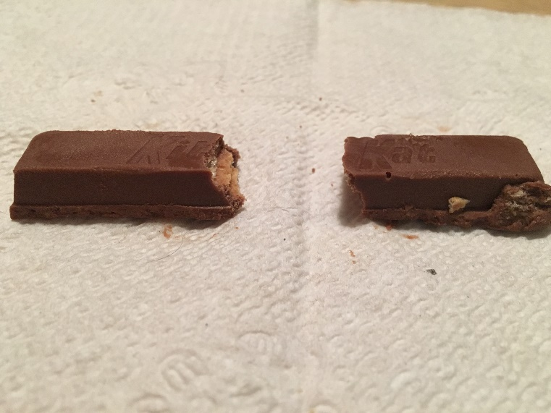
Stress
A force (compression=push or tensile=pull) applied to an object compared to its cross-sectional area measured in N/m². The formula for stress is $σ=\frac{F}{A}$.
The formula for stress ($σ$) is shown below, where force (F) is measured in Newtons and area is measured in square meters. Hence, stress is measured in N/m².
Example: A 3 m length of wire with a 2.4 mm diameter supports a 2.6 kg prism hanging in the classroom. Determine the stress on the wire.
$$F=m∙a=2.6 kg∙9.8 \frac{m}{s^{2}}=25.48 \frac{kg∙m}{s^{2}}=25.48 N$$
$$A= πr^{2}=π{\left(.0012\right)}^{2}=.00000144πm^{2}$$
$$σ=\frac{F}{A}=\frac{25.48N}{.00000144πm^{2}}=5,632,316.60\frac{N}{m^{2}}$$
→ candy under compression $$
$$candy under tension→

Slide 9
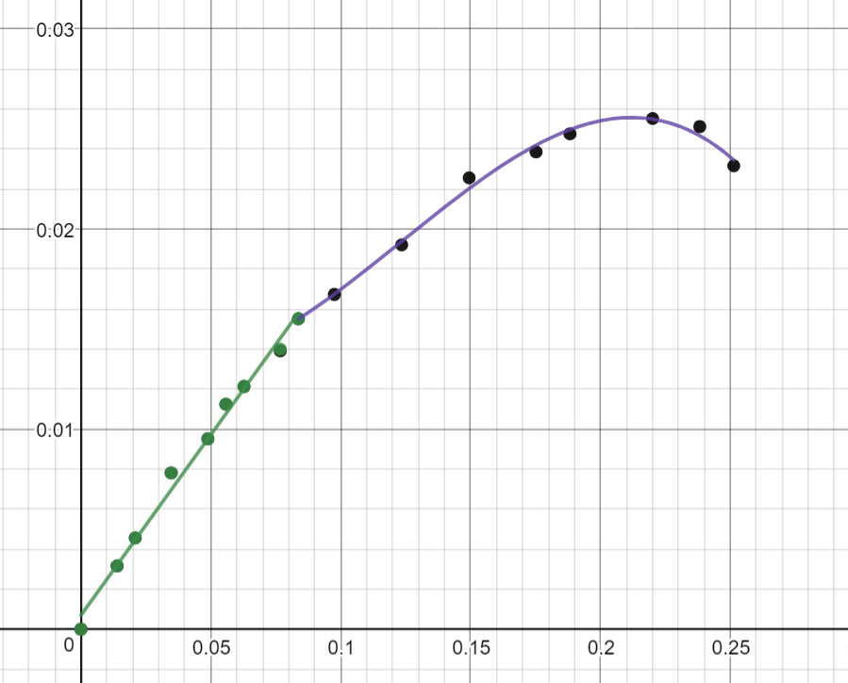
Strain
How an object changes shape in response to stress compared to its original length. The units cancel making it a dimensionless measurement. The equation for strain is $ε=\frac{∆L}{L}$.
Example: If the wire from the previous problem stretches $1.40x{10}^{−4} m$, determine the strain on the wire.
$$ε=\frac{∆L}{L}=\frac{1.40x{10}^{−4} m}{3 m}=4.67x{10}^{−5}$$
Stress-Strain Relationship
The more force you apply, the more an object will deform, depending on the material. Engineers and scientists analyze data and graph the stress-strain curve and perform a linear regression.
Stress versus Strain Graph
Stress (N/m²)
Strain

Slide 10
Young’s Modulus (Modulus of Elasticity)
A mechanical property measuring the elasticity of a material prior to any permanent deformation. It is the relationship between stress and strain on the linear part of a stress versus strain graph. (The slope of the linear section.)
Example: Determine the Young’s Modulus of the earlier wire problem.
$E=\frac{stress}{strain}=\frac{σ}{ε}=\frac{5,632,316.60\frac{N}{m^{2}}}{4.67x{10}^{−5}}=1.21x{10}^{11}\frac{N}{m^{2}}$
Example: Mrs. Walsh hangs a 1400 g framed portrait of her four cats Snickers, Tracksaur, Pickles, and JoJo. She secures it to a 1.6 m piece of yarn with a diameter of 5 mm that has a Young’s modulus of 9.3 x 10⁶. How much does the yarn stretch?
$$E=\frac{stress}{strain}=\frac{σ}{ε}=\frac{\frac{F}{A}}{\frac{∆L}{L}}$$
$$9.3x{10}^{6}\frac{N}{m^{2}}=\frac{\frac{1.4kg∙9.8 \frac{m}{s^{2}}}{π{\left(.0025\right)}^{2}m^{2}}}{\frac{∆Lm}{1.6m}}$$
$$9.3x{10}^{6}\frac{N}{m^{2}}∙\frac{∆Lm}{1.6m}=\frac{1.4kg∙9.8 \frac{m}{s^{2}}}{π{\left(.0025\right)}^{2}m^{2}}$$
$$∆Lm=\frac{1.4kg}{π{\left(.0025\right)}^{2}m^{2}}∙\frac{1.6m∙9.8 \frac{m}{s^{2}}}{9.3x{10}^{6}\frac{N}{m^{2}}}$$
$$∆L= .1202m$$

