Slide 1
What is a Brain Wave?

Slide 2
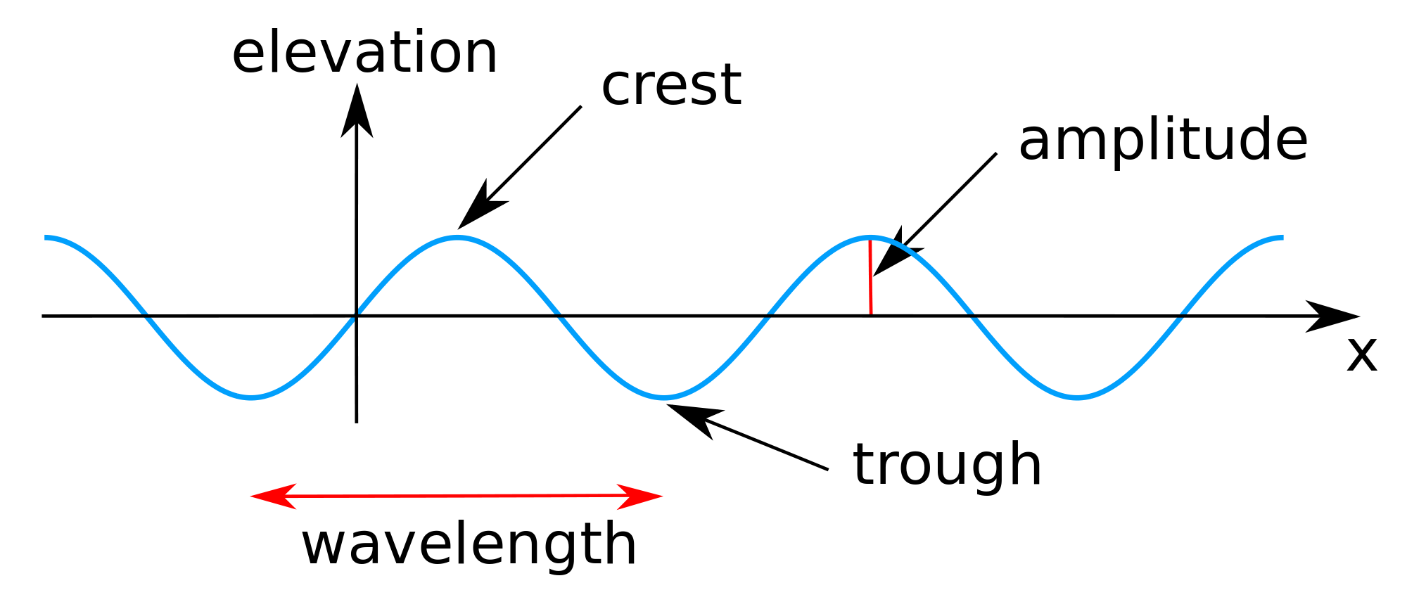
Wave Review
Waves carry energy through space
Examples of waves:
Ocean waves
Sound waves
Light waves
Waves may be characterized by their frequencies
How many full waves occur per second
https://upload.wikimedia.org/wikipedia/commons/thumb/8/84/Sine_wave_amplitude.svg/2000px-Sine_wave_amplitude.svg.png

Slide 3
More on Frequency
Higher frequencies result in more energy being transferred over time
Lower frequencies result in less energy being transferred over time
Example: electromagnetic (EM) waves
EM waves with higher frequencies (UV, x-ray, gamma) carry more energy, and can harm us if we are exposed to them for long periods of time
EM waves with lower frequencies (radio, infrared, light) carry less energy, and are safe for human contact

Slide 4
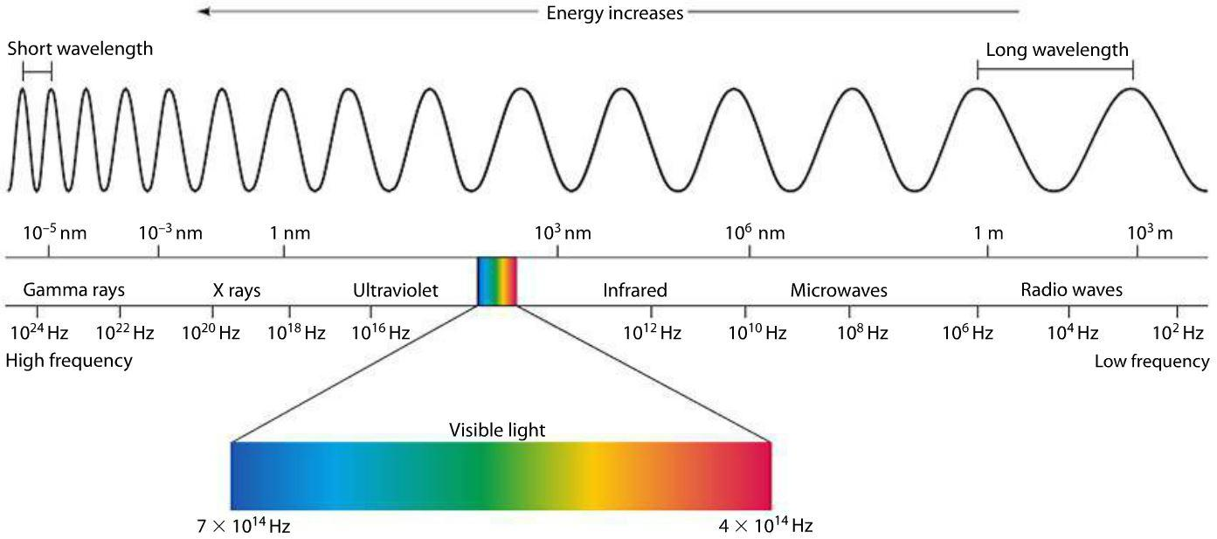
Example: Electromagnetic Spectrum

Slide 5
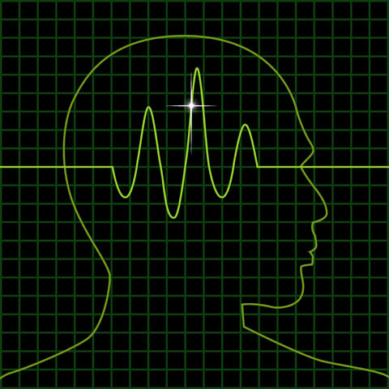
How do our brains use energy?
Our nervous system also uses waves to transfer energy throughout the body
We call these brain waves
Brain waves are classified by their frequencies, and each type is associated with a different level of human behavior

Slide 6
Types of Brain Waves: Delta
Delta waves are brain waves with frequencies between ~0.2 Hz – 3 Hz
These waves are associated with a deep, restful state
Example of associated behavior: deep sleep

Slide 7
Types of Brain Waves: Theta
Theta waves are brain waves with frequencies between ~4 Hz – 8 Hz
These waves are associated with a deeply relaxed, meditative state
Examples of associated behavior: napping/light sleep, deep meditation

Slide 8
Types of Brain Waves: Alpha
Alpha waves are brain waves with frequencies between ~9 Hz – 13 Hz
These waves are associated with a calm, lucid state
Examples of associated behaviors: light meditation, daze/daydreaming

Slide 9
Types of Brain Waves: Beta
Beta waves are brain waves with frequencies between ~14 Hz – 30 Hz
These waves are associated with a normal, awake state
Examples of associated behaviors: working, actively listening, reading

Slide 10
Types of Brain Waves: Gamma
Gamma waves are brain waves with frequencies greater than 30 Hz
These waves are associated with a concentrated state
Examples of associated behaviors: intense focus, working on a difficult problem

Slide 11
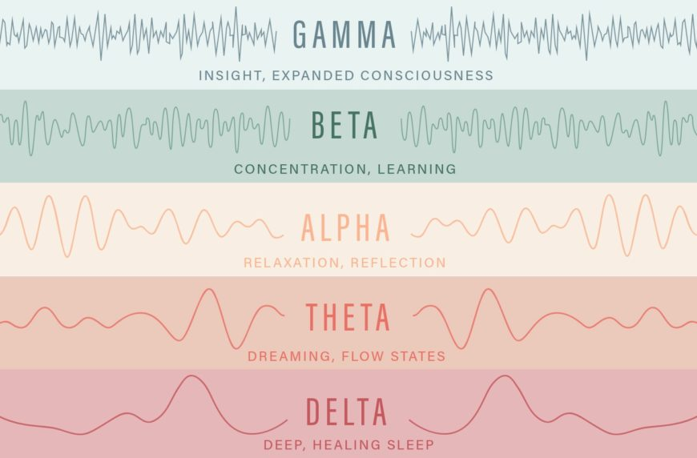
Brain Wave Overview

