Slide 1
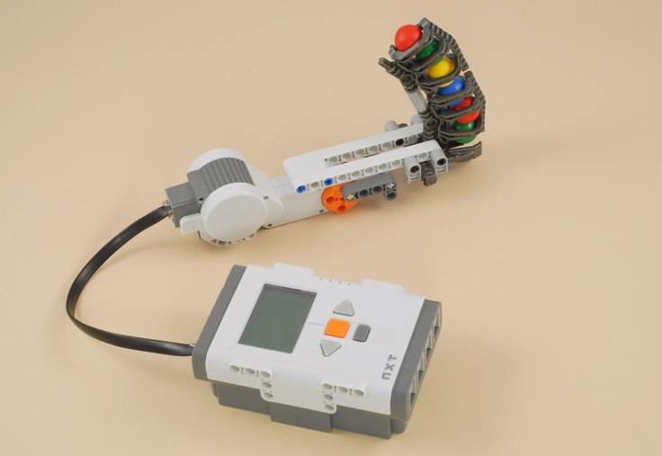
Activity: Let’s build a ball shooter using LEGO NXT
This activity assumes that the lesson ‘What is a robot?’ has already been covered. This activity takes 50 mins.

Slide 2
INSTRUCTIONS TO ASSEMBLE THE BALL SHOOTER
Follow the link below for building instructions. http://www.nxtprograms.com/NXT2/ball_shooter/steps.html
The instructions have also been provided at the end of this PowerPoint, starting at slide 4.
You can also watch the following ½ minute video to see what you’ll be building:
http://www.youtube.com/watch?v=_k8bqWySzk4

Slide 3
STUDENT ACTIVITY SHEET – to be handed out to the students prior to the activity. Students fill this as they complete the activity. The answers are to be discussed after the entire activity.
What happens when you turn the system on by pressing the enter button on the NXT brick?
Why does this happen?
Is there any similarity between this and how you throw a ball using your hand? Explain it clearly.

Slide 4
Attachment: Instructions for building and programming the NXT Ball Shooter – follows starting slide 5

Slide 5
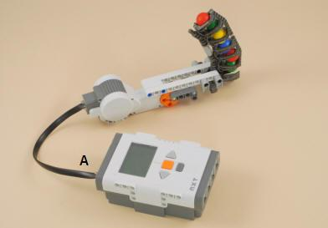
1. INSTRUCTIONS FOR BUILDING LEGO NXT BALL SHOOTER 2. PROGRAMMING INSTRUCTIONS FOR BALL SHOOTER ACTIVITY
Adapted with permission from the website http://www.nxtprograms.com/NXT2/ball_shooter/steps.html

Slide 6
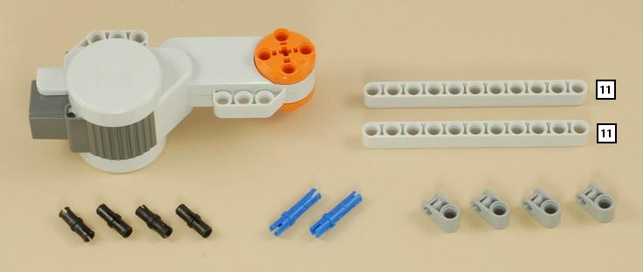
BUILDING: STEP 1
What you need:

Slide 7
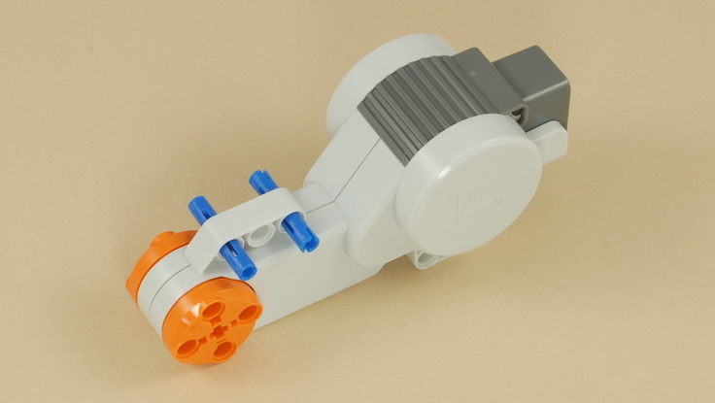
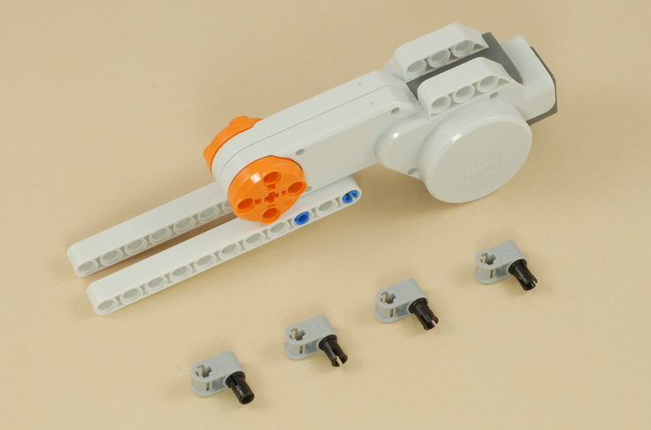
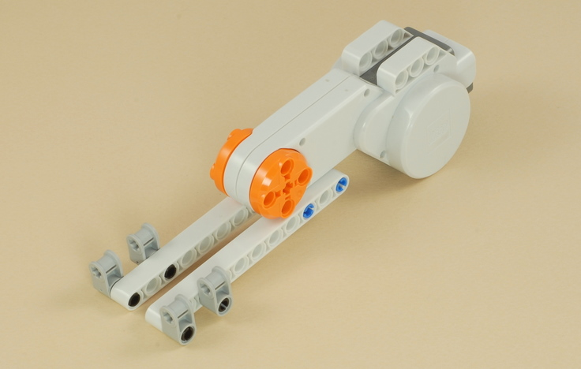
STEP 1 contd…….

Slide 8
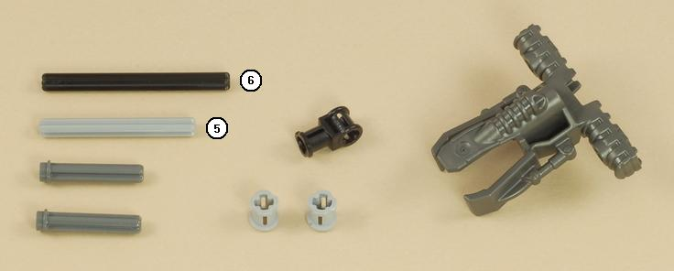
BUILDING: STEP 2
What you need:

Slide 9
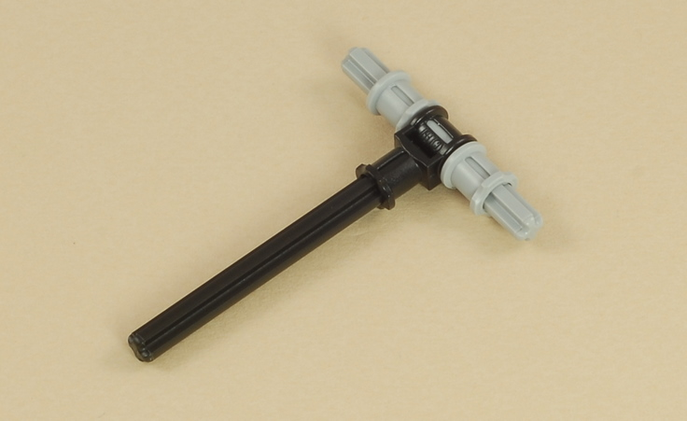
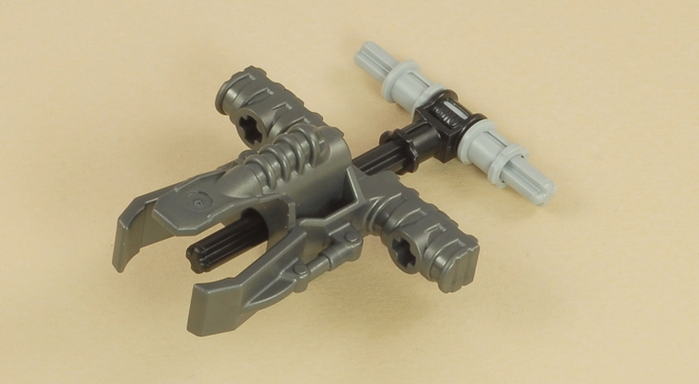
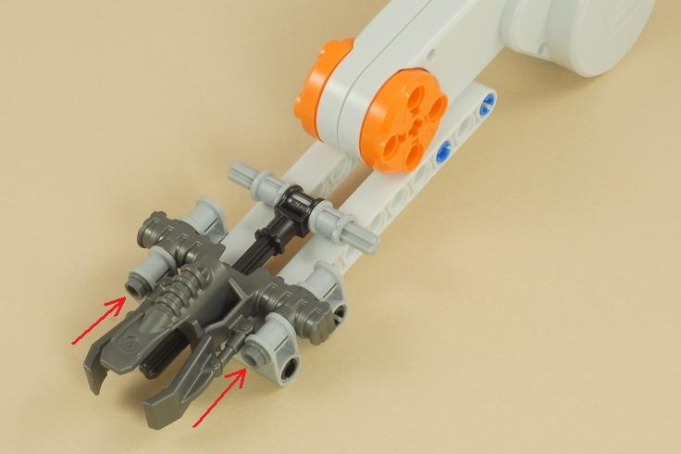
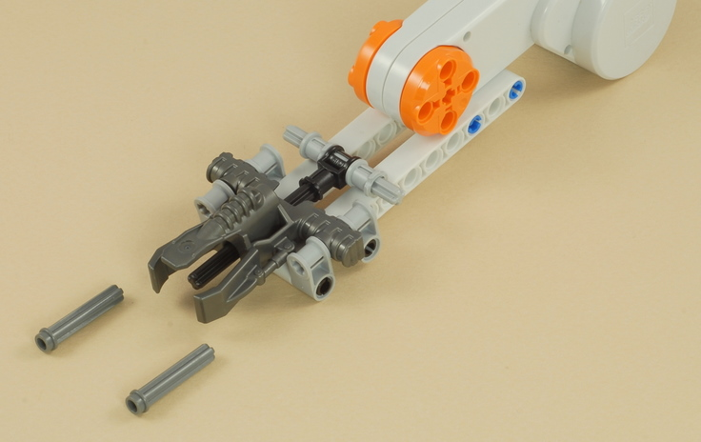
STEP 2 contd……

Slide 10
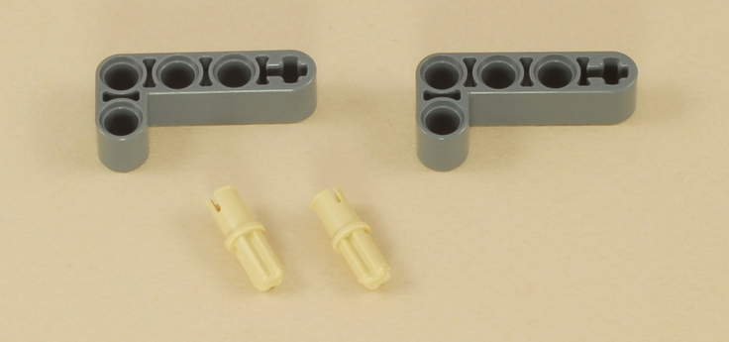
BUILDING: STEP 3
What you need:

Slide 11
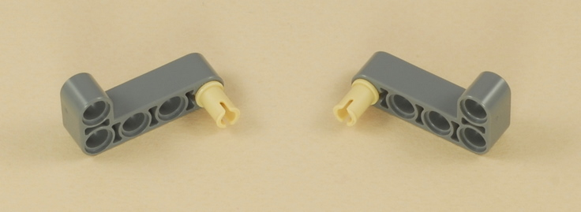
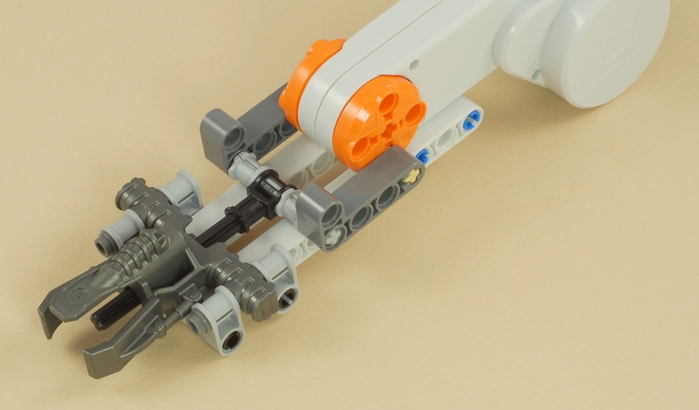
STEP 3 contd…..

Slide 12
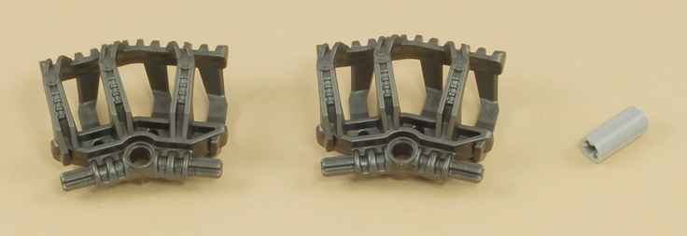
BUILDING: STEP 4
What you need:

Slide 13
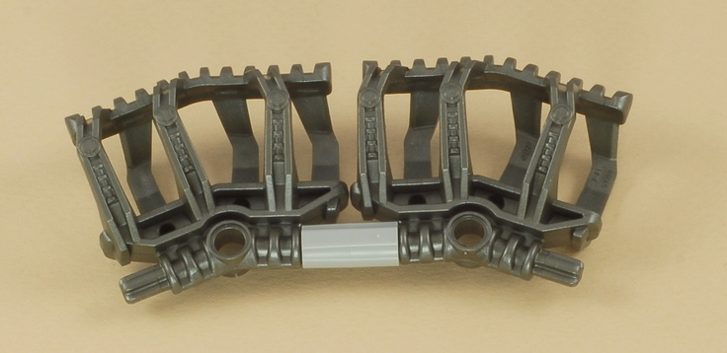
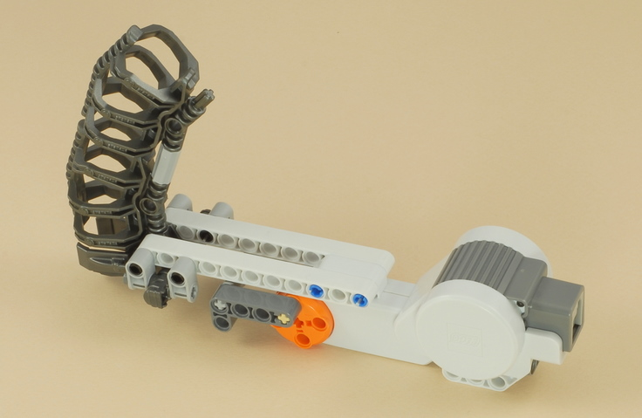
STEP 4 contd…….
Connect this to one of the ports of
the NXT brick

Slide 14
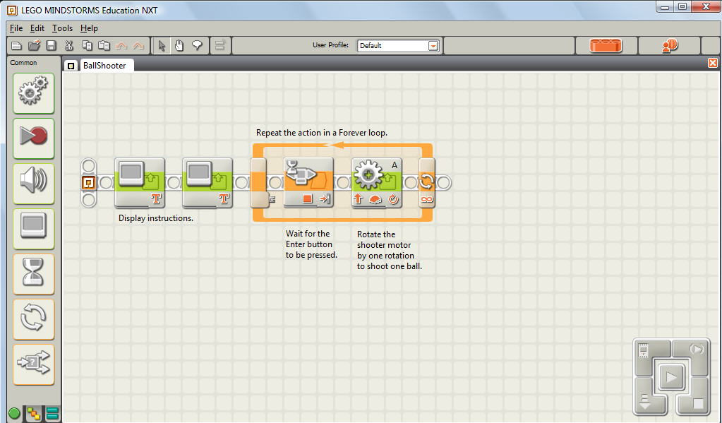
PROGRAMMING -NXT PROGRAM
Build NXT
program as
illustrated in
the figure.
Download and
run the
program after
building the ball
shooter.

Slide 15
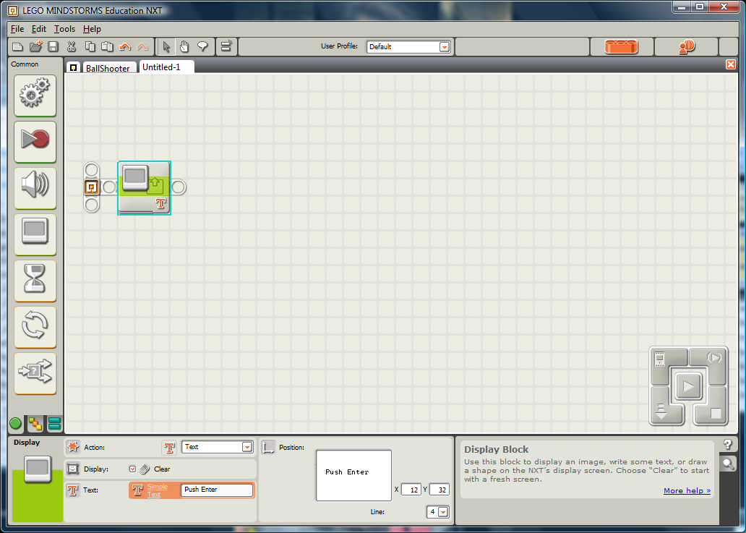
PROGRAMMING - Step 1
Settings

Slide 16
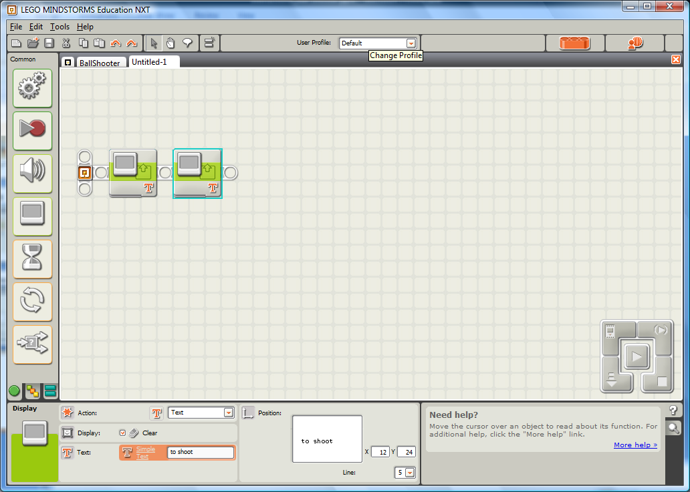
PROGRAMMING - Step 2
Settings

Slide 17
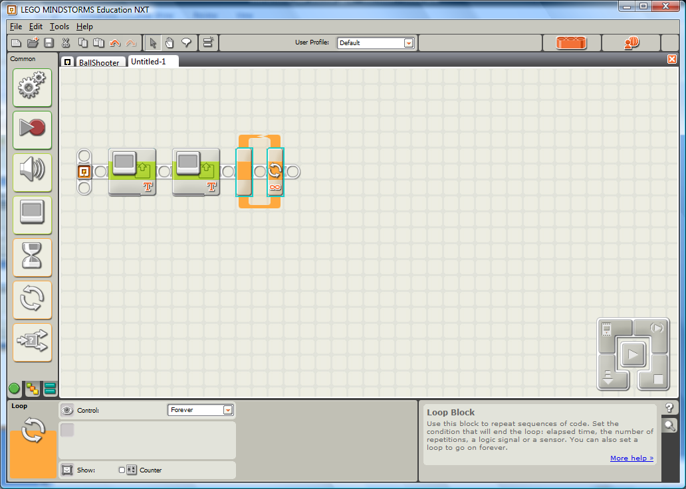
PROGRAMMING - Step 3
Settings

Slide 18
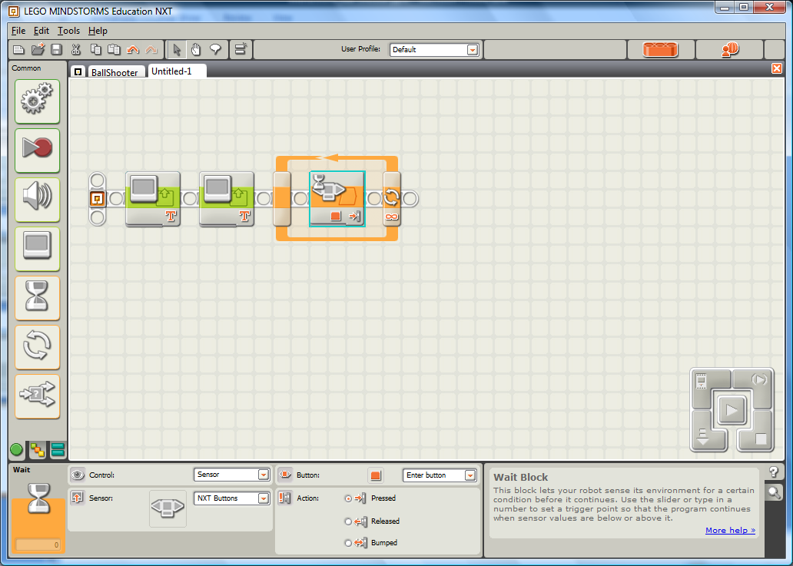
PROGRAMMING - Step 4
Settings

Slide 19
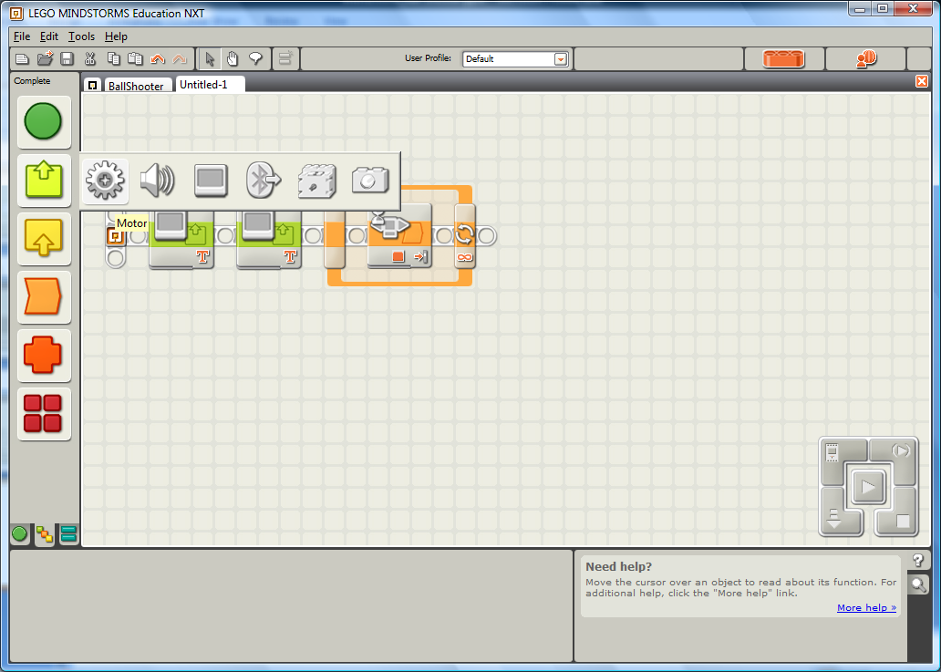
PROGRAMMING - Step 5

Slide 20
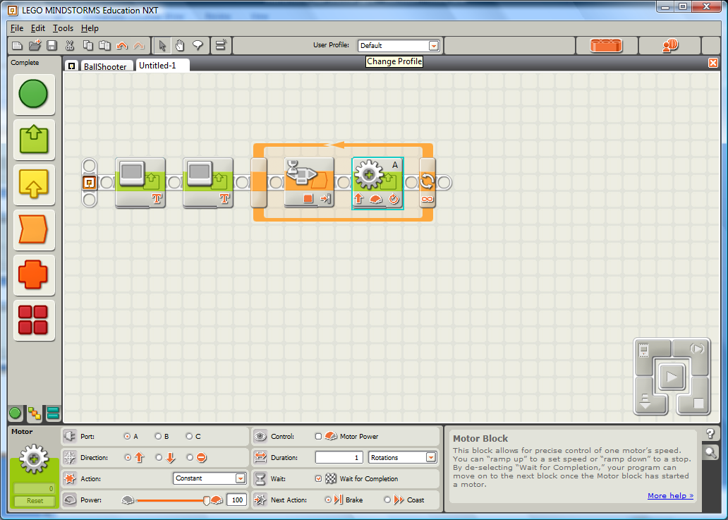
Step 5 contd….
Settings

Slide 21
STUDENT ACTIVITY SHEET ANSWERS
What happens when you press the enter button on the NXT brick?
The balls in the ring are shot out one after the other.
Why does this happen?
The NXT motor moves forward and every time it moves it also pushes the balls out with a force.
Is there any similarity between this and how you throw a ball using your hand?
The muscle in your arm is like the ‘motor’. Muscles use glucose energy to help your arm to move and throw the ball.

