Slide 1
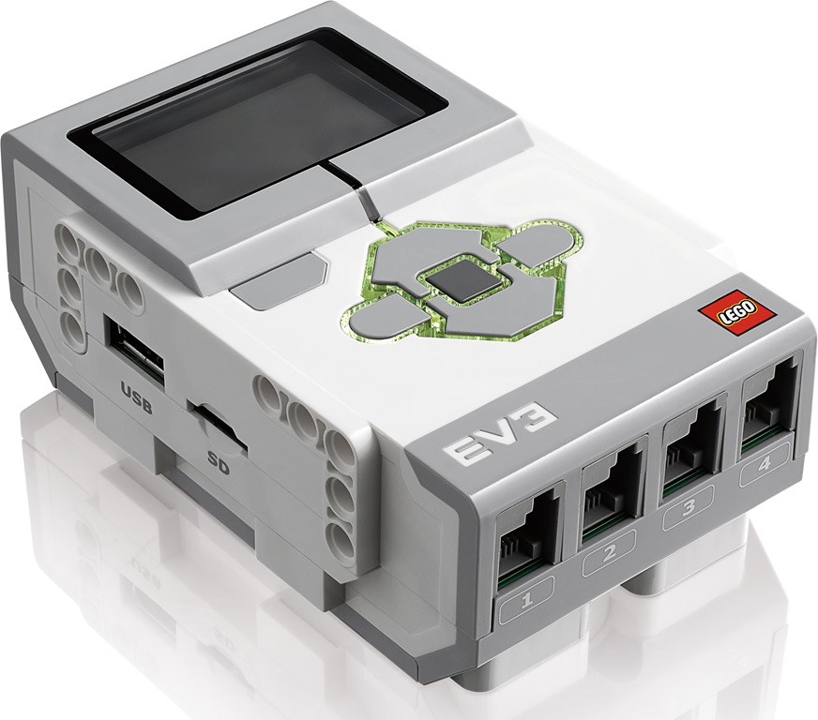
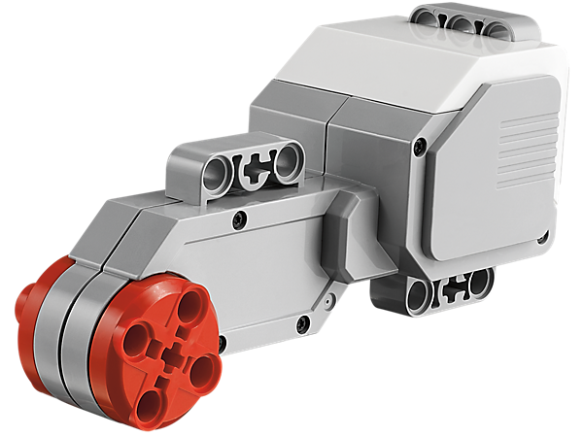
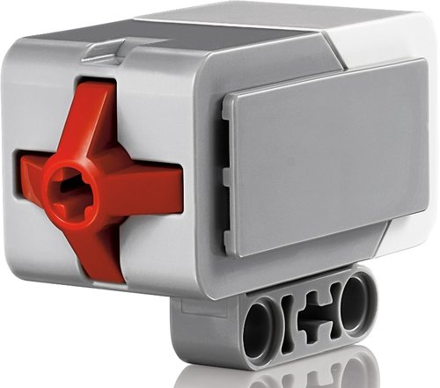
Music by Touch
Notes:
Music by Touch Presentation > TeachEngineering.org

Slide 2
Music by Touch Pre-Quiz
Provide an example “stimulus-sensor-coordinator-effector-response” framework for both your (human) sense of touch and the robotic touch sensor.
Explain how the LEGO touch sensor works.

Slide 3
Music by Touch Pre-Quiz Answers
Provide an example “stimulus-sensor-coordinator-effector-response” framework for both your (human) sense of touch and the robotic touch sensor.
  For human touch: hot object > touch using finger > nervous system > muscle > move finger back
  For LEGO setup: button pressed > touch sensor > cable connecting to brick > motor > move the motor
Explain how the LEGO touch sensor works.
  When the touch sensor button is pressed, it closes a circuit (similar to when you turn on a light switch) and a current is sent to the LEGO brick, which then knows that the touch sensor button was pressed.

Slide 4
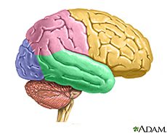

Human-Robot Similarities
Your hand is commanded by your brain.
Similarly, the LEGO MINDSTORMS EV3 intelligent brick commands its motor to move.
The next slide provides a design challenge to show how this might be done. ➔

Slide 5
Music by Touch Activity
Engineering Design Challenge
Do This:
Attach 2 touch sensors to the input ports, and a motor to an output port.
Write a program to do the following:
If one touch sensor is touched, play a piece of music and keep rotating the wheel (attached to the motor) slowly.
If the other sensor is also touched, play the music faster and make the wheel turn faster.
Do this in a loop, continuously, until the program is stopped.
Write your program on a separate page and have your teacher check it before you begin.

Slide 6
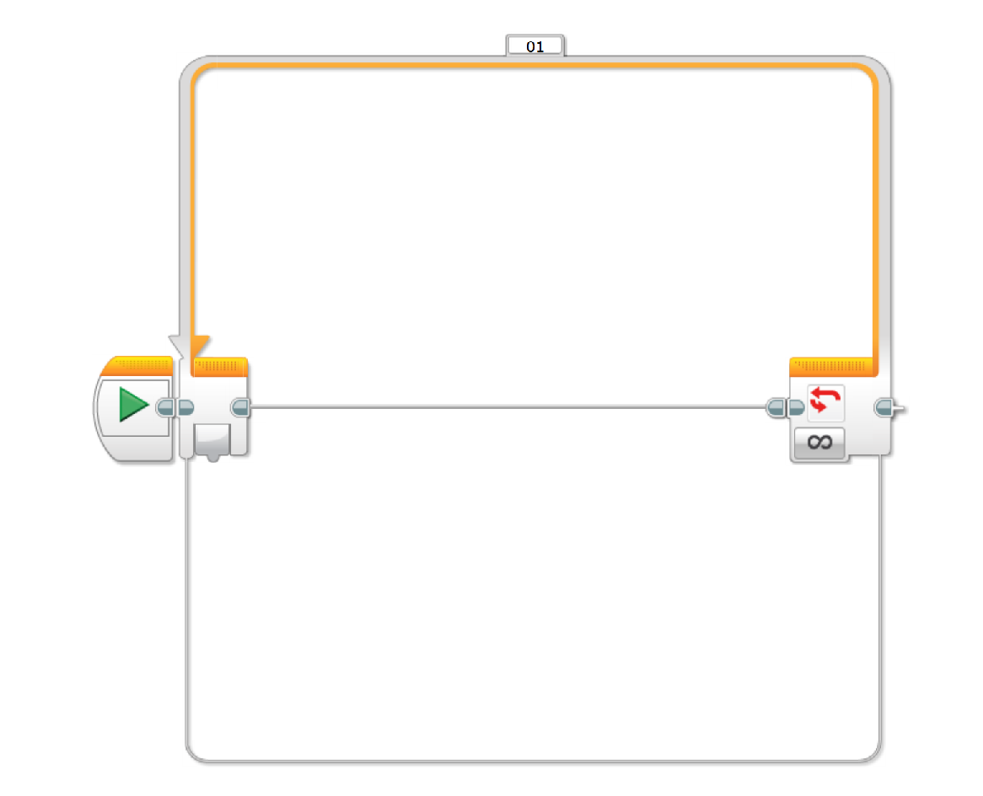
Answer: Programming the EV3 Touch Sensor
Description:
This program is for an EV3 robot with two touch sensors(one attached to port 1
And the other attached to port 2)and one motor (attached to port A), The program
Will cause a robot to play a music softly and rotate the motor slowly when one touch
Sensor is touched and play music loudly and turn the motor fast when the other touch
Sensor is touched, It will do this continuously till the program is stopped
Programming:
1)Click the “Loop” icon [3rd icon in Flow control] and drag the loop command
Onto the Play button beam
2)Click the “Switch” icon[4th icon in flow control] and drag and drop it onto the play sequence beam
Inside the loop command

Slide 7
With the switch command highlighted, verify that the touch sensor, port 1, and the “bumped”
option are selected.
3) Click and drag the “sound” icon [6th icon in Action] onto the top play sequence beam in the switch
Port 1
2) Change volume to 25
1) Leave it with the Play file selection
3) Click on blank part, click on “LEGO
Sound Files” and select the preferred
Sound you want to be played
Notes:
Answer: Programming the EV3 Touch Sensor (continued)

Slide 8
4) Click and drag a movement block next to the sound icon on the play sequence beam.
A) Select Port A
B) Set the speed to 25
C) Select “on” so that your motor rotates unlimitedly
5) Click and drag another “Switch” onto the bottom sequence beam in the first ”switch”
A) Make sure that touch
Sensor is selected
B) And “Bumped” is selected
Notes:
Answer: Programming the EV3 Touch Sensor (continued)

Slide 9
6) Click and drag another “sound” icon onto the top sequence beam in the second switch.
1) Select a sound option from the list.
2) Set the volume to 75.
7) Click and drag another “move” icon onto the sequence beam in the second switch next to the “sound icon”
1) Set to port A
2) Set the speed to 75.
3) Set to “ON” for unlimited turn
Notes:
Answer: Programming the EV3 Touch Sensor (continued)

Slide 10
Music by Touch Post-Quiz
Provide an example “stimulus-sensor-coordinator-effector-response” framework for both your (human) sense of touch and the robotic touch sensor activity you performed.
Explain how the LEGO touch sensor works.
Assume the brick is connected to a touch sensor and a motor. Sketch a simple program to move a motor when a touch sensor is pressed.

Slide 11
Music by Touch Post-Quiz Answers
Provide an example “stimulus-sensor-coordinator-effector-response” framework for both your (human) sense of touch and the robotic touch sensor activity you performed.
  For human touch: hot object > touch using finger > nervous system > muscle > move finger back
  For LEGO setup: button pressed > touch sensor > cable connecting to brick > motor > move the motor
Explain how the LEGO touch sensor works.
  When the touch sensor button is pressed, it closes a circuit (similar to when you turn on a light switch) and a current is sent to the LEGO brick, which then knows that the touch sensor button was pressed.
Assume the brick is connected to a touch sensor and a motor. Sketch a simple program to move a motor when a touch sensor is pressed.
  See #3 programming solution on next slide. ➔

Slide 12
Quiz Answer #3: Moving a Motor Using the Touch Sensor
Description: This program is for an EV3 robot with an attached touch sensor. This program will cause
The motor to move when the touch sensor is pressed. In this program the robot is set to do this motion
only once.
Programming:
1) Drag up the “wait” icon which is the second icon in the “flow control (yellow)” section. After that
drag up the “Move tank” icon which is the fourth icon in the section “Action”. Set in this order.
Set to port 1 and B+C
Set rotation to 1000 and power to 50
-Select Touch sensor from
The provided option.
-Go to compare, and select
State. Then set the state to 1.

Slide 13
Vocabulary
sensor: A device that converts one type of signal to another; for instance, the speedometer in a car collects physical data and calculates and displays the speed the car is moving.
tactile: Related to touch.
stimulus: A thing or event that causes a reaction.
transducer: Another term for a sensor (see above).

