Slide 1
Control Using Sound
Notes:
Control Using Sound Presentation > TeachEngineering.org

Slide 2
Control Using Sound Pre-Quiz
What is sound?
How does the LEGO sound sensor sense sound?

Slide 3
Control Using Sound Pre-Quiz Answers
What is sound?
Vibrations of air, or pressure pulses, are picked up by human ears as sound.
How does the LEGO sound sensor sense sound?
The LEGO sound sensor has a diaphragm that vibrates with pressure fluctuations, similar to our ears, and converts the diaphragm motion into electricity, which it transmits to the LEGO brick/computer.

Slide 4
Control Using Sound Activity
Let’s get started:
Divide the class into groups.
Distribute the assembled LEGO taskbots and the necessary parts to attach the sound sensors onto the taskbots.
Have each group attach its sound sensor to its taskbot using instructions in the LEGO base kit.

Slide 5
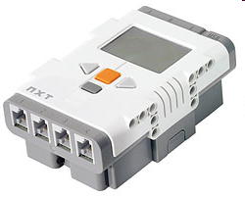
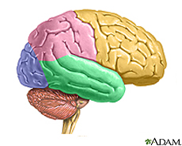
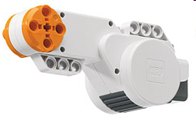
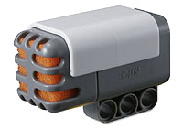
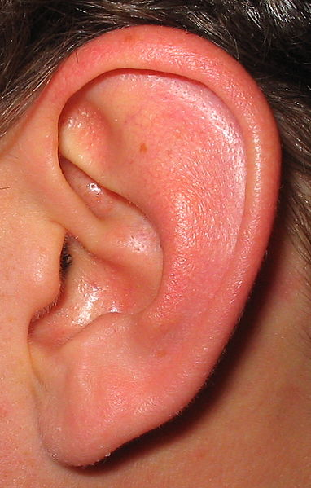
Human-Robot Similarities
Based on sensor input, our brains control our hands.
Similarly, based on sensor input, the LEGO brick commands its motor to move the taskbot.
The next slide provides a design challenge to show how this might be done. ➔

Slide 6
Control Using Sound Activity
Programming Objective – Engineering Challenge
Design a program that causes the robot to move forward until a clap sound is detected by its sound sensor.
Once this occurs, have the robot turn right, and then continue moving forward until it hears a second clap, and then have the robot turn left.
Continue this sequence until the LEGO brick’s “Stop” button (gray button below the orange button) is pressed.
Discuss as a group the logic of the program. Write down your program plan. Create, test and debug your program.

Slide 7
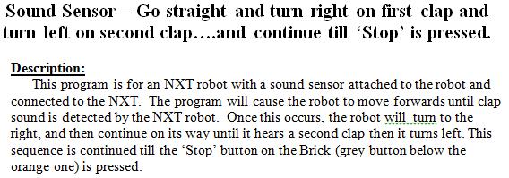
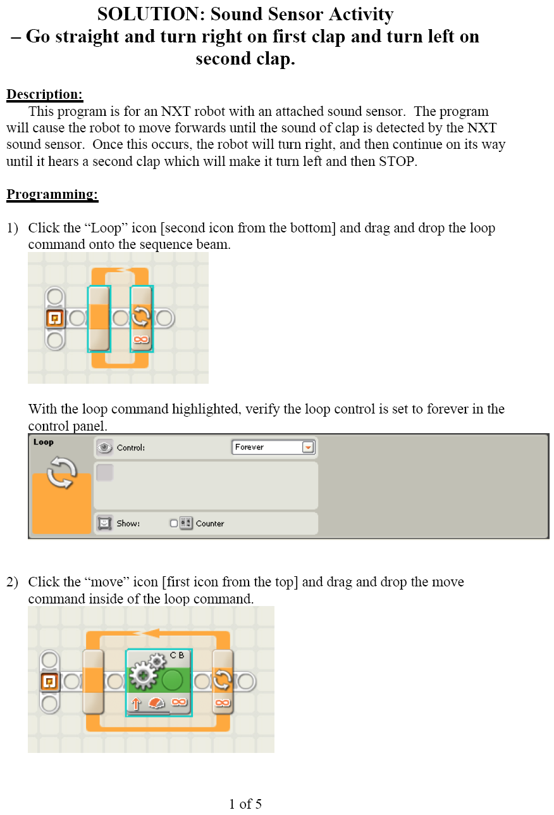
1 of 5
Answer: Programming the NXT Sound Sensor

Slide 8
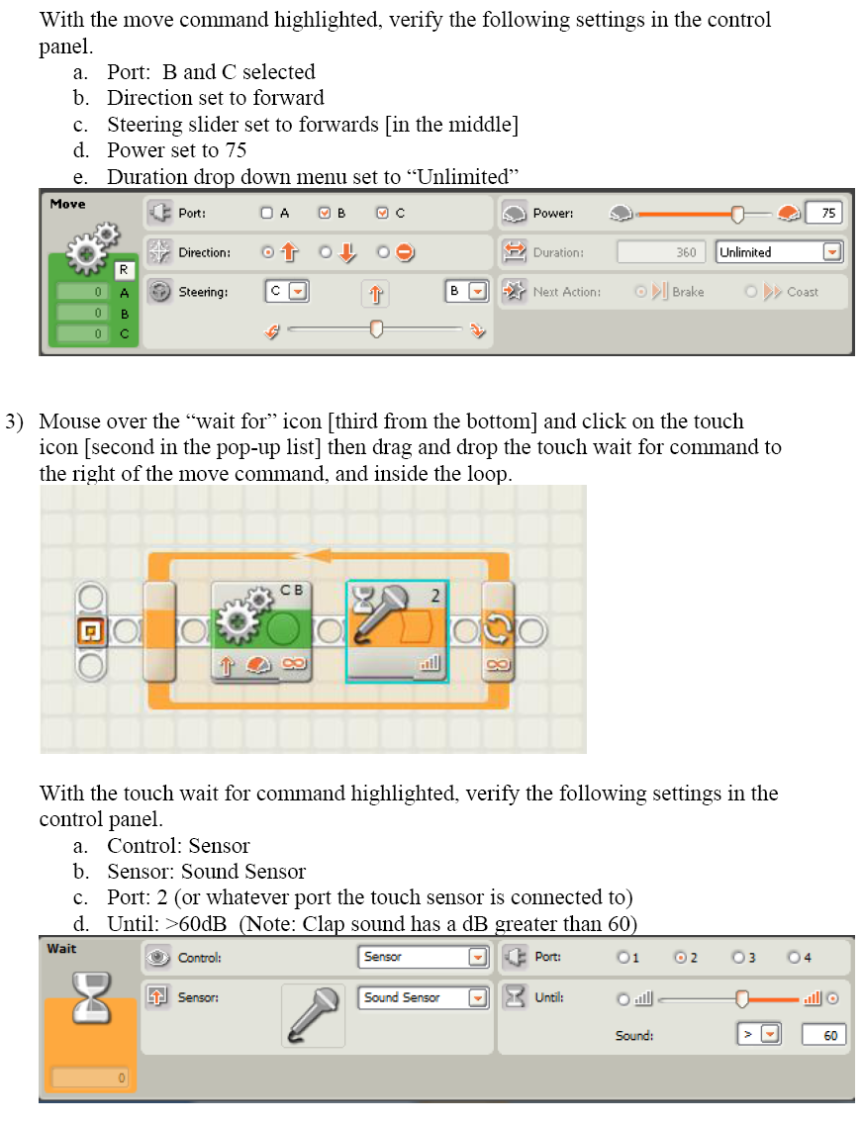
2 of 5
Answer: Programming the NXT Sound Sensor

Slide 9
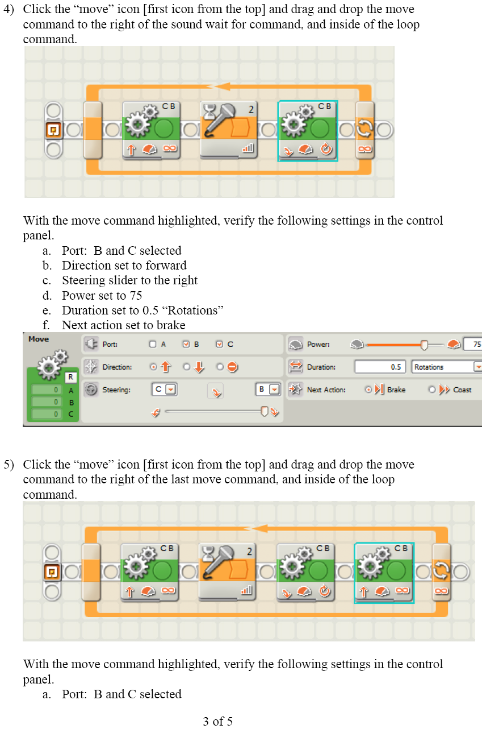
3 of 5
Answer: Programming the NXT Sound Sensor

Slide 10
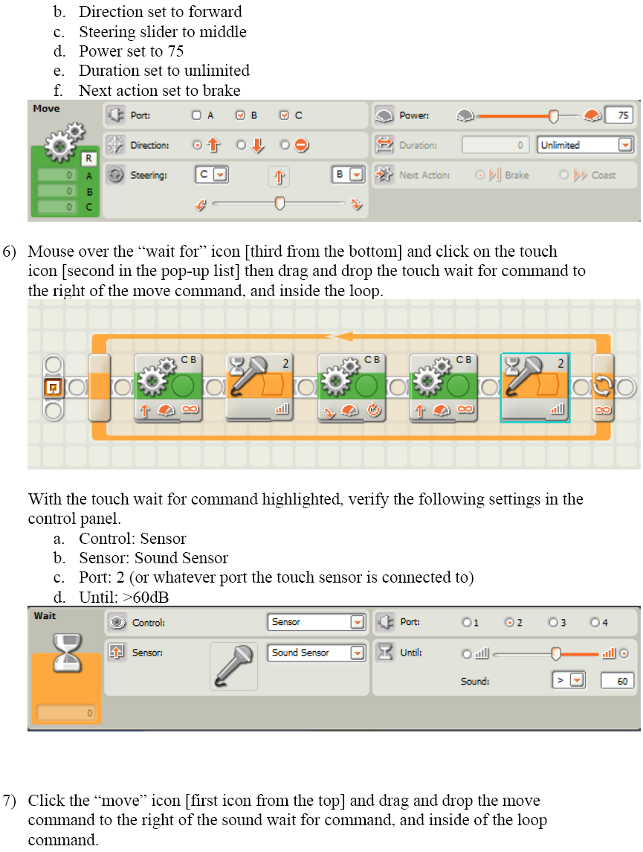
4 of 5
Answer: Programming the NXT Sound Sensor

Slide 11
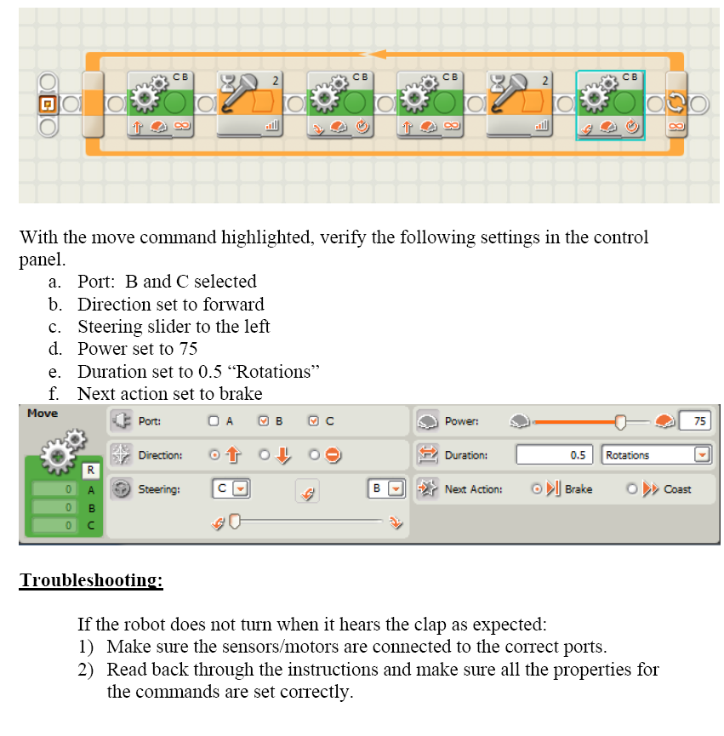
5 of 5
Answer: Programming the NXT Sound Sensor

Slide 12
Control Using Sound Post-Quiz
Sketch clearly a “stimulus-sensor-coordinator-effector-response” framework using the sound sensor on the LEGO taskbot and compare it with a stimulus-to-response framework using the human ear.
Give examples of sensors in engineering systems that are similar to the human sound sensor.

Slide 13
Control Using Sound Post-Quiz Answers
Sketch clearly a “stimulus-sensor-coordinator-effector-response” framework using the sound sensor on the LEGO taskbot and compare it with a stimulus-to-response framework using the human ear.
LEGO taskbot: sound of clap > LEGO sound sensor > signal to LEGO brick via wire > brick decides to move the motor > signal sent to LEGO motor > motor moves robot
Human ear: sound of thunder > human ear > human brain > leg muscles > run for shelter
Give examples of sensors in engineering systems that are similar to the human sound sensor.
Examples: Microphones in phones, computers and karaoke machines; voice-activated door openers

Slide 14
Vocabulary
sensor: A device that converts one type of signal to another, such as the tachometer that displays the speed that a car is traveling.
auditory: Related to hearing.
ultrasonic: A sound of a frequency that humans cannot hear, but dogs and bats can.
transducer: Another term for a sensor (see above).

Slide 15
Image Sources
Slide 1: A pair of hands clapping; source: 2011 Evan-Amos, Wikimedia Commons {PD}: http://commons.wikimedia.org/wiki/File:Hands-Clapping.jpg
Slide 5: brain; source: ADAM, Medline Plus, U.S. National Library of Medicine, National Institutes of Health: http://www.nlm.nih.gov/medlineplus/braindiseases.html
Slide 5: ear image; source: 2005 David Benbennick, Wikimedia Commons [PD}: http://commons.wikimedia.org/wiki/File:Ear.jpg
Slide 5: pointing finger; source: Microsoft® clipart: http://office.microsoft.com/en-us/images/results.aspx?qu=pointing+finger&ex=1#ai:MC900233154|
Slide 5: LEGO device images; source: LEGO NXT User’s Guide
Slides 7-11: screen capture images by the author

