Slide 1
Ultrasonic Sensor Robot Design Project: Don't Bump into Me!

Slide 2
1. How do bats sense distance? 2. Describe how bats sense distance in a “stimulus-sensor-coordinator-effectorresponse” framework. 3. Provide an example “stimulus-sensorcoordinator-effector-response” framework using an EV3 ultrasonic sensor.
Don’t Bump into Me! Pre-Quiz

Slide 3
1. How do bats sense distance? Bats sense distance using sound. They emit sound waves and receive back reflected waves. The time it takes to receive the waves back provides them with a very good estimate of the distance. This is exactly how ultrasonic sensors estimate distance. 2. Describe how bats sense distance in a “stimulus-sensorcoordinator-effector-response” framework. Calls made by mouth > ears hear the reflected waves > brain decides what to do > wing muscles move > flight path changed, as needed Bats use this same method to catch mosquitoes, too! 3. Provide an example “stimulus-sensor-coordinator-effectorresponse” framework for an EV3 ultrasonic sensor. Object in front of the ultrasonic sensor > ultrasonic sensor > LEGO brick/computer > robot motor > robot moves
Don’t Bump into Me! Pre-Quiz Answers

Slide 4
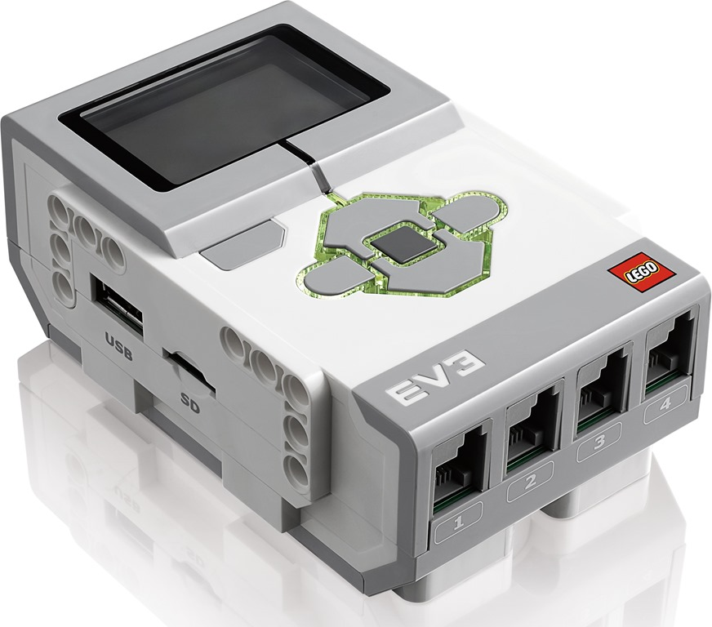
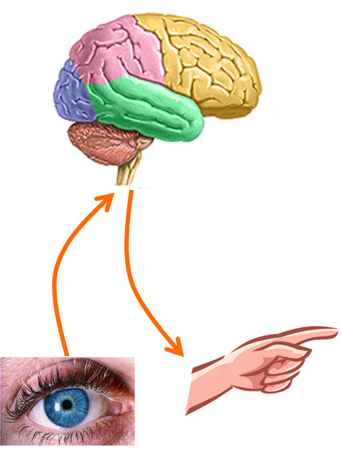
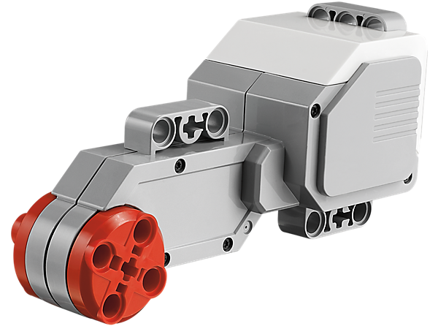
Your hand is commanded by your brain, depending in the input it receives from the senses. Similarly, the LEGO brick can move the taskbot. Here’s a design challenge to show how this might be done. →
Human-Robot Similarities

Slide 5
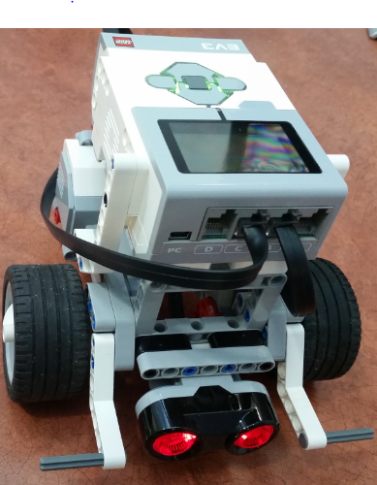
Don’t Bump into Me! Activity
Let’s get started:
Divide the class into groups of three students each.
Distribute the LEGO taskbots and the parts necessary to attach the ultrasonic sensor.
Have each group attach an ultrasonic sensor to its taskbot following the instructions in the LEGO base set.
Discuss as a group the logic of the program. Write down your programming design. Create, test and debug your program.

Slide 6
Program Objective: Control the taskbot using the ultrasonic sensor, so that it does not bump into any toy LEGO people. Program Description: Design the program to cause the robot to move forward until it detects a LEGO person within 10 inches in front of it. Once this occurs, have the robot back up by 5 wheel rotations, turn to the right, and then continue on its way until it sees a another LEGO person, at which time it makes a right turn and stops. 6 Don’t Bump into Me! Activity Engineering Design Challenge Answer on slides 7-11
Don’t Bump into Me! Activity
Engineering Design Challenge

Slide 7
1. Click the “Loop” icon (orange tab, third from left) and drag and drop the loop command onto the workspace. 2. Click on the Infinity sign on the loop command and select U=ultrasonic sensor then select proximity. Then verify the sensor settings : a. Select distance in inches b. Compare Type<4 c. Threshold value =50
Ultrasonic Sensor Activity Answers

Slide 8
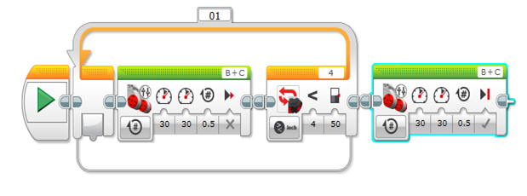
3. Select the “move tank” option under the green tab and drag into the loop. a. Make sure tank movement is set to rotations b. Select the Left and Right power to be 30 c. Set rotations to .5 d. Make sure that Break at end is set to coast/false. 4. Select “move tank” option and place outside of loop. a. Make sure tank movement is set to rotations b. Select the Left and Right power to be 30 c. Set rotations to .5 d. Make sure that Break at end is set to break/true.
Ultrasonic Sensor Activity Answers

Slide 9
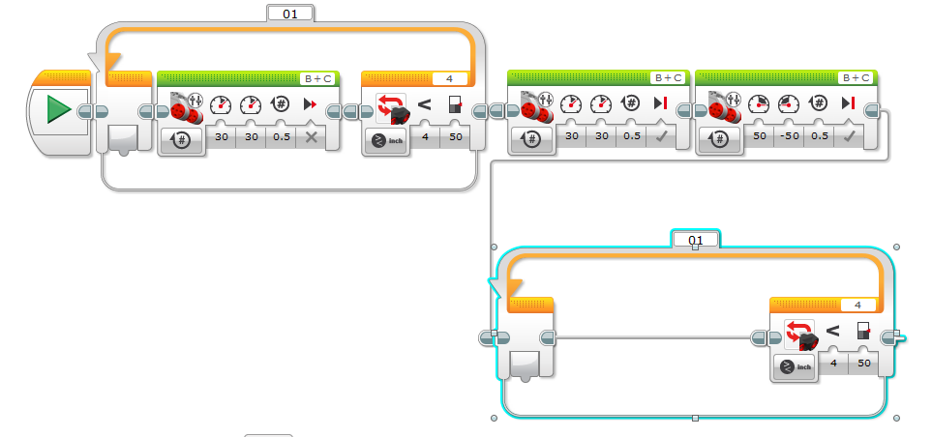
5. Select the “move tank” option under the green tab and drag into the loop. a. Make sure tank movement is set to rotations b. Select the Left to 50 and Right power to be -50 c. Set rotations to .5 d. Make sure that Break at end is set to brake/true. 6. Click the “Loop” icon (orange tab, third from left) and drag and drop the loop command onto the workspace. 7. Click on the Infinity sign on the loop command and select infared sensor then select proximity. Then verify the sensor settings : a. Select distance in inches b. Compare Type<4 c. Threshold value =50
Ultrasonic Sensor Activity Answers

Slide 10
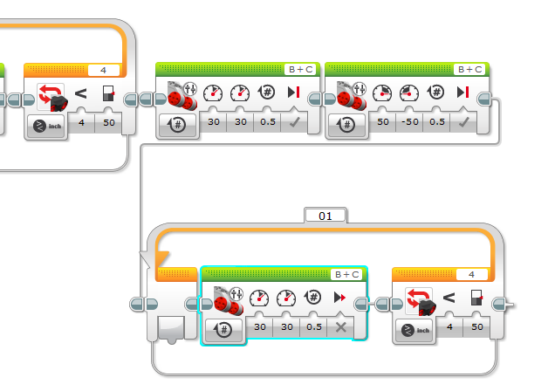
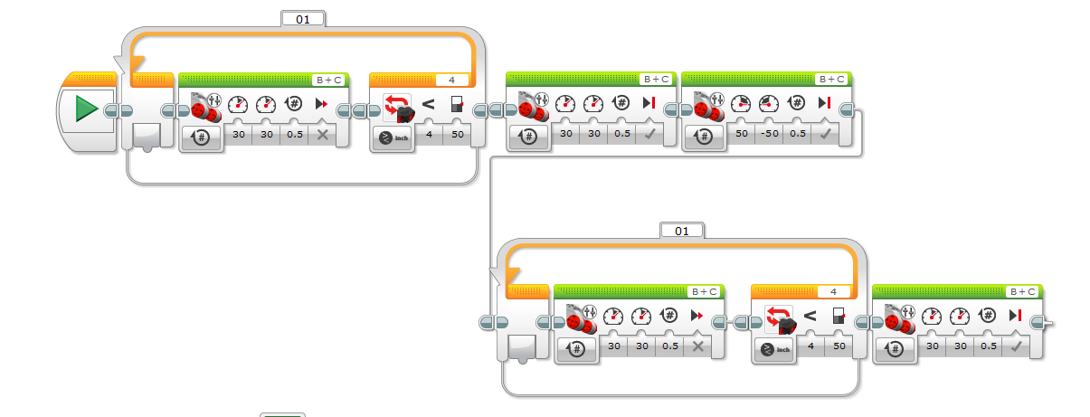
8. Select the “move tank” option under the green tab and drag into the loop. a. Make sure tank movement is set to rotations b. Select the Left and Right power to be 30 c. Set rotations to .5 d. Make sure that Break at end is set to coast/false. 9. Select the “move tank” option under the green tab and drag into the loop. a. Make sure tank movement is set to rotations b. Select the Left to 50 and Right power to be -50 c. Set rotations to .5 d. Make sure that Break at end is set to brake/true.
Ultrasonic Sensor Activity Answers

Slide 11
Troubleshooting: If the robot does not turn when it sees the Lego man as expected; 1. Make sure sensors/motors are connected to the correct port as directed in the Lego building booklet. 2. Read back through the instructions and make sure all the properties for the commands are set correctly. 3. If the robot is not stopping/ sensing objects in front of it make sure that there is no object with dark color blocking the path. The sensor has issues recognizing dark colored objects because it is both infrared and ultrasonic. 4. Instructions are for the Lego Education version of software not the Lego Home version
Ultrasonic Sensor Activity Answers

Slide 12
1. List three real-world examples of tools, technologies or equipment that use the echolocation concept. 2. Provide an example “stimulus-sensorcoordinator-effector-response” framework for one of your real-world examples
Don’t Bump into Me! Post-Quiz

Slide 13
1. List three real-world examples of tools, technologies or equipment that use the echolocation concept. Radar, sonar, ultrasound medical equipment (see more on slide 15) 2. Provide an example “stimulus-sensor-coordinator-effectorresponse” framework for one of your real-world examples Example: Radar on an airplane transmits sound waves into a region in the flight path > sound sensor in the radar system receives reflected sound waves > computer calculates the presence and location of rain, snow, clouds, storms and other planes > computer sends instructions by wires to display screen showing colored map of location of weather and obstacles > pilot adjusts flight path and/or elevation for safest route
Don’t Bump into Me! Post-Quiz Answers

Slide 14
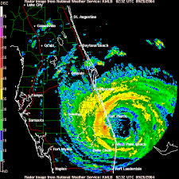
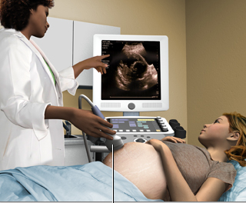
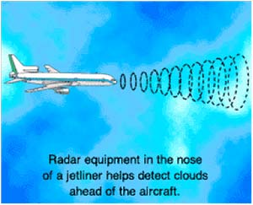
Real-World Applications
radar systems: airplane navigation, weather and storm monitoring, polar ice formation/melting measurement
sonar systems: ship navigation, fishing, underwater sea floor mapping for depth, navigation dangers and marine ecosystems
medical diagnostic: pregnancy, internal organs, tumors
measuring speed and distance: radar guns, radar, sonar

Slide 15
Vocabulary
auditory: Related to hearing.
echolocation: Biological sonar used by animals such as bats and dolphins in which the animal sends out a call and uses the echo to locate and identify surrounding objects.
peripheral: Surrounding.
sensor: A device that converts one type of signal to another; for instance, the speedometer in a car collects physical data and calculates and displays the speed the car is moving.
transducer: Another term for a sensor (see above).
ultrasonic: A sound of a frequency that humans cannot hear, but dogs and bats can hear.

Slide 16
Slide 1, 5: LEGO robot with ultrasonic sensor attached; source: 2006, Flickr: Robot 1 via Nogwater @ Wikimedia Commons http://commons.wikimedia.org/wiki/File:Robot_1.jpg Slides 1, 3: clipart flying black bats; source: Microsoft® clipart: http://office.microsoft.com/en-us/images/results.aspx?qu=bat&ex=1#ai:MC900304955| Slide 4: brain; source: ADAM, Medline Plus, U.S. National Library of Medicine, National Institutes of Health: http://www.nlm.nih.gov/medlineplus/braindiseases.html Slide 4: eye; source: Microsoft® clipart: http://office.microsoft.com/en-us/images/results.aspx?qu=eye&ex=1#ai:MP900406700|mt:2| Slide 4: pointing finger; source: Microsoft® clipart: http://office.microsoft.com/en-us/images/results.aspx?qu=pointing+finger&ex=1#ai:MC900233154| Slide 4: LEGO parts; source: LEGO MINDSTORMS EV3 User’s Guide Slides 7-11: Screen capture images by the author. Slide 14: ultrasound medical diagnostic tool; source: MedlinePlus, U.S. National Library of Medicine, National Institutes of Health http://www.nlm.nih.gov/medlineplus/ency/imagepages/1110.htm Slide 14: jetliner radar drawing; source: NASA: http://virtualskies.arc.nasa.gov/communication/8.html Slide 14: weather-storm radar; source: NOAA: http://www.srh.noaa.gov/mlb/?n=jeanne
Image Sources

