Slide 1
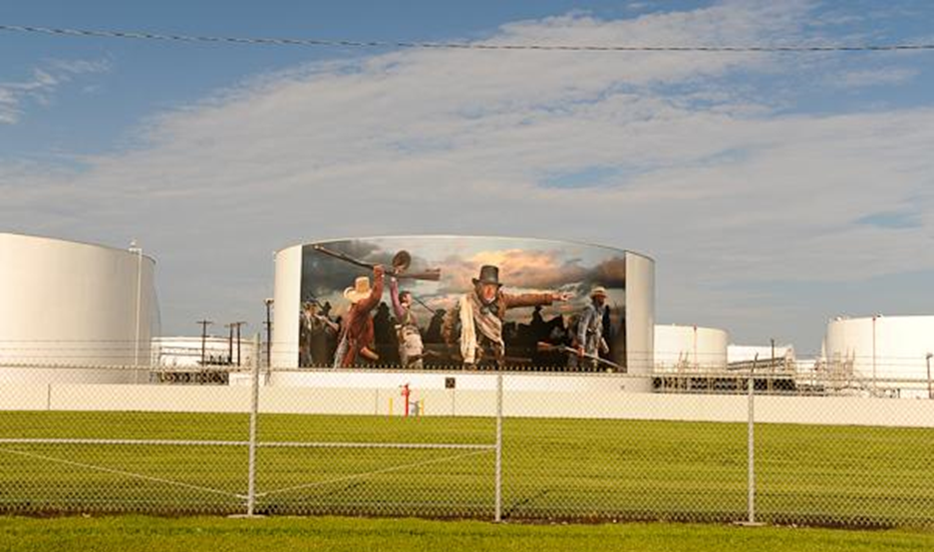
WHAT IS THIS!!!???
© Copyright 2013, State Impact.
Image source: The Center for Land Use Interpretation photo archive. Used with permission.
Notes:
Above-Ground Storage Tanks Presentation, Above Ground Storage Tanks in the Houston Ship Channel Lesson, TeachEngineering.org
Round above-ground storage tanks (ASTs) like this one are commonly used to hold fluids such as petrochemicals and petroleum.
A mural on this petrochemical tank in Deer Park, TX, depicts the Battle of San Jacinto that took place nearby.
Image source: The Center for Land Use Interpretation photo archive; used with written permission from sarah@clui.org

Slide 2
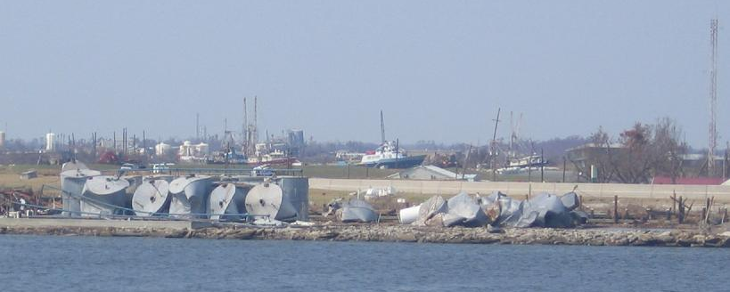
Hurricane Katrina: August 2005, Atlantic Hurricane Rita: Sept 2005, Gulf of Mexico
Images source: Jamie Padgett, SSPEED Center, Rice University. Used with permission.
Image sources: Wayneys Sailing World. Used with permission.
Notes:
Look at what happens to these ASTs during hurricanes…
Source of both images: “Hurricane Katrina on the Mississippi River” with written permission from Wayne Yeargain (mrwayney@yahoo.com) from http://waynessailingworld.tripod.com/HURRICANE/KATRINA2005.html
Copyright 9/21/2005 © Website Updated: 1/8/2006

Slide 3
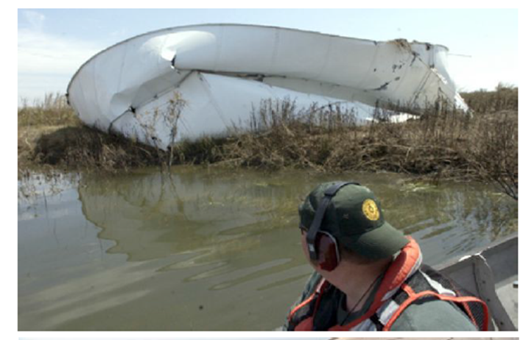
Hurricane Gustav: Aug 2008, Gulf of Mexico Hurricane Ike: Sept 2008, Gulf of Mexico
Images source: The Beaumont Enterprise. Used with permission.
Source: The Beaumont Enterprise. Used with permission.
Images source: Jamie Padgett, SSPEED Center, Rice University. Used with permission.
Notes:
More examples of damaged above-ground storage tanks, with resulting pollution…
left and right: A response officer with the Texas General Land Office Oil Spill Division surveys the damage to a Papco pumping and storage facility on Clam Lake in Texas. The tank on the left survived Hurricane Ike's winds and storm surge, but an oil boom was placed around it to absorb oil from a leak. The tank on the right was destroyed and found north of the Intercostal Waterway.
Image sources: 2013 The Beaumont Enterprise with written permission from Terry Maillet-Jones (TMaillet@beaumontenterprise.com) (Enterprise photos by Dave Ryan)
Image captions retained from The Beaumont Enterprise:
(left) Johnny Darcey, right, a Response Officer with the Texas General Land Office Oil Spill Division, who on Wednesday, was surveying the damage to a Papco pumping and storage facility on Clam Lake. This tank survived Hurricane Ike's winds and storm surge, but still had an oil boom around it picking up the oil from a leak. Dave Ryan/Photo: THE ENTERPRISE
(right) Johnny Darcey, a Response Officer with the Texas General Land Office Oil Spill Division, who on Wednesday, was surveying the damage to a Papco pumping and storage facility on Clam Lake, came across one of the storage tanks north of the Intercostal Waterway. Dave Ryan/Photo: THE ENTERPRISE
(Author was granted permission to use these images and signed a form stating she would not alter the image or caption in any way.)

Slide 4
AST Failure in Storms
What are the consequences when above-ground storage tanks (ASTs) are damaged in storms?
Pollution: Environmental impact from spillage of hazardous materials
Extensive costs:
To clean up material from the natural environment
For losses due to irrecoverable produce & vegetation
To repair ASTs
To replace ASTs

Slide 5
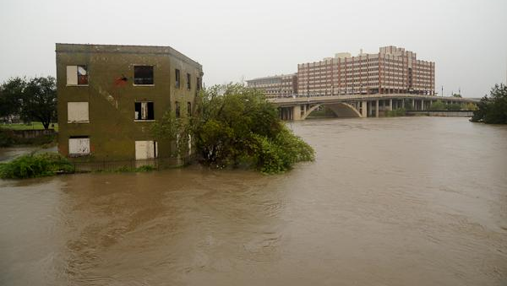
Flooding
The U.S. federal government paid for flood control structures like Addicks Reservoir, Barker Reservoir, etc., following a disastrous 1935 flood
Fairly effective, exceptions: tropical storm Allison in 2001 and Hurricane Ike in 2008
Buffalo Bayou was 20+ feet above normal levels
⬅The Sunset Coffee Company building, future Bayou visitor contact station, and occasional island seen here after Hurricane Ike in 2008.
Image source: The Center for Land Use Interpretation photo archive. Used with permission.
Notes:
Flooded Sunset coffee building image used with written permission (sarah@clui.org)
The Center for Land Use Interpretation photo archive
http://www.clui.org/newsletter/spring-2009/tour-houstons-water-and-oil

Slide 6
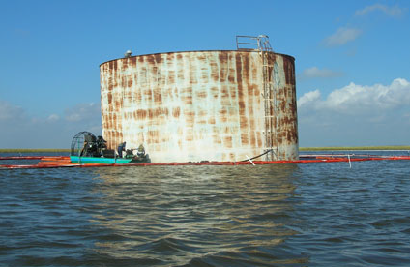
Flooding
Image source: NOAA. Used with permission.
Notes:
Image source: National Oceanic and Atmospheric Administration (NOAA) “Booming Oil Tank” with written permission from Paul Taylor (Paul.Taylor@noaa.gov); image taken by Debbie Payton, Emergency Response Division Chief, Office of Response and Restoration, National Ocean Service.
Image caption: Booming an oil tank damaged by Hurricane Rita, Louisiana (2005).
Website: http://oceanservice.noaa.gov/hazards/drc/contest/response/#15

Slide 7
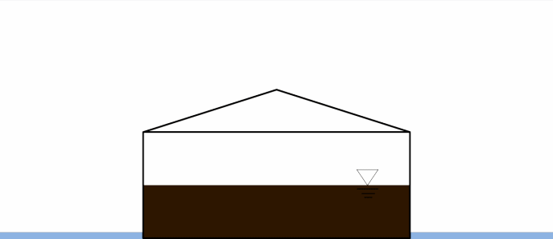
AST Displacement
Image source: Jamie Padgett and Sabarethinam Kameshwar, “Structural Integrity of Storage Tanks” SSPEED Center Conference September 24-25, 2013.
Notes:
Image source: “Structural Integrity of Storage Tanks” with written permission from Dr. Jamie Padgett (jamie.padgett@rice.edu)

Slide 8
Buckling
Flooding causes external water pressure on tank shell
PLUS: Debris and wave impact and external wind pressure
Image source: E-Learning from Engineering Failures. Used with permission.
Notes:
Image source: “E-Learning from Engineering Failures – Learning by Doing in a Computer-Based Simulated Environment” with written permission from Dr. Luis A. Godoy (lgodoy@com.uncor.edu)

Slide 9
Houston Ship Channel (HSC)
Largest port of foreign water-borne cargo in the country; it ships out more goods internationally than any other U.S. port
75% of cargo is petrochemicals — largest petrochemical production zone in the nation
Along the 50-mile HSC from near downtown Houston to the Gulf of Mexico you’ll find:
~300 industrial facilities
more explosive materials, toxic gases and deadly petrochemicals than anywhere else in the U.S.
production of nearly half the nation’s supply of gasoline and half its petrochemicals
Many facilities are only protected to 14-16 feet above mean sea level
Damaged facilities along the HSC could be shut down for months
In the event of large hurricanes, economic and environmental damage to the region and national economy could be catastrophic…
Notes:
Facts and figures about the Houston Ship Channel…
A petrochemical is a chemical obtained from petroleum or natural gas.

Slide 10
AST Locations Along the Houston Ship Channel
How many ASTs?
About 4,200 ASTs
Image source: Jamie Padgett and Sabarethinam Kameshwar, “Structural Integrity of Storage Tanks” SSPEED Center Conference September 24-25, 2013.
Notes:
Image source: “Structural Integrity of Storage Tanks” with written permission from Dr. Jamie Padgett (jamie.padgett@rice.edu)

Slide 11
Typical Tank Dimensions
Fixed roof tank (flat roof) | Tank diameter: 62 feet
Aspect ratio (H/D): 0.4 | Shell thickness: 0.394 inches
Tank height: 25 feet | Vary S and L
D: tank diameter
H: tank height
L: liquid level inside tank
S: surge height
Image source: Jamie Padgett and Sabarethinam Kameshwar, “Structural Integrity of Storage Tanks” SSPEED Center Conference September 24-25, 2013.
Notes:
Image from “Structural Integrity of Storage Tanks” with written permission from Dr. Jamie Padgett (jamie.padgett@rice.edu)

Slide 12
Safety Codes and Provisions
ASTs are regulated by several agencies in Texas:
U.S. Environmental Protection Agency (USEPA) “spill prevention” code
The Texas Commission on Environmental Quality (TCEQ) has rules, but has a “limited regulatory program” for ASTs
Some additional regulation by the State Fire Marshal’s Office
Industry associations provide “best practices” for designing and constructing storage tanks
Standards for tanks built in earthquake zones but few for tanks built where hurricanes are a risk
The American Petroleum Institute (API) said they do everything possible to protect the environment, but offer no specifics
Researchers say the work they’re now doing might make a case for creating some new rules that would require better ways to anchor the big tanks to keep them from floating away…

Slide 13
API Standard 650 (2013): Welded Tanks for Oil Storage
5.2.1 l(1) includes provisions for external pressure and flotation
States that the purchaser shall state the magnitude and direction of external loads or restraint for which the shell must be designed
E.6.2.1 includes provisions for anchorage due to seismic activity
F.1.3 includes provisions for anchorage due to internal pressure
No provisions for shell buckling or uplift due to flooding
Notes:
Source: American Petroleum Institute. Welded Tanks for Oil Storage, API Standard 650: 12th ed., March 2013.

