Slide 1
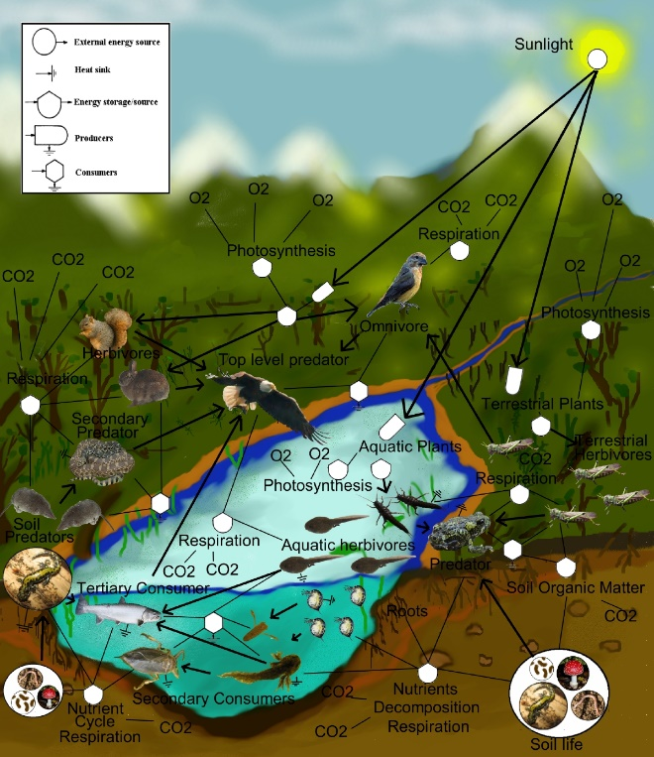
A freshwater aquatic and terrestrial food-web
Notes:
Food Web Visual Aid, Tracing Fluorescent Plastics in an Aquatic Environment activity; TeachEngineering.org
Diagram source:
2010 Thompsma, Wikimedia Commons CC BY SA-1.0 (universal public domain) https://commons.wikimedia.org/wiki/File:FoodWeb.jpg

