Slide 1
Green Infrastructure and Low-Impact Development Technologies
The guiding principles of these technologies is to manage stormwater at their sources using natural means, and establish conditions so that hydrology and water quality of developed sites approaches that of undeveloped sites.
Green roofs & vegetative walls
Bioretention or rain gardens
Bioswales
Planter boxes
Permeable pavement
Urban tree canopy
Rainwater harvesting
Downspout disconnection
Green streets and alleys
Green parking
Notes:
GI and LID Technologies Main Presentation
Green Infrastructure and Low-Impact Development Technologies Lesson > TeachEngineering.org

Slide 2
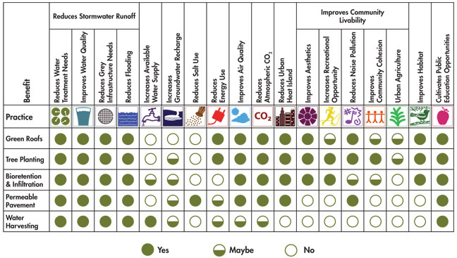
Green Infrastructure (GI) and Low-Impact Development (LID) Technologies
Benefits and Practices

Slide 3
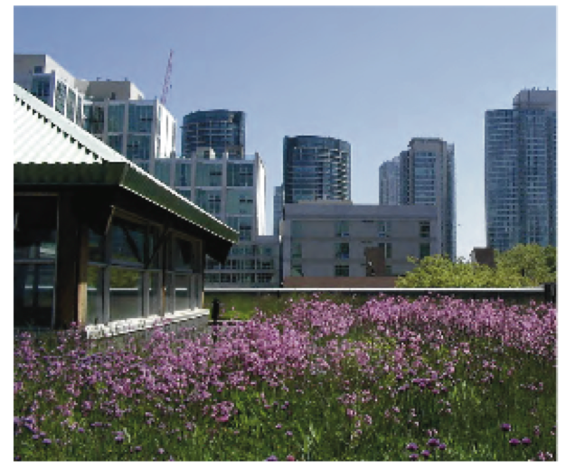
Green Roofs and Vegetative Walls
A rooftop or building wall planted with a media membrane and native vegetation over a waterproofing membrane/root zone barrier, which may include a drainage and irrigation system.
Benefits:
Reduces stormwater runoff
Reduces energy use
Improves air quality
Two categories of green roofs:
Extensive green roofs: media depth 2-6 inches
Intensive green roofs: media depth greater than 6 inches

Slide 4
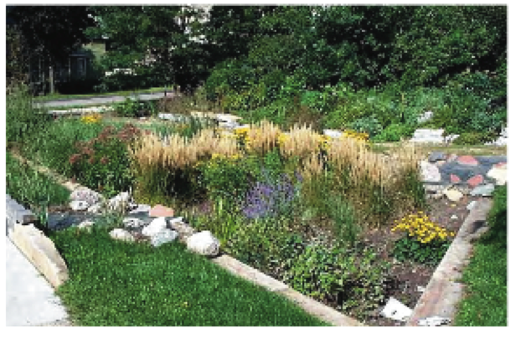
Bioretention or
Rain Gardens
Typically constructed with high-permeability media consisting of soil, sand and organic matter, designed to maximize infiltration, improve water quality, promote vegetative growth and biological transformation processes.
Designed with a ponding zone, storage volume capacity, stormwater overflow, and exfiltration/underdrain relief.
Ideally constructed:
Areas where stormwater naturally collects
Adjacent to roof runoff and impervious areas such as streets, parking lots, driveways
Benefits:
Improves local aesthetics
Traps and treats silts, fine particles, nutrients, heavy metals and bacteria from impacting downstream ecosystems
Increases property value
Increases biodiversity and habitat

Slide 5
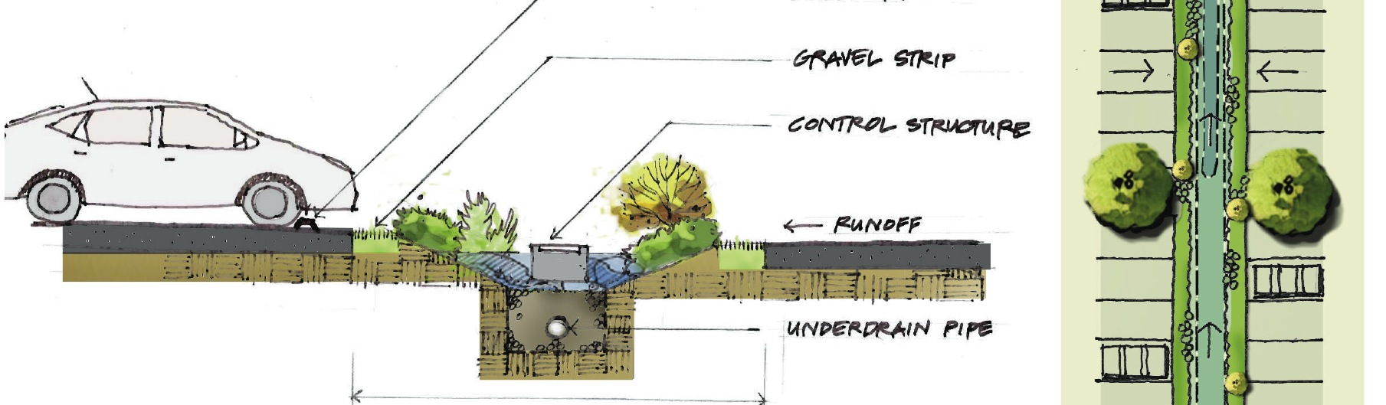
Bioswales
Bioswales may be vegetated, mulched or xeriscaped linear channels that provide stormwater retention and infiltration.
Bioswales are a linear form of a bioretention system with a length-to-width ratio greater than 2:1, typical of standard bioretention construction.
Designed as an alternative to traditional stormwater piping, integrated into parking lots and road medians.

Slide 6
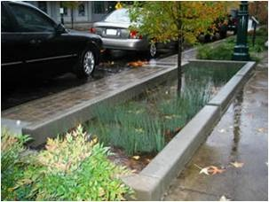
Planter Boxes
Planter boxes are urban bioretention systems with vertical concrete walls designed to collect and retain a specified volume of stormwater runoff and promote vegetative growth.
The design may have an open or closed bottom.
Collect stormwater runoff from sidewalks, parking lots and/or streets within the city right-of-way.

Slide 7
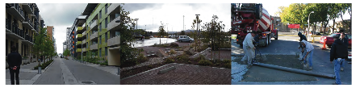
Permeable Pavement porous concrete, porous asphalt, interlocking permeable pavers
Surfaces that are similar to sidewalks and roadways in that they allow for vehicular traffic, but dissimilar due to their abilities to absorb and infiltrate stormwater runoff through their surfaces to underlying media layers.
Typically designed for low-volume traffic areas such as parking lots, driveways and sidewalks.

Slide 8
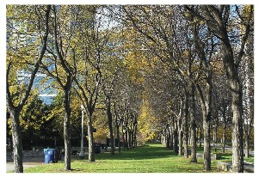
Urban Tree Canopy
Planting and protection of an urban tree canopy provides many social, ecological and economical benefits.
Benefits:
Intercepts rainfall
Increases infiltration and soil storage capacity
Increases evapotranspiration rates
Supports biological communities within root zone (rhizosphere)
Acts as a windbreak and provides shade, reducing residential heating and cooling
Reduces air pollution (such as NO₂, SO₂, O₃)
Appreciates and requires less maintenance with age
Increases habitats

Slide 9
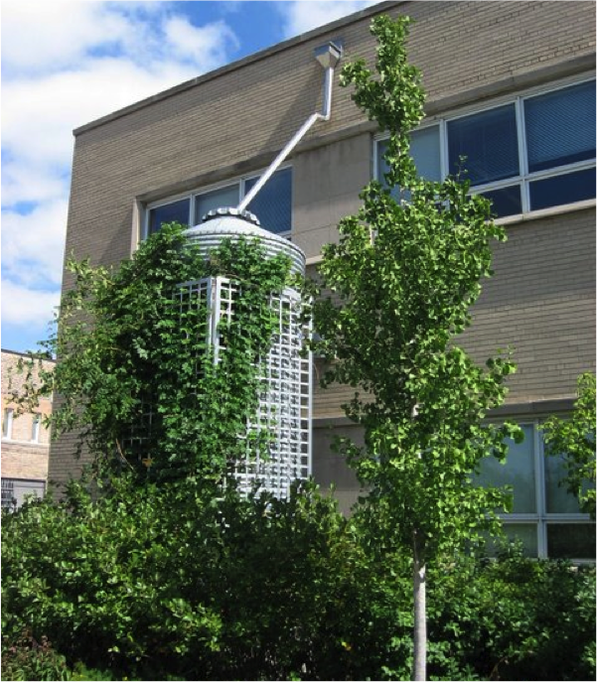
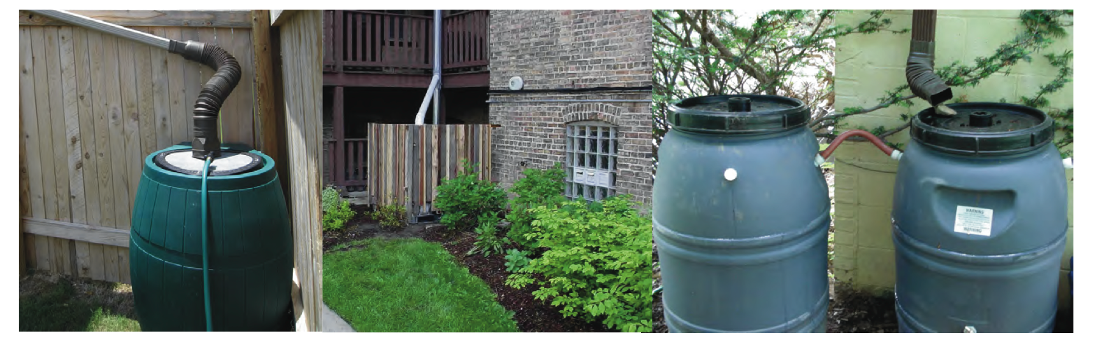
Rainwater Harvesting
Capturing and storing of rainwater with cisterns or rain barrels to be used for onsite irrigation, toilet flushing, car washing and other purposes.

Slide 10
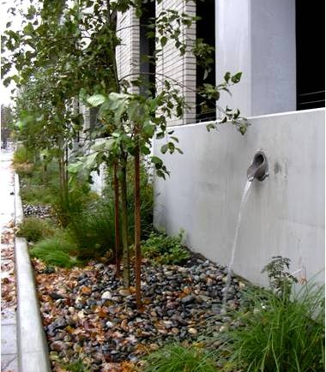
Downspout Disconnection
The process of redirecting roof runoff away from traditional storm sewer collection systems to rain gardens, bioswales, planter boxes and other GI technologies on site.
These systems allow for infiltration, improved water quality and treatment efficiency on site and at the runoff source.
Shown to reduce DCIA by 40-44%.
Notes:
DCIA = directly connected impervious areas

Slide 11
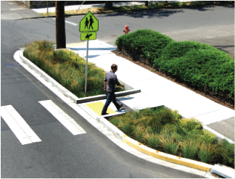
Green Streets and Alleys
The integration of permeable pavement, bioswales, planter boxes, bioretention and native vegetation into an urban streetscape.
These systems are designed to store storm event volume, promote evapotranspiration and biogeochemical processes.
Benefits:
Improves water and air quality
Enhances livability
Increases property values
Enhances pedestrian and bicycle access and safety
Protects surface and groundwater resources
Increases urban green space and wildlife habitat
Reduces pollution
Reduces stormwater into combined sewer systems
Reduces pumping and wastewater treatment costs

Slide 12
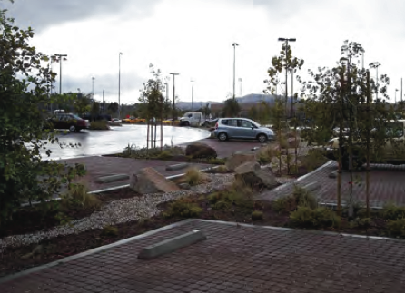
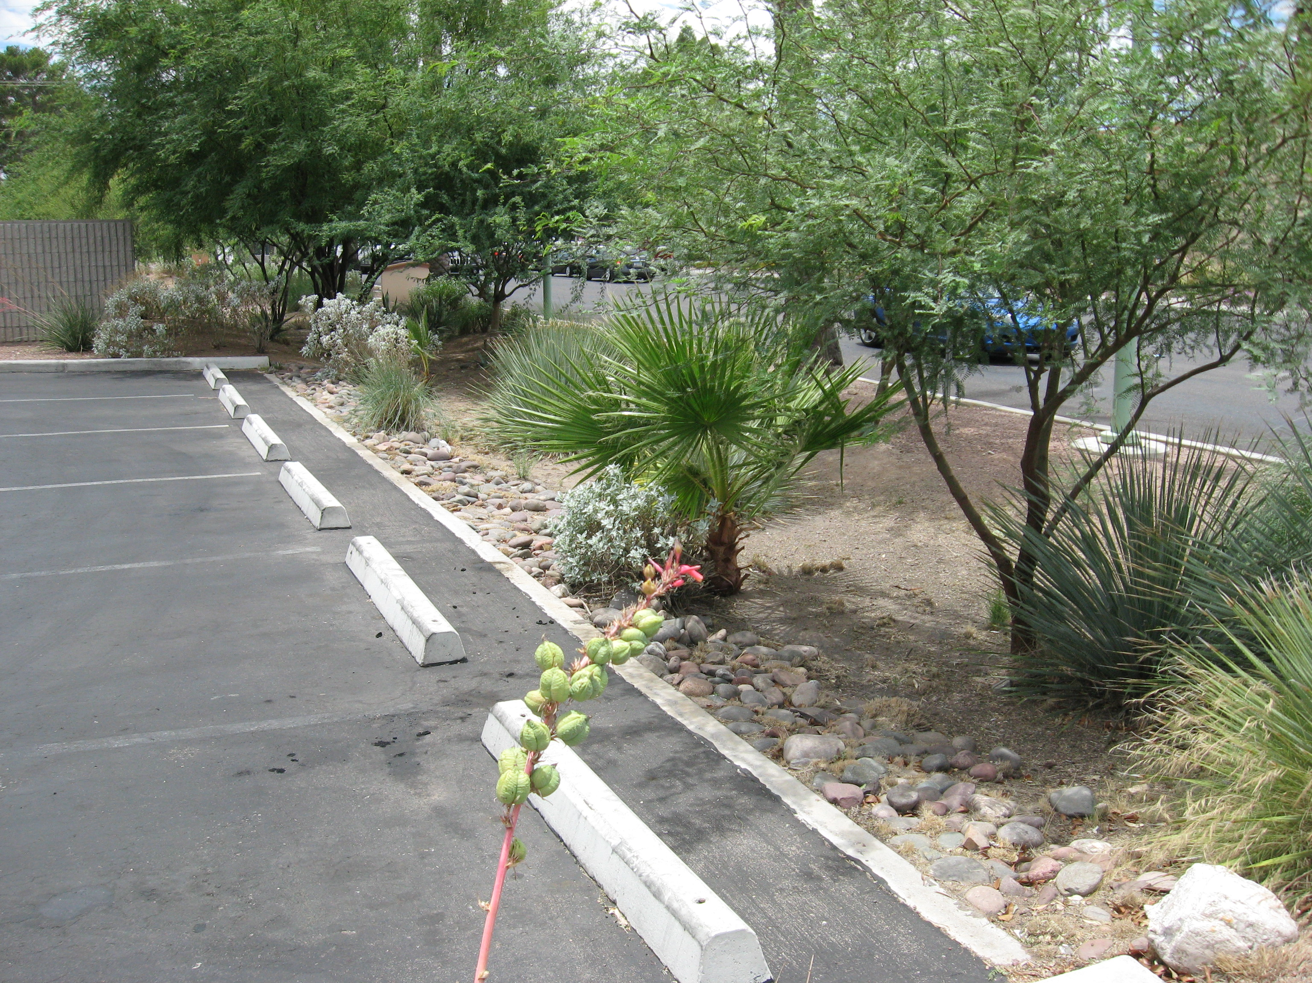
Green Parking
Parking lots have low traffic volume, high impervious area and vegetative islands, making them great locations to implement green infrastructure design.
The most commonly used GI technologies are pervious pavement, porous concrete, interlocking pavers, rain gardens, bioswales and tree canopies.

Slide 13
Sources of Images
Source of most images: U.S. Environmental Protection Agency at www.epa.gov
What Is Green Infrastructure? http://water.epa.gov/infrastructure/greeninfrastructure/gi_what.cfm
Slide 3 table from The Value of Green Infrastructure: A Guide to Recognizing Its Economic, Environmental and Social Benefits (page 3) http://www.cnt.org/repository/gi-values-guide.pdf

